Slide 1
SenseWalk 2.0
Group 23
Ross Applegate - Electrical Engineer
Chad Borgelin - Computer Engineer
Benoit Brummer - Computer Engineer
Diego Merida - Computer Engineer

Slide 2
Project Goals and Objectives
Create a device which helps the visually impaired navigate life
  Warn user of obstacles ahead of time
  Provide navigation assistance
  Audio input/output
This project was inspired by Sensewalk. Improvements include:
  Faster response time
  Lighter weight
  Improved battery life
  Greater precision

Slide 3
Design Constraints
Economic and Time Constraints
  Printed circuit board manufacture takes three weeks
    Any design mistake results in failure
  Hand assembly of extremely small (0.5mm pitch)components by inexperienced students
    Any excessive shaking results in failure
  Professional assembly is costly (used for some components of SenseWalk 2)
Firmware update may result in a bricked device
Everything was learned on the spot

Slide 4
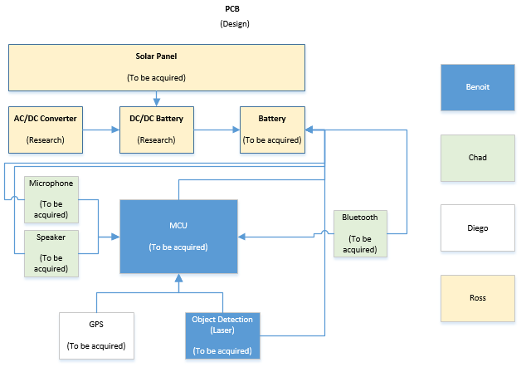
Block Diagram – 1st Design

Slide 5
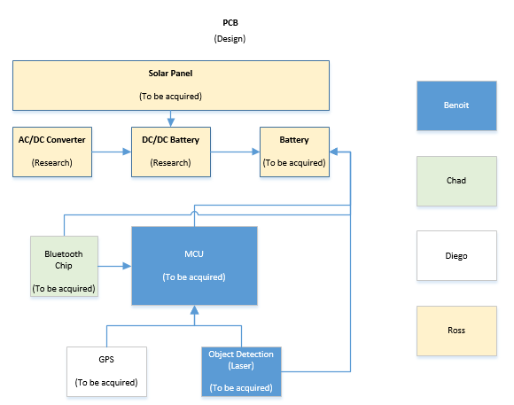
Block Diagram – 2nd Design

Slide 6
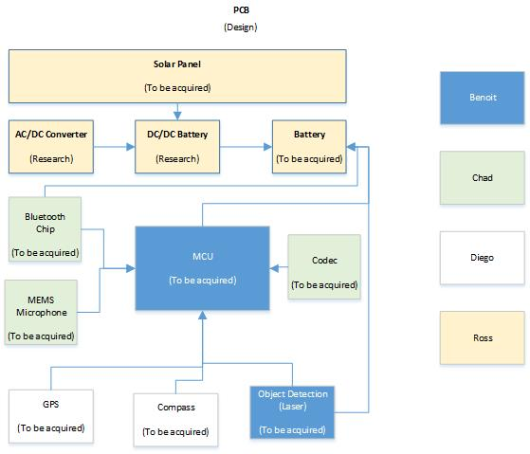
Block Diagram – Current Design

Slide 7
Bluetooth
Name | Bluetooth Classic | Bluetooth 4.0 Low Energy (BLE) | WiFi
IEEE Standard | 802.15.1 | 802.15.1 | 802.11 (a, b, g, n)
Frequency (GHz) | 2.4 | 2.4 | 2.4 and 5
Maximum raw bit rate (Mbps) | 1-3 | 1 | 11 (b), 54 (g), 600 (n)
Typical data throughput (Mbps) | 0.7-2.1 | 0.27 | 7 (b), 25(g), 150 (n)
Maximum (Outdoor) Range (Meters) | 10 (class 2), 100(class 1) | 50 | 100-250
Relative Power Consumption | Medium | Very low | High
Example Battery Life | Days | Months to years | Hours
Network Size | 7 | Undefined | 255

Slide 8

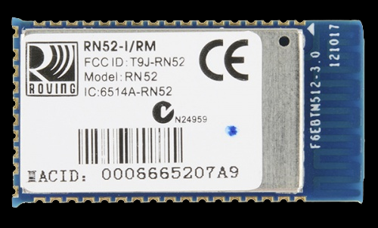
Audio Output
STA013 MPEG 2.5 LAYER III AUDIO DECODER
Audio Codec:
  Easy design
  Handles MPEG Audio Files
Bluetooth to Headphone
  User has freedom to choose a headphone or speaker device that best fits them.
Microchip RN52

Slide 9
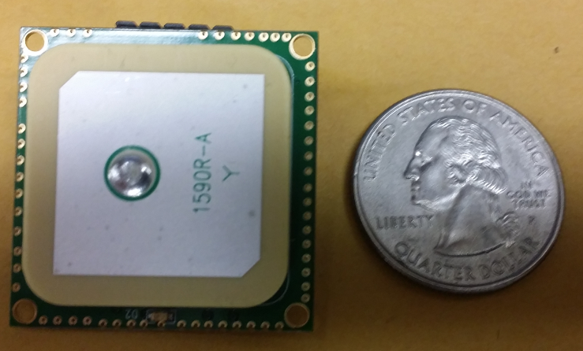
GPS
FEATURES
Update Rate | 5Hz -10 Hz
Channels | 66 (22 tracking)
Power Consumption | 3.3 V @ 41 mA
LED Indicator | Fix or no Fix
Acquisition Time | Hot Start 1s,Cold Start 32 s
Max altitude | 5000 m
Embedded Antenna
Built-in micro battery | Preserve the system data for rapid satellite acquisition
Velocity | 515 m/s
Price | $59.99
Locosys LS20031

Slide 10
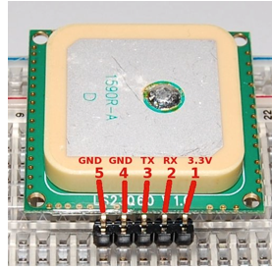
GPS
PIN ASSIGNMENT
Update Rate
5 Hz -10 Hz
Channels
66 (22 tracking)
Power Consumption
3.3 V @ 41 mA
LED Indicator
Fix or no Fix
Acquisition Time
Hot Start 1s,Cold Start 32 s
Max altitude
5000 m
Velocity
515 m/s
PIN# | NAME | DESCRIPTION
1 | VCC | Power Input
2 | RX | Data Input
3 | TX | Data Output
4 | GND | Ground
5 | GND | Ground

Slide 11
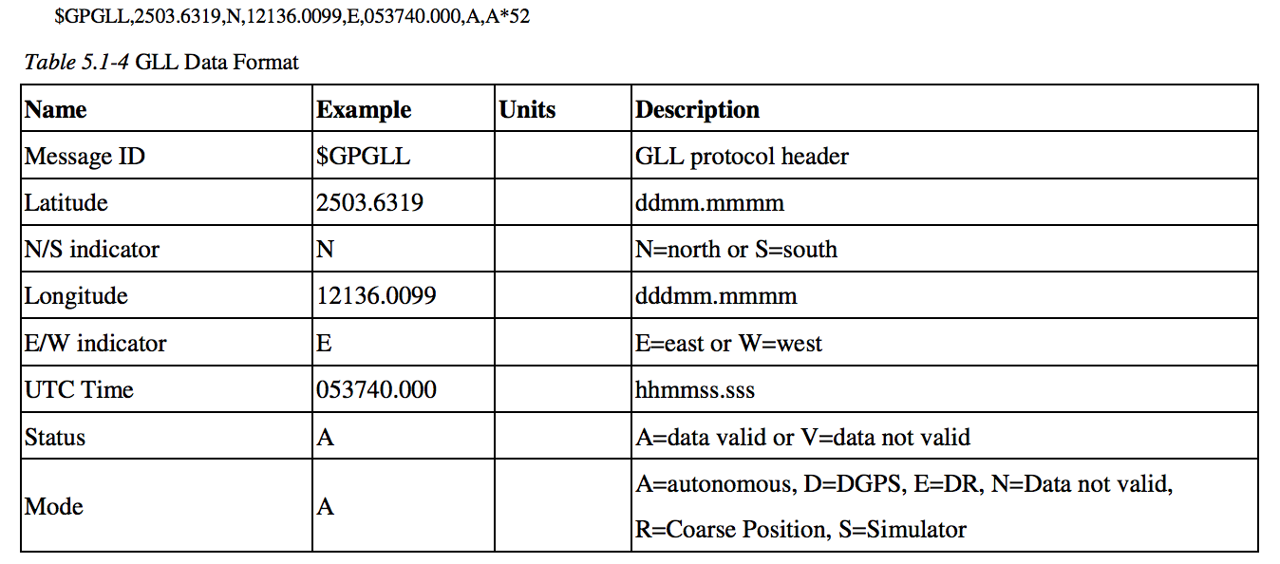
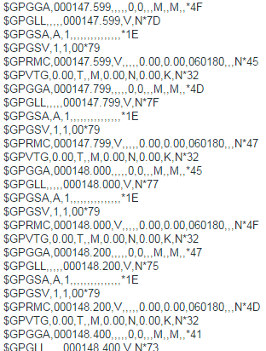
GPS
Data no Valid
$GPGGA,053740.000,2503.6319,N,12136.0099,E,1,08,1.1,63.8,M,15.2,M,,0000*64
GPS DATA RECEIVED

Slide 12
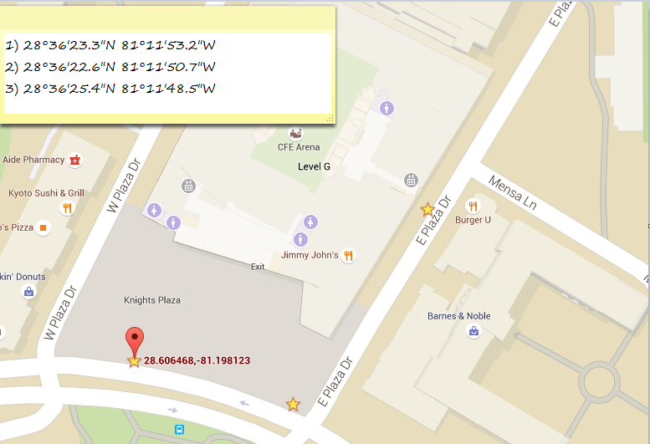
GPS
-Routes will pre-set as shown in the figure
-Routes will be given a specific name, for example “route one”. “School”, “restaurant one”
-User will be able to request which route to go through verbal commands since device will be able to receive and output audio since a microphone and a headset will be incorporated.
-Once the request is processed, the gps will read the user position and a voice command will tell the user how to get to the next coordinate
For example: go left , once user gets to the specific coordinate, a new voice command will be given to the user, “go right” and so on until the user gets to the final destination.
3
1
2

Slide 13
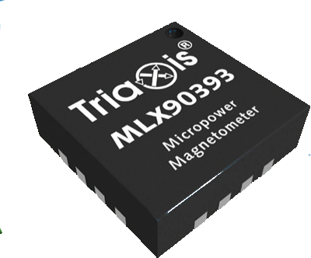
Magnetometer
A magnetometer is used to provide the user with a compass functionality, and to assist the GPS in directing the user.
We chose the Melexis MLX90393 Triaxis Magnetometer, which measures the magnetic field magnetic field in the X, Y, and Z direction using the Hall Effect. It returns three µT (micro Tesla) values.
Hardware: The MLX90393 comes in a 16-pads QFN package. (0.5mm pitch)
Interface: SPI with precise timing requirements
Software: Remember each axis' min and max value for calibration
Fun fact: The MLX90393 is made in Belgium

Slide 14
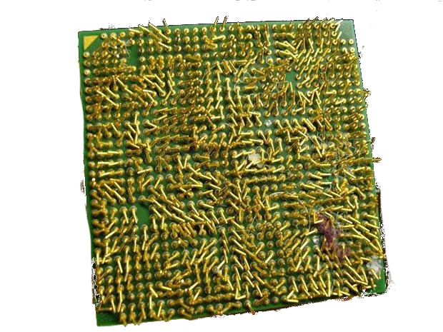
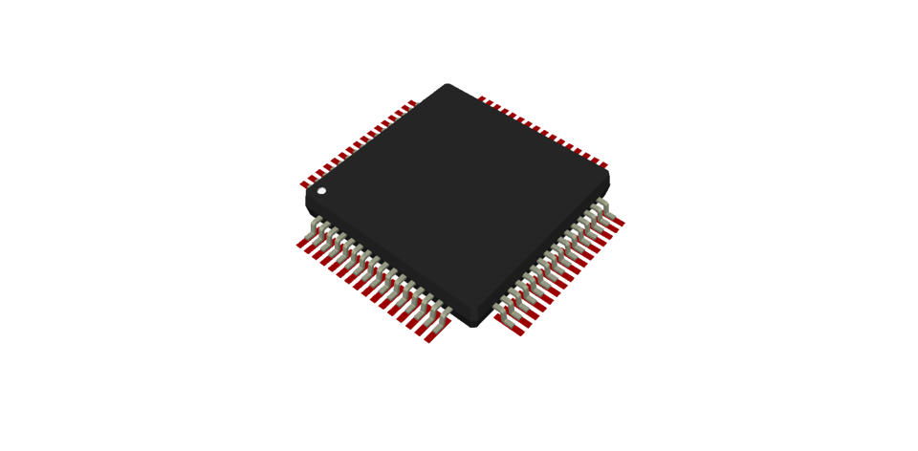
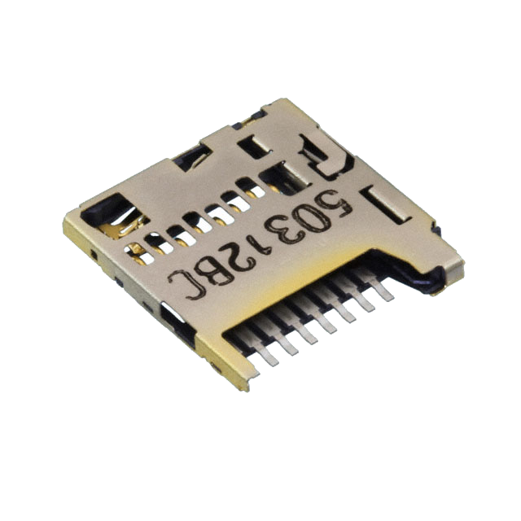
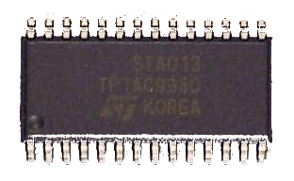



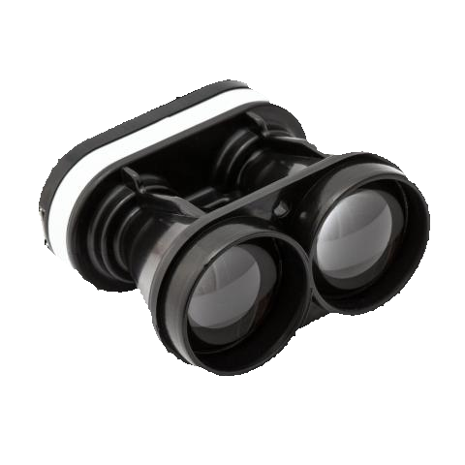
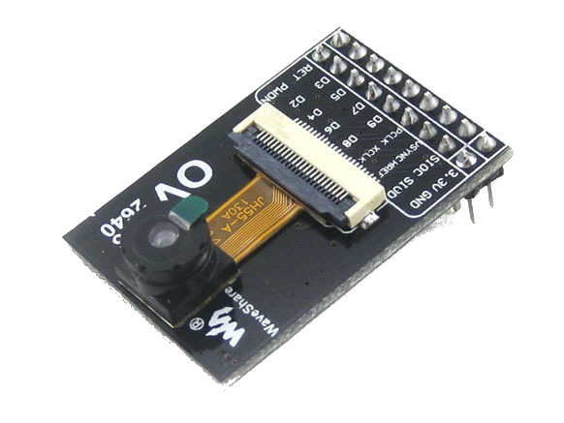


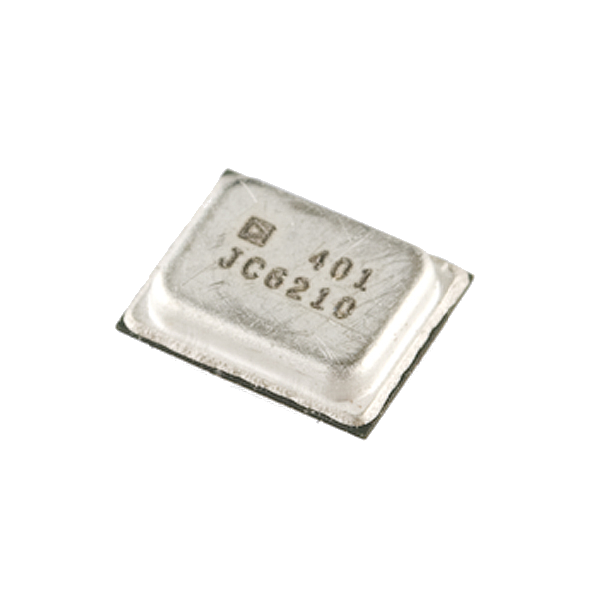
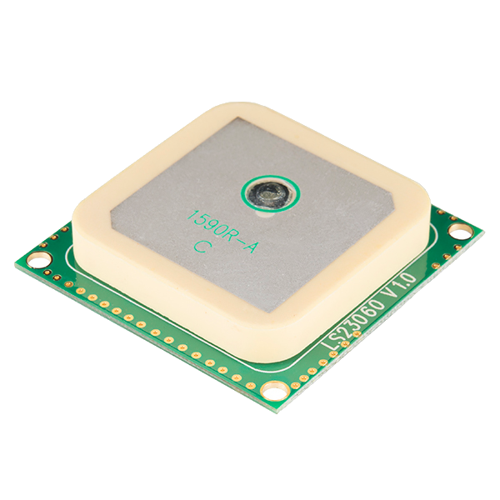

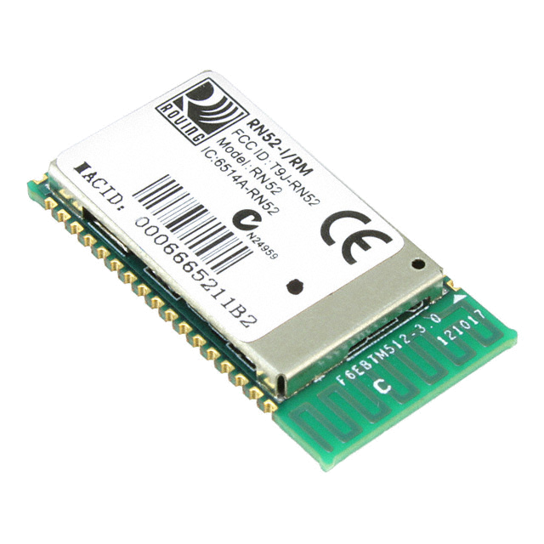
CPU vs MCU
MCU > CPU
Pin count, power usage
CPU > MCU
# of components Software libraries

Slide 15



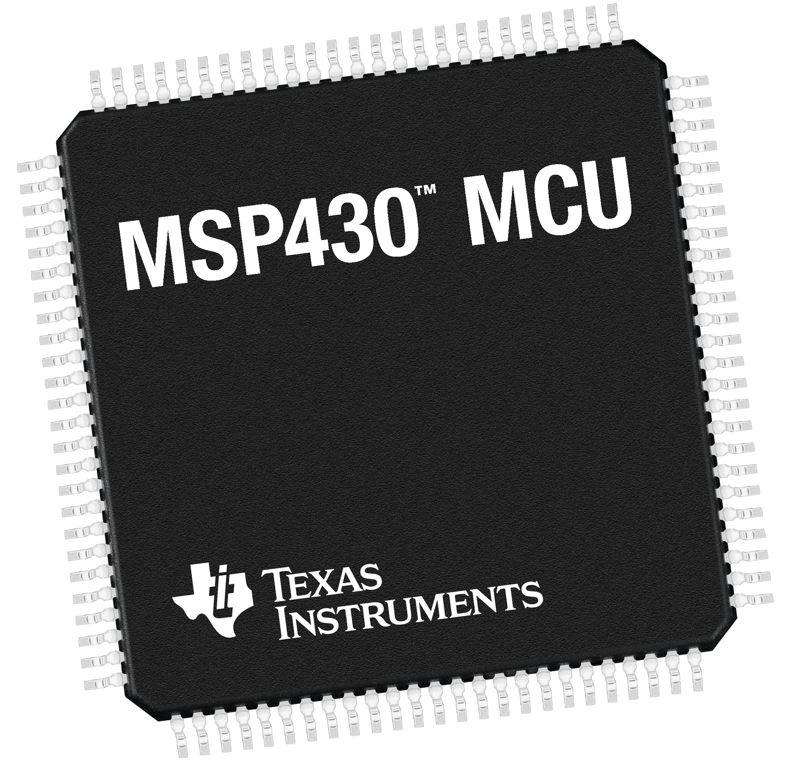
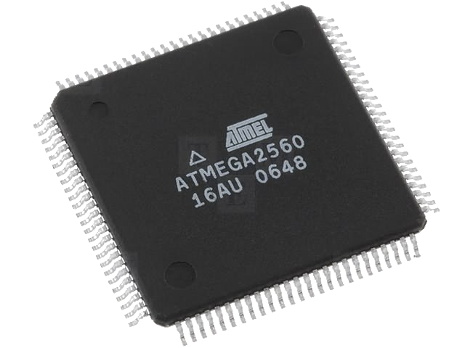

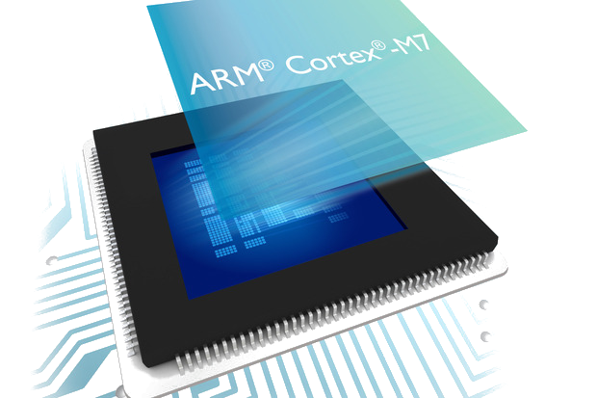
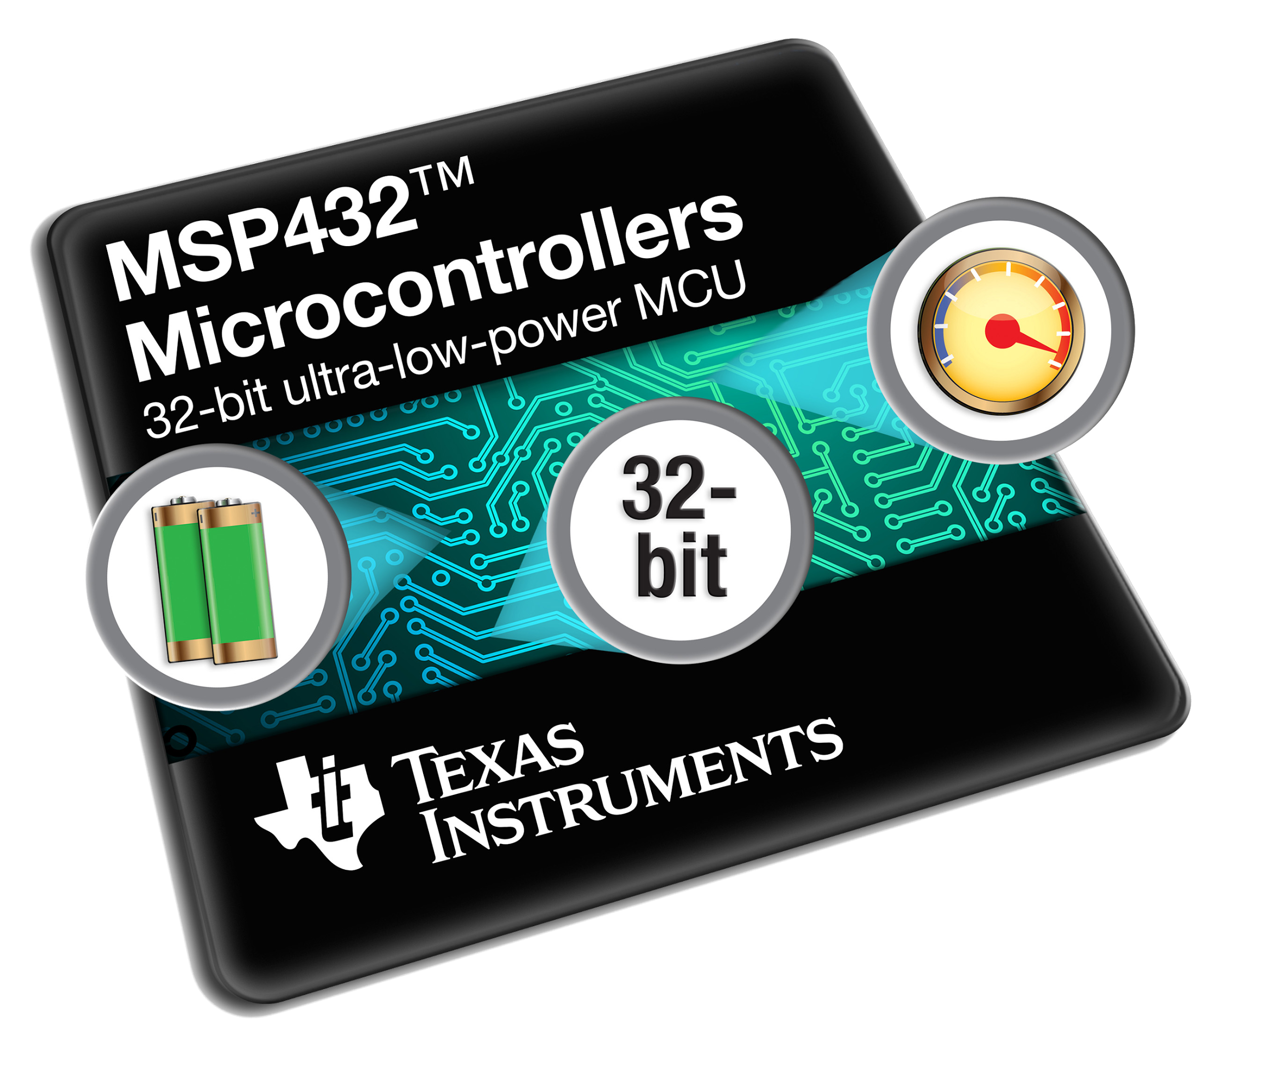
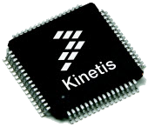
Choice of MCU
ARM Cortex-M7
Up to 300 MHz
Freescale Kinetis:
$160 development board
$200 programmer/debugger
STMicroelectronics STM32 F7:
$50 development board
$20 programmer/debugger
TI MSP43X, ATmel ATMega
16 MHz - 40 MHz (too slow)

Slide 16

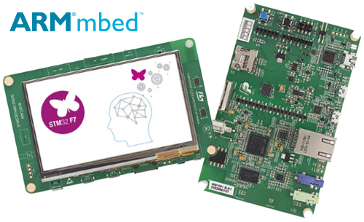
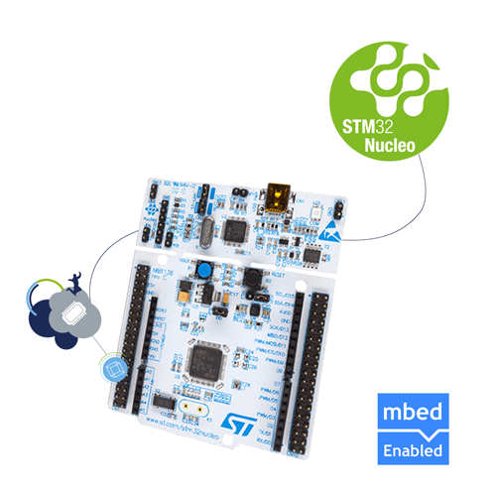
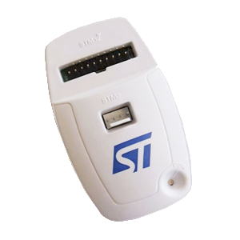
STM32F7
STM32L4
Microcontroller
and
Development Platform
STM32F7-Disco board: $49
ARM Cortex-M7, SD port
STM32L4-Nucleo board: $10.99
ARM Cortex-M4, ultra-low power
ST-Link/V2 programmer/debugger: $20.82
Serial-wire (2-wires), OpenOCD ($3.21 on eBay)
STM32F746
LQFP100,144,... 216MHz 320KB RAM 1MB Flash
STM32L476
LQFP64 80MHz 128KB RAM 512KB-1MB Flash ULP
Next:
Development
Environment

Slide 17
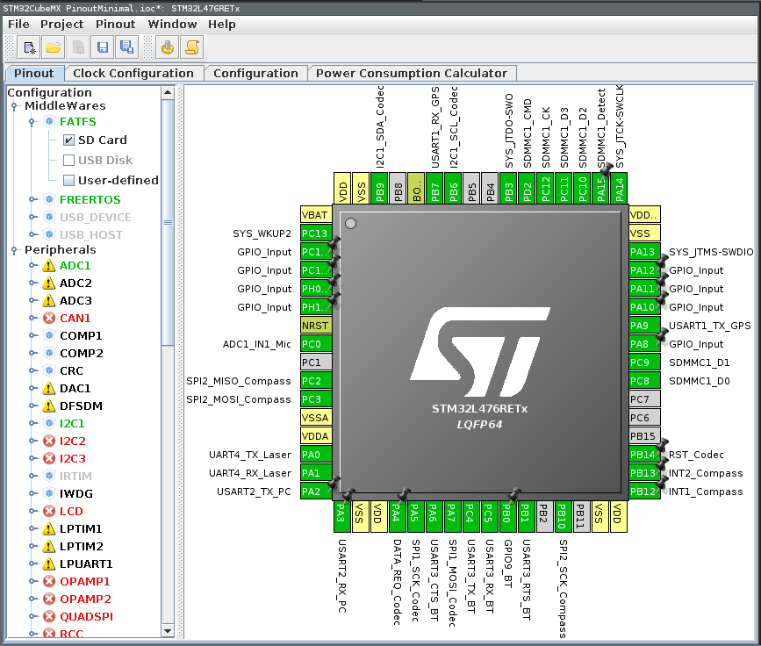
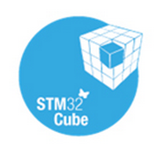





Development Environment
OpenSTM32
GCC, GDB, OpenOCD
packaged as an Eclipse plugin
Pros: Free, open-source, cross-platform IDE.
Cons: Not fully compatible with new STM32 L4
IAR Embedded Workbench
Pros: Compatible with newest STM32 L4 MCUs
Faster (C > Java)
Cons: Proprietary software
non-free, Windows-only

Slide 18
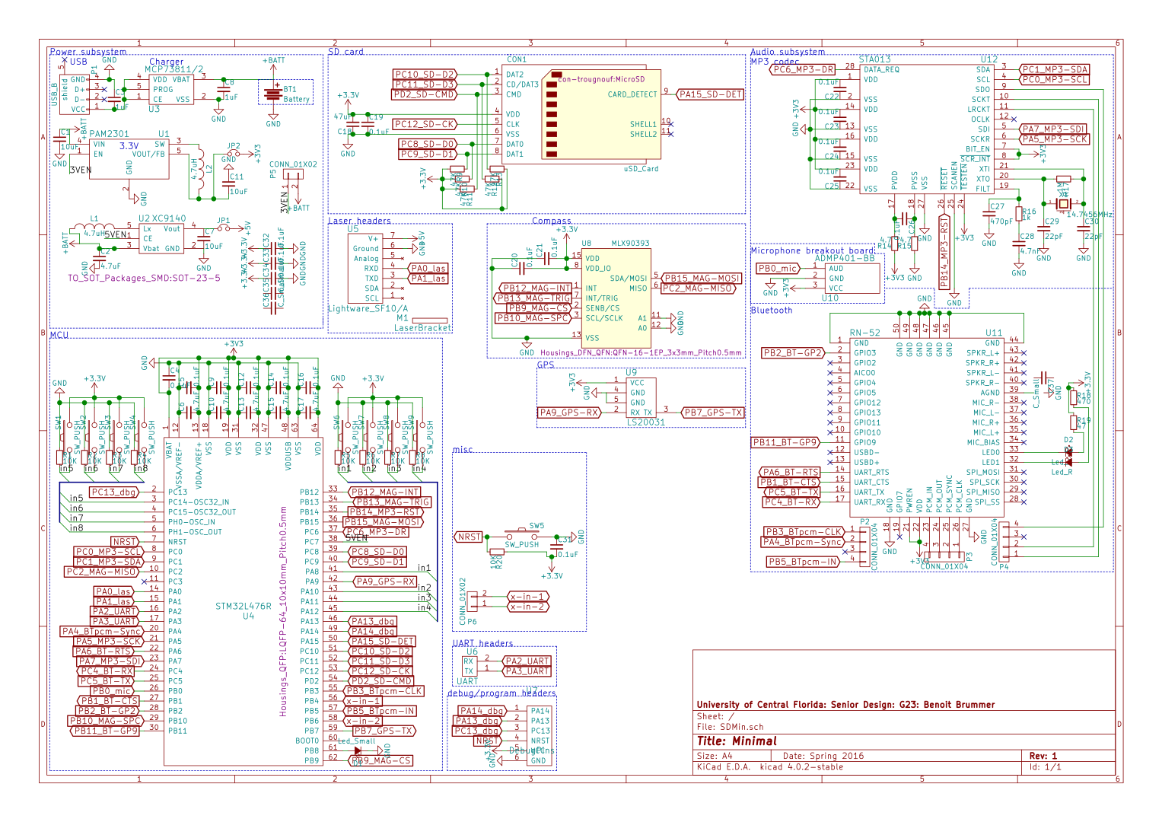

Sensewalk
9000 schematic

Slide 19
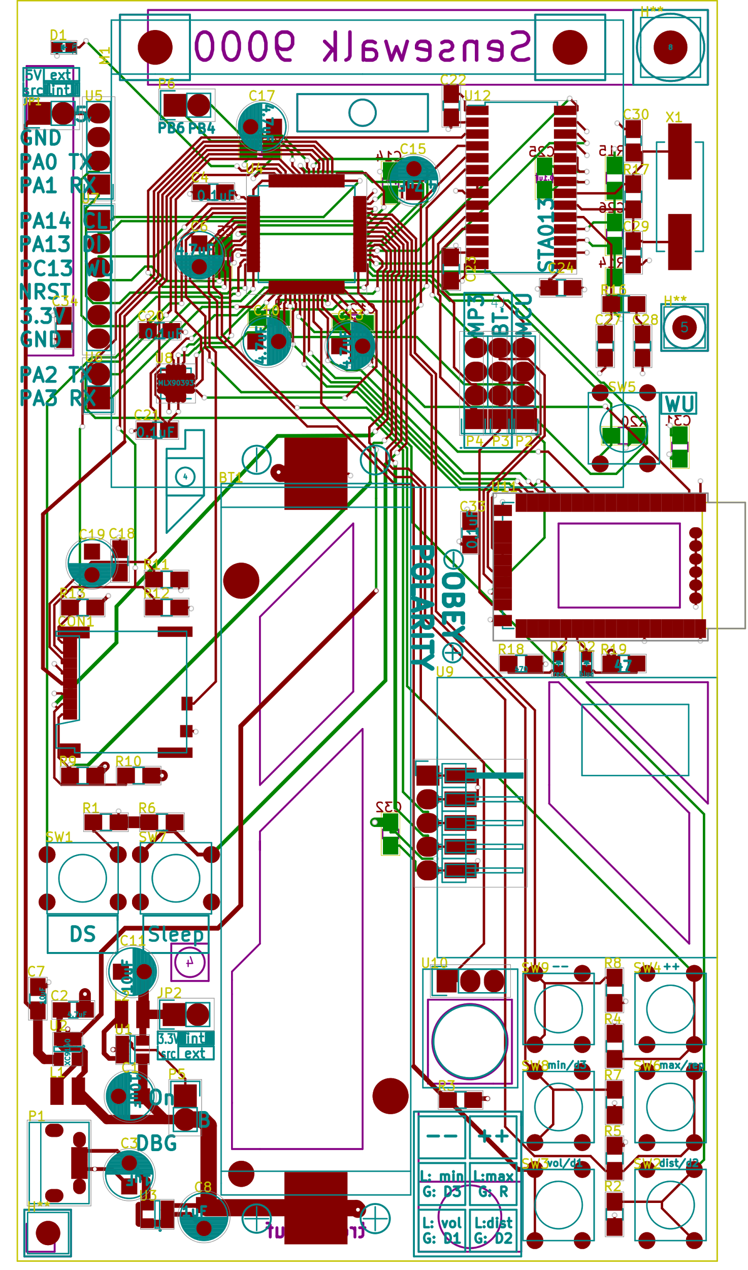
Sensewalk 9000 PCB layout
Laser / mount
LightWare SF10-A
Audio decoder
STMicroelectronics STA013
Microcontroller
STMicroelectronics
STM32L476
Programming
/debugging
headers
Software/hardware audio decoder switch
Bluetooth 3.0 module
Microchip RN52
MicroSD socket
Molex 5033981892
Power subsystem
Lithium-ion rechargeable battery
18650 form-factor, user-replaceable
3.3V DC-DC switching regulator
Diodes Inc. PAM2301
5V DC-DC switching regulator
Skyworks AAT1217
Battery management (USB charger)
Microchip MCP73811
GPS module
Locosys LS20031
Microphone (MEMS)
STMicroelectronics ADMP401
Push buttons

Slide 20





 | PCB design
 | Compiler
 | Debugger
 | IDE

Slide 21
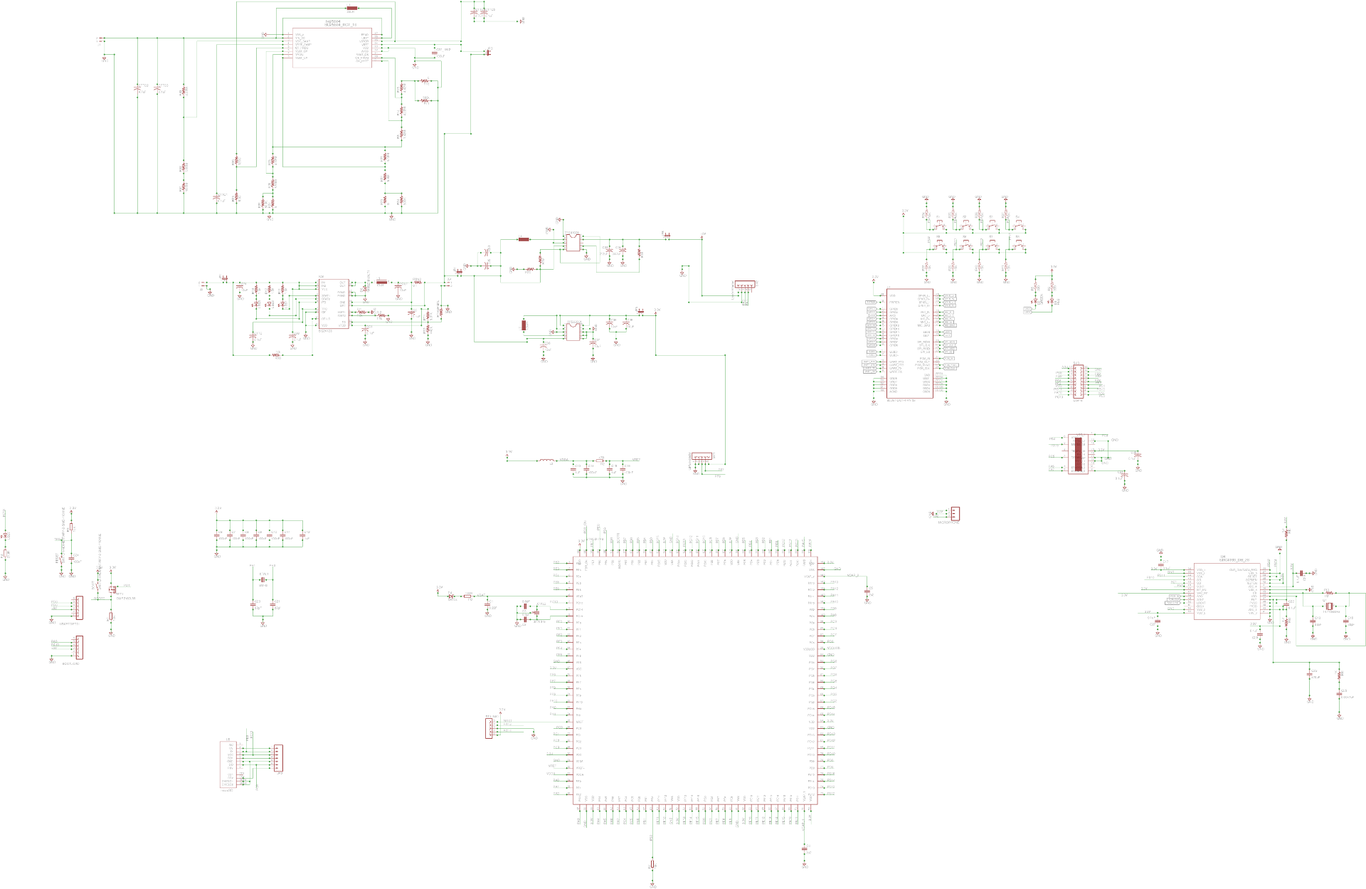
Sensewalk 2 schematic

Slide 22
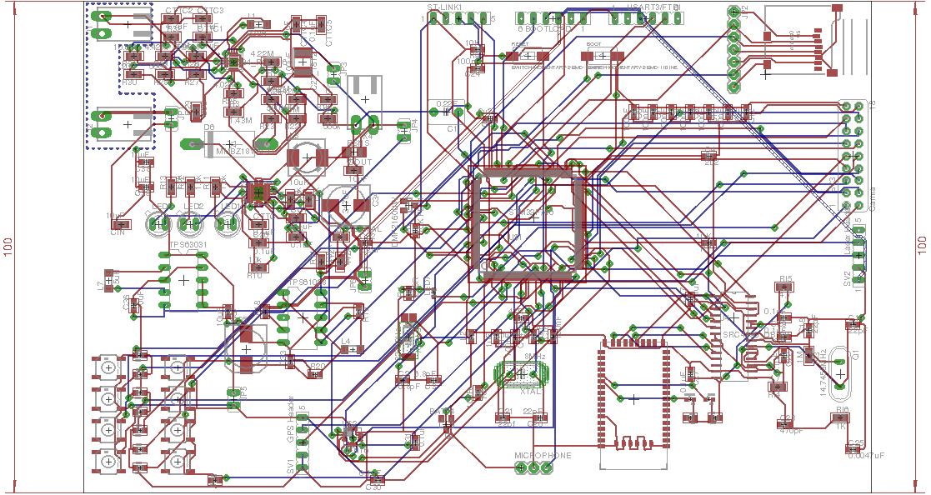
Sensewalk 2 PCB layout

Slide 23
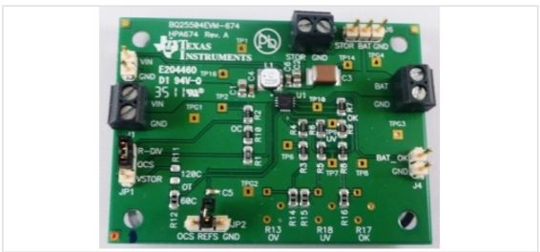
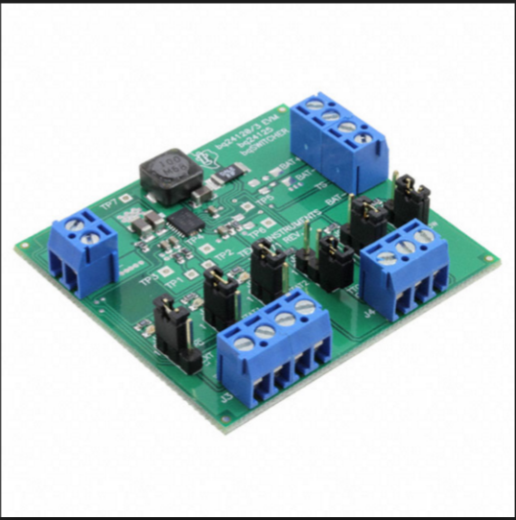
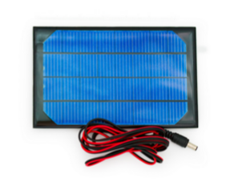
Charging management
Solar cell and DC-DC charger BQ25504 Battery management evaluation board. solar cell charges at .45W and the DC-DC charger BQ24123 supports the charge of 3.7 volts.

Slide 24
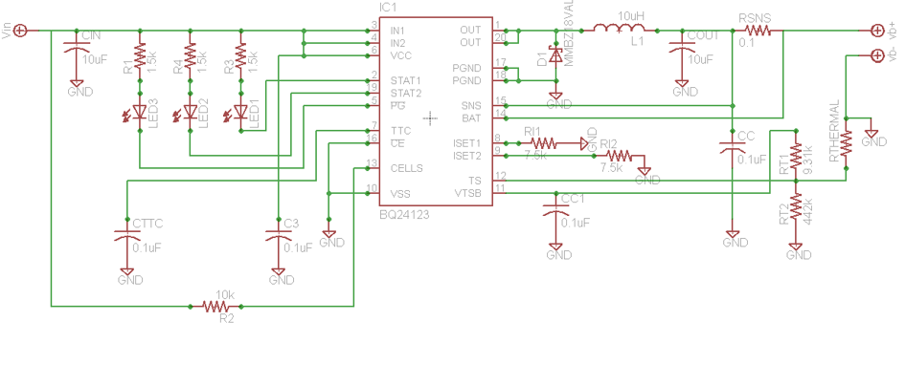
Battery charger schematic

Slide 25
Videos
https://youtu.be/B0nTJOjk9Rg
https://youtu.be/O5-MO2XVdNk
https://youtu.be/q0PLyxzlnzM
https://youtu.be/VR2hmE7ErHA

Slide 26
Expenses
 | Benoit | Chad | Diego | Ross | Funding
Laser |  |  |  |  | 286.15
Development boards | 121.98 |  | 40 |  | 21.98
PCB | 95.74 |  |  | X
Bluetooth BB |  | 50.00 |  |  | 89.9
GPS |  |  | 70.37
Audio decoder |  |  |  |  | 58.35
Memory (unused) |  |  |  |  | 45.51
Batteries / chargers | 36
MEMS microphone/breakout (unused) |  |  |  |  | 27.8
Image sensors (unused) | 25.58
Debugger / programmer | 24.51 | 3.20
MicroSD sockets |  |  |  |  | 20.36
Passive components | 17.75 |  |  |  | 40.47
Bluetooth module | 17.2 | 28.00 |  |  | 45.64
Breakout adapters | 16.87
Microcontrollers | 15.76 | 28.47 |  |  | 37.96
Soldering consumables | 14.89
Power subsystem | 12.45
Magnetometers | 8.05 |  |  |  | 25.02
Vibrator | 4.64 |  |  |  | 12
LEDs | 1.86
Misc |  |  |  | X | 10.5
Total | 413.28 | 109.67 | 110.37 |  | 758.76

Slide 27
Distribution of Workload
Ross Applegate | Chad Borgelin | Benoit Brummer | Diego Merida
Power (Solar Panel & Lithium Battery integration) | Bluetooth audio output | Hardware components selection, development environment selection | GPS
Schematic Design (SW2) |  | Laser detection
PCB Design (SW2) |  | Magnetometer
 |  | SD card / file system
 |  | Pinouts
 |  | Schematic design (SW9k)
 |  | PCB design (SW9k)
 |  | Boards bringup
 |  | Software integration

Slide 28


Sponsors

Slide 29
Questions

