Slide 1
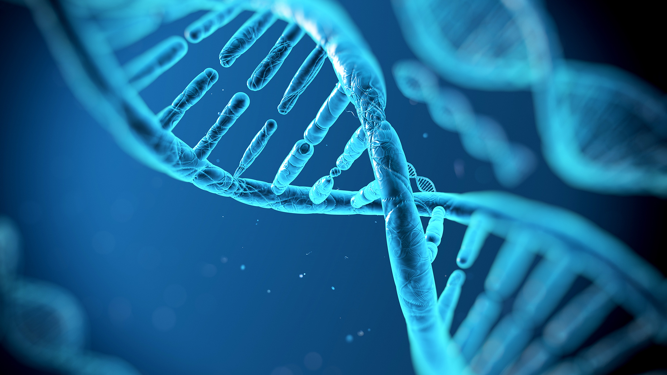
Evolutionary computation
Genetic Algorithms, Genetic Programming,
And Markov Brains
Presentation by Benoit Brummer and Pierrick Fichefet

Slide 2
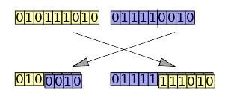
Genetic Algorithms: components
Genepool: individual bitstrings (initially random bits)
Each individual is assigned a score based on how it performs a task
Each subsequent generation is made of surviving individuals, mutated ones, and offsprings of other individuals
Survival rate and mating selection is influenced (but not dictated) by the individual's score
Predetermined number of iterations or run until a given score threshold is met

Slide 3
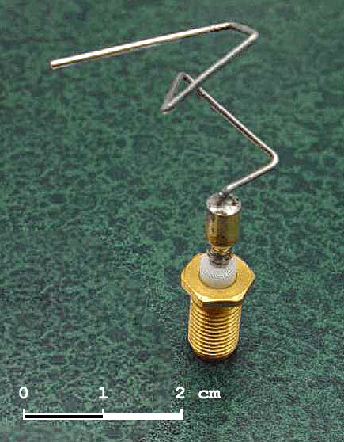
Genetic Algorithms: Applications
Timetabling and scheduling problems
  Mixed population allows to get away from local optima
Engineering
  Design novel designs using concepts we don‘t know
    Eg: Antenna design, FPGA programming

Slide 4
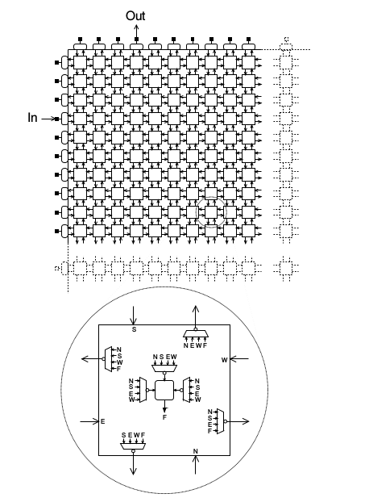
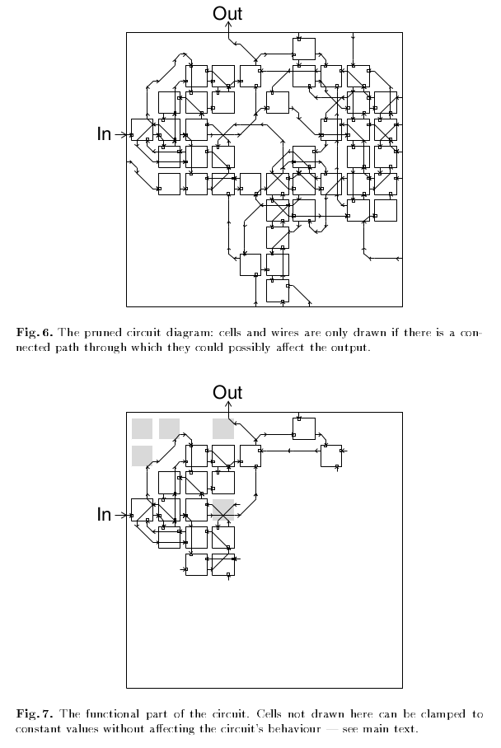
Genetic algorithms applied to FPGA

Slide 5
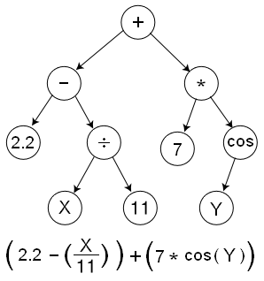
Genetic Programming
Genetic algorithms manipulate bitstrings,
genetic programming handles instructions
Components:
  Terminal Set
    External inputs (variables)
    Constants
    Functions with no arguments
  Function Set
    Eg: arithmetic, mathematical, boolean, conditional, looping
  Fitness function
    Eg: accuracy, error-rate, run-time, efficiency

Slide 6
Markov Brains
Markov Brains are a class of evolvable artificial neural networks (ANN).
Markov Brains are networks built from individual computational components. These computational components interact with each other, receive inputs from sensors, and control motor outputs. The function of the computational components, their connections to each other, as well as connections to sensors and motors are all subject to evolutionary optimization.

Slide 7
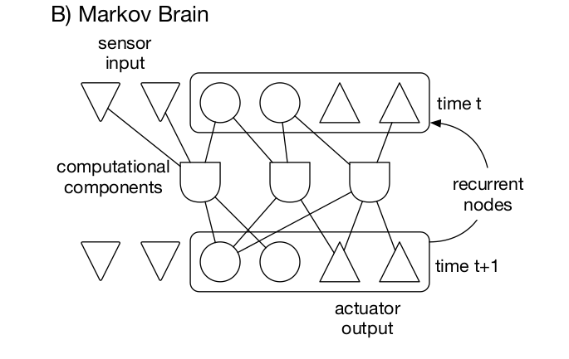
Markov Brains - 2
Defined by a state buffer
A Brain update applies a set of computations defined by the computational components
Outputs are read from a subset of the buffer

Slide 8
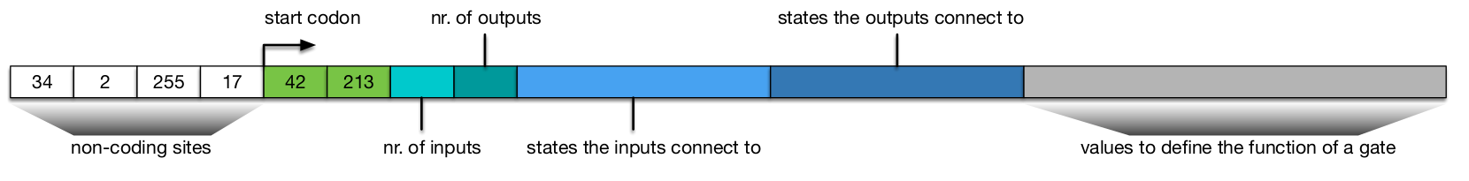
Markov Brains - 3

Slide 9
Markov Brains Applications
93.63% accuracy on MNIST (not impressive)
Maze solver with varying labyrinths and controls
Robot controllers which adapt to changes to the environment and themselves (ie: damage)
MABE:
Modular Agent Based Evolution Framework

Slide 10
Questions
How do genetic algorithms differ from genetic programming?

Slide 11
Questions
Give an example of application where genetic algorithms excel

Slide 12
Questions

