Slide 1
Image denoising using convolutional neural networks and the Natural Image Noise Dataset
Master thesis by Benoit Brummer
Promoter: Christophe De Vleeschouwer

Slide 2
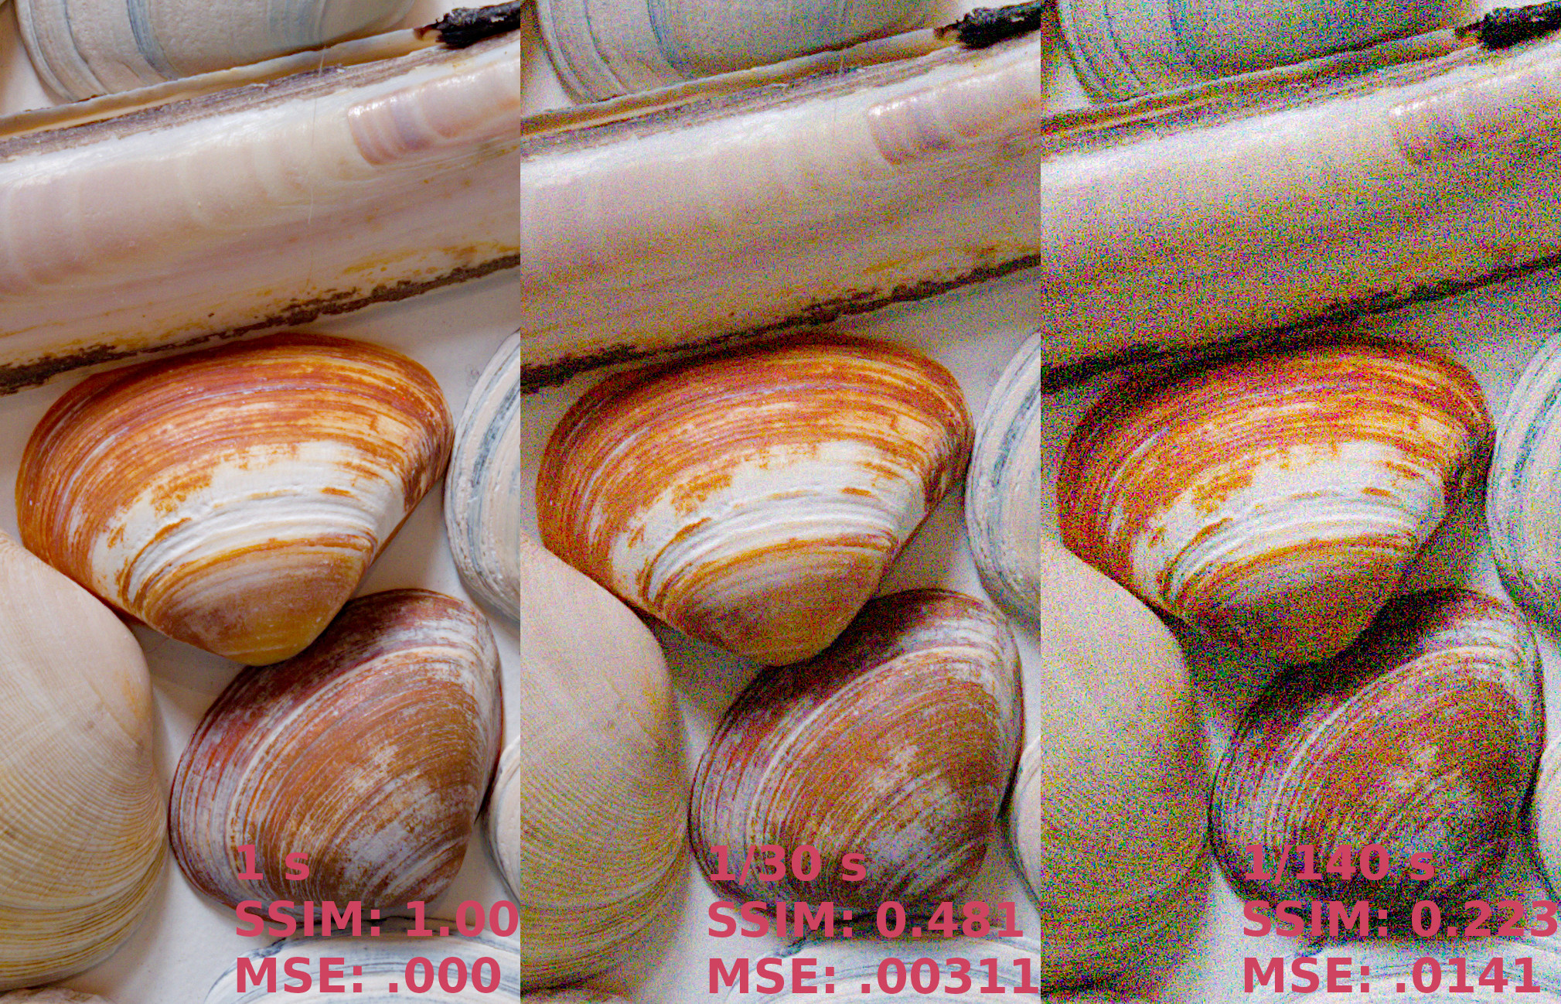
Problem: photographic image noise

