Slide 1

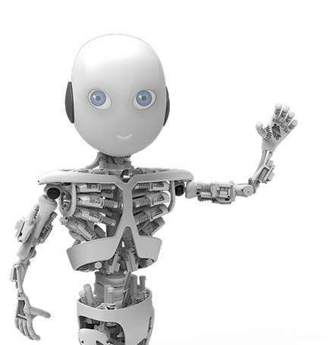

Practical Bayesian Optimization of Machine Learning Algorithms
Trabelsi oussema | Solofo Rabonarijaona
L3 info
Professeur : frédéric-hache

Slide 2
Summary:
1-Machine Learning introduction
2- Bayesian Optimization with Gaussian Process
3- Practical considerations for Bayesian Optimization of hyperparameters
…

Slide 3
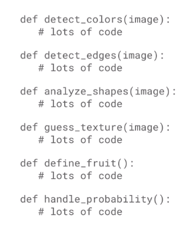
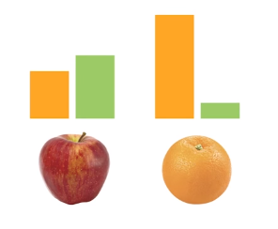
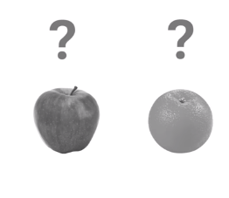
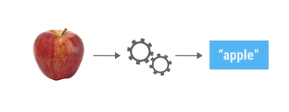
Machine Learning introduction
What’s the ML?

Slide 4
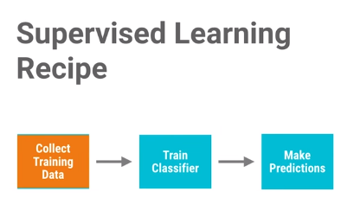
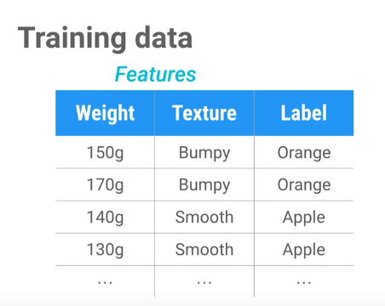
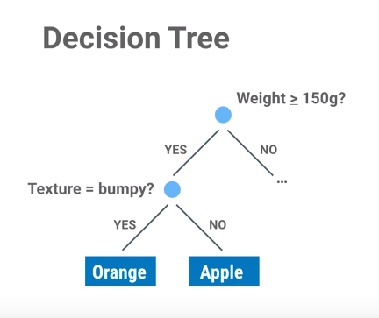
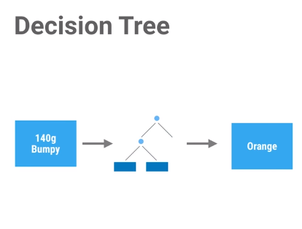

Slide 5
parameters vs hyperparameters

Slide 6
SECTION 2
“ In this section we briefly review the general Bayesian optimization approach, before discussing our novel contributions in Section 3 “
Authors

Slide 7
BAYESIAN OPTIMIZATION
(with Gaussian Process Priors)
GAUSSIAN PROCESS
ACQUISITION FUNCTIONS

Slide 8
BAYESIAN OPTIMIZATION WITH GAUSSIAN PRIPORS TARGET
f(X1) ….
… f(X1500)
….
… f(Xn) …
MIN f(x)

Slide 9
BAYESIAN OPTIMIZATION WITH GAUSSIAN PRIPORS PRINCIPLE/IDEA
Evaluation
f(X-1)
Infos
Evaluation f(X)
Infos…
Choose
X
Generate
P.Model of f(x)

Slide 10
BAYESIAN OPTIMIZATION WITH GAUSSIAN PRIPORS MAJOR CHOICES
1– SELECT FUNCTIONS (Give more infos)
GAUSSIAN PROCESS
2 – CHOOSE ACQUISITION FUNCTIONS
PROBABILITY OF IMPROVEMENT
EXPECTED IMPROVEMENT
GP UPPER CONFIDENCE BOUND

Slide 11
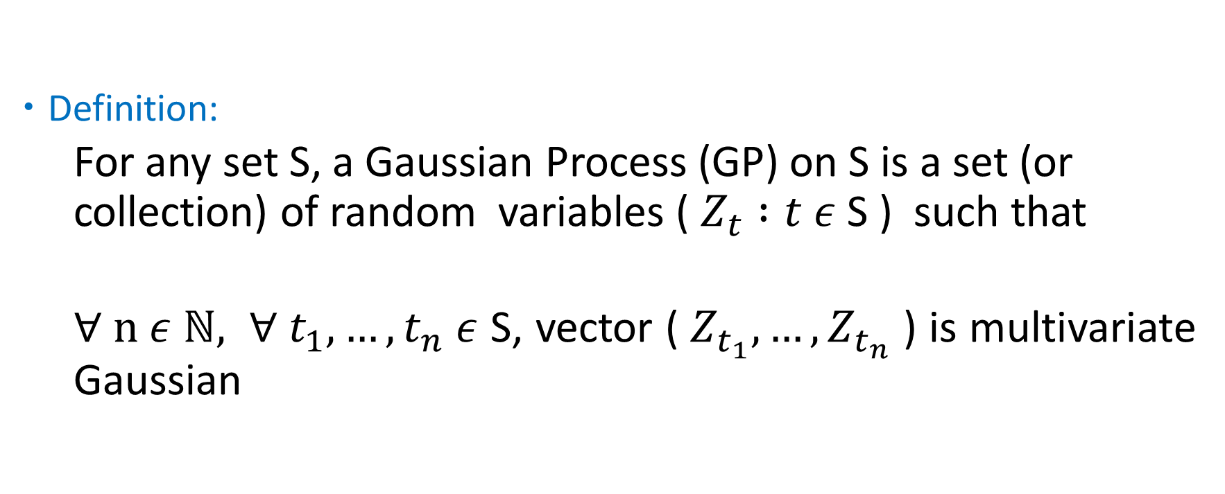
BAYESIAN OPTIMIZATION WITH GAUSSIAN PRIPORS GAUSSIAN PROCESS
Definition:
For any set S, a Gaussian Process (GP) on S is a set (or collection) of random variables ( $Z_{t} :t ε$ S ) such that
$∀ n ε$ $ℕ, ∀ t_{1},…,t_{n} ε$ S, vector (${ Z}_{t_{1}},…,Z_{t_{n}}$ ) is multivariate Gaussian
F.D.D

Slide 12

BAYESIAN OPTIMIZATION WITH GAUSSIAN PRIPORS GAUSSIAN PROCESS
Illustration: DRAW RANDOM LINES
$${s=ℝ, z}_{t}=tw, w≈N\left(0,1\right) ∈ℝ$$

Slide 13




BAYESIAN OPTIMIZATION WITH GAUSSIAN PRIPORS GAUSSIAN PROCESS
$$z_{1}$$
W = 0,2
$$z_{\frac{1}{2}}$$
W = 0,1
$$z_{−\frac{1}{2}}$$
$$z_{0}$$

Slide 14

BAYESIAN OPTIMIZATION WITH GAUSSIAN PRIPORS GAUSSIAN PROCESS
$\left(\begin{aligned}z_{t_{1}} \\ ⋮ \\ z_{t_{n}}\end{aligned}\right)$ = $\left(\begin{aligned}t_{1}w \\ ⋮ \\ t_{n}w\end{aligned}\right)$ = $\left(\begin{aligned}t_{1} \\ ⋮ \\ t_{n}\end{aligned}\right)$ . W
Affine property => Multivariate Gaussian

Slide 15
BAYESIAN OPTIMIZATION WITH GAUSSIAN PRIPORS STRATEGIES TO FIND ACQUISITION FUNCTIONS
PROBABILITY OF IMPROVEMENT
EXPECTED IMPROVEMENT
GP UPPER CONFIDENCE BOUND

Slide 16
BAYESIAN OPTIMIZATION WITH GAUSSIAN PRIPORS ACQUISITION FUNCTION CHOICE
EXPECTED IMPROVEMENT
Better behaved > P.I
not require its own tuning parameter > U.C.B
performs well in minimization problems

Slide 17
BAYESIAN OPTIMIZATION WITH GAUSSIAN PRIPORS OBSERVATION
+ Finding minimum of complex non-convex functions with few evaluation
- Request more extra computation
- Unclear how to choose covariance function and hyperparameters
- Doesn’t take in account variation of problem’s duration
- doesn't take advantage of multi-core parallelism

Slide 18
SECTION 3
“ In this section we propose solutions to each of these issues. “
Authors

Slide 19
BAYESIAN PRACTICAL BAYESIAN OPTIMISATION OF MACHINE LEARNING ALGORITHMS COVARIANCE FUNCTIONS AND TREATMENT OF BAYESIAN OPTIMIZATION OF HYPERPARAMETERS
GP
COVARIANCE FUNCTION
GP WITH RICH DISTRIBUTION

Slide 20

PRACTICAL BAYESIAN OPTIMISATION OF MACHINE LEARNING ALGORITHMS COVARIANCE FUNCTIONS AND TREATMENT OF BAYESIAN OPTIMIZATION OF HYPERPARAMETERS
BEFORE
ARD squared exponential kernel (Default choice) :
Generate unrealistic sample functions for practical optimization problem.

Slide 21


PRACTICAL BAYESIAN OPTIMISATION OF MACHINE LEARNING ALGORITHMS COVARIANCE FUNCTIONS AND TREATMENT OF BAYESIAN OPTIMIZATION OF HYPERPARAMETERS
CONTRIBUTION
Choose the form of the covariance function | Manage the hyperparameters that control the covariance function
ARD Matérn 5/2 kernel: | D + 3 Gaussian process hyperparameters
Marginalize over hyperparameters and compute the integrated acquisition function

Slide 22
PRACTICAL BAYESIAN OPTIMISATION OF MACHINE LEARNING ALGORITHMS COVARIANCE FUNCTIONS AND TREATMENT OF BAYESIAN OPTIMIZATION OF HYPERPARAMETERS
AFTER
It takes in consideration the uncertainty for hyperparameters for EI and probability of improvement.
It's possible to have a Monte Carlo estimate of the integrated EI.
It's computationally dominated by the cubic cost of solving an N-dimensional linear system

Slide 23

PRACTICAL BAYESIAN OPTIMISATION OF MACHINE LEARNING ALGORITHMS MODELING COSTS
TARGET :
Find good setting of hyperparameters
As quickly as possible

Slide 24
PRACTICAL BAYESIAN OPTIMISATION OF MACHINE LEARNING ALGORITHMS MODELING COSTS
BEFORE :
Try to make the best progress possible in the next function evaluation
Doesn’t consider the progress in term of execution time

Slide 25
PRACTICAL BAYESIAN OPTIMISATION OF MACHINE LEARNING ALGORITHMS MODELING COSTS
CONTRIBUTION :
Optimizing with
EI per second
Acquire points that are likely to be good
Acquire points that are likely to be evaluated quickly
SOLUTION
PRINCIPLE

Slide 26
PRACTICAL BAYESIAN OPTIMISATION OF MACHINE LEARNING ALGORITHMS MODELING COSTS
CONTRIBUTION :
Model
ln (C(x))
alongside F(x)
C(x)
F(x)
HOW
Compute the predicted inverse duration
Compute the EI per second

Slide 27
PRACTICAL BAYESIAN OPTIMISATION OF MACHINE LEARNING ALGORITHMS MODELING COSTS
AFTER :
Try to make the best progress possible in the next function evaluation
Consider the progress in term of execution time

Slide 28


PRACTICAL BAYESIAN OPTIMISATION OF MACHINE LEARNING ALGORITHMS MONTE CARLO ALGORITHM
ILLUSTRATION :
$$A_{C}=X^{2}$$
X
$$A_{T}=\frac{1}{2}x^{2}$$
X

Slide 29
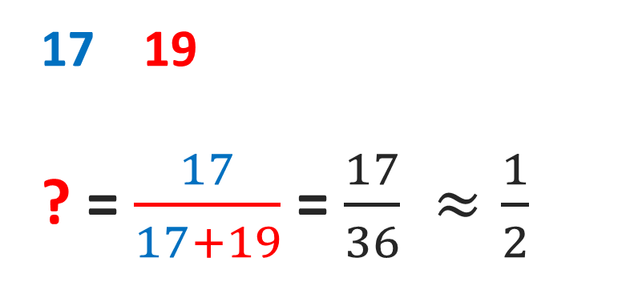
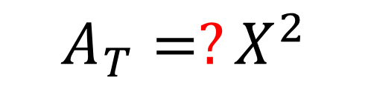
PRACTICAL BAYESIAN OPTIMISATION OF MACHINE LEARNING ALGORITHMS MONTE CARLO ALGORITHM
ILLUSTRATION :
$$A_{T}=?X^{2}$$
RANDOM SAMPLING :
X
17 19
? = $\frac{17}{17+19}$ = $\frac{17}{36} ≈\frac{1}{2}$
Count in triangle
Count in box
X

Slide 30
PRACTICAL BAYESIAN OPTIMISATION OF MACHINE LEARNING ALGORITHMS MONTE CARLO ALGORITHM
ILLUSTRATION :
X
X
X
X

Slide 31
PRACTICAL BAYESIAN OPTIMISATION OF MACHINE LEARNING ALGORITHMS MONTE CARLO ACQUISITION FOR PARALELLIZING BAYESIAN OPTIMIZATION
TARGET :
Parallelize Bayesian Optimization
Multi-core
Computing

Slide 32
PRACTICAL BAYESIAN OPTIMISATION OF MACHINE LEARNING ALGORITHMS MONTE CARLO ACQUISITION FOR PARALELLIZING BAYESIAN OPTIMIZATION
ISSUE :
Parallelize Bayesian optimization
Not to repeat one of the pending experiments

Slide 33
PRACTICAL BAYESIAN OPTIMISATION OF MACHINE LEARNING ALGORITHMS MONTE CARLO ACQUISITION FOR PARALELLIZING BAYESIAN OPTIMIZATION
CONTRIBUTION :
SEQUENTIAL
STRATEGY
GP
Monte Carlo estimates of acquisition function
PRINCIPLE

Slide 34
PRACTICAL BAYESIAN OPTIMISATION OF MACHINE LEARNING ALGORITHMS MONTE CARLO ACQUISITION FOR PARALELLIZING BAYESIAN OPTIMIZATION
CONTRIBUTION :
O₁
O₁
x₁
HOW
O₂
x
O₂
x₂
Pending
Evaluation
CHOSEN POINT
O_{n}
x_{n}
OUTCOMES
POINTS

Slide 35

PRACTICAL BAYESIAN OPTIMISATION OF MACHINE LEARNING ALGORITHMS MONTE CARLO ACQUISITION FOR PARALELLIZING BAYESIAN OPTIMIZATION
MATHEMATICALLY :

Slide 36
PRACTICAL BAYESIAN OPTIMISATION OF MACHINE LEARNING ALGORITHMS MONTE CARLO ACQUISITION FOR PARALELLIZING BAYESIAN OPTIMIZATION
CONCLUSION :
Monte Carlo estimation ( Highly effective in Practice – Proven in Section 3 )

