Slide 1








$$y$$
Cell
$$w_{o}^{T}𝕩_{o}+b_{o}$$
LSTM
LSTM
LSTM
LSTM
LSTM
$$h_{i}=o_{i}tanh⁡(c_{i})$$
$$𝕩_{0}$$
$$𝕩_{1}$$
$$𝕩_{2}$$
$$𝕩_{t−1}$$
$$𝕩_{t}$$

Slide 2
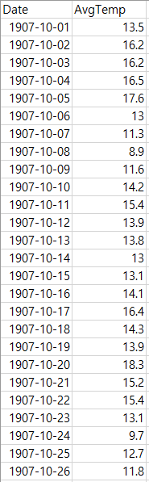
Input
Input
Input
Input
Target
Target
Target
Target

