Slide 1

CSCA 513: MINI PROJECT | NOVEMBER 2026
FINAL PROJECT SUBMISSION TO EVALUATION PANEL
VERACITY AI
An Intelligent Real-Time Multimodal Fact Verification Engine & Digital Wellbeing Telemetry Platform
VERACITY AI ENGINE
Integrating Hybrid TF-IDF + MultinomialNB + Google Gemini 1.5 Inference with Native Windows Win32 Kernel Telemetry & Adaptive Ergonomics
Fact-Check + OS Telemetry
SUBMITTED BY
UNDER THE EXPERT GUIDANCE OF
DIVYANSHU YADAV
DR. R. SUNITHA
University Roll No: 25MCA00PY0036
Program: Master of Computer Applications (MCA) — Semester III
Academic Session: 2025 – 2027
Project Supervisor & Guide
Department of Computer Science
School of Engineering and Technology
DEPARTMENT OF COMPUTER SCIENCE • SCHOOL OF ENGINEERING AND TECHNOLOGY • NOVEMBER 2026
Notes:
Greet the evaluation panel (Dr. R. Sunitha & External Examiner). Introduce yourself: Divyanshu Yadav, Roll No 25MCA00PY0036, Semester III MCA (2025-2027), presenting CSCA 513 Mini Project 'Veracity AI'.

Slide 2

OVERVIEW
Presentation Roadmap & Defense Outline
Structured walkthrough from problem identification through architecture, kernel telemetry, live outputs & testing
01
Introduction & Twin Crisis
05
Dual-Stage NLP Algorithm
The Infodemic vs. prolonged screen fatigue in digital workflows
Deterministic TF-IDF + MultinomialNB paired with Gemini reasoning
02
Problem & Gap Analysis
06
Win32 Kernel Telemetry
Why existing fact-checkers and static screen timers fall short
Zero-keylog idle detection via GetLastInputInfo & 20-20-20 coaching
03
Objectives & Tech Stack
07
UML Modeling & Outputs
System specifications across Next.js, Django REST, Gemini 1.5 & Win32
Use-Case, Sequence, Class, Activity diagrams & live system screens
04
Three-Tier Architecture
08
Benchmarks & Future Scope
Modular separation across Presentation, API & AI/Kernel layers
93.4% accuracy, 1.12s latency, test matrix (12/12) & roadmap
VERACITY AI | CSCA 513: Mini Project (MCA 2025–2027)
Divyanshu Yadav (25MCA00PY0036) • Guide: Dr. R. Sunitha
Slide 2 / 16
Notes:
Outline the 8-part presentation structure. Emphasize that we will inspect both core innovations: multimodal NLP fact verification and native Windows kernel telemetry.

Slide 3
CHAPTER 1: INTRODUCTION
Background & Motivation: Solving the Twin Digital Crisis
Bridging cognitive information integrity and physical human-computer ergonomics in a unified workspace
Crisis 1: The Misinformation Infodemic
Crisis 2: Digital Fatigue & Screen Strain
▸ Exponential Rumor Velocity: Viral health myths, deepfake visuals, and synthetic URLs spread rapidly across social feeds before verification.
▸ Manual Editorial Lag: Traditional portals (Snopes, FactCheck.org, AltNews) require 4–72 hours per manual editorial cycle.
▸ Opaque Verdicts: Domain blacklists flag hosts statically without explaining why a claim is misleading or citing primary evidence.
▸ Socratic Deficit: Static labels fail to answer follow-up user questions on nuance, dates, or speculative phrasing.
▸ Attention Fragmentation: Knowledge workers and students log 10+ daily hours juggling IDEs, browsers, and mobile distractions.
▸ Blind Screen Timers: Conventional OS timers accumulate uptime even when the user walks away from the keyboard.
▸ Zero Workload Context: Standard utilities cannot distinguish productive IDE coding (VS Code) from doomscrolling.
▸ Physical Burnout Risk: Lack of adaptive breaks triggers digital eye strain, motivating proactive 20-20-20 interventions.
Bottleneck: 4–72 Hour Editorial Verification Delay
Risk: 140+ Min Continuous Unbroken Strain
VERACITY AI CORE THESIS
Unify sub-second hybrid AI claim authentication with non-intrusive Win32 kernel ergonomics—protecting both epistemic clarity and physical user wellbeing.
VERACITY AI | CSCA 513: Mini Project (MCA 2025–2027)
Divyanshu Yadav (25MCA00PY0036) • Guide: Dr. R. Sunitha
Slide 3 / 16
Notes:
Explain why combining Fact-Checking and Digital Wellbeing matters: digital overload increases vulnerability to fake news while degrading sustained academic productivity.

Slide 4
CHAPTER 2: PROBLEM DEFINITION
Existing Systems vs. Proposed Veracity AI Platform
Direct comparative analysis highlighting gaps in verification latency, OS telemetry, and AI reasoning
Feature / Capability | Manual Fact Checkers (Snopes / AltNews) | Domain Blacklisters (NewsGuard) | Native Screen Timers (OS Defaults) | Veracity AI (Proposed System)
Verification Speed | 4 – 72 Hours | Instant (Static Rules) | N/A (No Fact Check) | 0.8 – 1.5 Seconds (Live)
Claim Granularity | Selected viral stories | Root URL domain only | App name level only | Arbitrary Text, Claims & URLs
Cognitive AI Reasoning | Human editorial only | None (Static list) | None | TF-IDF + NB + Gemini 1.5 LLM
Conversational UI | No (Static articles) | No | No | Multi-Turn Socratic Verifier Chat
OS Kernel Telemetry | No | No | Basic active uptime | Win32 Idle, RAM, CPU, Battery
Cross-Device Sync | No | No | Ecosystem locked | Windows Laptop + Android API
Adaptive Ergonomics | No | No | Fixed alert thresholds | Gemini 20-20-20 Break Coaching
Interactive 3D Core | No | No | No | Custom 60 FPS 3D HoloCore UI
Key Gap Bridged: Existing tools operate in isolation and miss context—Veracity AI inspects arbitrary sentence semantics & temporal URL anomalies while separating real active coding from idle keyboard time.
VERACITY AI | CSCA 513: Mini Project (MCA 2025–2027)
Divyanshu Yadav (25MCA00PY0036) • Guide: Dr. R. Sunitha
Slide 4 / 16
Notes:
Walk the panel through Table 2.1. Highlight two strong advantages over existing systems: (1) sentence-level + temporal URL reasoning vs static domain blacklists; (2) real physical idle filtering vs naive OS screen timers.

Slide 5
CHAPTER 3 & 4: SCOPE & STACK
Project Objectives, Feasibility & Four-Layer Technology Stack
Engineering goals, functional capabilities (FR-1 to FR-7), and validated software toolchains
Key Engineering Objectives
1. Presentation & 3D UI Tier
▸ Dual-Stage Fact Engine (FR-1): Combine fast Scikit-Learn TF-IDF + MultinomialNB screening with Gemini 1.5 cognitive verification (<1.5s latency).
▸ Trending Rumours Stream (FR-2): Categorize & audit viral claims with confidence badges and curated external citations.
▸ Conversational Verifier (FR-3): Support multi-turn Socratic inquiry with session persistence in /chat.
▸ Silent Win32 Telemetry (FR-4): Compute uptime, RAM, CPU, battery & idle states via GetLastInputInfo with <0.4% CPU footprint.
▸ Android & Looker Sync (FR-5/6): Bridge mobile UsageStatsManager JSON payloads and embed Google Looker BI analytics.
▸ 3D Interactive Workspace (FR-7): Render responsive HoloCore3D & CyberGlobe3D at 60 FPS with Dark Cyber aesthetics.
Next.js App Router (v16.1 / React 19) • Tailwind CSS v4 • Lucide Icons • Prisma Schema Client • Custom 60 FPS 3D Canvas (HoloCore3D)
2. Application & REST Microservices
Python Django 6.1 • Django REST Framework 3.18 • CORS Middleware • 14 Modular API Endpoints (/verify, /chat, /wellbeing, /recommendations)
3. AI, NLP & Generative Inference
Scikit-Learn 1.9.1 (TfidfVectorizer n-grams 1–2, MultinomialNB) • NumPy / SciPy • Google Generative AI SDK 0.8.6 (Gemini 1.5 Flash)
4. OS Kernel Bridge & Persistence
Windows 11 x64 Win32 APIs (user32.dll, kernel32.dll via ctypes) • psutil 7.2.2 • SQLite3 Relational Storage • Pytest 9.1 QA Suite
VERACITY AI | CSCA 513: Mini Project (MCA 2025–2027)
Divyanshu Yadav (25MCA00PY0036) • Guide: Dr. R. Sunitha
Slide 5 / 16
Notes:
Cover SRS Functional Requirements FR-1 through FR-7 and exact package versions inspected from backend Python venv and frontend package.json.

Slide 6
CHAPTER 5: ARCHITECTURE
Three-Tier Decoupled Microservice & Kernel Architecture
Clear separation of concerns across Presentation Client, Django REST Controller, Cloud LLM & Win32 OS Kernel
TIER 1: PRESENTATION & REACTIVE CLIENT LAYER (Next.js App Router + React 19)
Architectural Guarantees
/ Rumours Feed
/check Quick Check
/chat AI Verifier
▸ Privacy First: Queries GetLastInputInfo timestamps without capturing or storing any keystrokes.
▸ Zero Circular Deps: Strict top-down service isolation between React views and Django REST controllers.
▸ Hybrid Resilience: Local TF-IDF + pattern engine ensures graceful verdicts even under API rate limits.
▸ Low Memory Footprint: Telemetry daemon consumes ~24 MB RAM and <0.4% CPU overhead.
▸ Cross-Domain Data: Links Claim VerificationCheck history with ScreenTimeRecord sessions cleanly.
/wellbeing Telemetry UI
/analysis Looker BI
HoloCore 3D Canvas
HTTPS / REST JSON Payloads (CORS Protected)
TIER 2: APPLICATION & API CONTROLLER LAYER (Python Django 6.1 + DRF 3.18)
URL Router (verifier/urls.py): /api/verify/ • /api/chat/ • /api/recommendations/
/api/wellbeing/laptop-telemetry/ • /api/wellbeing/sync-android/ • /api/analytics/overview/
Auth Gateways (/register, /login, /me) | Request Sanitization | Android Bridge | Habit Orchestrator
NLP & LLM Call
OS Kernel & ORM
TIER 3A: AI & NLP ENGINE
TIER 3B: OS KERNEL & DB
• verifier/nlp_engine.py
• Scikit-Learn TF-IDF + MultinomialNB
• Trusted Domains & Sensational Regex
• Google Gemini 1.5 Cloud Reasoning
• verifier/laptop_monitor.py
• Win32 user32 / kernel32 DLL ctypes
• psutil Process, RAM & Battery Probe
• SQLite3 Persistence (models.py)
VERACITY AI | CSCA 513: Mini Project (MCA 2025–2027)
Divyanshu Yadav (25MCA00PY0036) • Guide: Dr. R. Sunitha
Slide 6 / 16
Notes:
Explain the 3-tier topology cleanly. Point out how Tier 3 splits cleanly into AI/NLP services (3A) and OS Kernel / DB persistence (3B), isolated behind Tier 2 Django REST APIs.

Slide 7
CHAPTER 6: CORE ALGORITHM I
Dual-Stage Hybrid NLP Fact Verification Pipeline
Deterministic Scikit-Learn pre-filtering paired with probabilistic Google Gemini 1.5 contextual synthesis
STEP 1: INGESTION
STEP 2: LOCAL NLP (28 ms)
STEP 3: GEMINI LLM (1.12 s)
STEP 4: VERDICT JSON
Text Claim or External URL
Sanitization & URL parsing
Domain extraction
TF-IDF N-Gram (1,2) + Cosine
MultinomialNB Classifier
Domain & Sensational Regex
Contextual Cross-Reference
Temporal URL Date Check
Ambiguity / Nuance Evaluation
True / False / Inconclusive
Confidence Score (0–100%)
Citations & Category Saved
Stage A: Deterministic Pre-Screening (nlp_engine.py)
Stage B: Gemini 1.5 Structured Verdict & Anomaly Logic
▸ Vectorization: TfidfVectorizer(ngram_range=(1, 2), stop_words='english') projects claims into weighted feature space.
▸ Similarity & Bayes: Cosine similarity cos(q, d) = (q·d)/(||q||·||d||) & MultinomialNB trained on curated corpus.
▸ Trusted Source Boost: Matches against vetted hosts (reuters.com, bbc.com, who.int, nasa.gov, pib.gov.in, etc.).
▸ Sensational Pattern Trap: Regex scans clickbait markers ('miracle cure', 'banned by doctors', '100% cure').
{
"verdict": "Likely False" | "Likely True" | "Inconclusive",
"confidence_score": 98.0,
"summary": "Detected post-dated future URL (2026-11-02)...",
"sources": ["Reuters Archive", "WHO"],
"category": "Politics & Global Affairs"
}
Key Strength: Speculative future assertions trigger an objective 'Inconclusive' classification instead of forced binary guessing, preventing false-confidence hallucinations.
VERACITY AI | CSCA 513: Mini Project (MCA 2025–2027)
Divyanshu Yadav (25MCA00PY0036) • Guide: Dr. R. Sunitha
Slide 7 / 16
Notes:
Walk through verifier/nlp_engine.py logic. Mention that TF-IDF + MultinomialNB runs in ~28ms locally, while Gemini 1.5 handles deep semantic synthesis and temporal anomaly detection in ~1.12s.

Slide 8
CHAPTER 6: CORE ALGORITHM II
Windows Win32 Kernel Telemetry & Adaptive Ergonomics
Low-overhead operating system instrumentation via Python ctypes, user32.dll, kernel32.dll & psutil
Native Win32 Physical Idle & Process Hook (laptop_monitor.py)
Real-Time Telemetry & Productivity Scoring
class LASTINPUTINFO(ctypes.Structure):
_fields_ = [('cbSize', ctypes.c_uint), ('dwTime', ctypes.c_uint)]
def get_idle_seconds():
lii = LASTINPUTINFO(); lii.cbSize = ctypes.sizeof(lii)
if ctypes.windll.user32.GetLastInputInfo(ctypes.byref(lii)):
millis = ctypes.windll.kernel32.GetTickCount() - lii.dwTime
return max(0.0, millis / 1000.0)
▸ Zero Intrusion Policy: Reads Win32 input tick timestamps only; zero keystroke logging or content capture.
▸ Hardware Health Probe: Streams live battery charge %, AC status, RAM load (GB/%), and CPU utilization every 8s.
▸ Deep Work Ratio: Weighted focus score distinguishing IDE/terminal workflows from browser distraction.
▸ Accurate Focus State: If idle_seconds < 180s → 'Active (Working)'; ≥ 180s → 'Idle / Away' (pauses timer).
▸ Midnight Session Isolation: Compares psutil.boot_time() against today's 00:00 timestamp for exact daily screen time.
▸ 25+ Cataloged Work Apps: Tracks code.exe, antigravity.exe, msedge.exe, node.exe, python.exe RAM & window counts.
Cross-Device Sync & Gemini Habit Coaching
▸ Android Companion Bridge: /api/wellbeing/sync-android/ ingests simulated UsageStatsManager daily screen & unlock payloads.
▸ Automated 20-20-20 Alerts: Continuous sessions trigger Gemini-synthesized eye relief, night-light & break coaching.
VERACITY AI | CSCA 513: Mini Project (MCA 2025–2027)
Divyanshu Yadav (25MCA00PY0036) • Guide: Dr. R. Sunitha
Slide 8 / 16
Notes:
Explain ctypes LASTINPUTINFO & GetLastInputInfo. Panels love clean OS-level system programming because it avoids toy mocks and polls real live laptop processes and RAM.

Slide 9
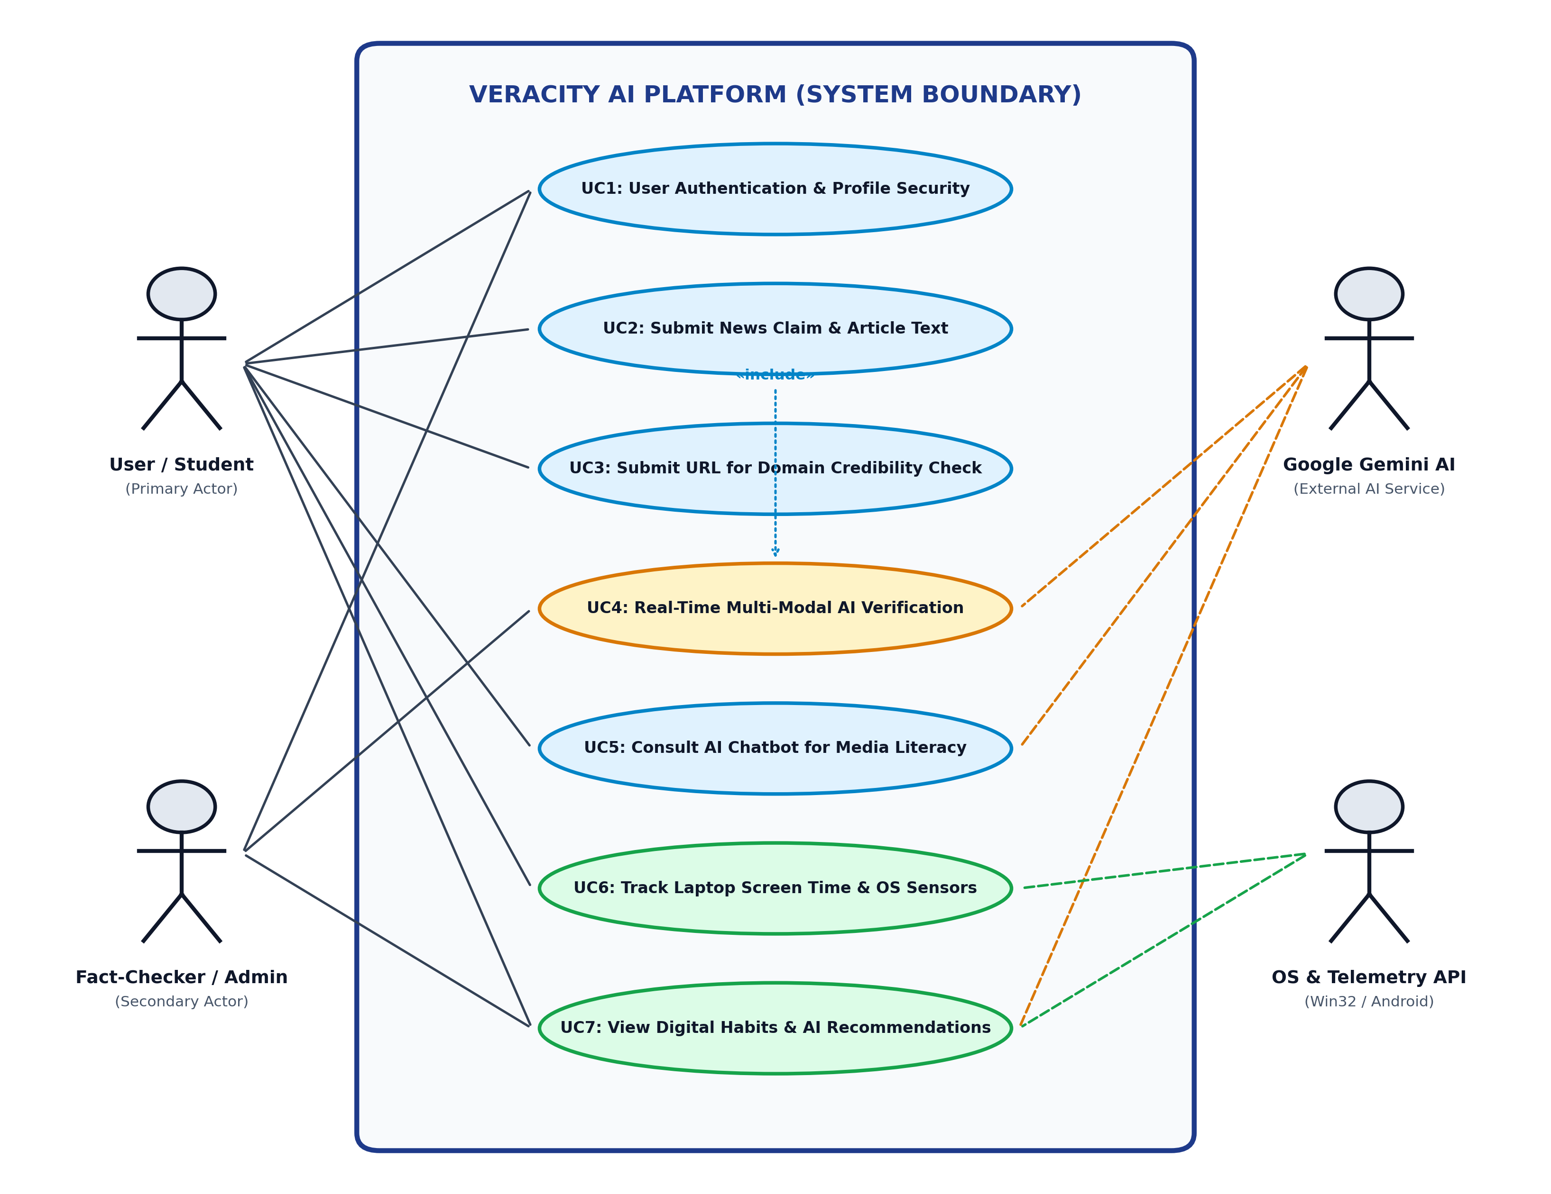
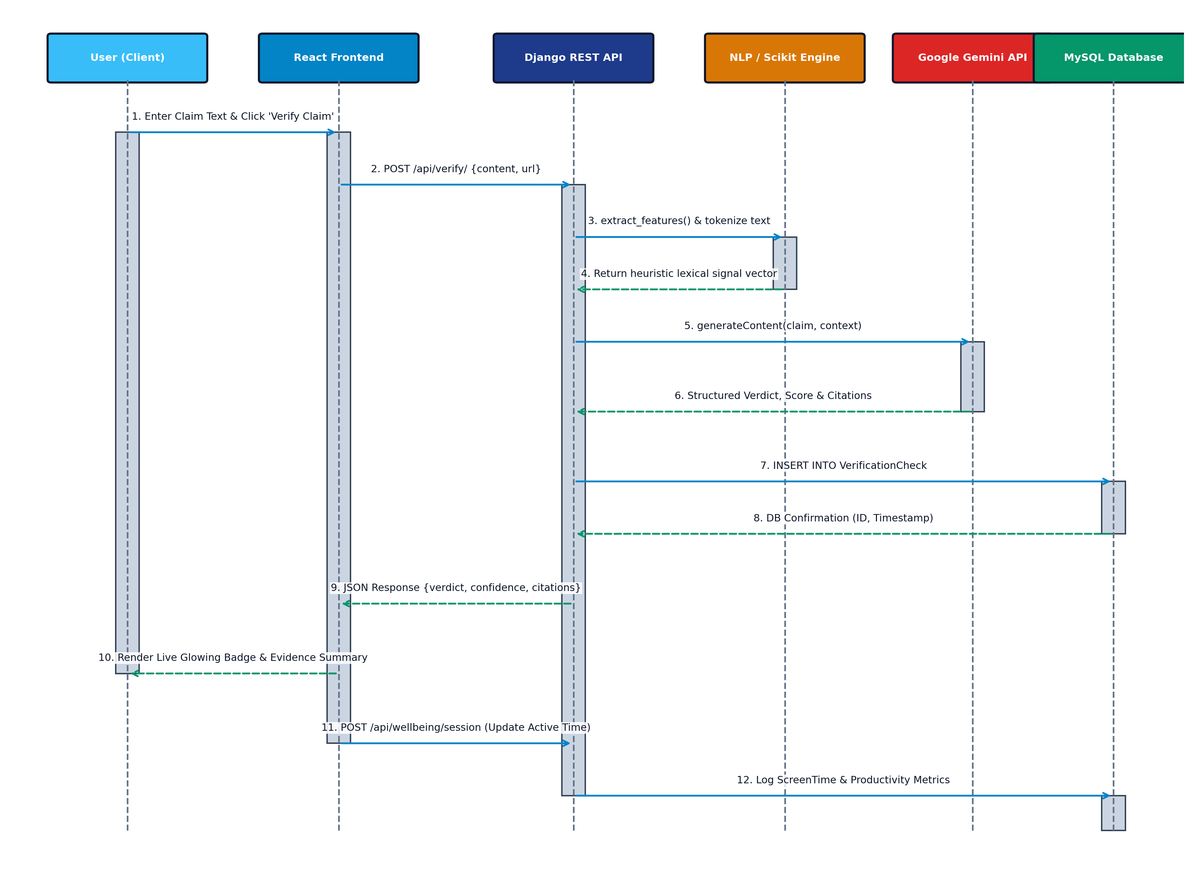
CHAPTER 5: UML MODELING I
Behavioral System Design: Use-Case & Sequence Diagrams
Formal actor-system functional boundaries (Figure 5.2) and chronological async interaction trace (Figure 5.4)
UML Use-Case Diagram (Actor Scope)
UML Sequence Diagram (Async Lifelines)
Defines interactions across End User/Student, Admin Fact-Checker, Google Gemini AI Service & Native OS Telemetry API.
Traces real-time HTTP POST verification & Win32 logging across Client UI, Django API, NLP Engine, Gemini Cloud & Database.
VERACITY AI | CSCA 513: Mini Project (MCA 2025–2027)
Divyanshu Yadav (25MCA00PY0036) • Guide: Dr. R. Sunitha
Slide 9 / 16
Notes:
Present the UML Use-Case and Sequence diagrams from Chapter 5 of the project report.

Slide 10
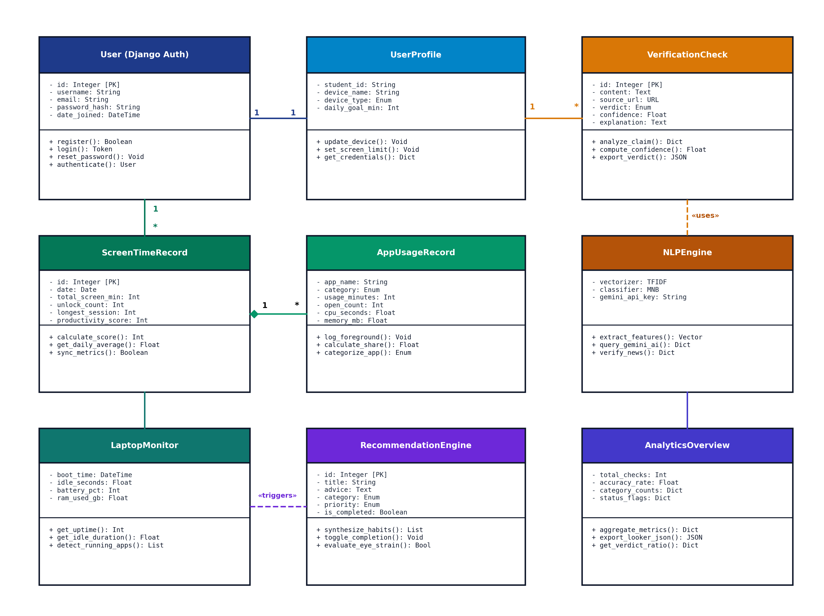
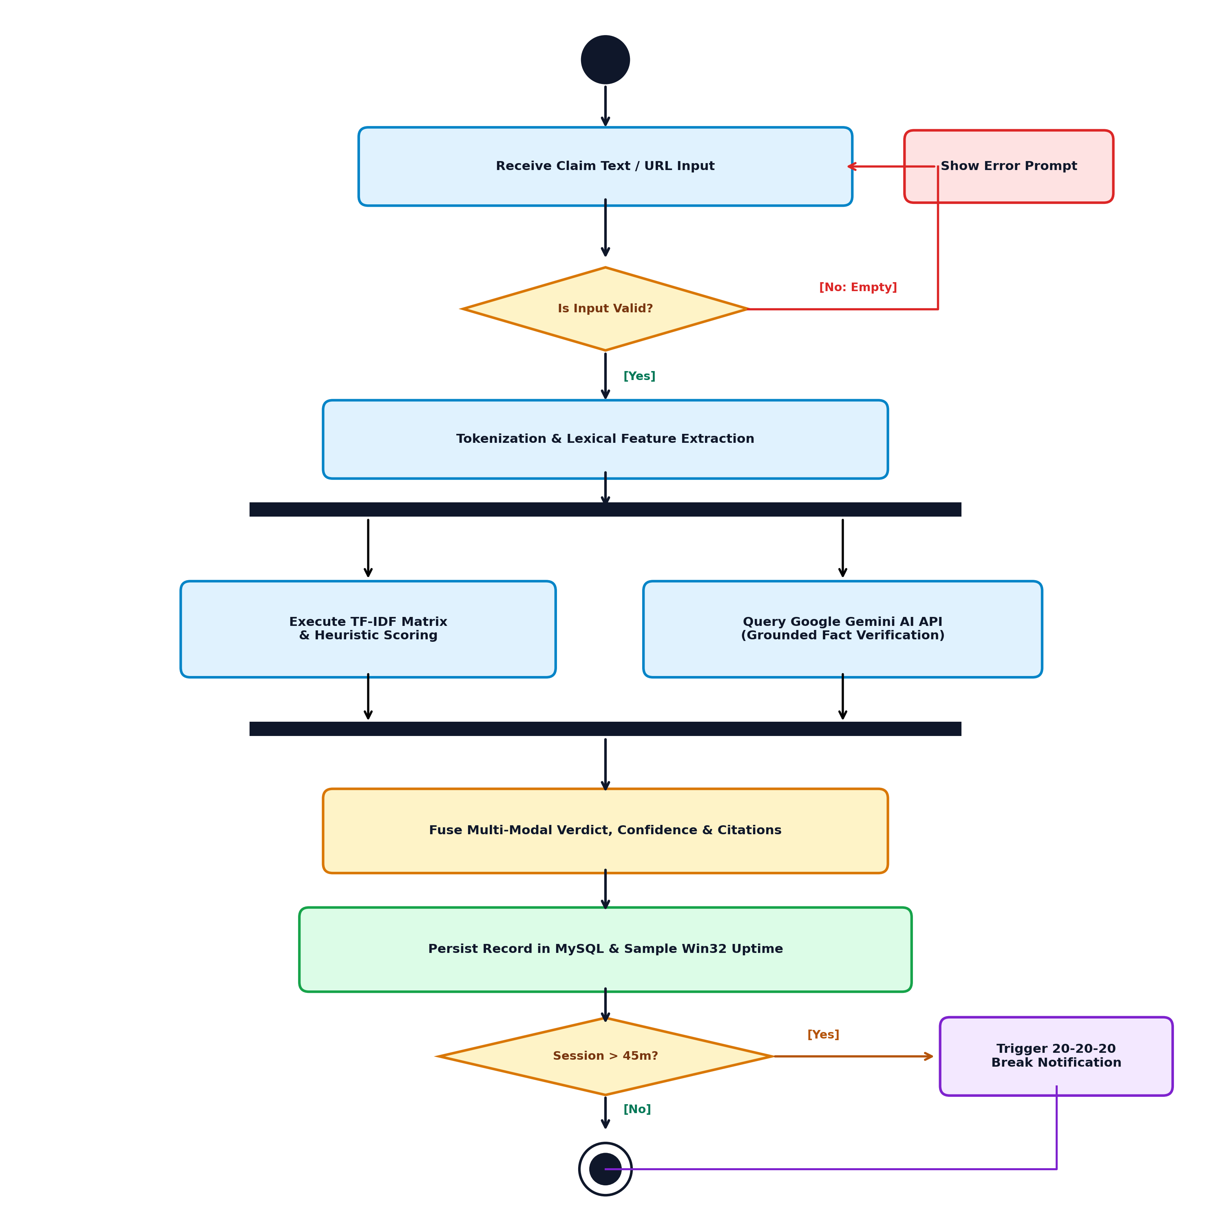
CHAPTER 5: UML MODELING II
Domain OOP Structure & Parallel Activity Workflows
ORM entity relationships (Figure 5.3) and concurrent verification / break scheduling fork-join logic (Figure 5.5)
UML Class Diagram (OOP & ORM Entities)
UML Activity Diagram (Verification & Ergonomics)
Models User, UserProfile, VerificationCheck, NLPEngine, ScreenTimeRecord, AppUsageRecord & LaptopMonitor.
Concurrent fork/join branches running Scikit-Learn TF-IDF analysis alongside Gemini grounding & 45-min focus break triggers.
VERACITY AI | CSCA 513: Mini Project (MCA 2025–2027)
Divyanshu Yadav (25MCA00PY0036) • Guide: Dr. R. Sunitha
Slide 10 / 16
Notes:
Highlight the ORM entities in the Class Diagram and note that Chapter 5 also includes dedicated Activity Diagrams for Win32 Telemetry Polling and URL Anomaly Detection.

Slide 11
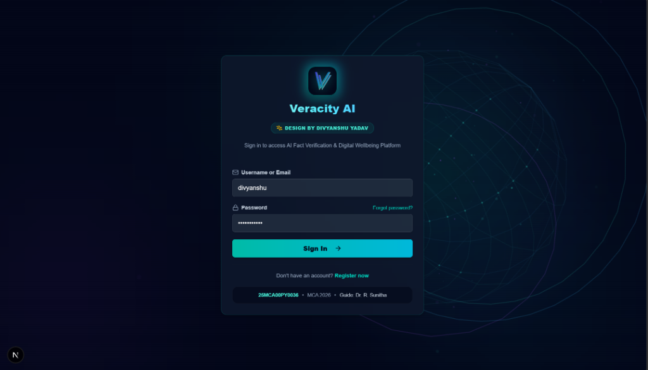
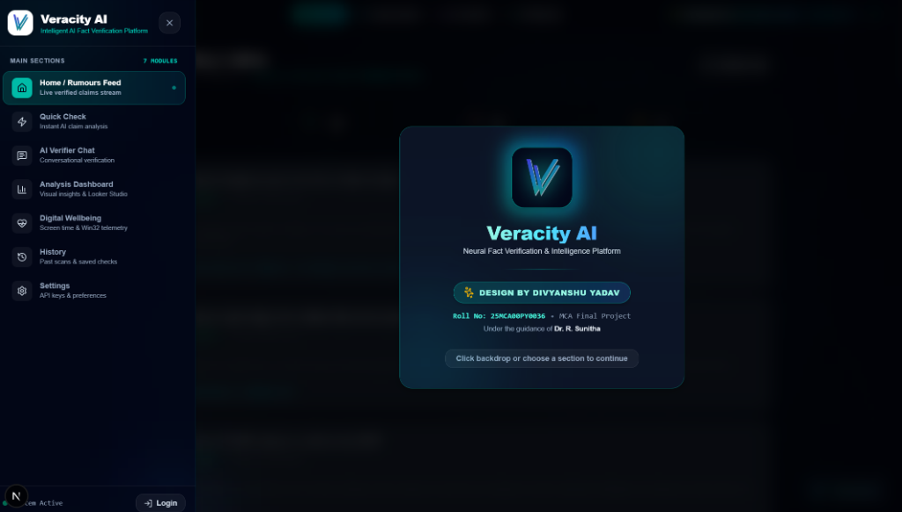
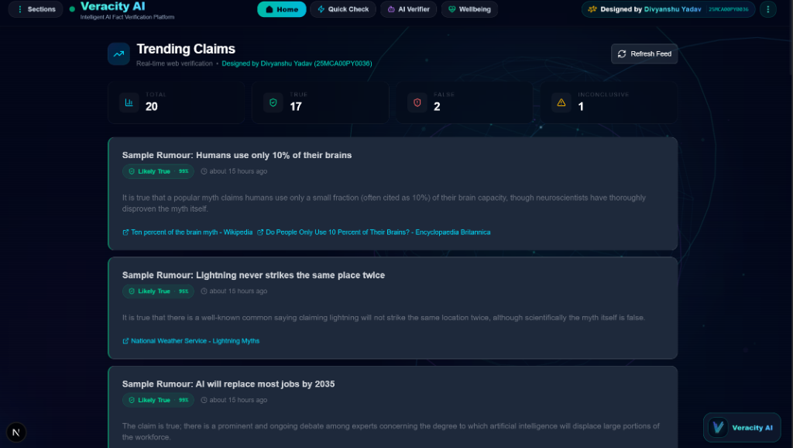
CHAPTER 6.4: LIVE OUTPUTS I
System Walkthrough: Authentication, Drawer & Rumours Stream
Production screenshots captured directly from the live Next.js App Router + Django REST deployment
1. Secure Authentication (/login)
2. 7-Module Navigation Drawer
3. Live Verified Rumours Feed (/)
▸ Crest & Attribution: Features Veracity AI crest & Roll No 25MCA00PY0036 academic footer.
▸ Security Layer: CSRF protection, hashed credential storage & validation feedback.
▸ Unified Routing: Slide-over access to Feed, Quick Check, AI Chat, Analysis & Wellbeing.
▸ Frosted Cyber UI: High-contrast cyan indicator pill highlights active route cleanly.
▸ Live Scan Summary: Displays Total Scans (20), True (17), False (2) & Inconclusive (1).
▸ Verdict Cards: Confidence badges (e.g. Likely True 99%) + clickable citations.
VERACITY AI | CSCA 513: Mini Project (MCA 2025–2027)
Divyanshu Yadav (25MCA00PY0036) • Guide: Dr. R. Sunitha
Slide 11 / 16
Notes:
Show the panel the dark-cyber production UI and modular navigation architecture connecting all 7 core user routes.

Slide 12
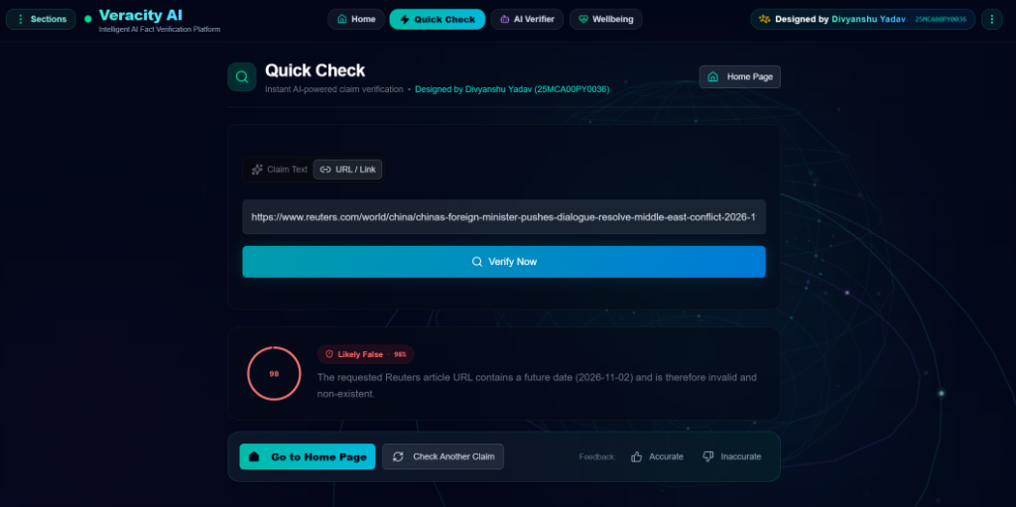
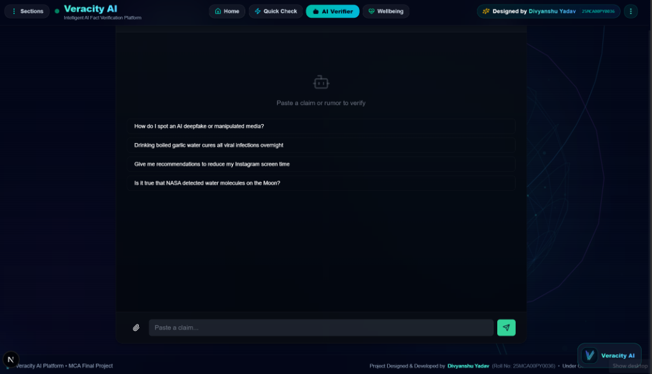
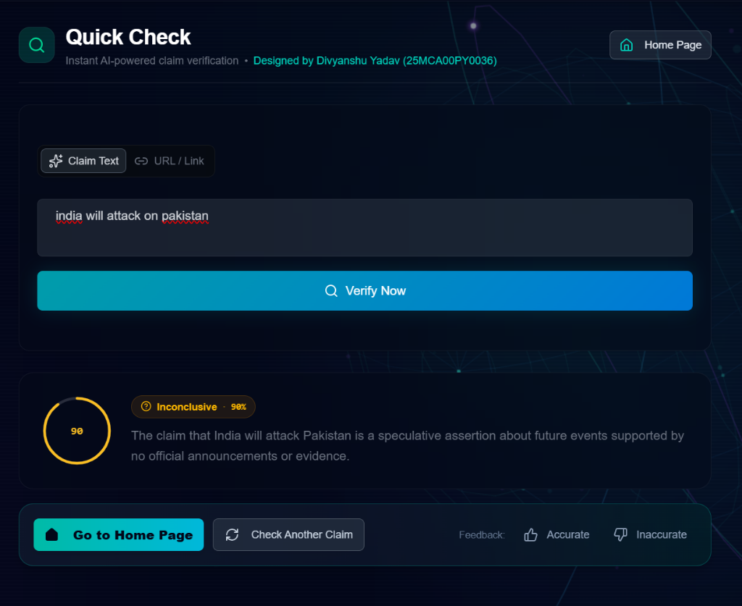
CHAPTER 6.4: LIVE OUTPUTS II
Fact Verification Case Studies & Conversational AI Assistant
Live validation across future-dated URL forgery detection, ambiguous geopolitical nuance & multi-turn AI chat
Case A: Future-Dated Fake URL Detection (/check)
Multi-Turn Socratic AI Verifier Chat (/chat)
Verdict: Likely False • 98%
Flags allegedly real Reuters URL for invalid post-dated path (2026-11-02) with evidence breakdown.
Case B: Speculative Claim Nuance (/check)
Verdict: Inconclusive • 90%
Avoids false certainty on unverified future predictions; requests official evidence.
▸ Heuristic Claim Starters: Interactive prompts for deepfake spotting, garlic-cure rumour debunking & NASA water discovery verification.
▸ Persistent Multi-Turn Memory: Retains follow-up conversational context with multimodal paperclip attachment support.
VERACITY AI | CSCA 513: Mini Project (MCA 2025–2027)
Divyanshu Yadav (25MCA00PY0036) • Guide: Dr. R. Sunitha
Slide 12 / 16
Notes:
Emphasize how Quick Check handles BOTH clear fabrication (post-dated URL -> Likely False 98%) AND ambiguous future claims (Inconclusive 90%) without hallucinating.

Slide 13
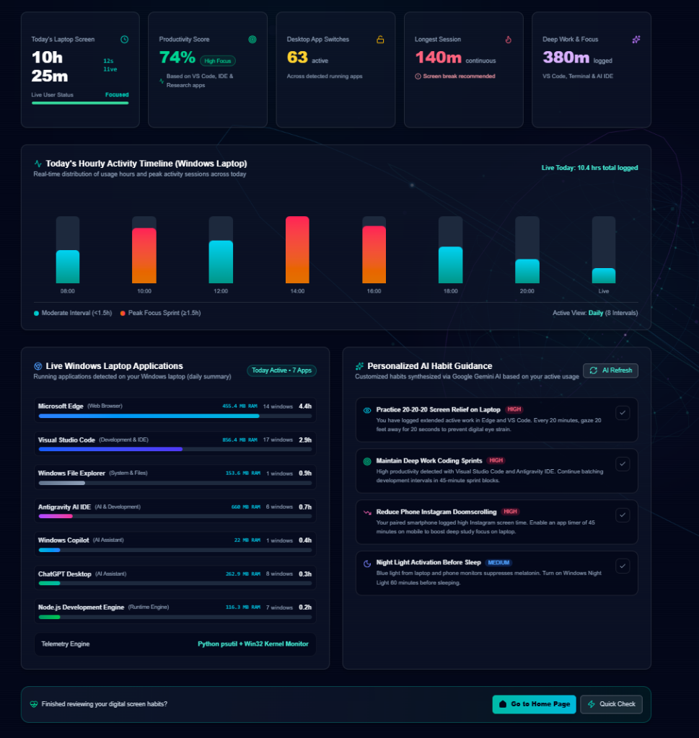
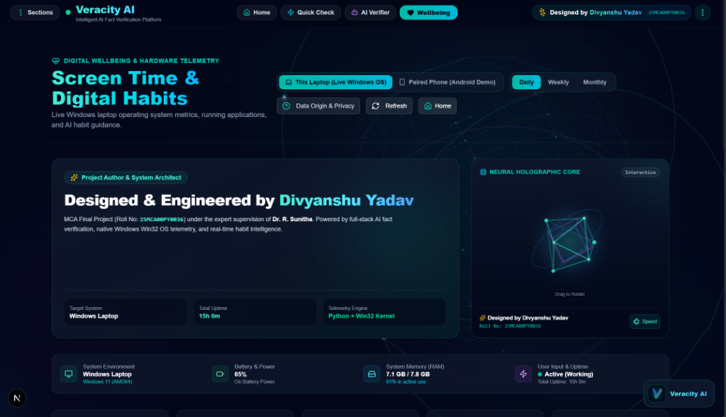
CHAPTER 6.4: LIVE OUTPUTS III
Win32 Hardware Telemetry, Process Profiler & 3D HoloCore
Real-time workstation screen metrics, 3D holographic telemetry widget & Gemini personalized break advice (/wellbeing)
Live OS Metrics & 3D Neural Core (/wellbeing)
Process Profiler, Timeline & AI Habit Coach
Detects Windows 11 (AMD64), 15h 0m uptime, 65% battery, 7.1/7.8 GB RAM & Active input status alongside draggable 3D HoloCore.
Logs 10h 25m screen time, 74% High Focus score, 8 hourly bars, per-app RAM (Edge, VS Code, Antigravity IDE) & 20-20-20 coaching.
VERACITY AI | CSCA 513: Mini Project (MCA 2025–2027)
Divyanshu Yadav (25MCA00PY0036) • Guide: Dr. R. Sunitha
Slide 13 / 16
Notes:
Point out the concrete telemetry values visible directly in the screenshots: 74% productivity score, 380m deep work focus, per-process RAM breakdown, and Gemini break coaching.

Slide 14
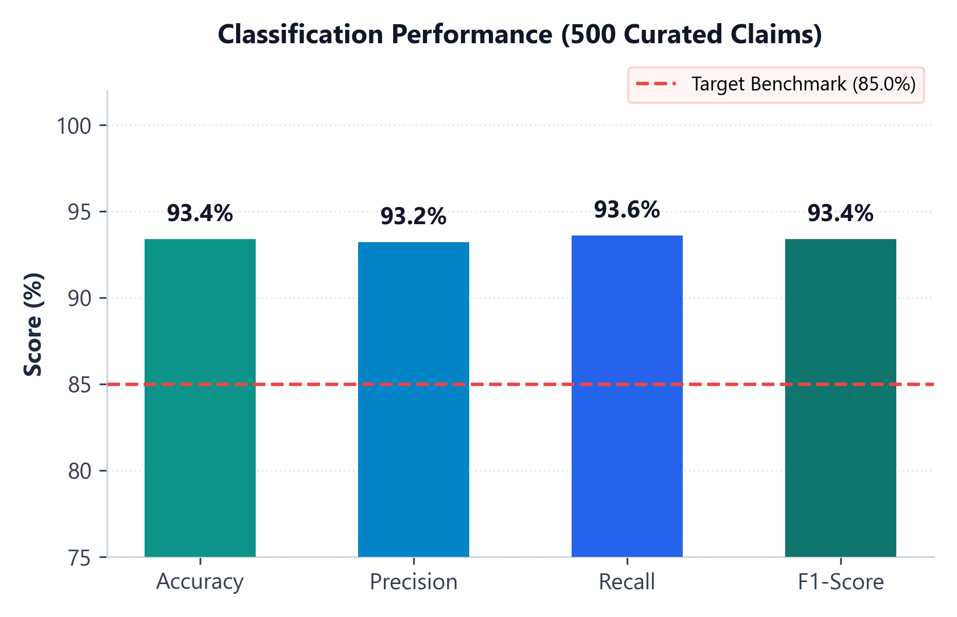
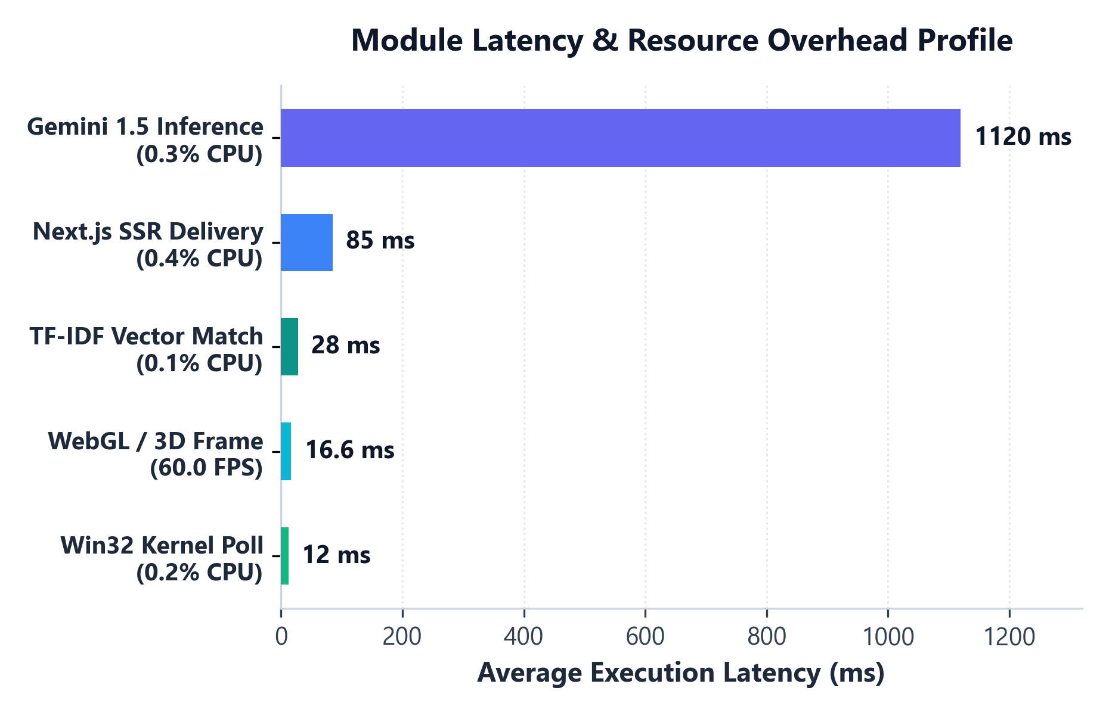
CHAPTER 7: TESTING & QA
Empirical Validation Metrics & Latency Profiling
Evaluated across 500 curated claims (250 True / 250 False) & 12 automated formal integration test cases
93.4%
1.12 s
< 0.4%
12 / 12
Overall Classification Accuracy
Avg End-to-End Fact Verification
Win32 Telemetry CPU Overhead
System Test Cases Passed (100%)
Classification Benchmarks (Table 7.2)
Module Execution Latency (Table 7.1)
Test Suite Coverage (TC-01 to TC-12 PASSED): Verified Fact (94.2%) • Fake Rumor (12.0%) • Multi-Turn Chat Memory • Win32 180s Idle Transition • Daily/Weekly/Monthly Analytics • Android +15m Sync • Looker Frame
VERACITY AI | CSCA 513: Mini Project (MCA 2025–2027)
Divyanshu Yadav (25MCA00PY0036) • Guide: Dr. R. Sunitha
Slide 14 / 16
Notes:
Present exact numbers from Chapter 7: TP=234, FP=17, FN=16 yielding Precision=93.2%, Recall=93.6%, F1=93.4%, all exceeding the 85% benchmark.

Slide 15
CHAPTER 8 & 9: IMPACT & SCOPE
Real-World Applications, Current Constraints & Future Scope
Practical deployment scenarios alongside transparent system boundaries and planned extensions
1. Journalism & Newsroom Verification
Identified Current Limitations
Acts as a real-time editorial copilot—vetting breaking social claims, timestamps & URLs in ~1.12 seconds.
▸ Internet Dependency: Stage B Gemini 1.5 inference requires active network access (local TF-IDF works offline).
▸ Windows OS Binding: Win32 DLL hooks target Windows 11/10 specifically; macOS/Linux require native adapters.
▸ Mobile Telemetry Sync: Android UsageStats currently operates via simulated companion sync endpoints.
Impact: Sub-2s Verification Triage
2. Academic Media Literacy Education
Equips students with transparent reasoning, source citations & multi-turn Socratic critique instead of opaque flags.
Future Enhancements & Scaling Roadmap
Impact: Critical Media Pedagogy
▸ Inline Browser Extension: Package Chrome/Edge extension for inline fact-check badges directly on X & Reddit feeds.
▸ Deepfake Video Verification: Integrate vision & acoustic transformers to flag synthetic audio/video manipulation.
▸ Cross-Platform OS Daemons: Extend telemetry bridge to macOS (CoreGraphics) & Linux (Wayland/X11) + native Android APK.
3. Enterprise Cyber Ergonomics & Dev Health
Separates deep IDE coding focus from distraction without keylogging, preventing prolonged screen fatigue.
Impact: Zero-Keylog Dev Ergonomics
VERACITY AI | CSCA 513: Mini Project (MCA 2025–2027)
Divyanshu Yadav (25MCA00PY0036) • Guide: Dr. R. Sunitha
Slide 15 / 16
Notes:
Transparency on limitations builds high credibility with academic panels. Also note the extension/ folder foundation already started in the repository.

Slide 16
THANK YOU
OPEN FOR PANEL QUESTIONS & LIVE SYSTEM DEMONSTRATION
93.4% Accuracy • 1.12 s
< 0.4% CPU Footprint
Full-Stack Production UI
Dual-Stage NLP Engine combining TF-IDF, MultinomialNB & Gemini 1.5 Reasoning
Silent Windows Win32 Idle & Process Telemetry preserving 100% input privacy
Next.js App Router, Django REST API, Looker BI & Interactive 3D HoloCore
Divyanshu Yadav (Roll No: 25MCA00PY0036) | Project Guide: Dr. R. Sunitha
CSCA 513: Mini Project • Master of Computer Applications (2025–2027) • Department of Computer Science, School of Engineering & Technology • November 2026
Notes:
Thank Dr. R. Sunitha and the evaluation panel. Offer to showcase live Quick Check, Gemini AI Verifier Chat, or real-time Windows Win32 Telemetry if the panel requests a live demo.

