Slide 1

CSCA 513: MINI PROJECT | NOVEMBER 2026
FINAL PROJECT SUBMISSION TO EVALUATION PANEL
VERACITY AI
An Intelligent Real-Time Multimodal Fact Verification Engine & Digital Wellbeing Telemetry Platform
VERACITY AI ENGINE
Integrating Hybrid TF-IDF + MultinomialNB + Google Gemini 1.5 Inference with Native Windows Win32 Kernel Telemetry & Adaptive Ergonomics
Fact-Check + OS Telemetry
SUBMITTED BY
UNDER THE EXPERT GUIDANCE OF
DIVYANSHU YADAV
DR. R. SUNITHA
University Roll No: 25MCA00PY0036
Program: Master of Computer Applications (MCA) — Semester III
Academic Session: 2025 – 2027
Project Supervisor & Guide
Department of Computer Science
School of Engineering and Technology
DEPARTMENT OF COMPUTER SCIENCE • SCHOOL OF ENGINEERING AND TECHNOLOGY • NOVEMBER 2026
Notes:
Greet the evaluation panel. Introduce Veracity AI (CSCA 513 Mini Project, Nov 2026) — Divyanshu Yadav (25MCA00PY0036), guided by Dr. R. Sunitha.

Slide 2

INTRODUCTION & PROBLEM
Motivation & Comparative Gap Analysis
Bridging the 4–72 hour verification lag and blind screen timers into one intelligent platform
Crisis 1: Misinformation Infodemic
Existing Systems vs. Veracity AI (Table 2.1)
▸ Manual Delay: Editorial fact-checkers require 4–72 hours per claim.
▸ Static Blacklists: Host rules miss arbitrary sentence-level claims & post-dated URLs.
▸ Zero Explanation: Lack Socratic Q&A and primary evidence synthesis.
Capability | Manual / Blacklist | OS Screen Timers | Veracity AI (Proposed)
Verification Speed | 4–72 hrs / Static | N/A | 0.8 – 1.5 Seconds (Live)
Claim Granularity | Domain / Viral only | App name only | Arbitrary Claims & URLs
AI Cognitive Engine | None (Rules/Manual) | None | TF-IDF + NB + Gemini 1.5
Conversational UI | Static pages | None | Multi-Turn Socratic Chat
OS Kernel Telemetry | No | Basic uptime | Win32 Idle, RAM, CPU, Battery
Cross-Device Sync | No | Vendor locked | Laptop + Android API
Ergonomics & 3D UI | No | Fixed limits | Gemini Habits + 3D HoloCore
Crisis 2: Digital Fatigue & Blind Timers
▸ Idle Inaccuracy: OS timers count screen time even when away from the desk.
▸ Context Blindness: Cannot distinguish deep IDE coding from social scrolling.
▸ Screen Strain: 140+ min uninterrupted focus triggers cognitive burnout.
Core Objective: Unify sub-second hybrid AI fact verification with zero-keylog Win32 kernel telemetry in a modular full-stack platform.
VERACITY AI | CSCA 513: Mini Project (MCA 2025–2027)
Divyanshu Yadav (25MCA00PY0036) • Guide: Dr. R. Sunitha
Slide 2 / 10
Notes:
Highlight the two crises cleanly and use Table 2.1 to prove why combining NLP verification and OS kernel ergonomics fills a real engineering gap.

Slide 3
SYSTEM ARCHITECTURE
Three-Tier Decoupled Architecture & Technology Stack
Clean separation across Next.js Presentation UI, Django REST Controllers, Gemini 1.5 NLP & Win32 Kernel
TIER 1: PRESENTATION & 3D CLIENT (Next.js App Router + React 19)
Frontend UI
/ Feed
/check Quick Check
/chat AI Chat
Next.js App Router v16.1, React 19, Tailwind CSS v4, Lucide Icons, Interactive 3D HoloCore & CyberGlobe Canvas
/wellbeing UI
/analysis Looker
HoloCore 3D Canvas
HTTPS / REST JSON (CORS Middleware)
Backend APIs
TIER 2: APPLICATION & API CONTROLLERS (Django 6.1 + DRF 3.18)
Python Django 6.1, Django REST Framework 3.18, CORS Headers, Auth & Telemetry Serializers
14 Endpoints (verifier/urls.py): /api/verify/ • /api/chat/ • /api/recommendations/
/api/wellbeing/laptop-telemetry/ • /api/wellbeing/sync-android/ • /api/analytics/overview/
JWT/Session Auth (/register, /login, /me) | Request Sanitizer | Android Bridge
AI & ML Suite
NLP & LLM Call
Kernel & ORM
Scikit-Learn 1.9.1 (TfidfVectorizer n-gram 1–2, MultinomialNB), NumPy, Google GenAI SDK 0.8.6
TIER 3A: AI & NLP ENGINE
TIER 3B: WIN32 KERNEL & DB
• verifier/nlp_engine.py
• Scikit-Learn TF-IDF + MultinomialNB
• Trusted Domains & Regex
• Google Gemini 1.5 Flash SDK
• verifier/laptop_monitor.py
• user32.dll / kernel32.dll ctypes
• psutil Process, RAM & Battery Probe
• SQLite3 + Prisma Client Schema
OS & QA Env
Windows 11 x64 Win32 APIs via ctypes, psutil 7.2.2, SQLite3, Pytest 9.1 (<0.4% CPU footprint)
VERACITY AI | CSCA 513: Mini Project (MCA 2025–2027)
Divyanshu Yadav (25MCA00PY0036) • Guide: Dr. R. Sunitha
Slide 3 / 10
Notes:
Walk through the decoupled 3-tier topology and cite exact libraries from requirements.txt and frontend/package.json.

Slide 4
CORE ALGORITHMS
Dual-Stage NLP Engine & Native Win32 Kernel Telemetry
Combining deterministic pre-filtering + Gemini 1.5 synthesis with low-level OS idle & process polling
Algorithm 1: Hybrid Fact Verification (nlp_engine.py)
Algorithm 2: Win32 Kernel Telemetry (laptop_monitor.py)
1. Ingest
2. Local (28ms)
3. Gemini (1.12s)
class LASTINPUTINFO(ctypes.Structure):
_fields_ = [('cbSize', c_uint), ('dwTime', c_uint)]
def get_idle_seconds():
lii = LASTINPUTINFO(); lii.cbSize = sizeof(lii)
if windll.user32.GetLastInputInfo(byref(lii)):
return (windll.kernel32.GetTickCount() - lii.dwTime)/1000.0
Claim text or URL parsed
TF-IDF + MultinomialNB
Grounded LLM reasoning
▸ Stage A — Local Screening: TfidfVectorizer(ngram_range=(1,2)) + Cosine Similarity & MultinomialNB check trusted hosts (reuters.com, who.int, nasa.gov, pib.gov.in) & sensational clickbait regex.
▸ Stage B — Gemini 1.5 Inference: Validates factual plausibility, detects temporal URL forgeries (e.g., future-dated news paths), and preserves scientific nuance.
▸ Objective Ambiguity Handling: Speculative future predictions trigger 'Inconclusive' ratings instead of forced binary guessing.
▸ True Idle Detection (Zero Keylog): Queries OS input tick timestamps only; idle ≥ 180s transitions state to 'Idle / Away' and pauses screen timer.
▸ Midnight Session Isolation: Computes today's active duration accurately via psutil.boot_time() against 00:00 AM.
▸ 25+ App Process Profiler: Measures live RAM & CPU load across VS Code, Antigravity IDE, Edge, Node.js & Python.
▸ Android & 20-20-20 Coaching: Syncs UsageStatsManager companion metrics & triggers Gemini eye-relief break interventions.
JSON Verdict: {"verdict": "Likely False", "confidence": 98.0,
"summary": "Post-dated future URL (2026-11-02) is invalid.",
"sources": ["Reuters Archive"], "category": "World"}
VERACITY AI | CSCA 513: Mini Project (MCA 2025–2027)
Divyanshu Yadav (25MCA00PY0036) • Guide: Dr. R. Sunitha
Slide 4 / 10
Notes:
Compare both core algorithms side by side: dual-stage NLP on left (28ms local + 1.12s Gemini) and native ctypes Win32 idle telemetry on right.

Slide 5
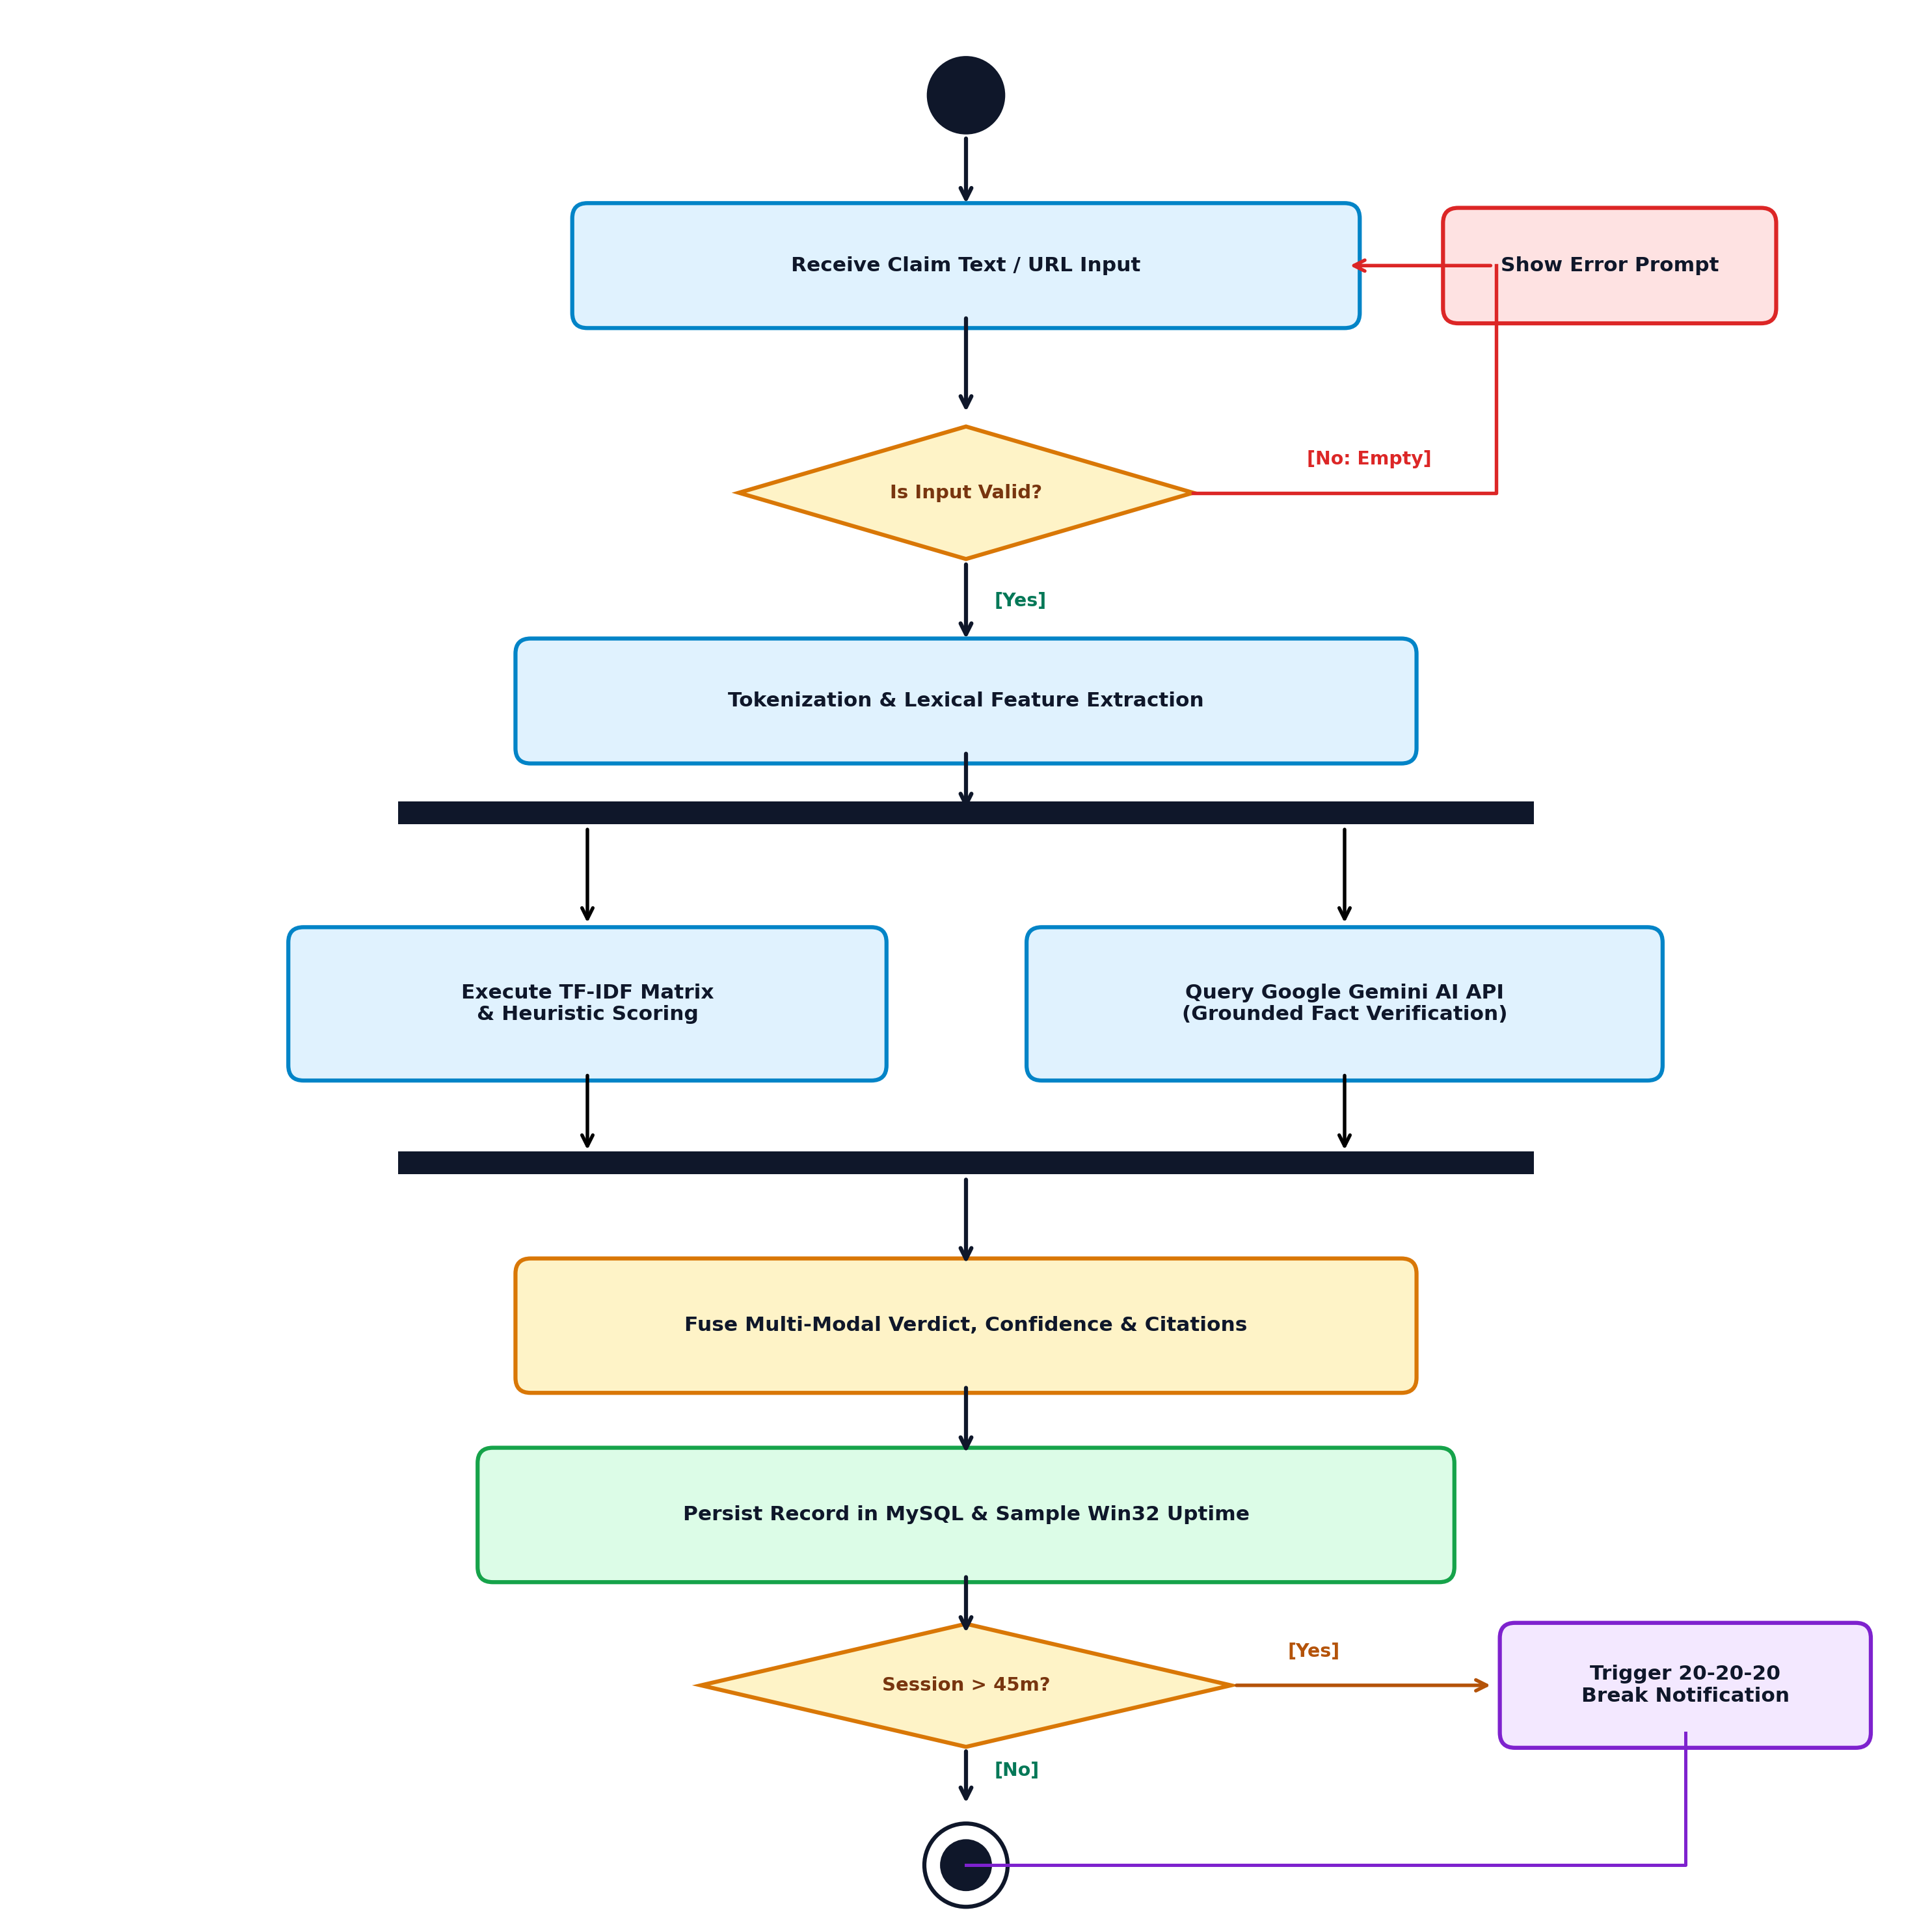
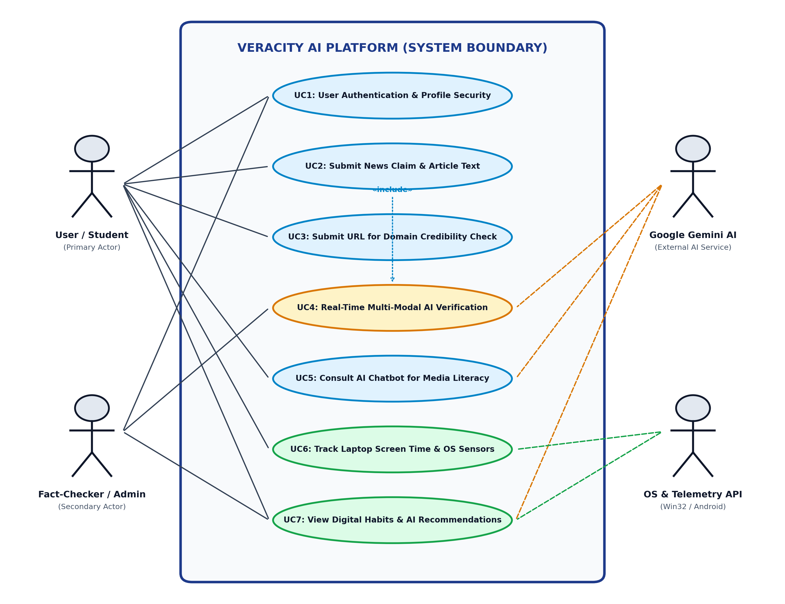
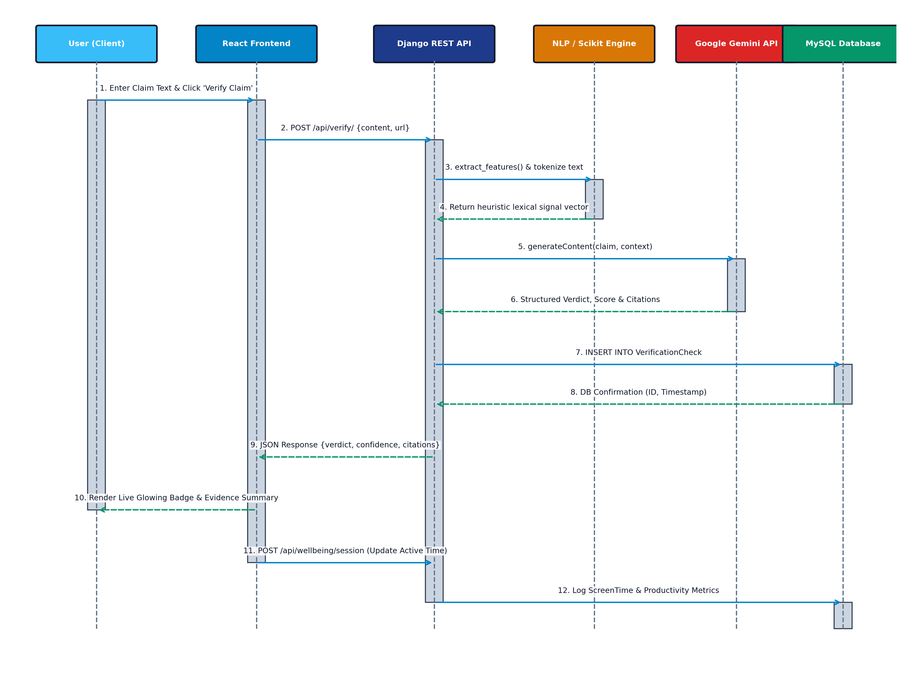
CHAPTER 5: SYSTEM DESIGN
UML Behavioral, Interaction & Workflow Modeling
Highlighted architectural models from the complete 14-diagram specification (Use-Case, Sequence, Class, 3 Activity, DFD & ER)
1. UML Use-Case Diagram
2. UML Sequence Diagram
3. UML Activity Diagram
Actors (End User, Admin, Gemini Cloud, OS Telemetry API) & UC1–UC7 functional scope.
Chronological async HTTP POST verification & DB logging across UI, Django, NLP & Gemini.
Concurrent Fork/Join executing TF-IDF + Gemini verification & 45-min screen break logic.
Full Design Coverage in Report Ch. 5: Class Diagram (ORM) • Win32 Telemetry & URL Anomaly Activity Flows • State Machine • Package & Deployment Topologies • DFD L0/L1/L2 • ER Schema
VERACITY AI | CSCA 513: Mini Project (MCA 2025–2027)
Divyanshu Yadav (25MCA00PY0036) • Guide: Dr. R. Sunitha
Slide 5 / 10
Notes:
Present the Use-Case, Sequence, and Verification Activity diagrams cleanly, and reference the complete 14-diagram Chapter 5 suite in the report.

Slide 6
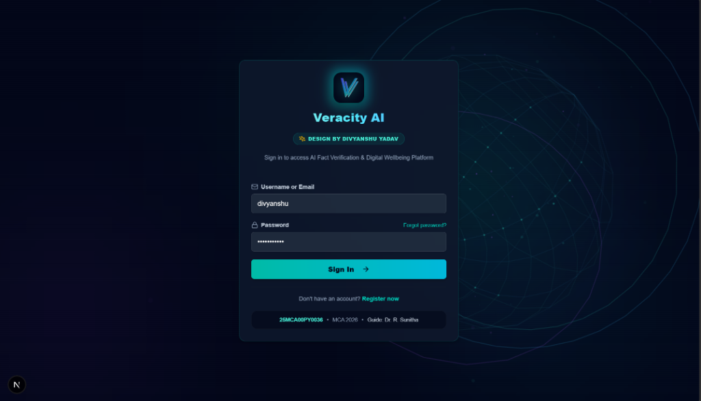
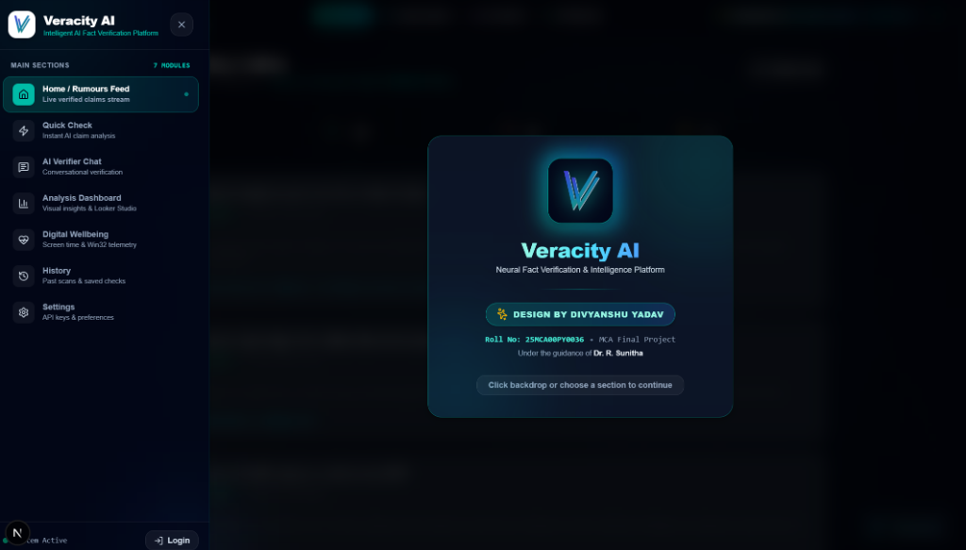
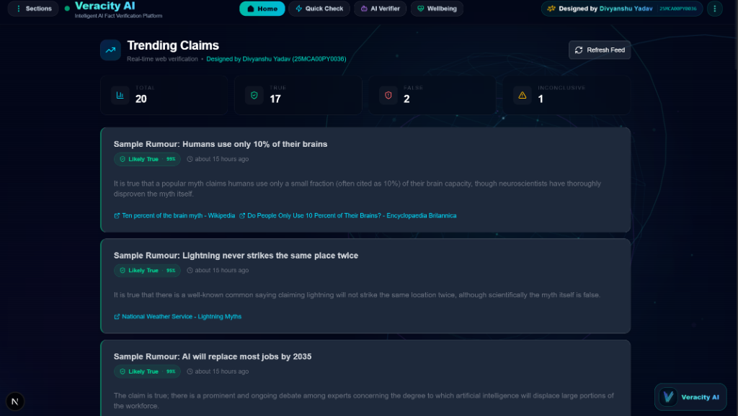
CHAPTER 6.4: LIVE OUTPUTS I
System Walkthrough: Auth, Navigation Drawer & Rumours Stream
Production screenshots captured directly from the live Next.js App Router + Django REST interface
1. Secure Authentication (/login)
2. 7-Module Navigation Drawer
3. Live Verified Rumours Feed (/)
▸ Crest & Attribution: Features Veracity AI crest & Roll No 25MCA00PY0036 academic footer.
▸ Security Layer: CSRF protection, hashed credential storage & validation feedback.
▸ Unified Routing: Slide-over access to Feed, Quick Check, AI Chat, Analysis & Wellbeing.
▸ Frosted Cyber UI: High-contrast cyan indicator pill highlights active route cleanly.
▸ Live Scan Summary: Displays Total Scans (20), True (17), False (2) & Inconclusive (1).
▸ Verdict Cards: Confidence badges (e.g. Likely True 99%) + clickable citations.
VERACITY AI | CSCA 513: Mini Project (MCA 2025–2027)
Divyanshu Yadav (25MCA00PY0036) • Guide: Dr. R. Sunitha
Slide 6 / 10
Notes:
Showcase the sleek Dark Cyber UI, academic attribution on the login card, and the live Verified Rumours Feed aggregating 20 scanned claims.

Slide 7
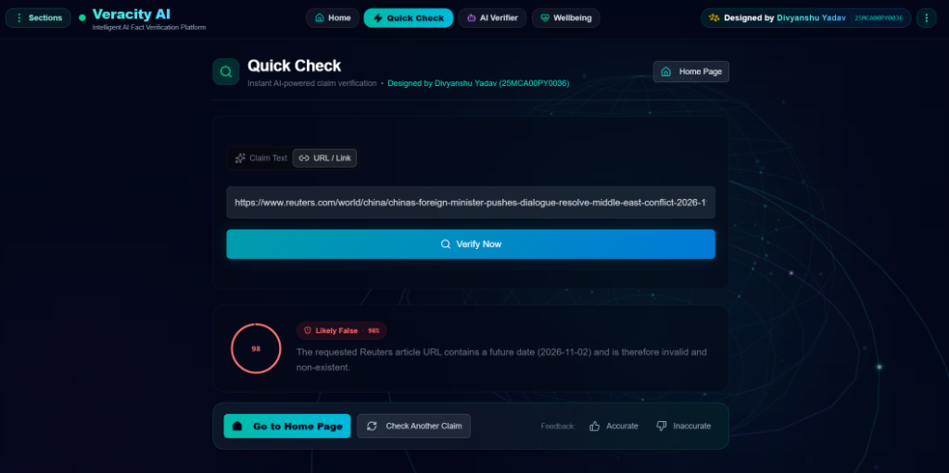
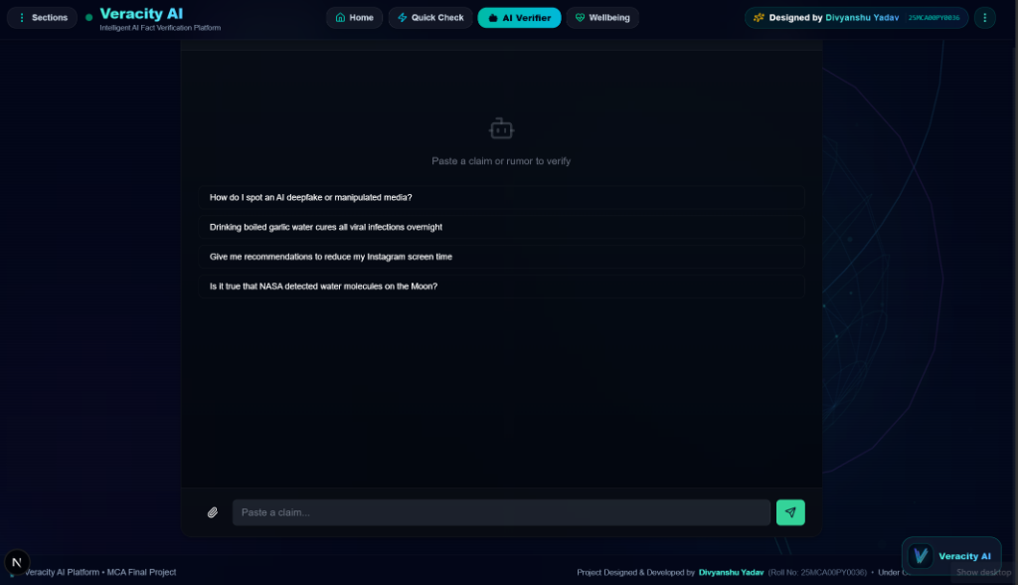
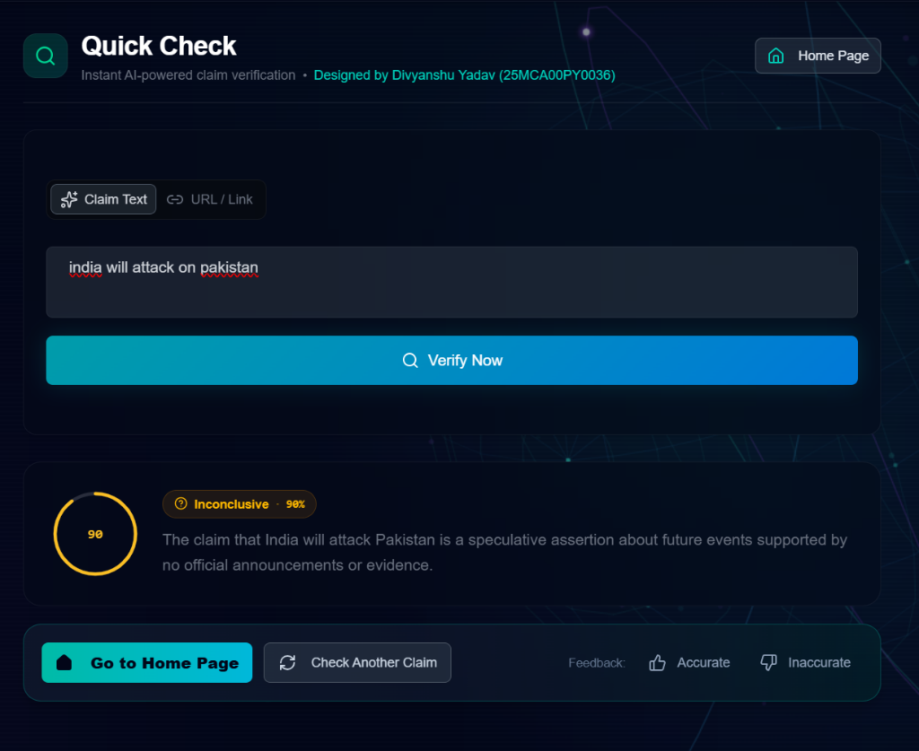
CHAPTER 6.4: LIVE OUTPUTS II
Fact Verification Case Studies & Conversational AI Assistant
Live outputs verifying future-dated URL fabrication, geopolitical ambiguity & multi-turn AI chat
Case A: Future-Dated Fake URL Detection (/check)
Multi-Turn Socratic AI Verifier Chat (/chat)
Verdict: Likely False • 98%
Flags allegedly real Reuters URL for invalid post-dated path (2026-11-02) with evidence breakdown.
Case B: Speculative Claim Nuance (/check)
Verdict: Inconclusive • 90%
Avoids false certainty on unverified future predictions; requests official evidence.
▸ Heuristic Claim Starters: Interactive prompts for deepfake spotting, garlic-cure rumour debunking & NASA water discovery verification.
▸ Persistent Multi-Turn Memory: Retains follow-up conversational context with multimodal paperclip attachment support.
VERACITY AI | CSCA 513: Mini Project (MCA 2025–2027)
Divyanshu Yadav (25MCA00PY0036) • Guide: Dr. R. Sunitha
Slide 7 / 10
Notes:
Demonstrate how Veracity AI handles both blatant URL fabrication (Likely False 98%) and uncertain future claims (Inconclusive 90%) accurately.

Slide 8
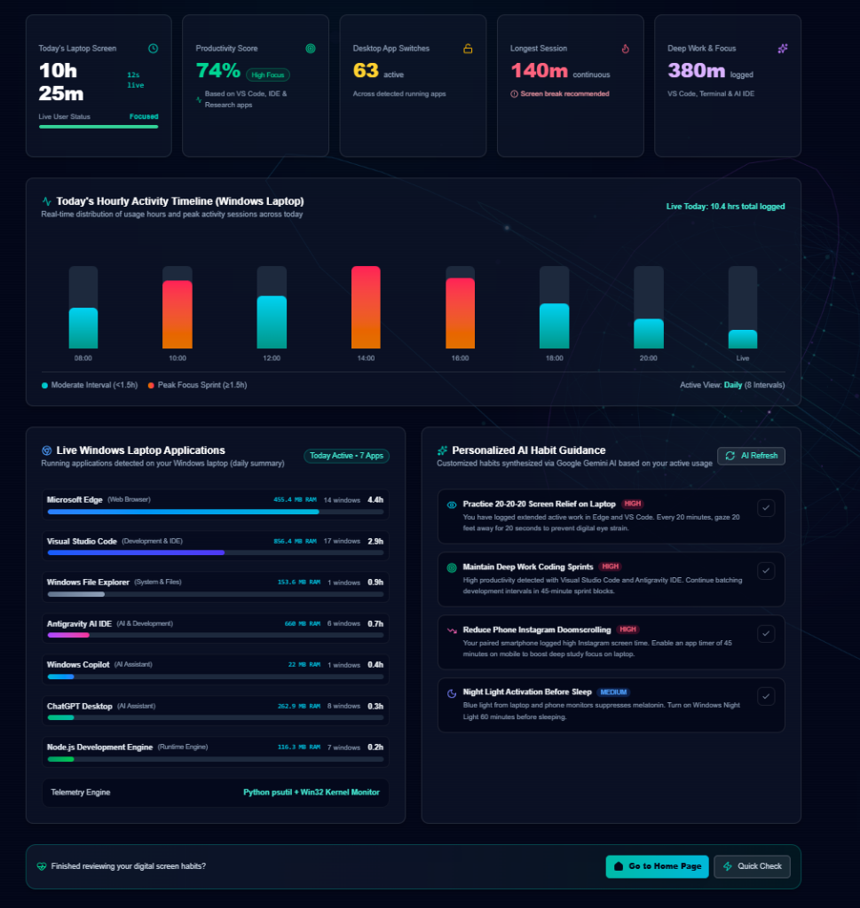
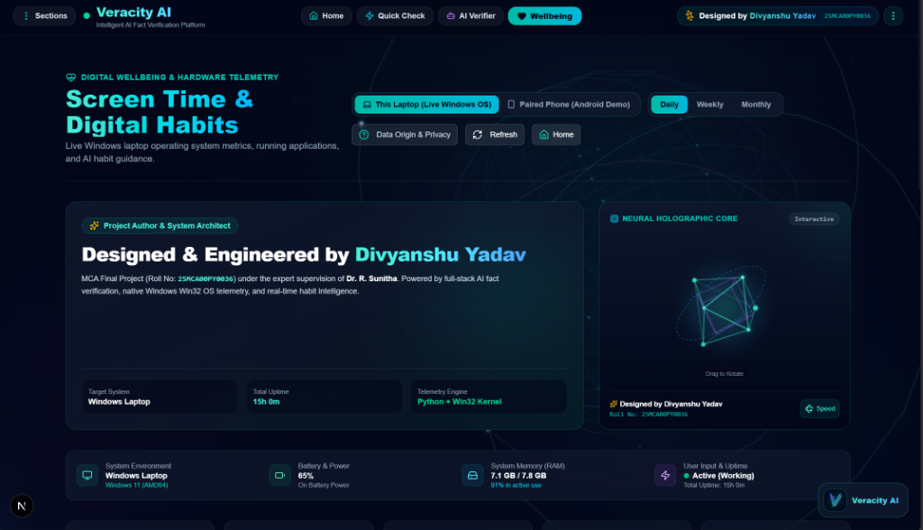
CHAPTER 6.4: LIVE OUTPUTS III
Win32 Hardware Telemetry, Process Profiler & 3D HoloCore
Real-time workstation metrics, draggable 3D Holographic Core & Gemini break coaching (/wellbeing)
Live OS Metrics & 3D Neural Core (/wellbeing)
Process Profiler, Timeline & AI Habit Coach
Detects Windows 11 (AMD64), 15h 0m uptime, 65% battery, 7.1/7.8 GB RAM & Active input status alongside draggable 3D HoloCore.
Logs 10h 25m screen time, 74% High Focus score, 8 hourly bars, per-app RAM (Edge, VS Code, Antigravity IDE) & 20-20-20 coaching.
VERACITY AI | CSCA 513: Mini Project (MCA 2025–2027)
Divyanshu Yadav (25MCA00PY0036) • Guide: Dr. R. Sunitha
Slide 8 / 10
Notes:
Highlight the live system telemetry (Windows 11 AMD64, 7.1/7.8 GB RAM, 74% High Focus Score, per-process usage) and personalized Gemini habit recommendations.

Slide 9
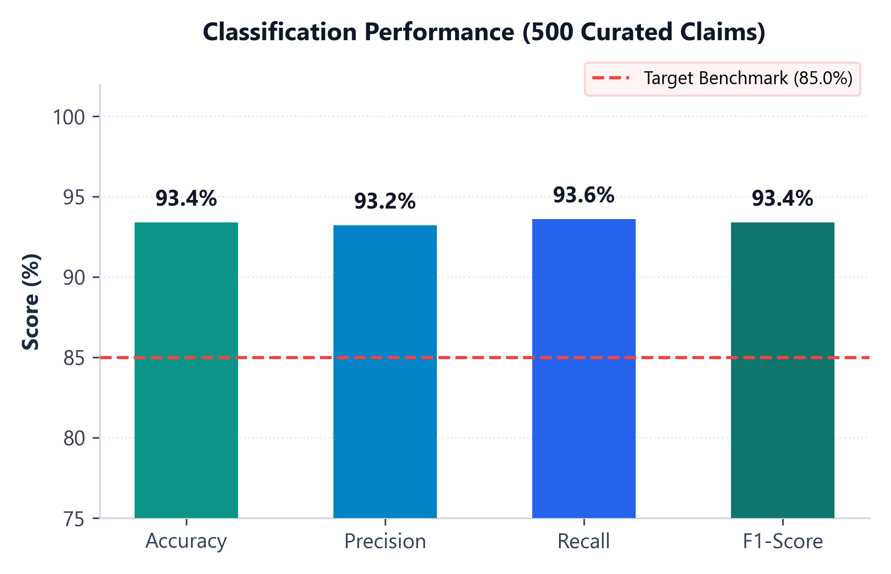
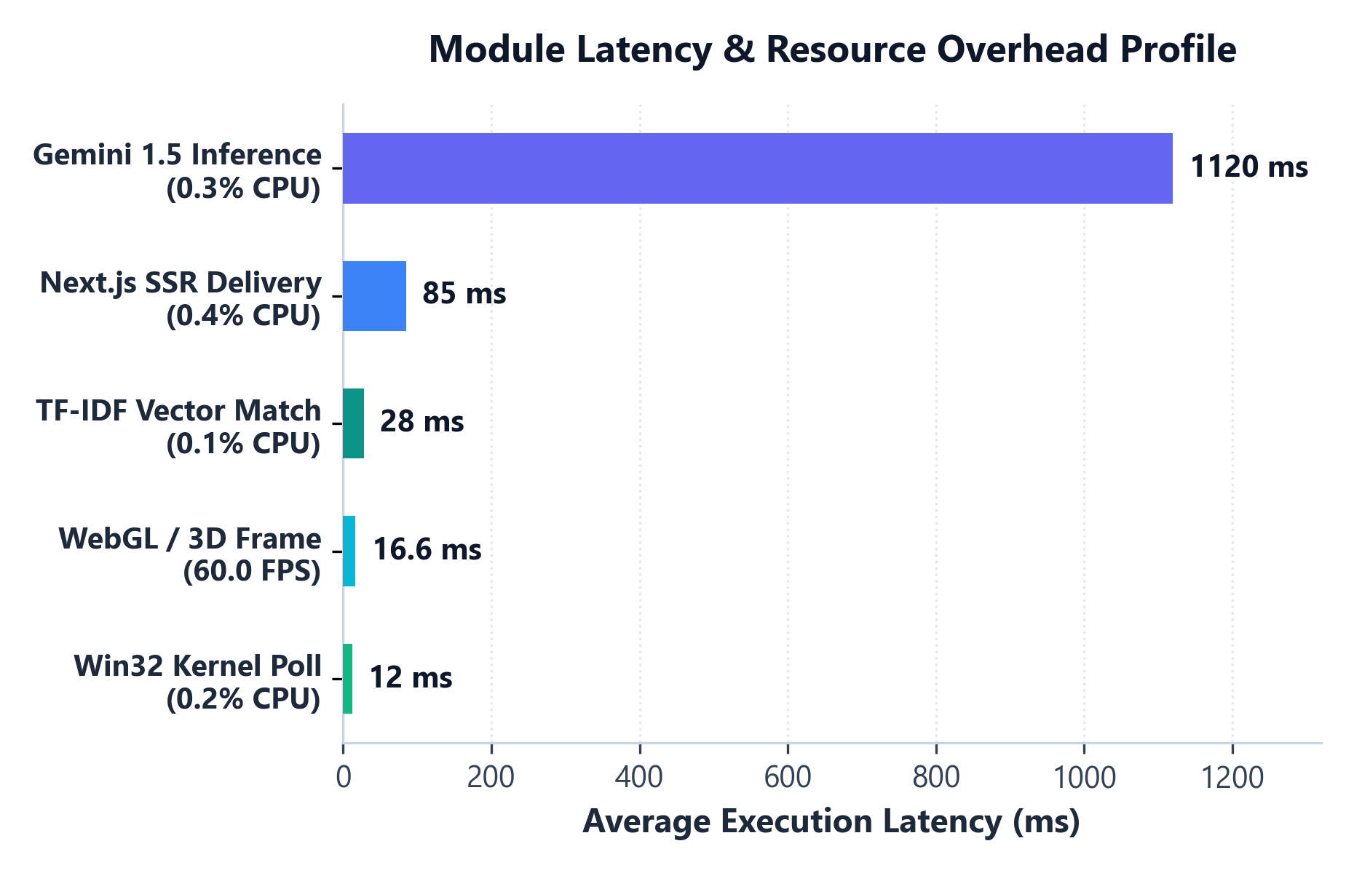
CHAPTER 7: TESTING & QA
Empirical Validation Metrics & Performance Benchmarks
Evaluated across 500 curated claims (250 True / 250 False) & 12 automated formal integration test cases
93.4%
1.12 s
< 0.4%
12 / 12
Overall Classification Accuracy
Avg End-to-End Fact Verification
Win32 Telemetry CPU Overhead
System Test Cases Passed (100%)
Classification Benchmarks (Table 7.2)
Module Execution Latency (Table 7.1)
Test Suite Coverage (TC-01 to TC-12 PASSED): Verified Fact (94.2%) • Fake Rumor (12.0%) • Multi-Turn Chat Memory • Win32 180s Idle Transition • Daily/Weekly/Monthly Views • Android Sync
VERACITY AI | CSCA 513: Mini Project (MCA 2025–2027)
Divyanshu Yadav (25MCA00PY0036) • Guide: Dr. R. Sunitha
Slide 9 / 10
Notes:
Cite exact Chapter 7 results: Precision=93.2%, Recall=93.6%, F1=93.4%, 28ms TF-IDF match, 1,120ms Gemini call, 12ms Win32 poll, 60 FPS WebGL/Canvas.

Slide 10
CHAPTER 8 & 9: IMPACT, SCOPE & CONCLUSION
Real-World Applications, Future Roadmap & Final Defense Summary
Journalism & Newsrooms
Academic Media Literacy
Enterprise Dev Ergonomics
Acts as a 1.12s editorial copilot verifying breaking claims & post-dated URLs.
Equips students with source citations & Socratic AI debunking critique.
Protects focus health via zero-keylog Win32 telemetry & 20-20-20 breaks.
KEY PROJECT ACHIEVEMENTS
CURRENT SCOPE & FUTURE ROADMAP
▸ 93.4% F1 / Accuracy: Validated on 500 claims at 1.12 s avg response latency.
▸ Silent Win32 Daemon: <0.4% CPU overhead via GetLastInputInfo & psutil.
▸ 100% QA Pass Rate: All 12 formal unit & integration tests verified cleanly.
▸ Current Limits: Cloud LLM requires internet; OS hooks target Windows; Android simulated.
▸ Browser Extension: Inline fact-check badges on social feeds (extension/ scaffold).
▸ Multimodal & Cross-OS: Deepfake video transformers + macOS/Linux & native Android.
THANK YOU • OPEN FOR PANEL QUESTIONS & LIVE DEMO
Divyanshu Yadav (University Roll No: 25MCA00PY0036) | Project Guide: Dr. R. Sunitha
CSCA 513: Mini Project • Master of Computer Applications (2025–2027) • Department of Computer Science, School of Engineering & Technology • November 2026
Notes:
Conclude clearly with applications, transparent scope boundaries, future enhancements, and invite the panel for Viva-Voce questions or a live system demonstration.

