Slide 1
Midnight Compiler
Dillon Troxell

Slide 2
Background / Goals
The main motives behind the project:
Fun
Personal Interest
Wanted to create a compiler from scratch without any dependencies
Wanted to learn more about compilers and their various stages
Wanted to learn to create my own compilers/interpreters

Slide 3
Intellectual Merits
Built from scratch: The compiler uses no external dependencies, and all code is written from scratch in C.
Direct Code Generation: The compiler compiles directly to C, there is no intermediate layer. This allows the most control over optimizations and performance.
Subset of C: This compiler will generate code for a subset (nearly all) of C features such as:
Pointers
Structs
Unions
Etc.

Slide 4
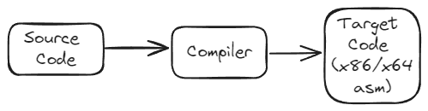
System Overview / Design (1)
Most Interpreters/Compilers are comprised of many layers that work together to accomplish a common goal
This compiler is no different
At a high level, a compiler just translates text in one format (source code – input) to another format (target code – output)

Slide 5
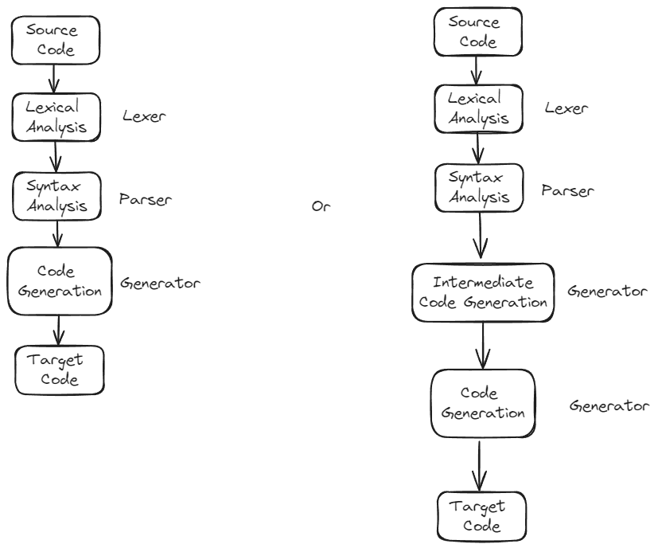
System Overview / Design (2)
The compiler does this translation by working with the input and generating IR’s (Intermediate Representations) that help with the translation of source to destination format.
Compilers (and interpreters to an extent) are generally made up of many components that work together to achieve a common goal.
My compiler has 4 main components:
Lexer: Takes text (source code) and produces a list of tokens from that text
Parser: Takes our list of tokens (output by the lexer) and parses it to an AST (Abstract Syntax Tree)
Resolver: Resolves expression (relative) addresses at compile time to assist the code generator with generation. In my case, this is done while parsing but you can also make this a separate process.
Code Generator: Takes the AST with additional information from resolver and generates/produces code in the desired format (x86 asm in our case)

Slide 6
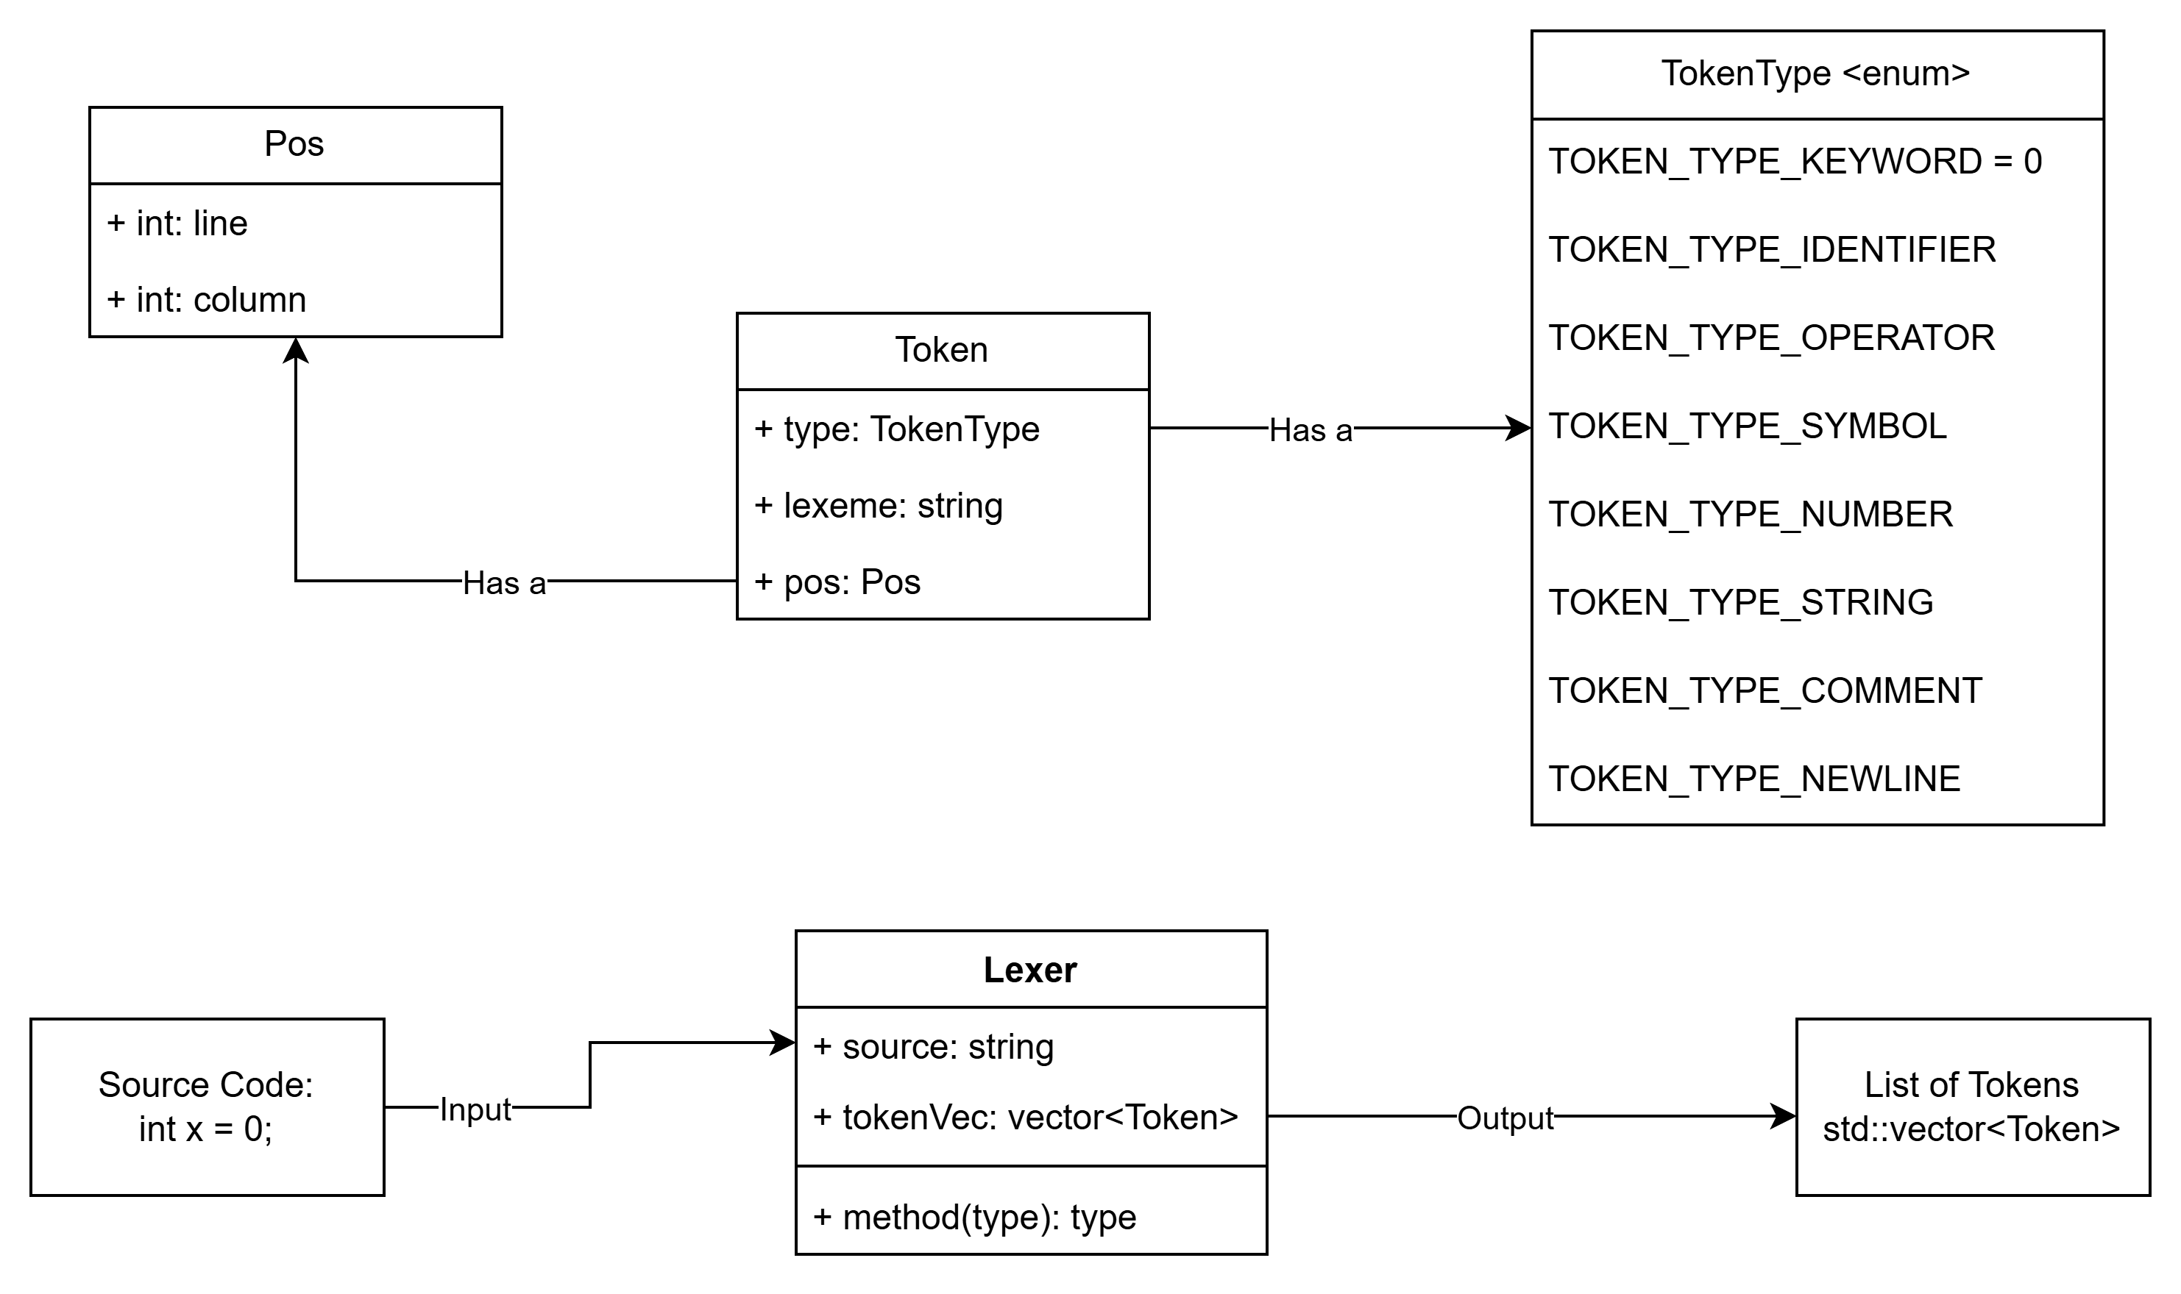
A Closer Look: Lexical Analysis (Simplified)
Classes:
Lexer
Token: Smallest meaningful unit of program (contains a lexeme – string representation)
Pos: Position in input file
Enumerations:
TokenType

Slide 7
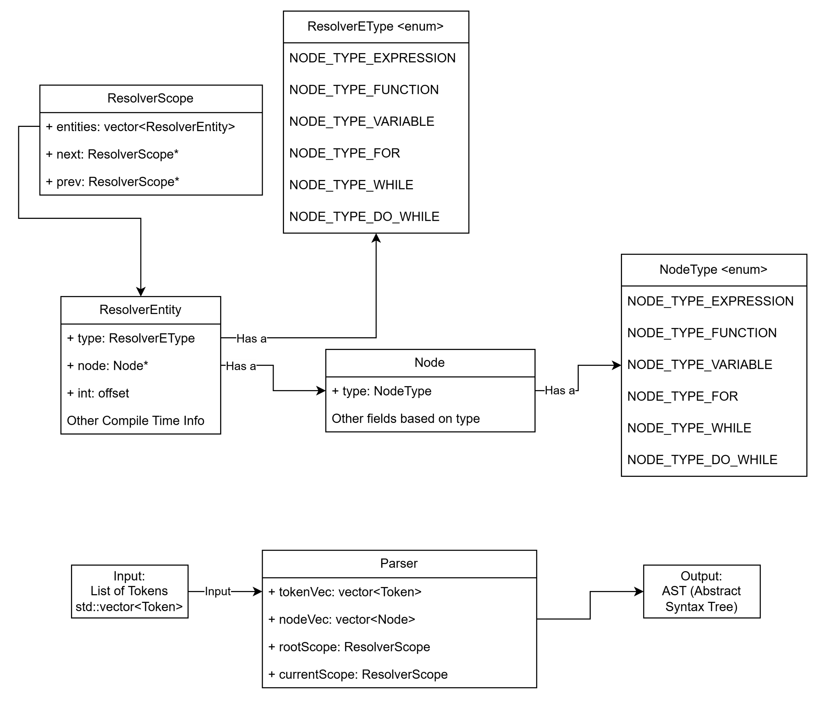
A Closer Look: Parsing (Simplified)
Classes:
Node: Represents a node in the AST
ResolverEntity: Wraps around node and provides additional compile time information (offsets, type sizes, etc.)
ResolverScope: Represents a psedo-scope in our IR and holds resolverEntities
Enumerations:
NodeType
ResolverEType (Resolver Entity Type)

Slide 8
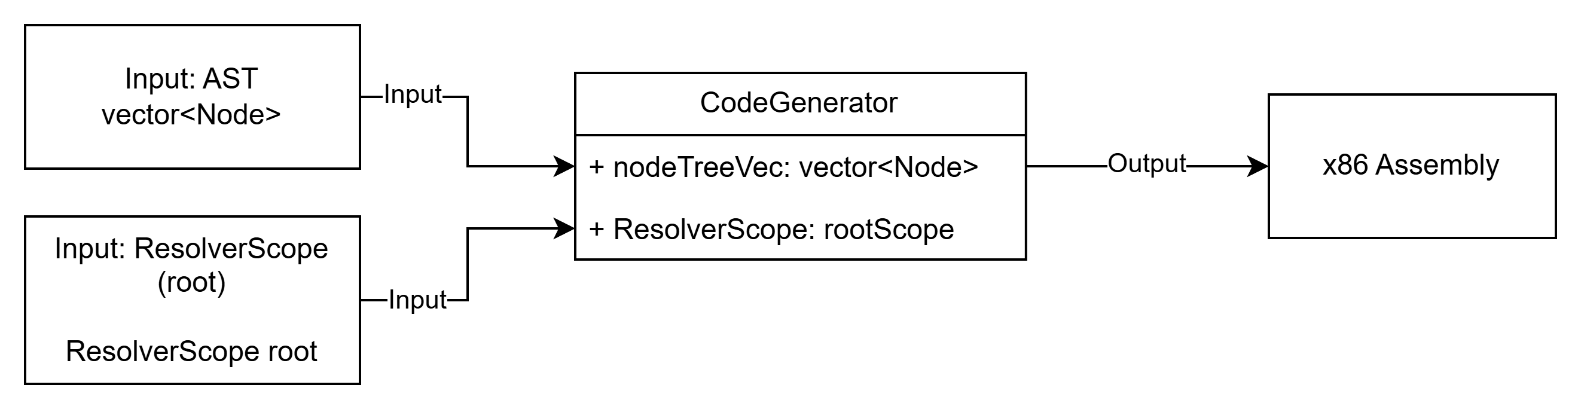
A Closer Look: Code Generation (Simplified)
Classes:
CodeGenerator
Based on information in ResolverScopes and types of nodes in AST; generate code.

Slide 9


Technologies
Two Very Simple Technologies Used:
C
Make (C build tool)

Slide 10
Milestones
Milestone | Start | End
Lexer | 9/1/24 | Completed
Parser | 9/1/24 | Completed
Generator | 9/1/24 | Completed
Function Support Added | 12/1/24 | Completed
Preprocessor Functionality | 2/1/24 | 3/1/24

Slide 11
Results
As of now, we have a lexer, parser/resolver, and generator that can generate code for a large subset of C language features.
I am now working on creating the logic for handling preprocessor directives (such as #include or #define)

Slide 12
Challenges
Code Generation: Had a hard time finding the right approach / structure for code generation.
Preprocessor Directives (currently working): These preprocessor directives need to be handled before compilation occurs. Meaning that there needs to be another process to handle these.
Error Handling / Debugging: There are a lot of cases you need to watch for when building a compiler. Making sure to relay descriptive error messages back to the user is important so they know how to fix their code.

Slide 13
Links
Github Repo
Usage Guide

