Slide 1
Senior Compiler
Team: Midnight Squad
Dillon Troxell (troxeldj@mail.uc.edu)

Slide 2
Group Info
Team Name: Midnight Squad
Team Members:
Dillon Troxell (troxeldj@mail.uc.edu)

Slide 3
Purpose and Goal Statement
Purpose: The purpose of this project is to design and implement a compiler from scratch that can generate assembly code for a custom programming language. This compiler will implement a lexer, parser, and code generator that encompasses the entire compilation pipeline
Goal Statement: The goal of this project is to deliver a fully functional compiler that can lex, parse, and generate assembly code for a custom programming language. Users should be able to write code in a high-level language and it should compile down to assembly code

Slide 4
Project Abstraction
The project involves creating a compiler for a custom programming language. The project will implement core components such as a lexer, parser, and code generator. The compiler first processes source code by lexing this code into “tokens”. From here, we use the order and type of these tokens to generate statements that we fit to a language grammar. Once we have our AST (abstract syntax tree) from the parser, we use another component called a code Generator to traverse this parse tree and generate assembly code that can be run on x86/x64 machines. Our language will include: functions, variables, and mathematical expressions.

Slide 5
User Stories
As a user, I want my source code to compile into x86/x64 assembly so that I can link, load, and execute my code.
As a user, I want the compiler to generate detailed error messages so that I can easily debug issues with my code.
As a developer, I want the the compiler to handle variable declarations so that users can perform operations on variable data.

Slide 6
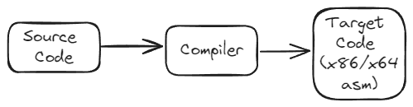
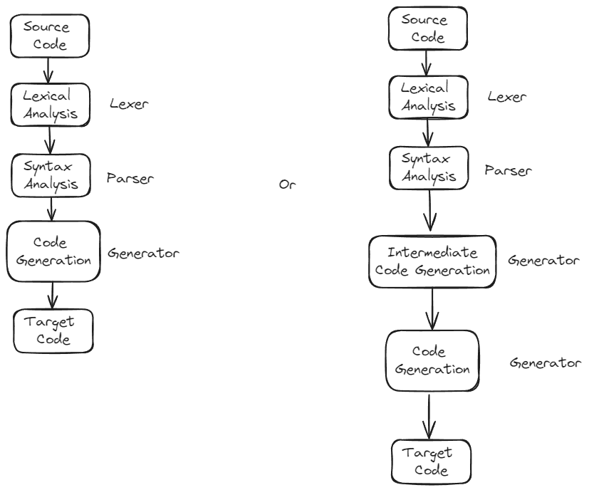
Design Diagrams (1/2)
Compiler Basic Function
Compiler Stages Diagram

Slide 7
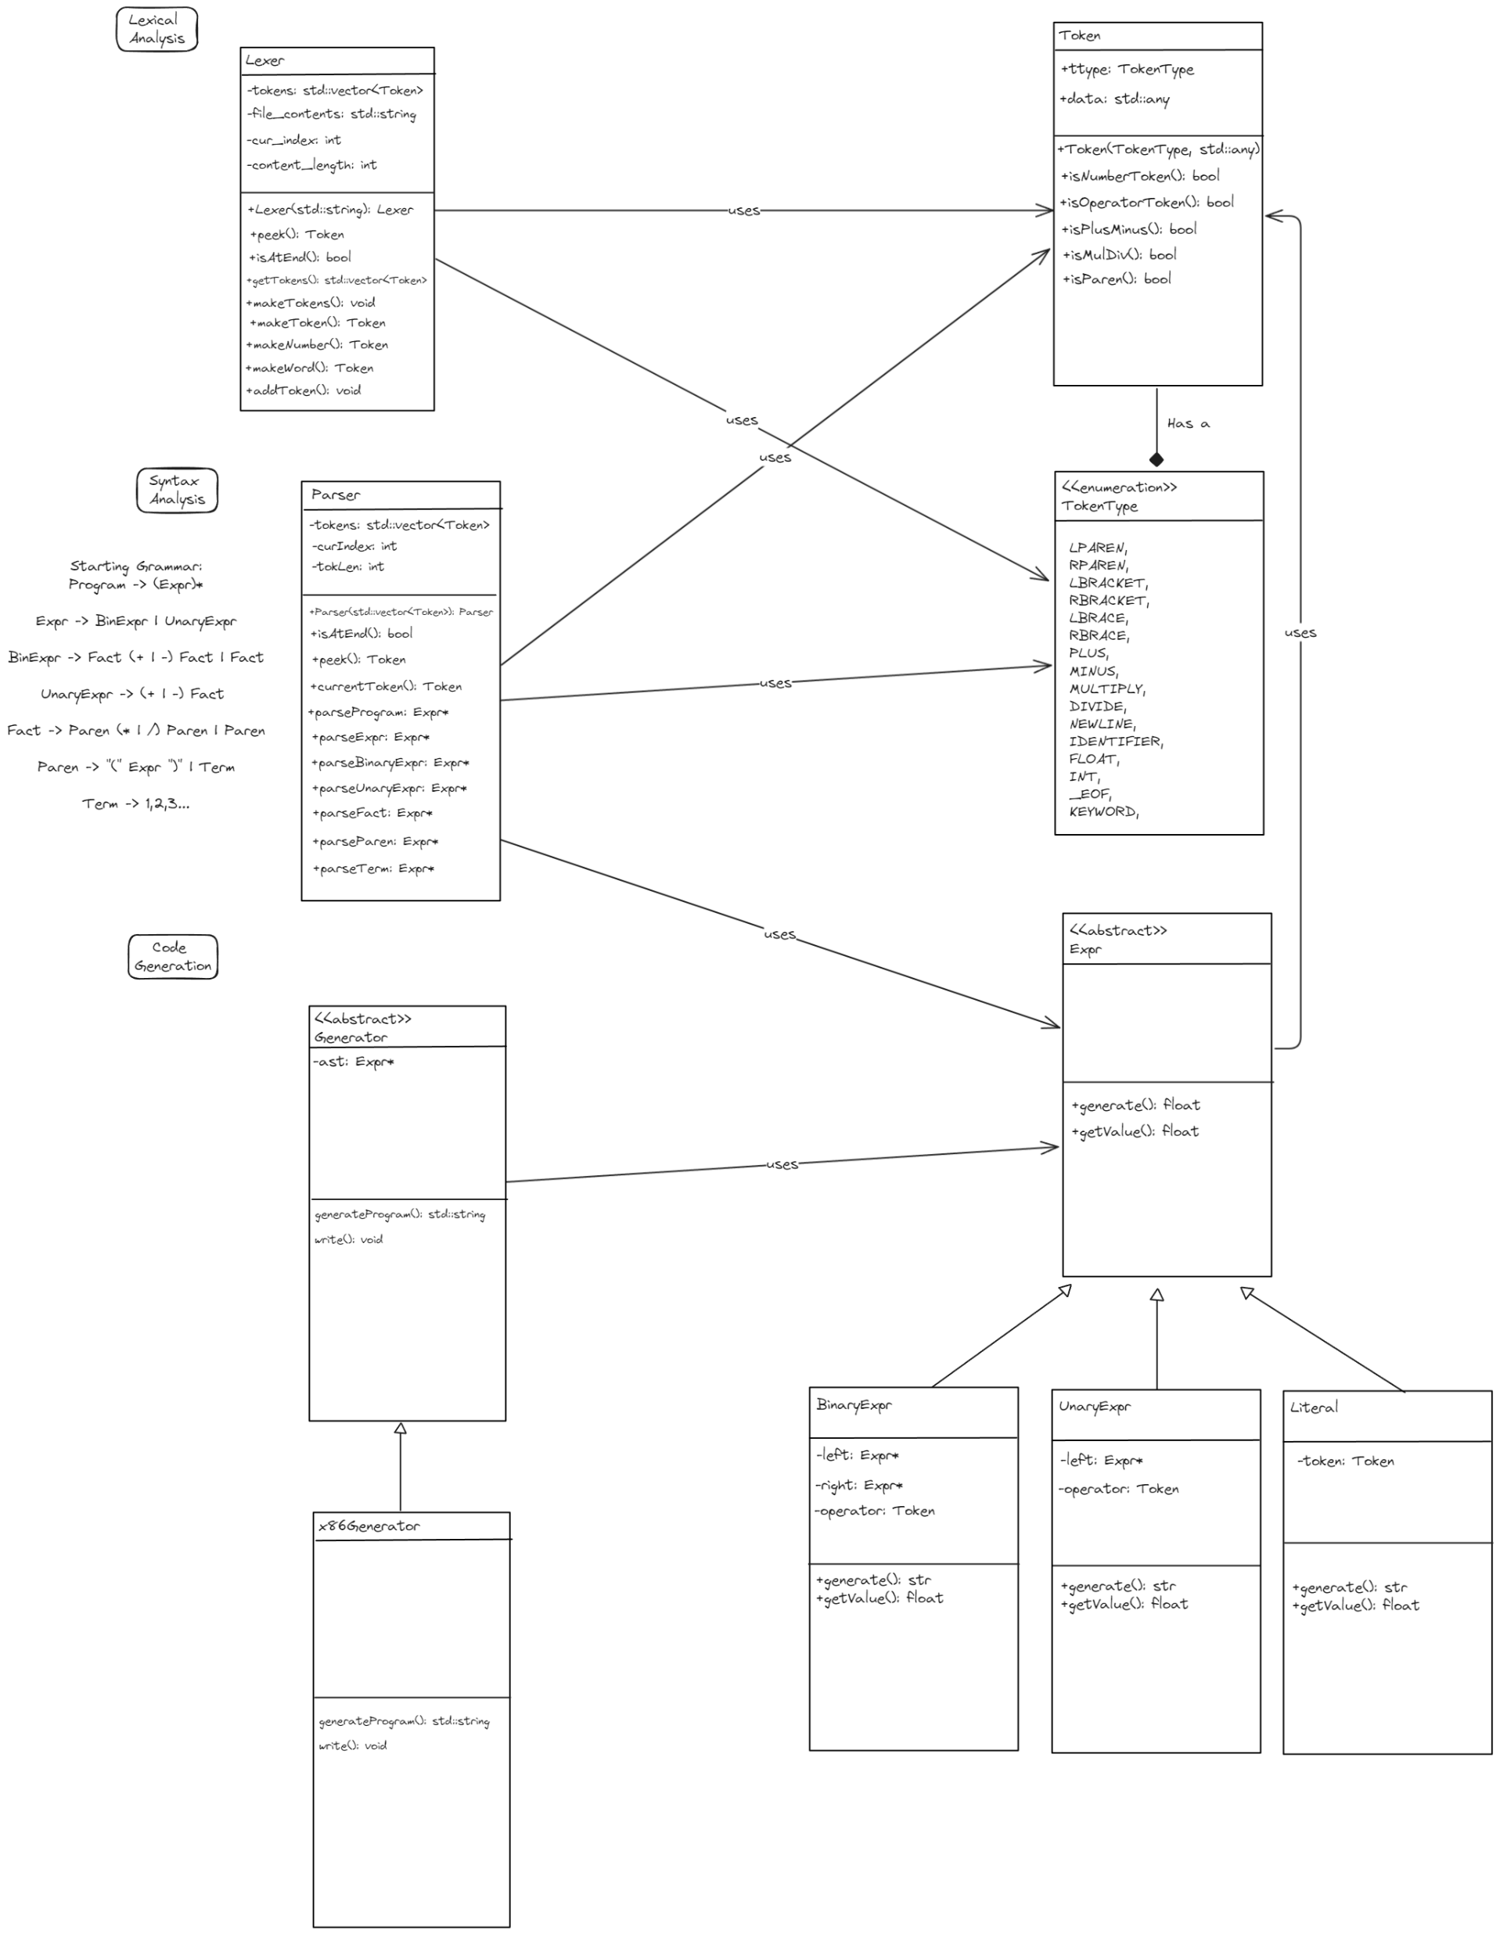
Design Diagrams (2/2)
Here, we can see a number of classes that make up the compiler.
Token: Class to represent a token. Has a token type and an std::any (data).
Lexer: Class to take source code and generate a list (std::vector<Token>) of tokens
Parser: Class to take in list of tokens from lexer and generate an AST (returns AST)
Expr: Base class for expressions (used in parser)
UnaryExpr (Derived/Child class)
BinaryExpr (Derived/Child class)
Literal (Derived/Child class)
Generator: Class to take in AST and “Generate” ASM

Slide 8
Major Project Constraints
Security (User Input): The compiler needs to be safe. All sensitive user information must be secure to ensure safety of users.
Accessibility: Our compiler needs to be easy to use and produce good debugging information. This ensures that the compiler is user-friendly and can be used by the widest audience.
Legal: There is a lot of tooling in the compiler space. Any use of open-source software needs to abide by the license that accompanies this software to stay in good legal standing.
Safety and Security: Transmission between user and the machine needs to be secure. Our compiler should be able to handle malicious user input and process (or ignore) the input safely. We also need to keep in mind memory safety (as we are using C++). We can use modern C++ features such as smart pointers and std::variant to keep memory safe and close attack vectors (buffer overflow, etc.)

Slide 9
Project Progress
We are currently working on implementing the generator. We are caught up at the moment. After completion of the generator, we will work on adding more language features (functions and classes).
Github Repo
Timeline Table
Milestone | Start | End
Basic Lexer | 9/1/24 | Completed
Basic Parser | 9/1/24 | Completed
Basic Interpreter | 9/1/24 | Completed
Basic Generator (WIP) | 10/7/24 | 12/1/24
Function Support Added | 12/1/24 | 1/1/24
Class Support Added | 1/1/24 | 2/1/24
Whole Project QA and Refactor | 2/1/24 | 4/1/24

Slide 10
Expected Accomplishments by End of Term
By the end of the term, we hope to have the generator working and generating code that contains mathematical expressions, and variable declarations/initializations
This will be a fully working compiler, but will not contain all intended language features (functions and classes). These features will be designed and implemented in the following stages of development

Slide 11
Division of Work
I (Dillon Troxell), am currently the only member of my team. All work will be design, implemented, and tested by me.

Slide 12
Expected Demo at Expo
By the time expo comes around, we hope to have a working compiler that we can demonstrate. We will write a program that abides by our language’s syntax, and have the compiler produce assembly code that we can then run and demonstrate the output.

