Slide 1






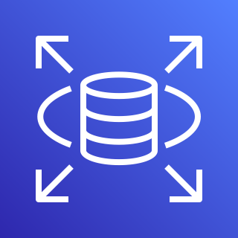





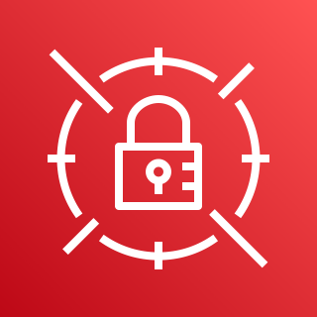
AWS Cloud
Availability Zone 1
Availability Zone 2
VPC
Private subnet
Private subnet
AWS Systems Manager
Amazon MQ
Amazon MQ
Private subnet
Private subnet
SWIFT network BAPs
Amazon CloudWatch
Colocation site or customer on-premises
Amazon RDS
Amazon RDS
Access point
Private subnet
Private subnet
VPN gateway
Access point
AWS Direct Connect
Additional corporate
data center
Amazon EC2 (AMH)
Amazon EC2 (AMH)
Access point
Private subnet
Private subnet
AWS Secrets Manager
Amazon EC2 (SAG/SNL)
Amazon EC2 (SAG/SNL)

