Slide 1
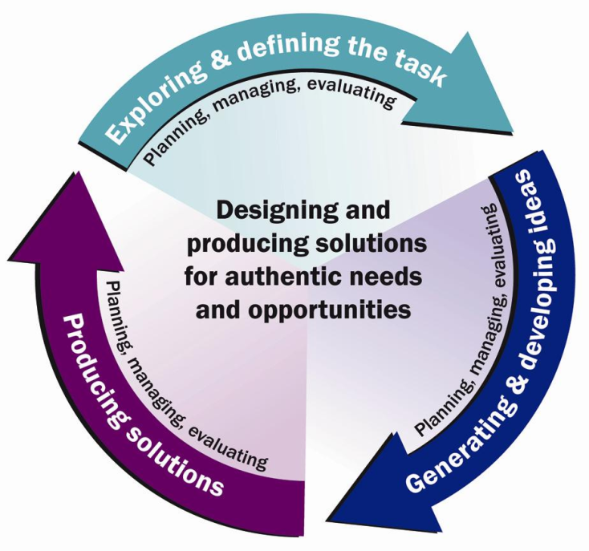
Students designing in Stage 4 Technology (Mandatory)
Technology education integrates both procedural and conceptual knowledge based on a holistic view of design. Students identify needs that have personal relevance, apply design theory and use design processes that encourage flexibility, resourcefulness and imagination in the development, communication and production of quality solutions.
At Stage 4, students build on their learning of design and they apply design processes in more technologically specialised learning environments in secondary schools.
They have a greater appreciation of design theory and the work of designers. They develop more authentic skills in researching, experimenting, generating and communicating creative design ideas and solutions.
Stage 4 students take greater responsibility for the management of their own projects and for the selection and safe use of materials, tools and techniques. They have a more global appreciation of the impact of innovation and emerging technologies on the individual, society and the environment.
Following are two samples of classroom practice.

Slide 2
Sample Task A: Design a household product that encourages children to learn

Slide 3

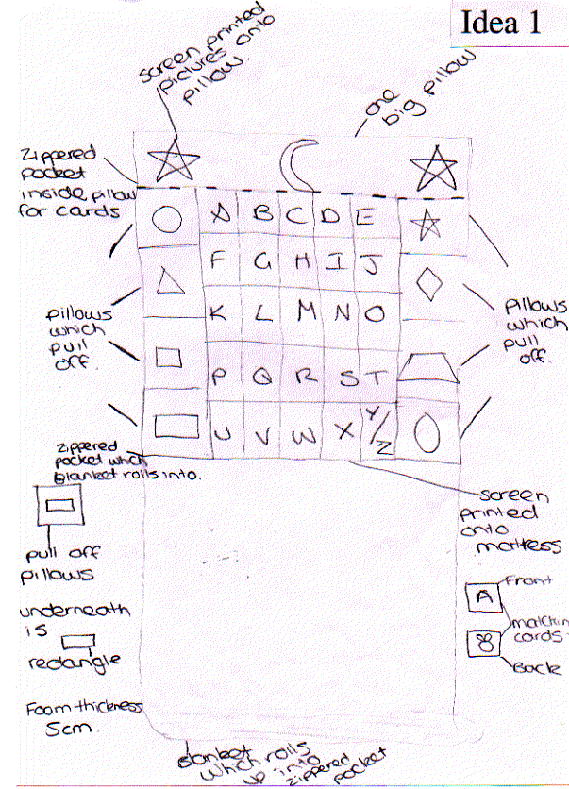
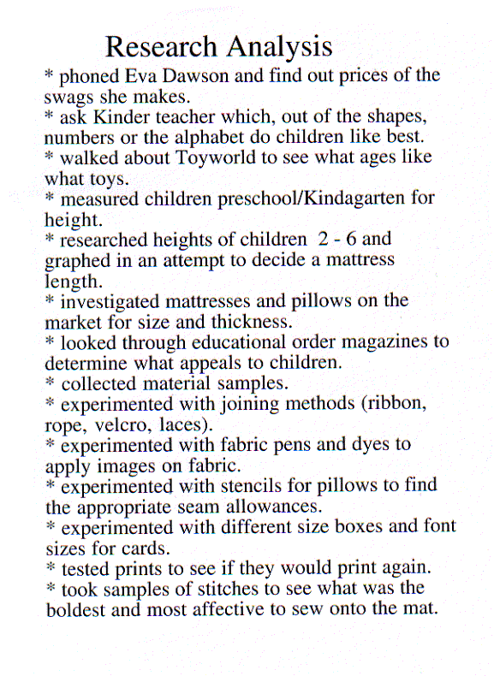
Stage 4 Task A: Design a household product that encourages children to learn
Design situation: The design situation was identified by the student. She felt that “…as adult lives become more and more involved and hectic … there is a concern that families are having less ‘prime’ time as a family.” She wanted to design something that would motivate parents to “give their children more of their time”
Brief: Design and produce a functional and practical item that will encourage parents/caregivers to spend extra stimulating time with their children and at the same time can be used by the children as a mental motivational game.
defining the task
planning
Research: The student’s research took a number of different directions: • a height survey of children • fabric samples and testing • samples of possible stitching for individual design selections • an experiment with joining materials.
generating ideas

Slide 4
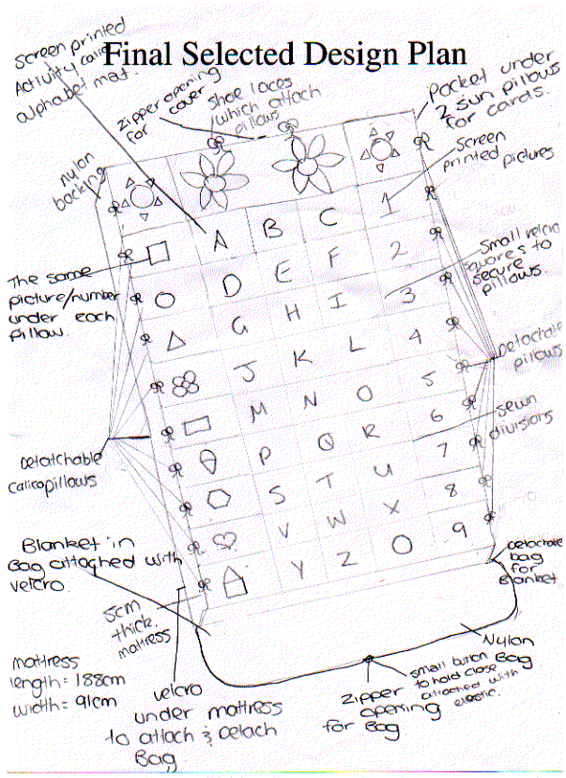
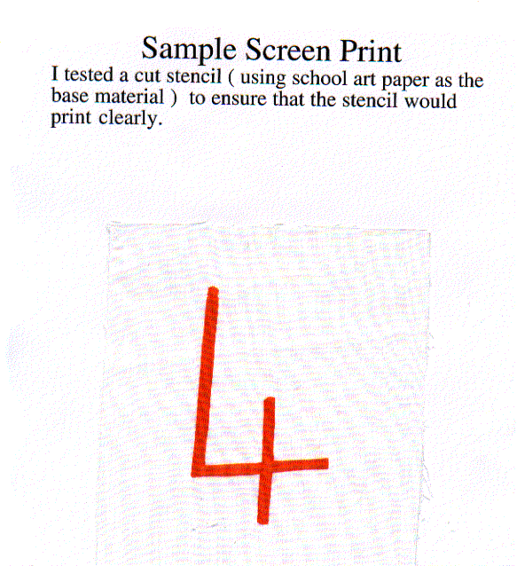
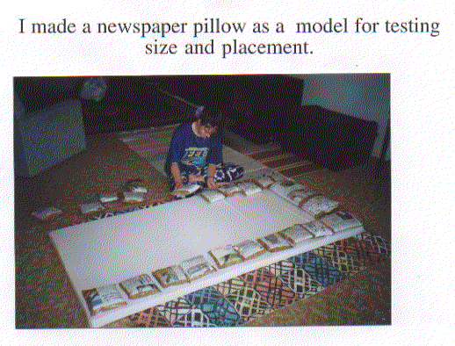
Stage 4 Task A: Design a household product that encourages children to learn (cont.)
Planning and production The student needed to experiment with a range of techniques: • laminating the educational alphabet cards • screen printing for tie on cushions • prototype pillows using newspaper • measurement and placement of ties and pillows.
developing ideas by testing
developing ideas by testing
developing ideas
The design was to be based on a mattress that could be used as a spare bed or a play centre. Each idea was then analysed for its effectiveness. The first idea was selected and some changes made to the original concept.

Slide 5
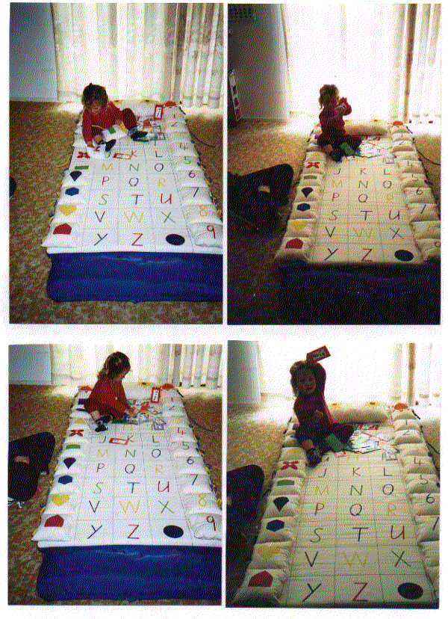
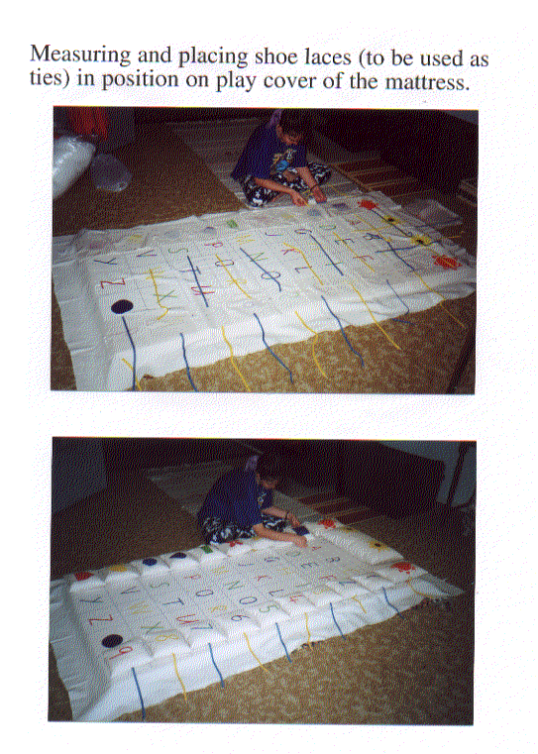
Stage 4 Task A: Design a household product that encourages children to learn (cont.)
A two and a half year old was also invited to “play” — the result was very positive.
evaluating the product
testing
producing
To test and evaluate her design the student asked parents, grandparents and friends to examine the design and give their opinion of it. A general summary of comments was: • “wish we had owned one when our children were young” • “great and very convenient how you can detach every piece for washing (particularly when it is targeted at children)” • “fantastic design” • “my kids would love this mattress” • “great for shoe lace tying practice in a fun way” • “I like the way it folds away”.
evaluating the product
The student analysed the comments received and found that her design had been a success. After examining the comments she discovered that children use the pillows in ways she hadn’t considered, such as: • for throwing and catching games • as soft building blocks.
In addition, Jessica outlined: • marketing strategies • management of time, money and resources.
evaluating the product

Slide 6
Sample Task B: Design a watercraft to transport bicycle riders across waterways

Slide 7
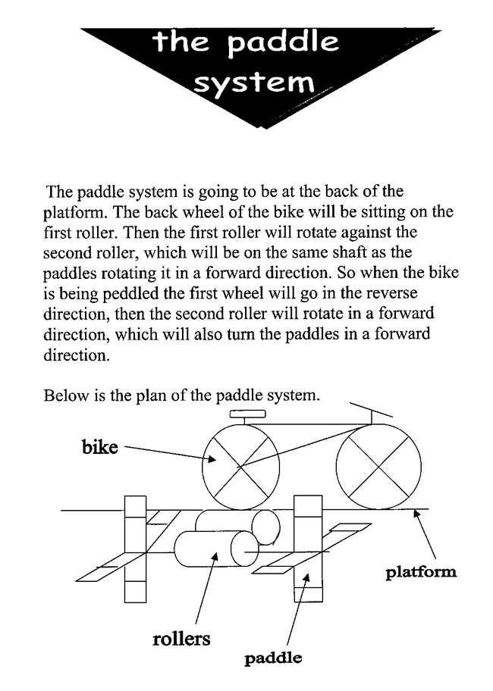
Stage 4 Task B: Design a watercraft to transport bicycle riders across waterways
Jessica had a clearly defined need. She and her brother enjoy mountain bike riding in their local area, however, it was difficult to gain access to the trails as the only access was via water, across a dam.
generating ideas
Design brief: Design a watercraft to get the bike and myself across the dam in an easy and cheap fashion. Jessica further clarified her needs and established the following design criteria for the bike carrier: • light to carry • able to get the bike on and off in very little time • able to be steered • easy to pedal • good buoyancy • transportable.
clarifying the task
Three design ideas were drawn and explored. Each design was clearly labelled including side and top views and an explanation was given for each. The advantages and disadvantages of each design were noted. Jessica chose design number three which was a modification of number one: the paddles were positioned on the inside of the floats making a more compact design.
ongoing evaluation

Slide 8
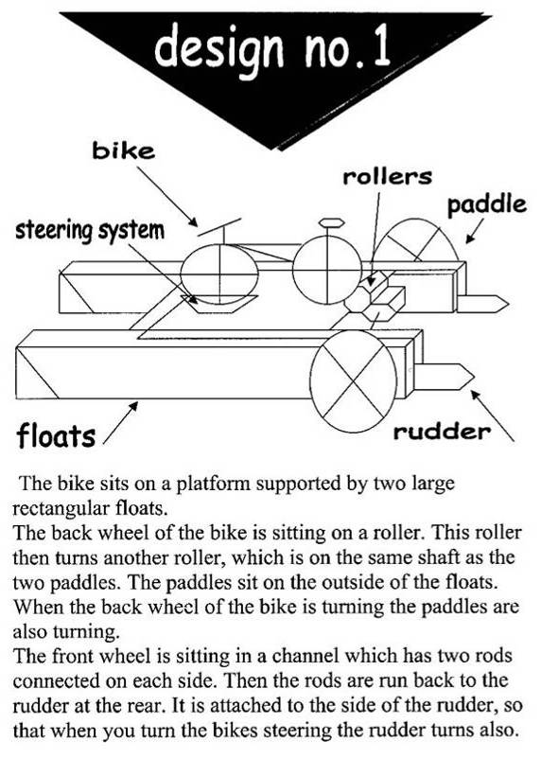
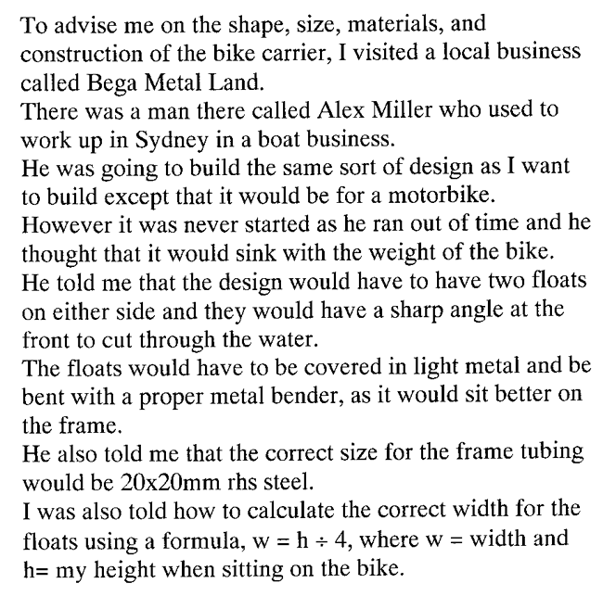
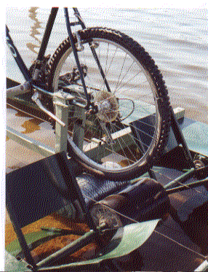
Stage 4 Task B: Design a watercraft to transport bicycle riders across waterways (cont.)
learning from others
Jessica developed new metal working skills during the construction of the bike carrier. She appreciated the team work that was needed to make the bike carrier a success.
communicating ideas

Slide 9
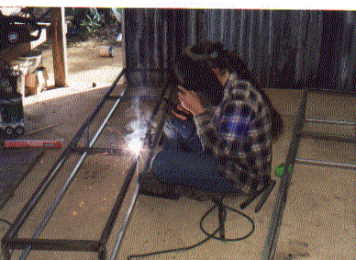
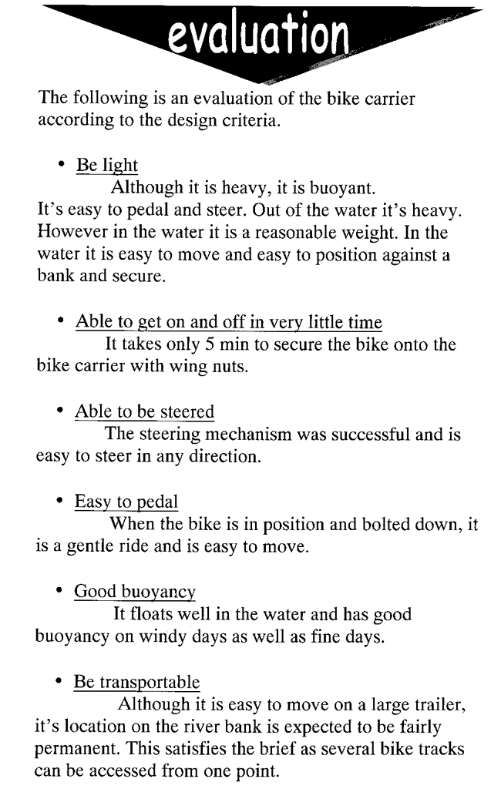
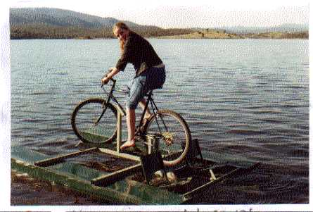
Stage 4 Task B: Design a watercraft to transport bicycle riders across waterways (cont.)
evaluating the product
constructing
testing the product

