Slide 1
Data processing and cross-check of TRF output file and soap-outputfile
Xuan Li & Yuan Zou

Slide 2
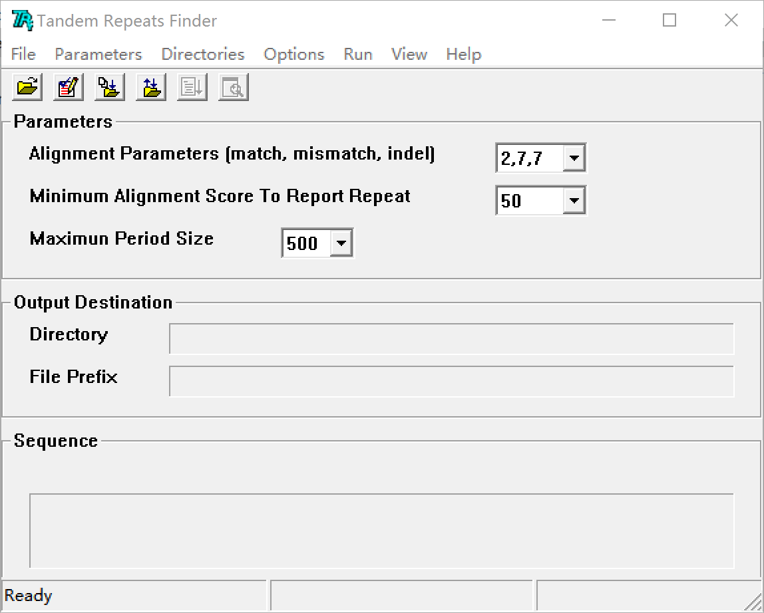
INTRODUCTION
A tandem repeat in DNA is two or more adjacent, approximate copies of a pattern of nucleotides. Tandem repeats have been shown to cause human disease, may play a variety of regulatory and evolutionary roles and are important laboratory and analytic tools.
E.g. Tandem repeats can determine an individual's inherited traits which can be very useful in determining parentage and genealogical DNA tests.

Slide 3
INTRODUCTION
Assign tandem repeats to bac clones
Tandem
Repeat
TRF Output file
Use clone plasmid as probe
SOAP Output file
fluorescence in situ hybridization
Markers for
Cytogenetic study

Slide 4
TRF Output file
##gff-version 3 |  |  | Start positon | End position |  |  |  | ID | PeriodSize | Copy Number | Percent Matches | Percent Indels | Consensus
scaffold7644 | TRF | TandemRepeat | 13096 | 13126 | 53 | + | . | PY_TR0000003 | 16 | 1.9 | 93 | 0 | TTTCTGCAAATATGAC
SOAP Output file
CloneName | TotalMap | CloneTaq | S-Number
PFS24-bsa16-7-C18P16- | 3 | 3 | 1 | DETAILS: | PFS24-bsa16-7-C18P16-7 | scaffold41968 | 17254 | PFS24-bsa16-7-C18P16-2 | scaffold41968 | 17724 | PFS24-bsa16-7-C18P16-6 | scaffold41968 | 35373
PFS24-bsa12-2-J10P9- | 2 | 2 | 1 | DETAILS: | PFS24-bsa12-2-J10P9-2 | scaffold22345 | 167837 | PFS24-bsa12-2-J10P9-1 | scaffold22345 | 182969

Slide 5
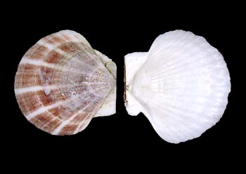
goal
Material
1. TRF output file of Patinopecten yessoensis genome.
2. bsa_SOAP output file
1. Reformat the output file of the TRF software, extract the information that we want and give a overview about the data.
2. Reformat the SOAP output file.
3. Cross-check the SOAP file and the TRF file, assign each tandem repeat sequence to single bacteria clone.

Slide 6
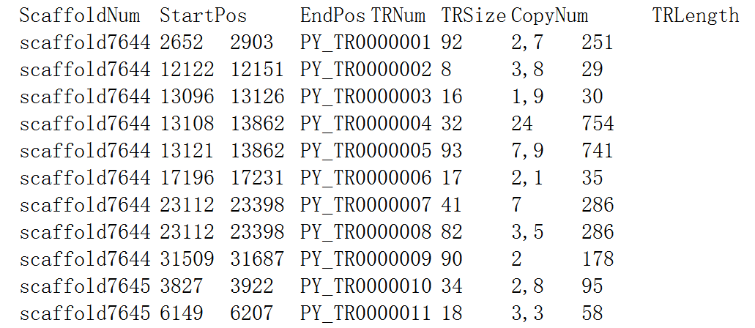
Part1 trf output file
for Line in InFile:
if LineNumber > 0:
Line=Line.strip('\n')
ElementList=Line.split('\t')
Scaffold=ElementList[0]
Start=int(ElementList[3])
End=int(ElementList[4])
Number=ElementList[8]
Size=int(ElementList[9])
Copy=ElementList[10]
Length=int(End-Start)
ChangedLine='''
%s %d %d %s %d %s %d'''%(Scaffold,Start,End,Number,Size,Copy,Length)
print "Reformatted",LineNumber,"records from",InFileName,"as",OutFileName

Slide 7
Part1 trf output file
BufferedLine=str(InFile2.readlines()[1])
for Line2 in InFile2:
if LineNumber2>0:
ElementList2=Line2.split('\t')
Scaffold2=str(ElementList2[0])
Start2=int(ElementList2[1])
End2=int(ElementList2[2])
ElementList3=BufferedLine.split('\t')
Scaffold3=str(ElementList3[0])
Start3=int(ElementList3[1])
End3=int(ElementList3[2])
if Scaffold2==Scaffold3
if Start2==Start3:
if End2>=End3:
BufferedLine=Line2
else:
BufferedLine=BufferedLine
else:
OutFile2.write(BufferedLine)
BufferedLine=Line2
else:
BufferedLine=Line2
OutFile2.write(BufferedLine)
Reformatted 1001 records from TEST_TRFoutput.txt as TRFreformatted.txt
Repetitive items are removed, records from TRFreformatted.txt are saved in TRFsimplified.txt
There are 910 tandem repeats in total. Including 46 microsatellite DNA; 547 minisatellite DNA; 237 satellite DNA. The total length of the tandem repeats are 439026 .

Slide 8
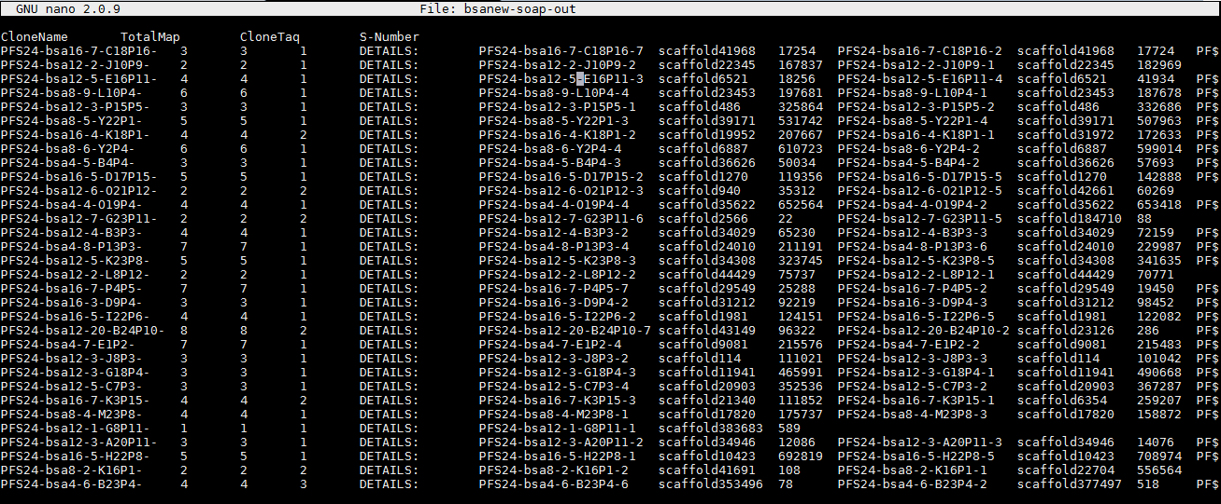
Part2 soap output file
BAC SOAP OUTPUT FILE

Slide 9
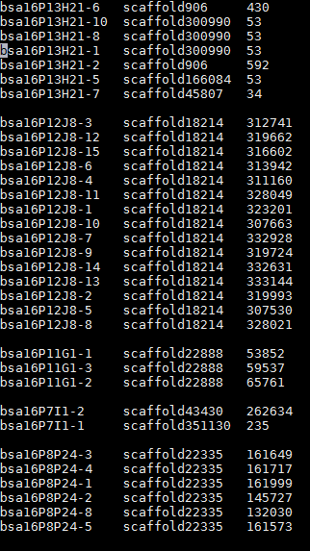
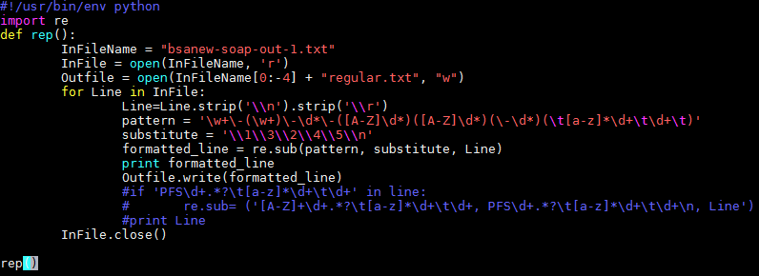
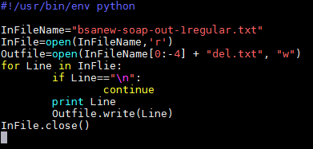
STEP ONE:
delete first five columns and reformat to three columns
Trchniques:
regular expression in jEdit
Python re module

Slide 10
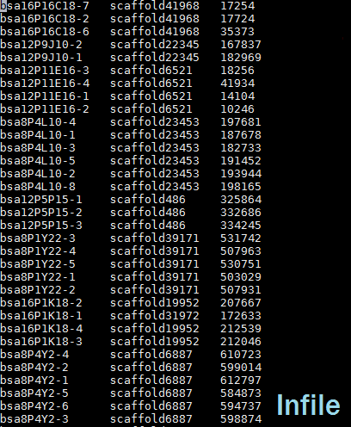
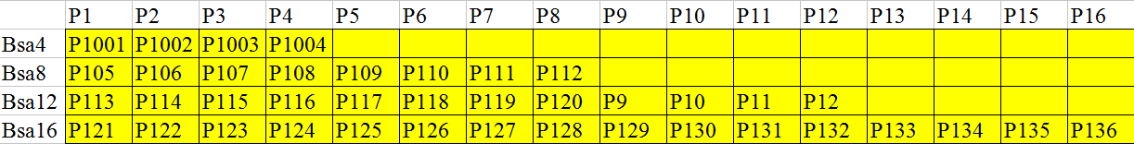
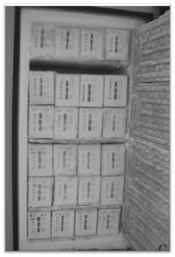
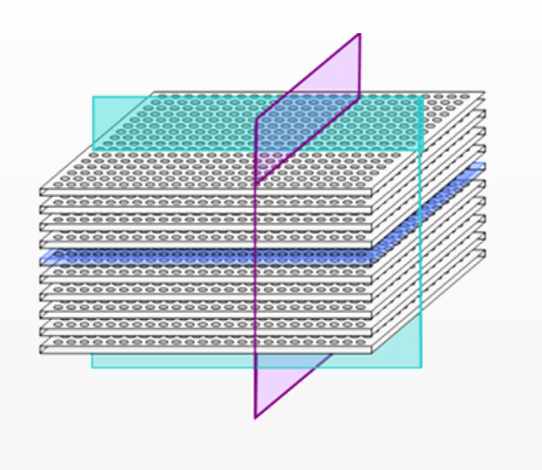
Step two:
decoding

Slide 11
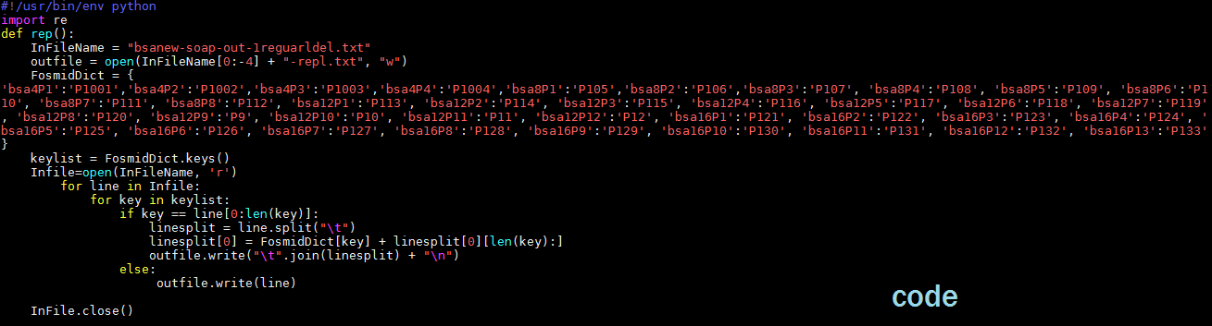
make a dictionary,
bsaNo. + PNo. as the key,
the Pxx as the value.

Slide 12
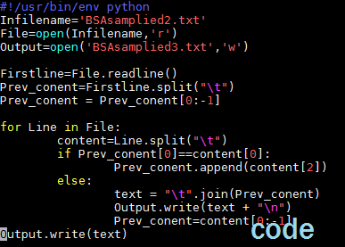
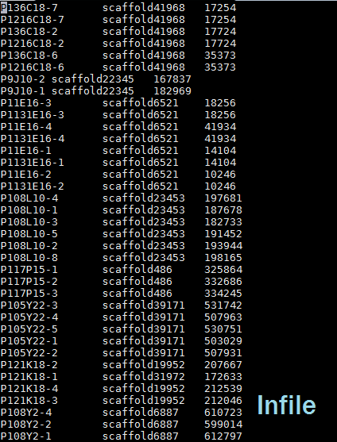
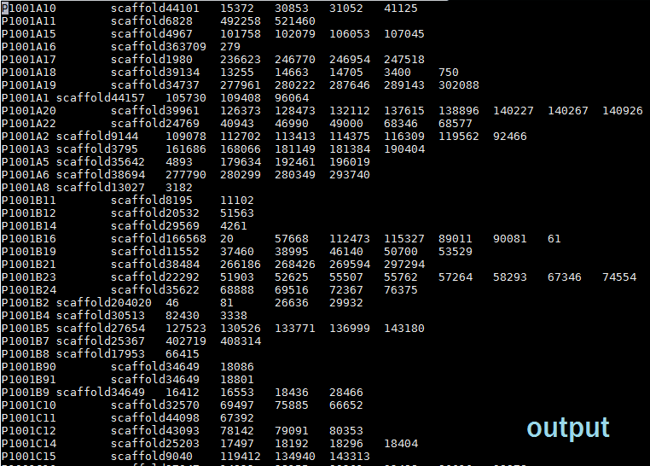
Step three:
combine the same conlny
sort the position No.

Slide 13
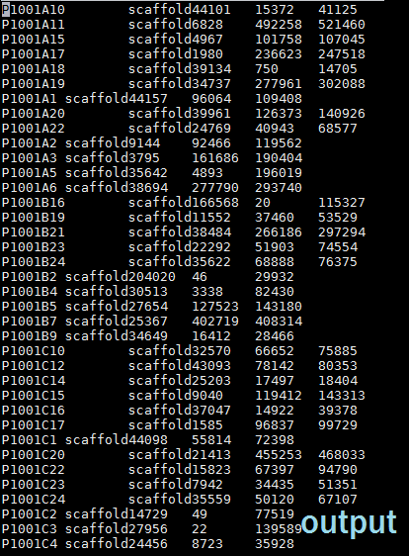
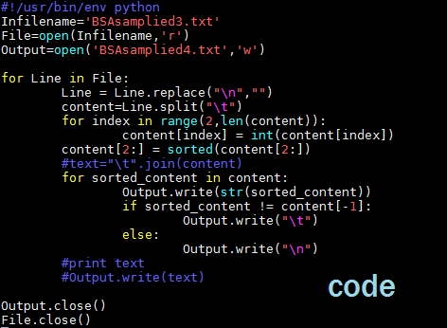
sort the position number and keep the low and large number_regex,jDeit
Search : ^(\w+\s\w+\s\w+).*(\s\w+)$
Replace: $1$2

Slide 14
Part3 cross check
for Line1 in InFile1:
if LineNumber1>0:
Line1=Line1.strip('\n')
ElementList1=Line1.split('\t')
Scaffold1=ElementList1[0]
Start1=int(ElementList1[1])
End1=int(ElementList1[2])
Number1=ElementList1[3]
Size1=int(ElementList1[4])
Copy1=ElementList1[5]
Length1=int(ElementList1[6])
List=[]
InFile2=open(InFileName2,'r')
for Item in List:
ElementList3=Item.split('\t')
Clone=ElementList3[0]
Scaffold3=ElementList3[1]
Start3=int(ElementList3[2])
End3=int(ElementList3[3])
if Start3<=Start1 and End1<=End3:
JointLine='''
%s %s %d %d %s %d %d %d''' %(Clone,Scaffold3,Start3,End3,Number1,Start1,End1,Length1)
OutFile.write(JointLine)
for Line2 in InFile2:
if LineNumber2>0:
Line2=Line2.strip('\n')
ElementList2=Line2.split('\t')
Scaffold2=ElementList2[1]
Start2=int(ElementList2[2])
End2=int(ElementList2[3])
if Scaffold2==Scaffold1:
List.append(Line2)

Slide 15
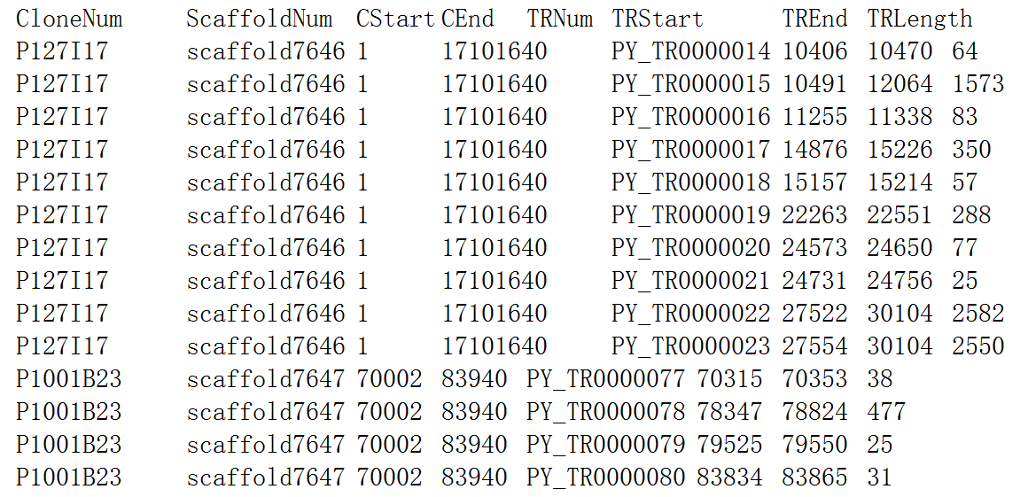
Part3 cross check
for Line1 in InFile1:
if LineNumber1>0:
Line1=Line1.strip('\n')
ElementList1=Line1.split('\t')
Scaffold1=ElementList1[0]
Start1=int(ElementList1[1])
End1=int(ElementList1[2])
Number1=ElementList1[3]
Size1=int(ElementList1[4])
Copy1=ElementList1[5]
Length1=int(ElementList1[6])
List=[]
InFile2=open(InFileName2,'r')
for Item in List:
ElementList3=Item.split('\t')
Clone=ElementList3[0]
Scaffold3=ElementList3[1]
Start3=int(ElementList3[2])
End3=int(ElementList3[3])
if Start3<=Start1 and End1<=End3:
JointLine='''
%s %s %d %d %s %d %d %d''' %(Clone,Scaffold3,Start3,End3,Number1,Start1,End1,Length1)
OutFile.write(JointLine)
for Line2 in InFile2:
if LineNumber2>0:
Line2=Line2.strip('\n')
ElementList2=Line2.split('\t')
Scaffold2=ElementList2[1]
Start2=int(ElementList2[2])
End2=int(ElementList2[3])
if Scaffold2==Scaffold1:
List.append(Line2)

Slide 16
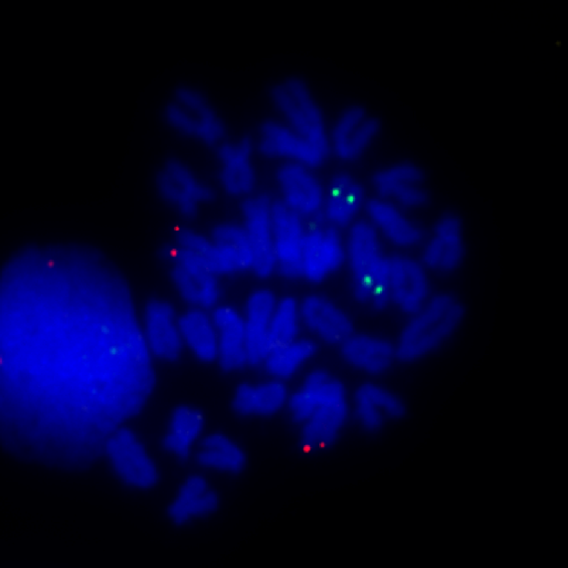
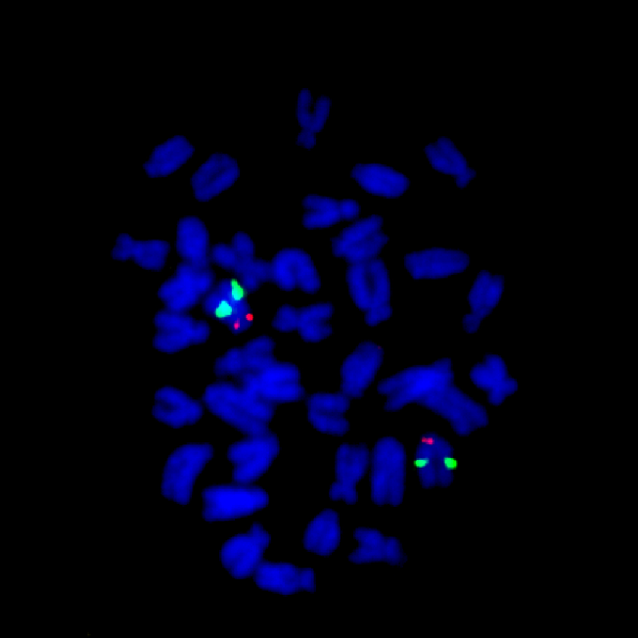
THE END TAHNK YOU ANY QUESTIONS?

