Slide 1
Speed and Balance Training
By Abdul and others

Slide 2
Introduction
In this topic, we will discuss speed training, which involves various exercises aimed at helping athletes and Individuals develop explosive power in the lower body. These drills enhance quickness, acceleration, and overall athletic performance. By focusing on proper technique and muscle strength, athletes can improve their speed and agility effectively.

Slide 3
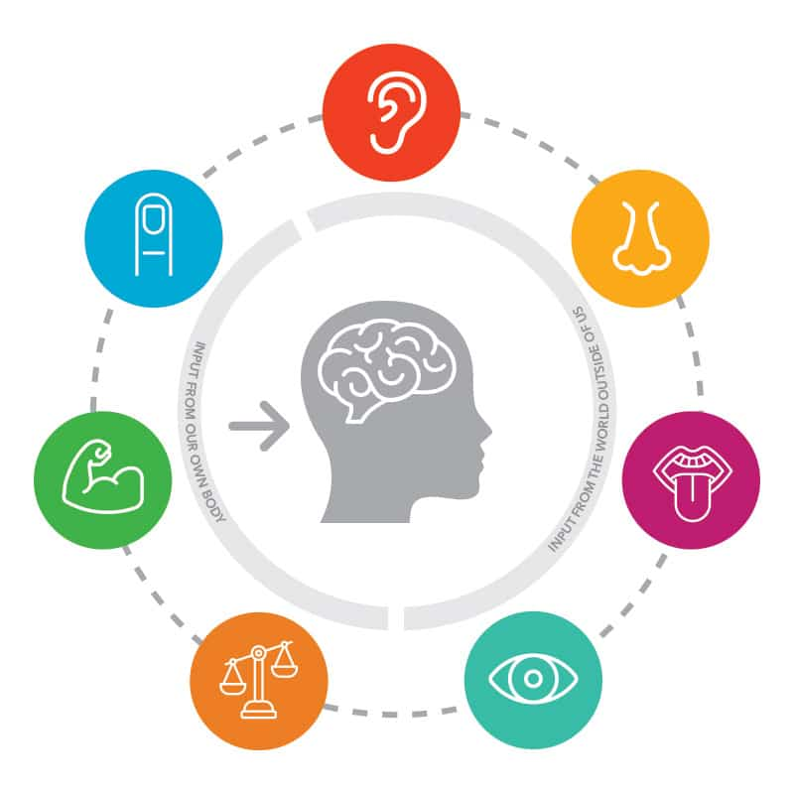
1. Sensory Integration
Utilizing the vestibular (inner ear), visual, and proprioceptive (muscle and joint) systems to gather information about body position and movement.

Slide 4
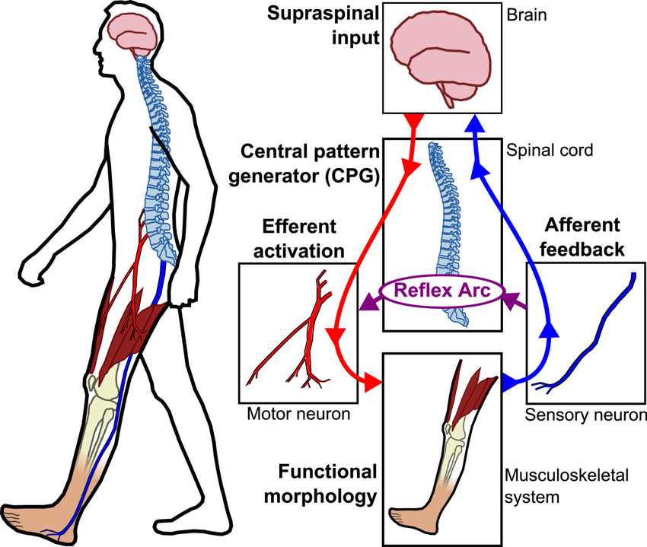
2. Motor Control:
The brain coordinates muscle responses to maintain posture and stability.

Slide 5

3. Cognitive Processes
Attention, concentration, and higher-level functions contribute to effpective balance management.

Slide 6
Static Balance

Slide 7
This involves maintaining equilibrium when not in motion. It requires the body to stay stable while the center of mass remains over the base of support. Examples include standing on one leg or holding a yoga pose.

Slide 8
examples

Slide 9
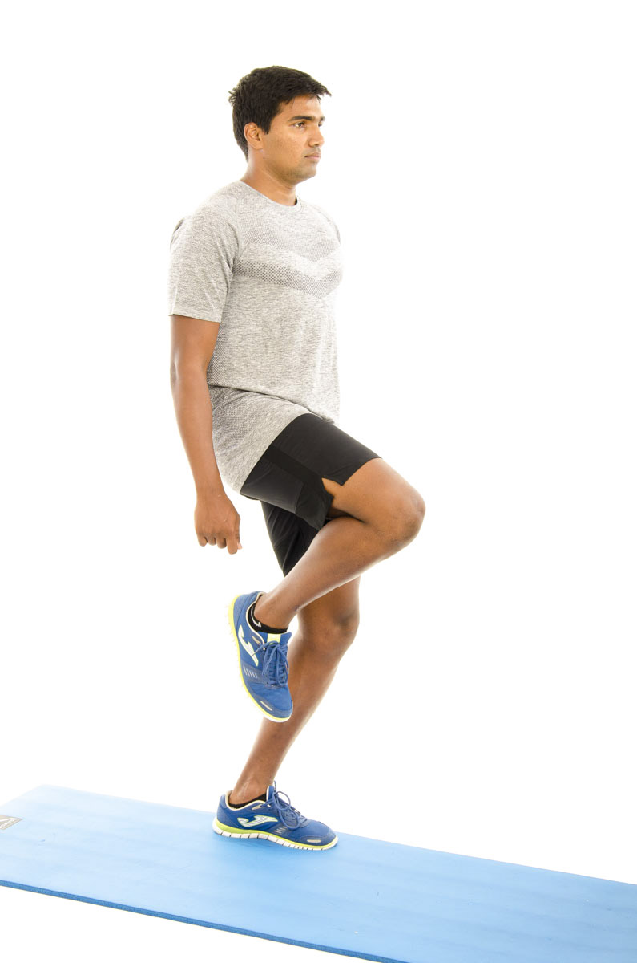
Single-Leg Stand
Stand on one leg to improve stability.

Slide 10
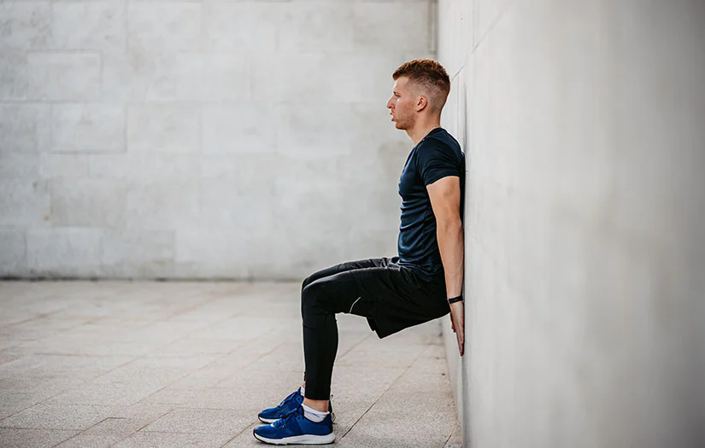
Wall Sits:
Hold a seated position against a wall to strengthen legs and balance.

Slide 11
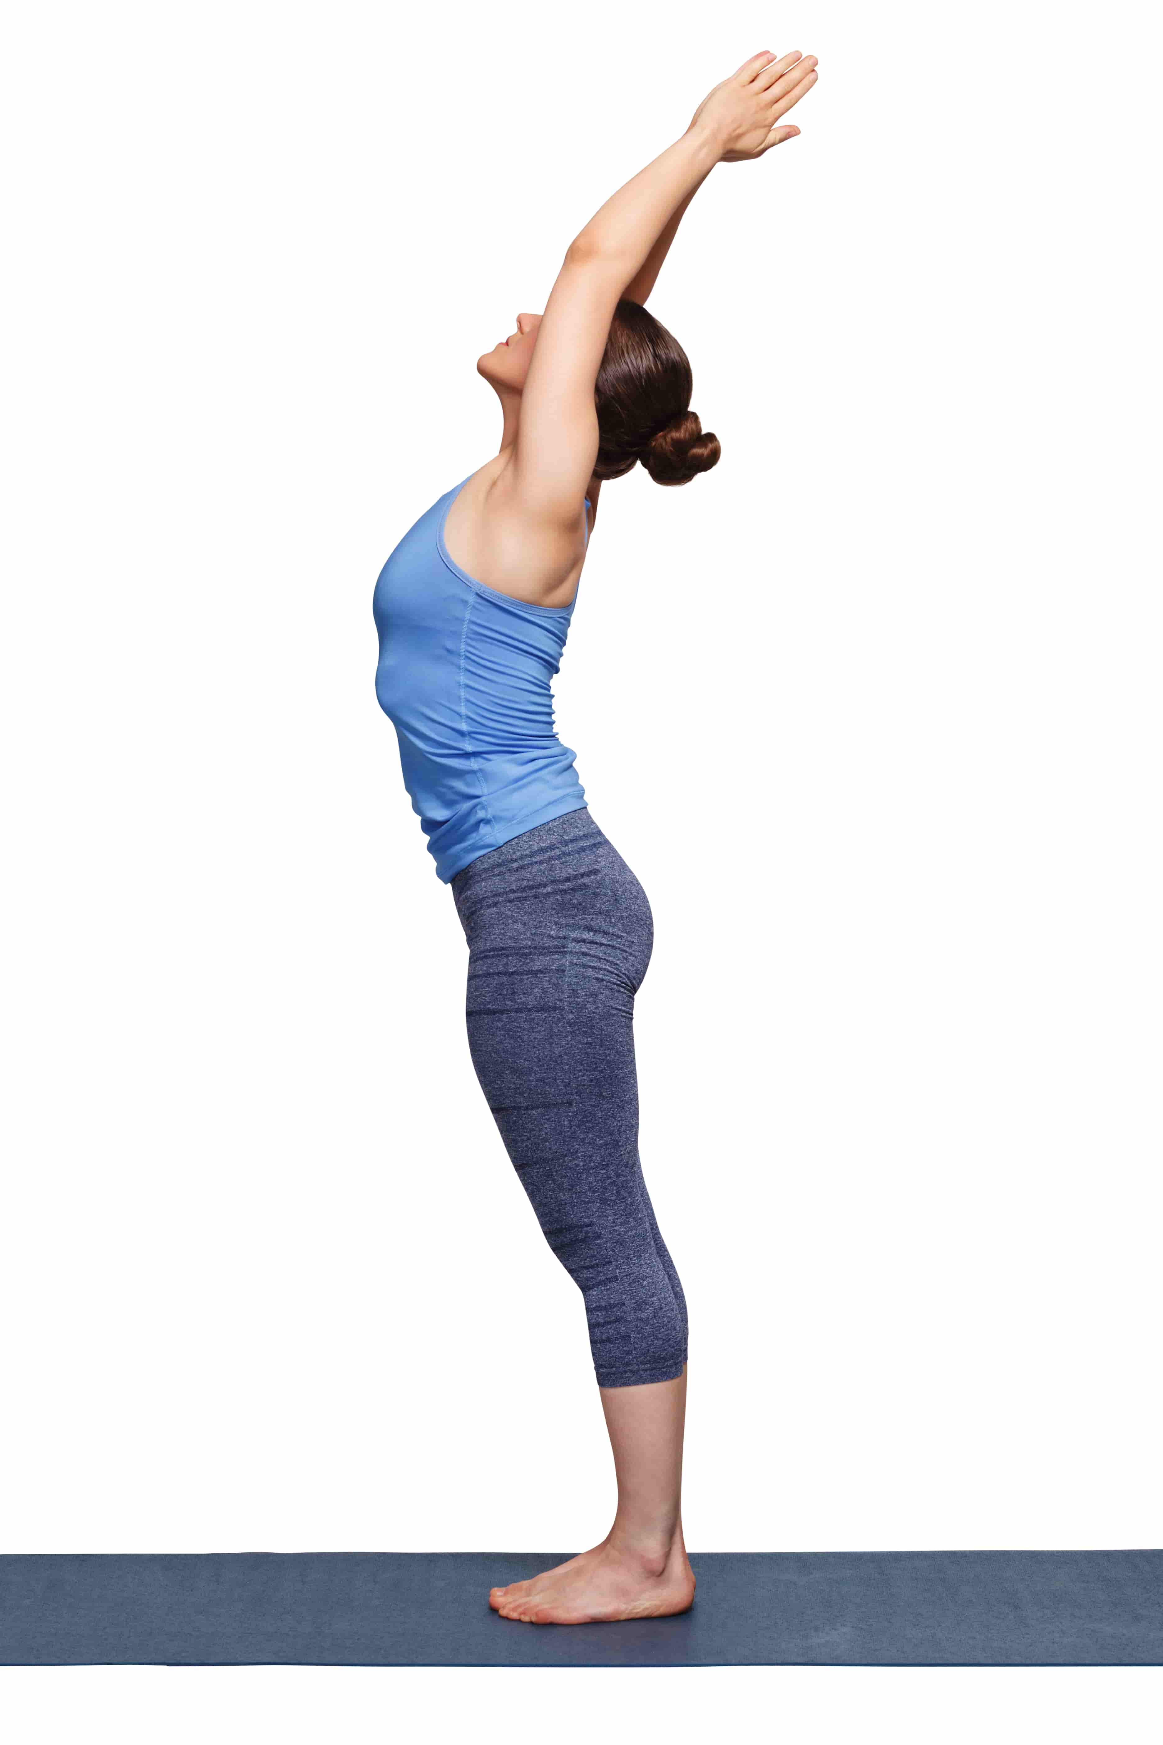
Mountain Pose (Tadasana)
Stand with proper posture to enhance balance and stability

Slide 12
Next: Dynamic balance

Slide 13
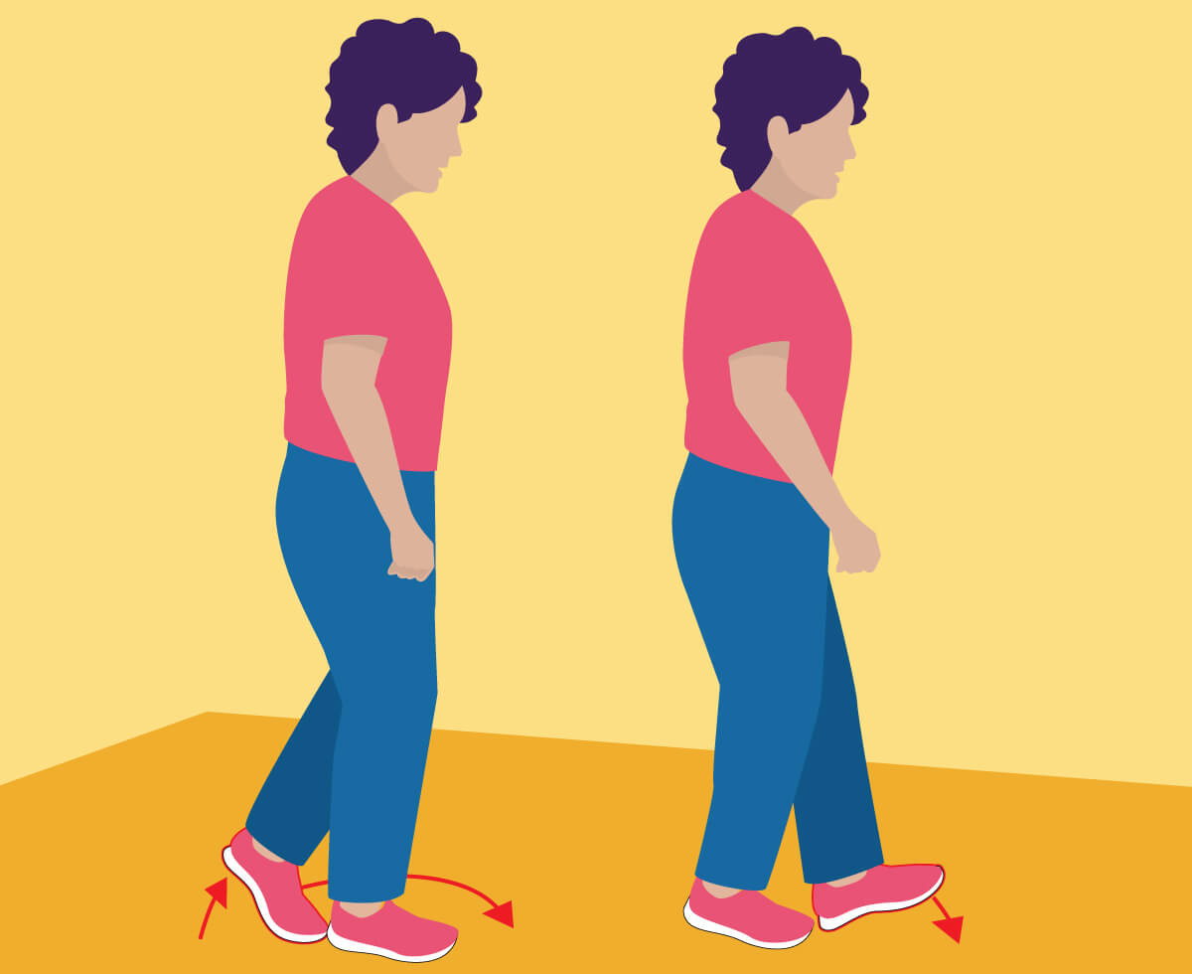
Walking Heel-to-Toe
Walk in a straight line with heel-to-toe placement to challenge balance.

Slide 14
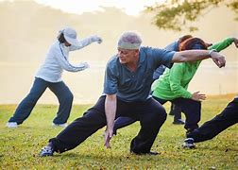
Tai Chi
Perform slow, controlled movements to improve coordination and stability.
example of tai Chi Exercise

Slide 15
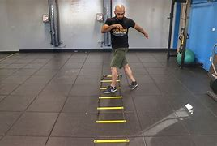
Agility Ladder Drills
Use an agility ladder for footwork exercises to enhance dynamic balance.

Slide 16
Next: Balance training with equipment

Slide 17
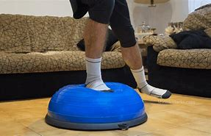
BOSU Ball Exercises:
Perform exercises on a BOSU ball to engage stabilizing muscles.

Slide 18
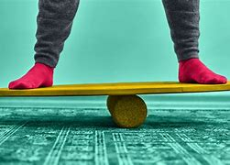
Balance Board Exercises
Use a balance board for activities that challenge stability.

Slide 19
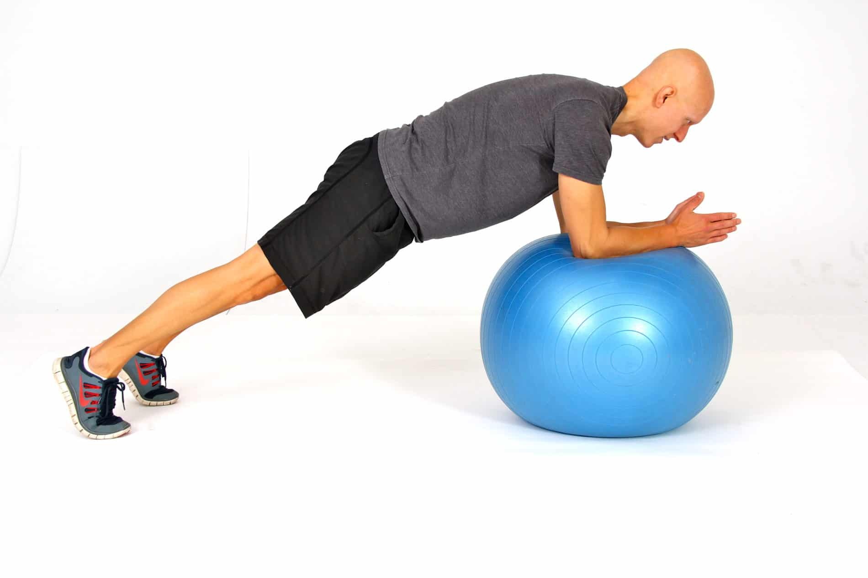
Stability Ball Exercises
Sit on a stability ball during exercises to engage core muscles.

Slide 20
Next: Functional Balance

Slide 21
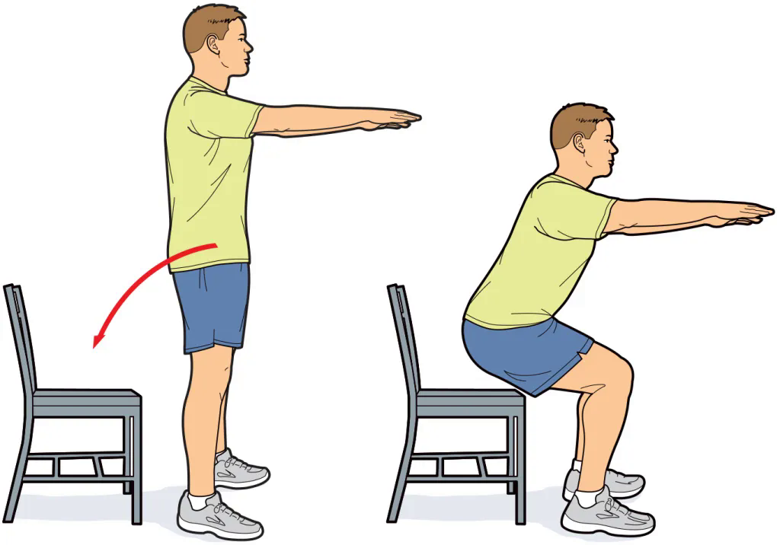
Chair Stand
Stand up from a seated position to mimic real-life movements.

Slide 22
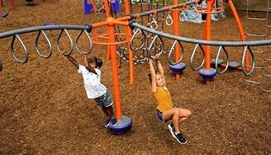
Obstacle Course
Navigate through a course with various elements to improve balance and coordination.

Slide 23
Benefits of Balance Training:
1. Improved Stability and Coordination: Strengthens core muscles and enhances neuromuscular coordination.
2. Fall Prevention: Increases proprioception and strengthens lower body muscles to reduce fall risk.
3. Support for Aging: Helps older adults maintain independence and reduces the risk of falls.

Slide 24
Benefits of Balance Training:
4. Enhanced Athletic Performance: Boosts agility, posture, and overall performance in sports.
5. Increased Functional Independence: Eases daily activities and improves mobility.
6. Cognitive Benefits: Enhances mental focus and stimulates brain areas involved in coordination.
7. Better Postural Control: Promotes proper alignment, reducing back and neck pain.

Slide 25
thank you for listening!!
Members:
Aaron Walter Selga
Cyrus Troy Bazar
Dreiko Alvarado
Edzhel Caniedo
Ej Tolentino
HAyst Marayag Jr.
Jay Lloyd Duque
Mohammed Macadatu - Abu sayaf
Reagan Rhodes
Renz Joshua Serrano
Ruben De Vera
Seb Salamin
Vince Christoper Sumawang

Slide 26
thank you for listening!!
https://github.com/troy600/DSA/blob/main/speedandtraining.pptx
(reviewer)
/\
/ \
/\ \
/ > ω < \
/ __ \
/ __| |__ -\
/_-'' ''-_\

