Slide 1
Speed and Balance Training
By Abdul and others

Slide 2
Introduction
In this topic, we will discuss speed training, which involves various exercises aimed at helping athletes and Individuals develop explosive power in the lower body. These drills enhance quickness, acceleration, and overall athletic performance. By focusing on proper technique and muscle strength, athletes can improve their speed and agility effectively.

Slide 3
Speed Training
speed training can help you level up your athletic ability by making you faster, stronger, and more agile. There are many different types of speed training, so you can find one that’s right for you.

Slide 4
Velocity based training
Velocity based training is a modern approach to strength training and power training which utilises velocity tracking technology to provide rich objective data as a means to motivate and support real-time adjustments in an athlete's training plan. Typical strength and power programming and periodisation plans[1][2] rely on the manipulation of reps, sets and loads as a means to calibrate training stressors in the pursuit of specific adaptations.

Slide 5
Reaction time
Reaction time is the time taken for a human to respond to an incoming sensory signal.

Slide 6
seven step approach to increase playing speed
brain power
body composition
aerobic speed
overreaching
Muscle function
balance
strenght
Footforce
Nutrition

Slide 7
Techniques for Increasing Playing Speed
1. Gradual Progression
2. Chunking
3. Focus on Accuracy
4. Use of Rhythmic Variations
5. Relaxation

Slide 8
Increase playing speed.
Increasing playing speed is a common goal for musicians, athletes, and other performers aiming to enhance their skill and proficiency. This report explores strategies to effectively increase playing speed, focusing on techniques, practice methods, and considerations for maintaining quality.

Slide 9
Examples of speed Training exercises

Slide 10
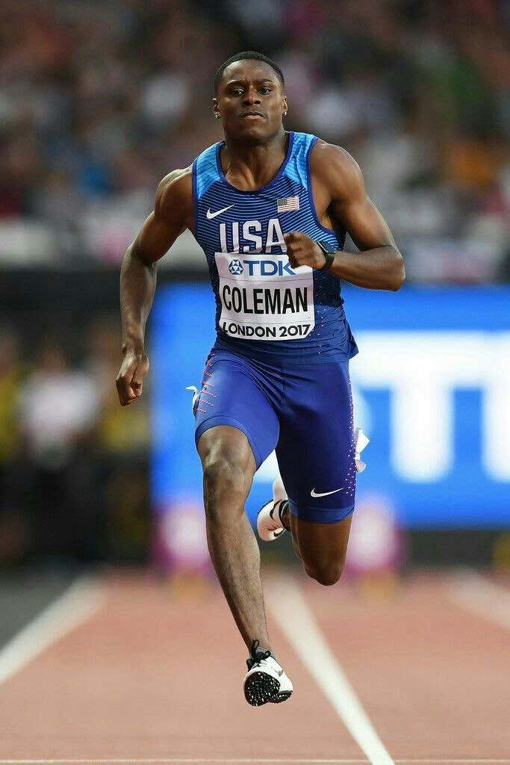
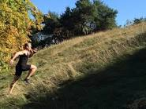
Sprinting
hill-Sprinting

Slide 11
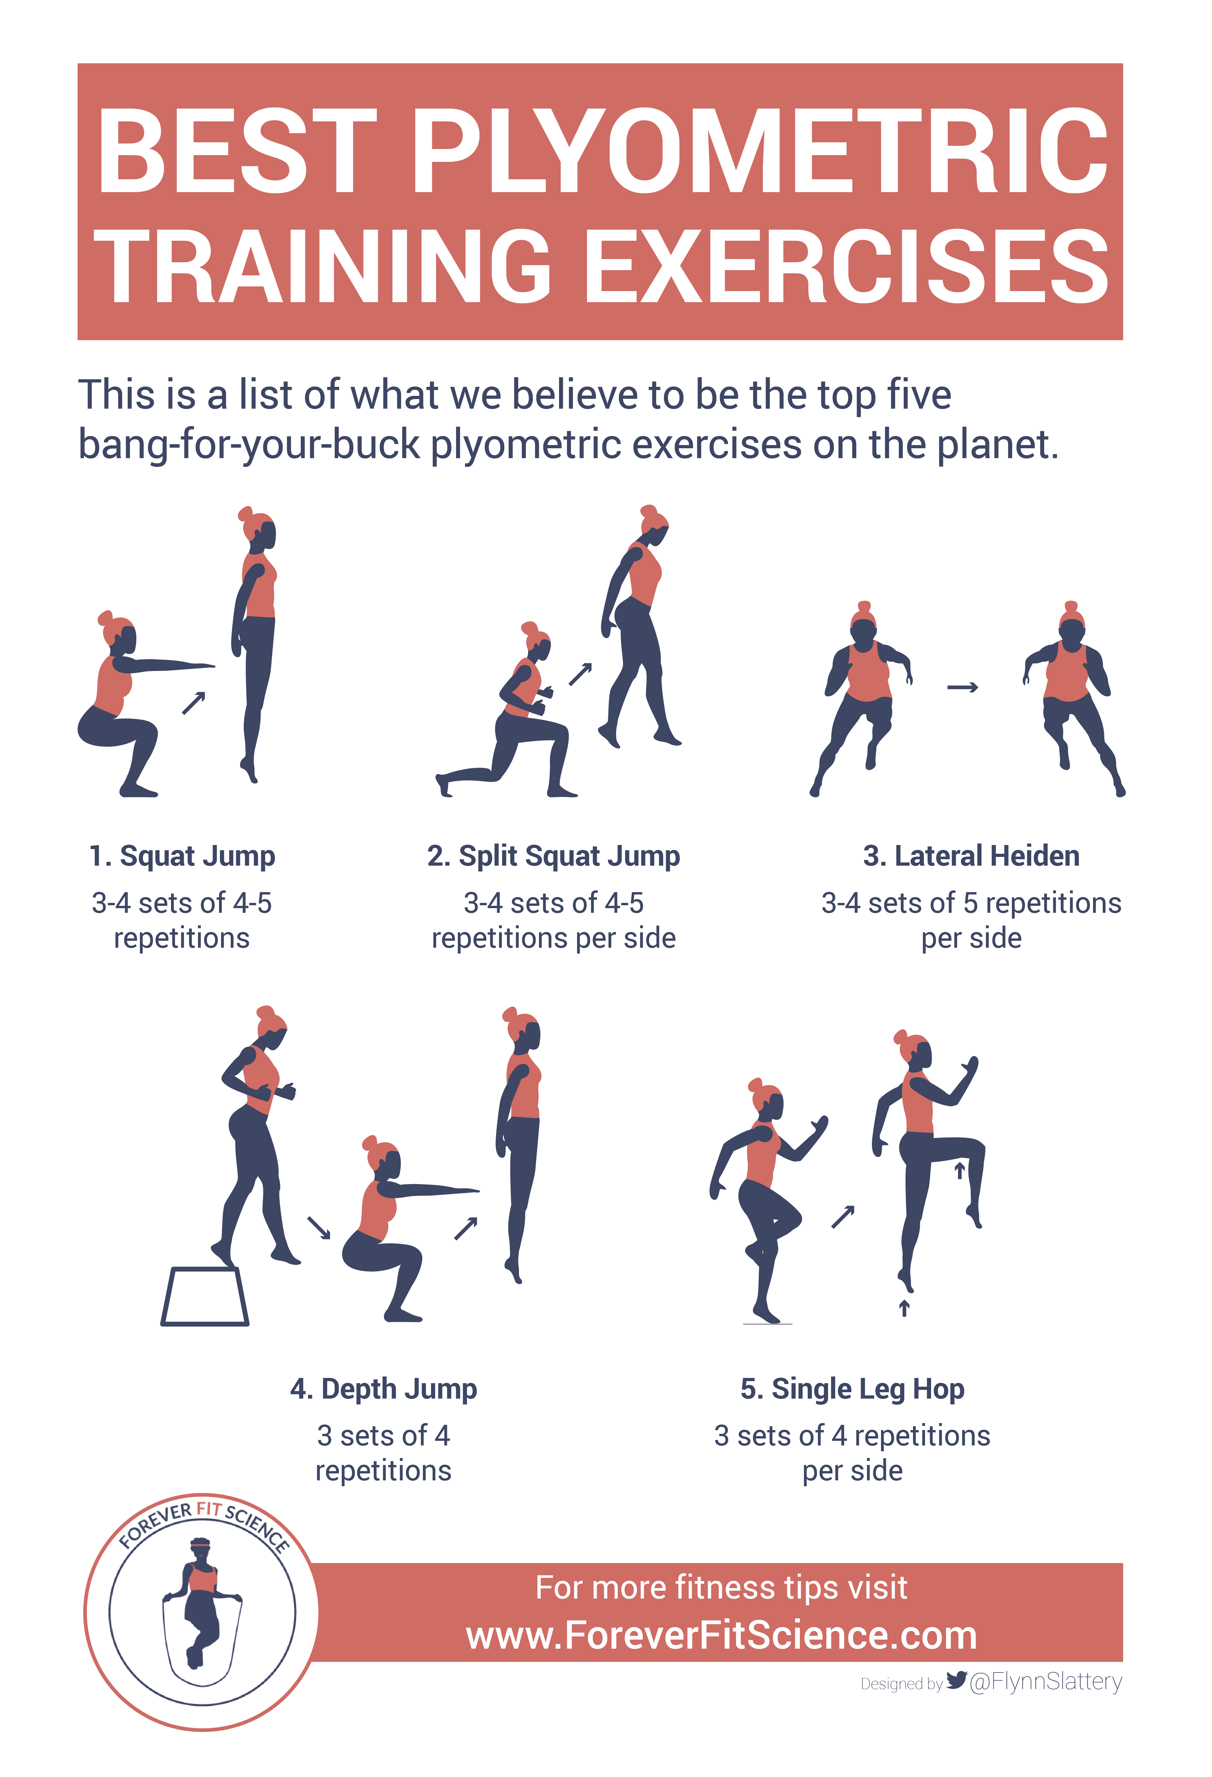
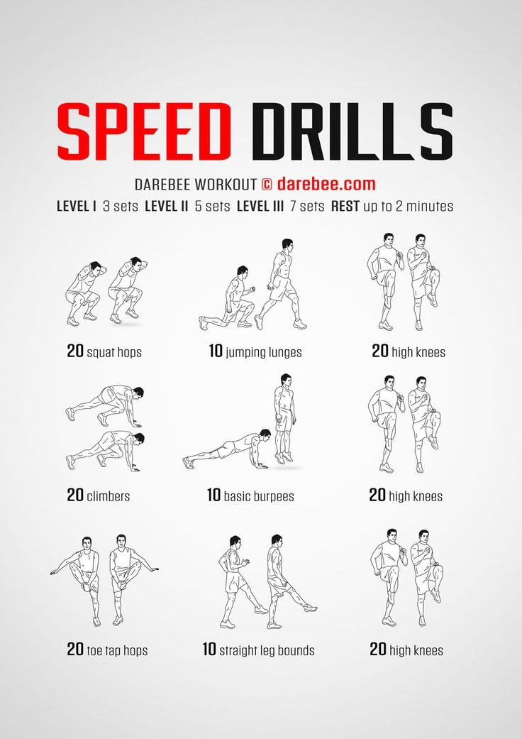
Plyometrics-
Dot Drills

Slide 12
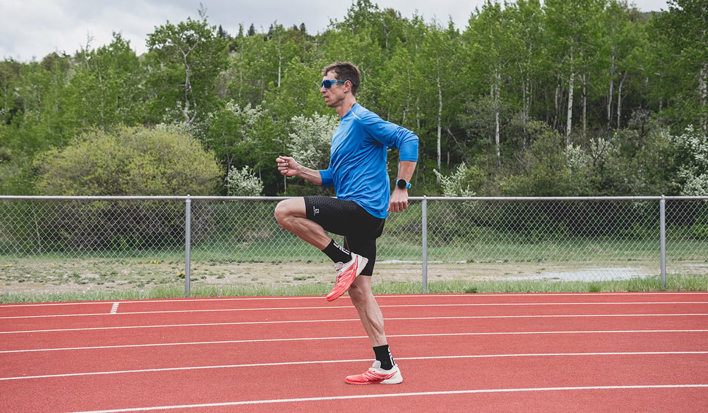
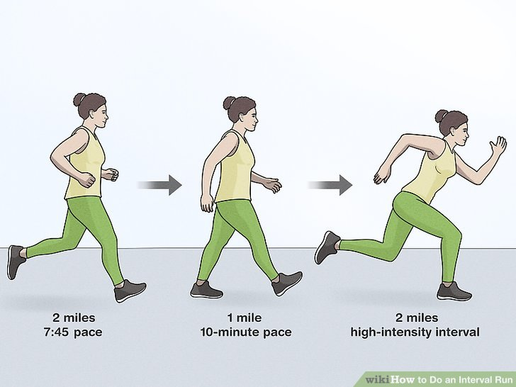
High knees- workout.
Interval Runs-

Slide 13
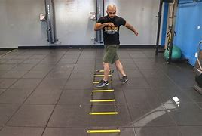
Agility ladder drills

Slide 14
these are the 10 benefits of speed training
1.A Stronger Stride
2.More Muscle
3. Better Fat Burn
4.Reduced Risk of Injury
5. Stronger Bones
6.Improved Running Economy
7.More Anaerobic Endurance
8.Better Balance and Proprioception
9.Improved Agility
10. Easier Strides

Slide 15
Balance Training

Slide 16
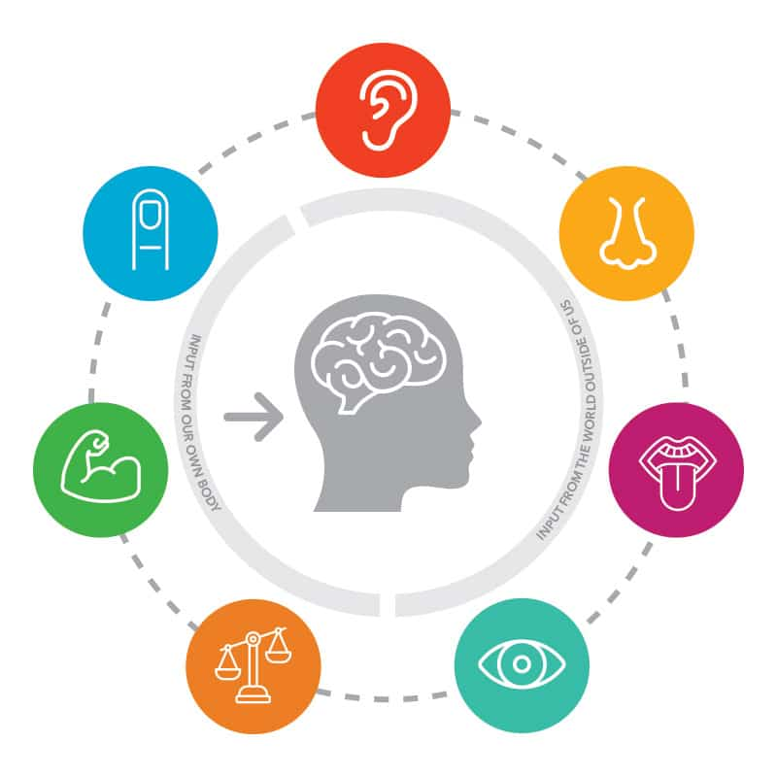
1. Sensory Integration
Utilizing the vestibular (inner ear), visual, and proprioceptive (muscle and joint) systems to gather information about body position and movement.

Slide 17
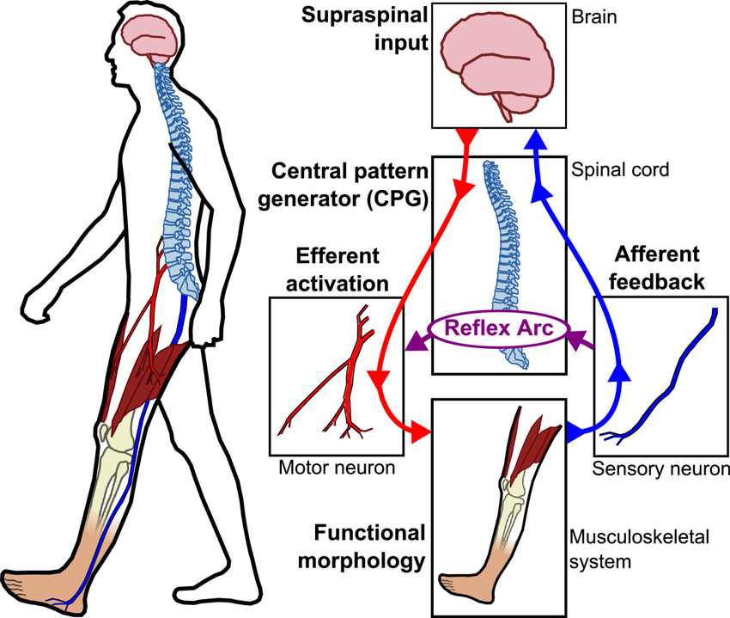
2. Motor Control:
The brain coordinates muscle responses to maintain posture and stability.

Slide 18

3. Cognitive Processes
Attention, concentration, and higher-level functions contribute to effpective balance management.

Slide 19
Static Balance

Slide 20
This involves maintaining equilibrium when not in motion. It requires the body to stay stable while the center of mass remains over the base of support. Examples include standing on one leg or holding a yoga pose.

Slide 21
examples

Slide 22
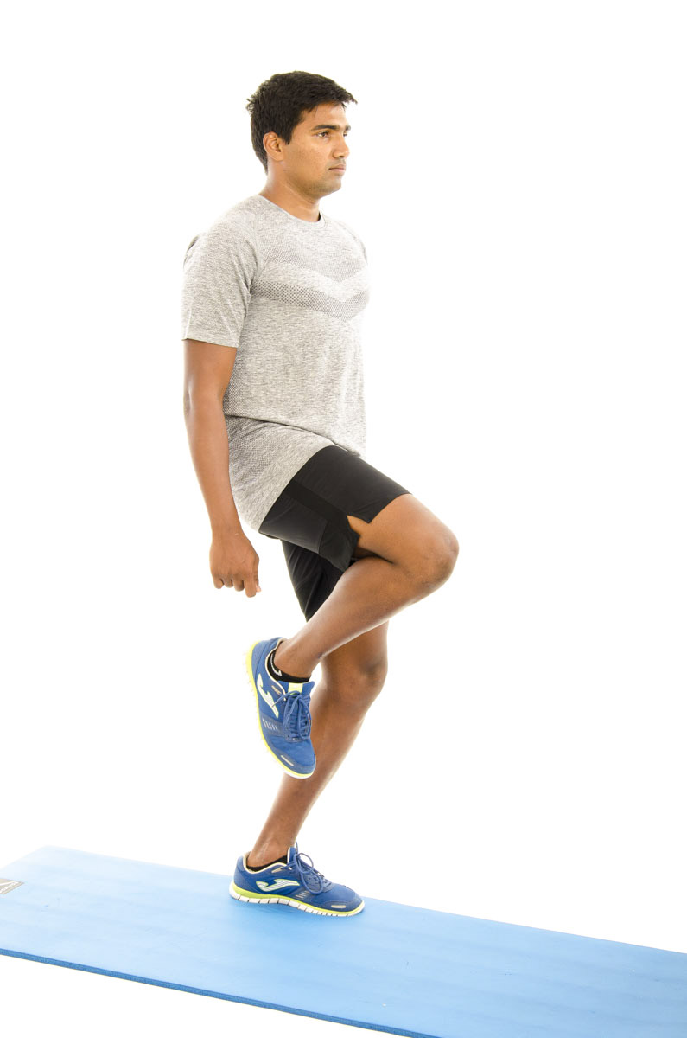
Single-Leg Stand
Stand on one leg to improve stability.

Slide 23
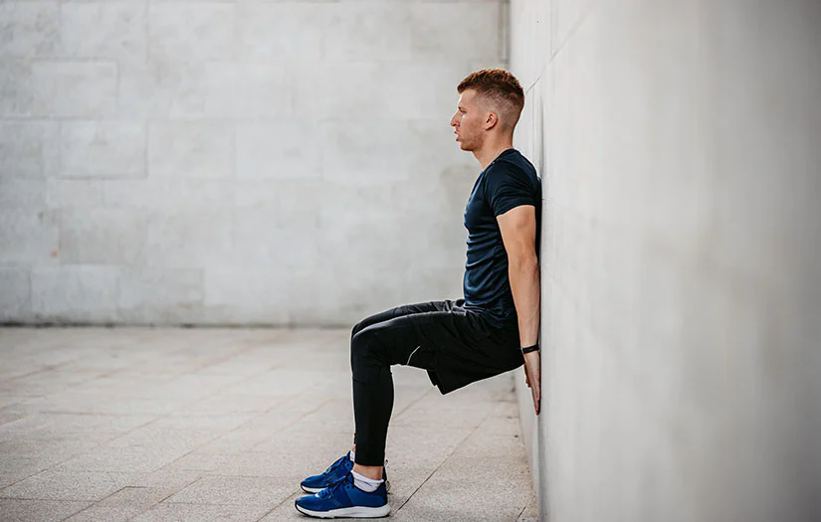
Wall Sits:
Hold a seated position against a wall to strengthen legs and balance.

Slide 24
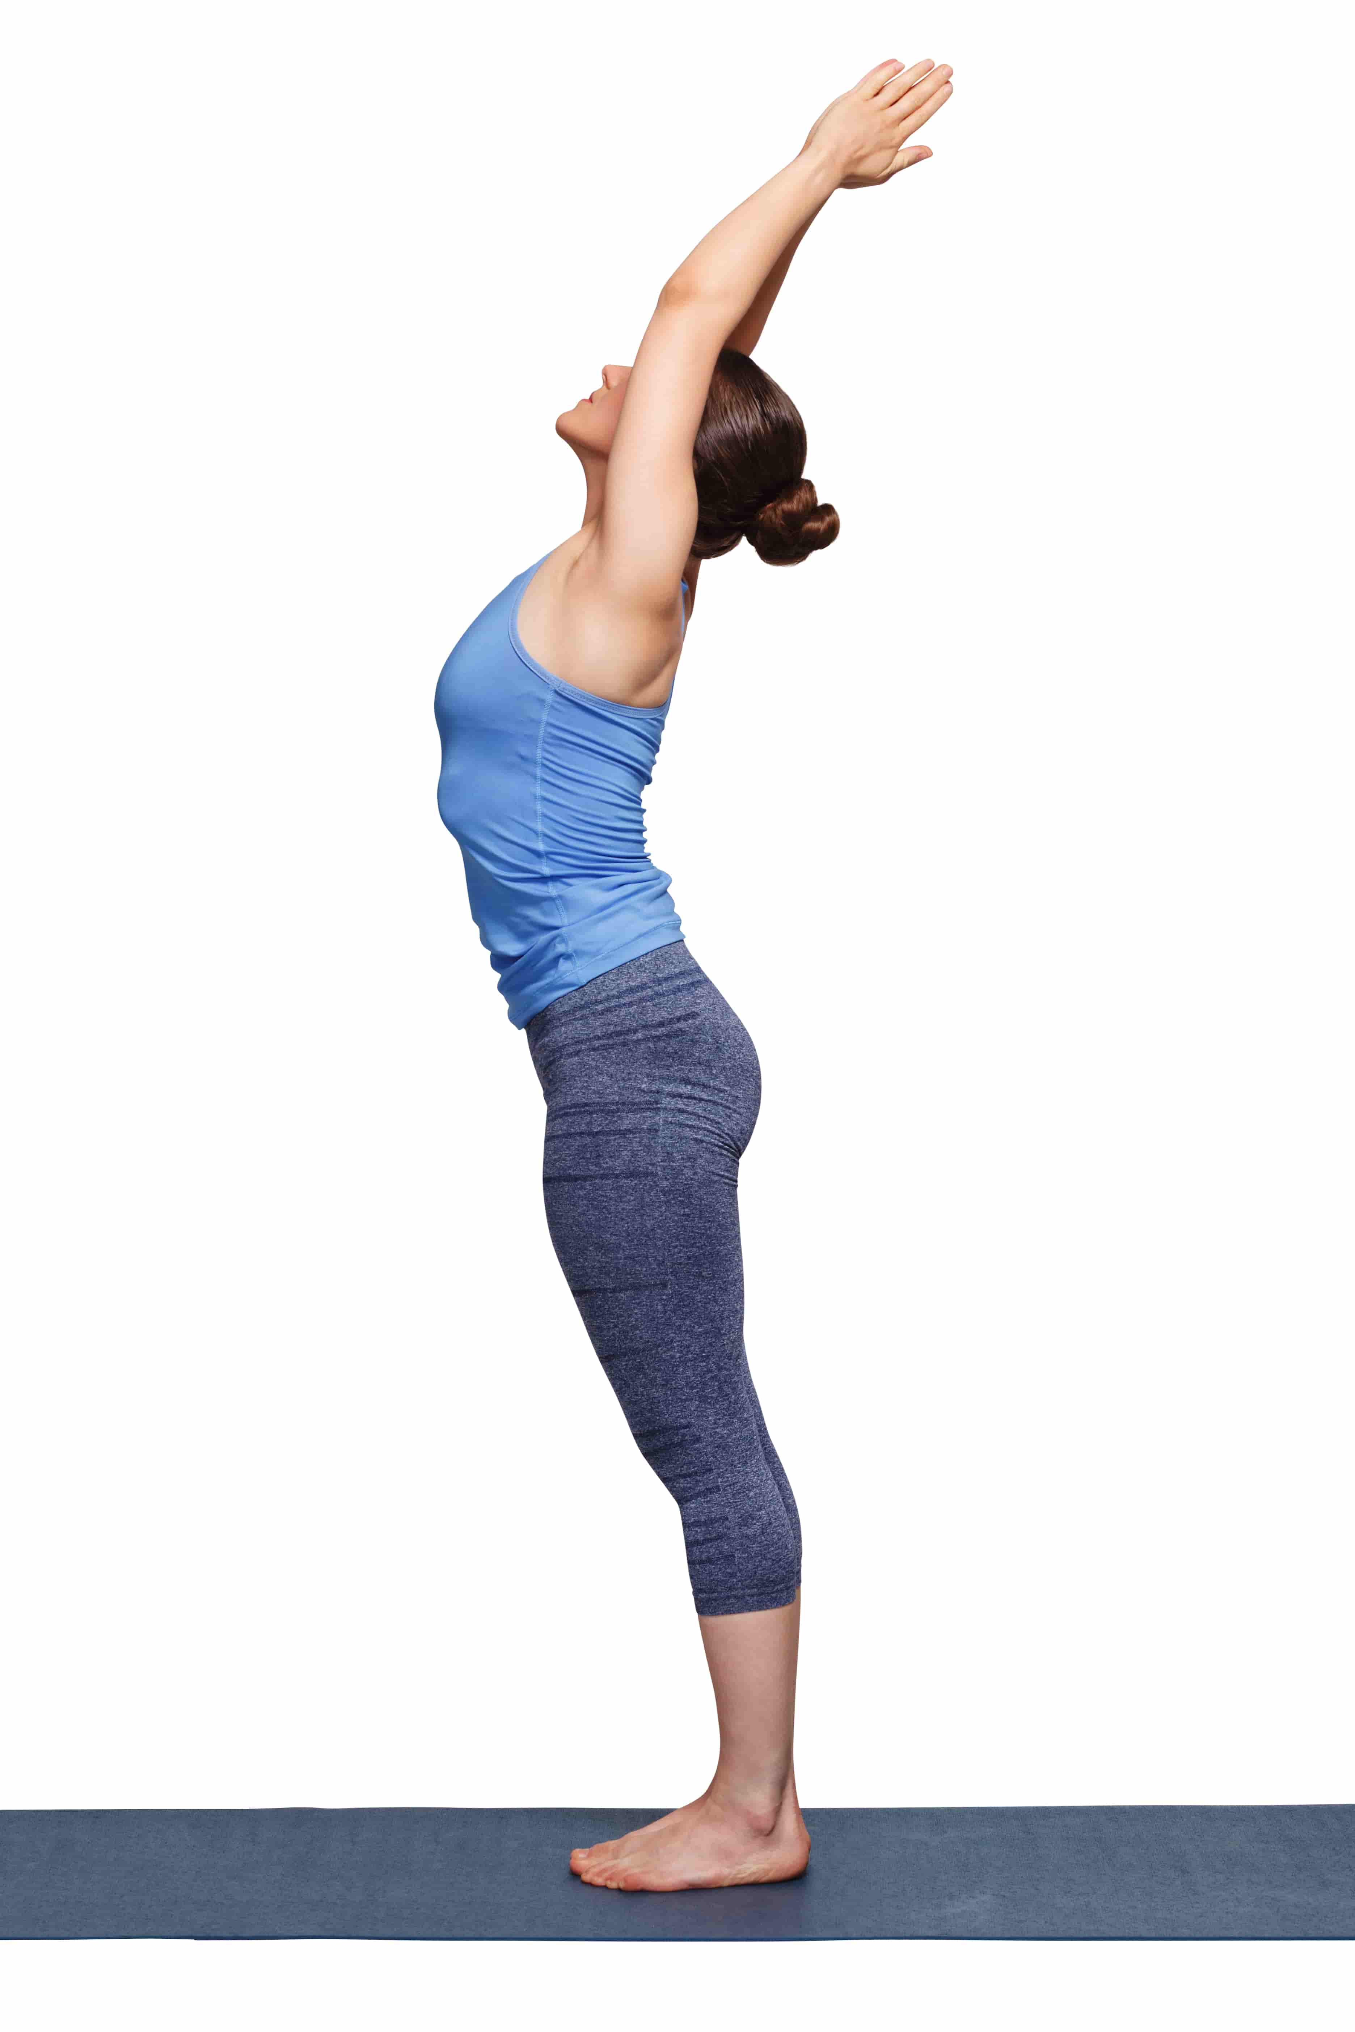
Mountain Pose (Tadasana)
Stand with proper posture to enhance balance and stability

Slide 25
Next: Dynamic balance

Slide 26
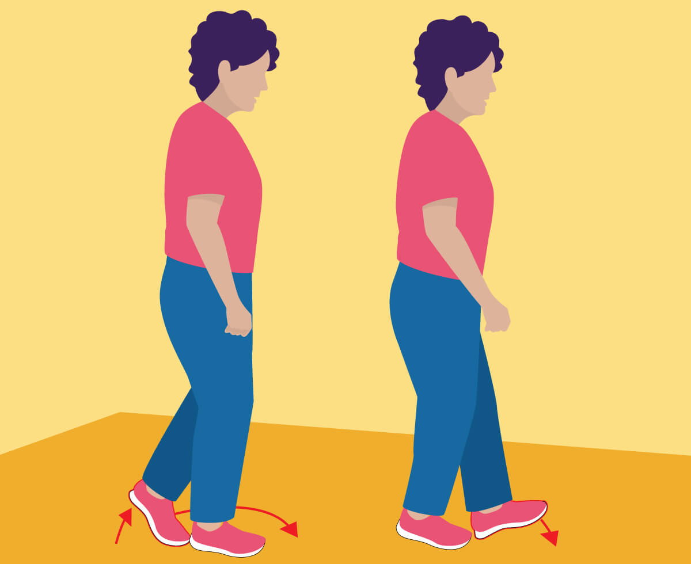
Walking Heel-to-Toe
Walk in a straight line with heel-to-toe placement to challenge balance.

Slide 27
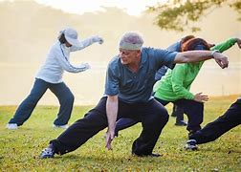
Tai Chi
Perform slow, controlled movements to improve coordination and stability.
example of tai Chi Exercise

Slide 28
Agility Ladder Drills
Use an agility ladder for footwork exercises to enhance dynamic balance.

Slide 29
Next: Balance training with equipment

Slide 30
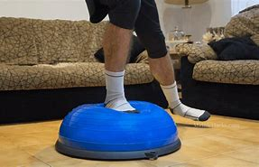
BOSU Ball Exercises:
Perform exercises on a BOSU ball to engage stabilizing muscles.

Slide 31

Balance Board Exercises
Use a balance board for activities that challenge stability.

Slide 32
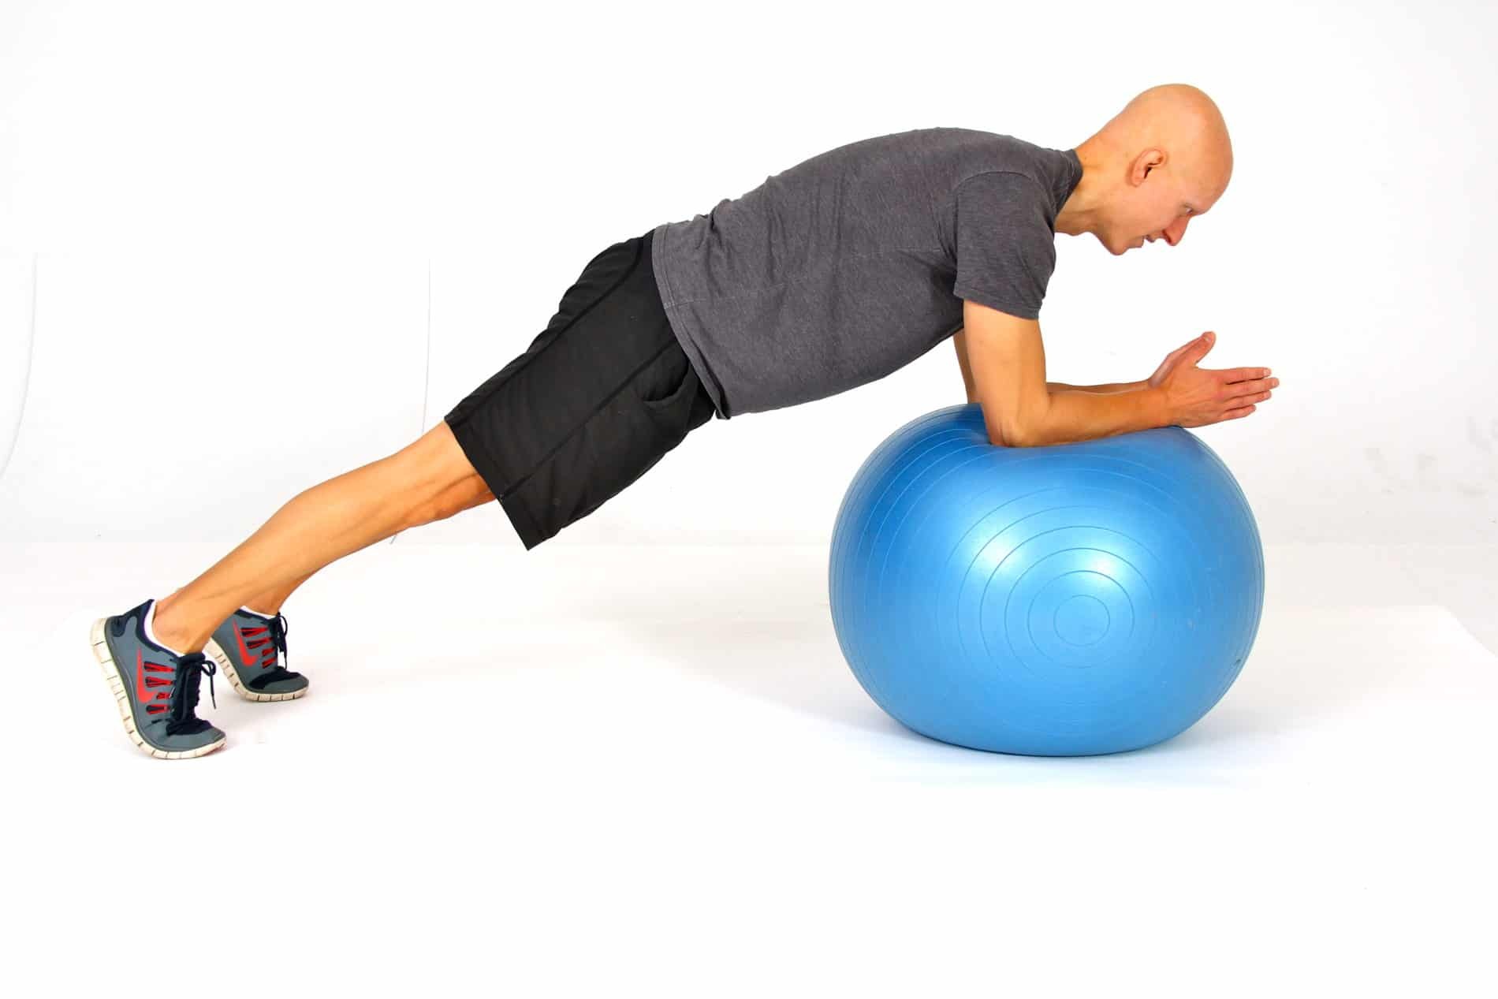
Stability Ball Exercises
Sit on a stability ball during exercises to engage core muscles.

Slide 33
Next: Functional Balance

Slide 34
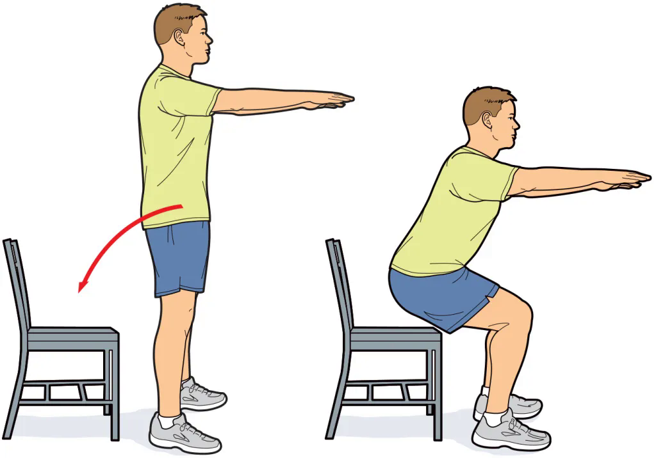
Chair Stand
Stand up from a seated position to mimic real-life movements.

Slide 35
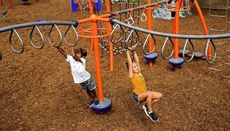
Obstacle Course
Navigate through a course with various elements to improve balance and coordination.

Slide 36
Benefits of Balance Training:
1. Improved Stability and Coordination: Strengthens core muscles and enhances neuromuscular coordination.
2. Fall Prevention: Increases proprioception and strengthens lower body muscles to reduce fall risk.
3. Support for Aging: Helps older adults maintain independence and reduces the risk of falls.

Slide 37
Benefits of Balance Training:
4. Enhanced Athletic Performance: Boosts agility, posture, and overall performance in sports.
5. Increased Functional Independence: Eases daily activities and improves mobility.
6. Cognitive Benefits: Enhances mental focus and stimulates brain areas involved in coordination.
7. Better Postural Control: Promotes proper alignment, reducing back and neck pain.

Slide 38
thank you for listening!!
Members:
Aaron Walter Selga
Cyrus Troy Bazar
Dreiko Alvarado
Edzhel Caniedo
Ej Tolentino
HAyst Marayag Jr.
Jay Lloyd Duque
Mohammed Macadatu - Abu sayaf
Reagan Rhodes
Renz Joshua Serrano
Ruben De Vera
Seb Salamin
Vince Christoper Sumawang

Slide 39
thank you for listening!!
https://github.com/troy600/DSA/blob/main/speedandtraining.pptx
(reviewer)
/\
/ \
/\ \
/ > ω < \
/ __ \
/ __| |__ -\
/_-'' ''-_\

