Slide 1
Speed and Balance Training
By:Abdul and members

Slide 2
Introduction
In this topic, we will discuss speed training, which involves various exercises aimed at helping athletes and Individuals develop explosive power in the lower body. These drills enhance quickness, acceleration, and overall athletic performance. By focusing on proper technique and muscle strength, athletes can improve their speed and agility effectively.

Slide 3
What is speed training?
Speed training can help you level up your athletic ability by making you faster, stronger, and more agile. There are many different types of speed training, so you can find one that’s right for you.

Slide 4
Velocity based training
Is a method of strength training that uses the speed at which an athlete moves a load to adjust the intensity and volume of the workout in real-time. It uses velocity to describe training intensity and track strength progress.

Slide 5
Reaction time
Reaction time is the time taken for a human to respond to an incoming sensory signal. It reflects how quickly an individual can process information and respond to it, and it plays a key role in activities that require speed and precision.

Slide 6
7 Factors that can increase speed
Body composition
Aerobic speed
Muscle function
Balance
Strength
Foot force
Nutrition

Slide 7
5 Techniques that can increase speed
1. Gradual Progression
2. Chunking
3. Focus on Accuracy
4. Use of Rhythmic Variations
5. Relaxation

Slide 8
What is Increase Playing Speed?
It refers to enhancing the rate at which movements, actions, or responses are executed during sports or physical activities. This concept applies to various fields like sports, fitness, and skill-based exercises, where quick reactions, rapid movement, and faster execution are crucial for performance improvement.

Slide 9
Examples of Speed Training Exercises

Slide 10
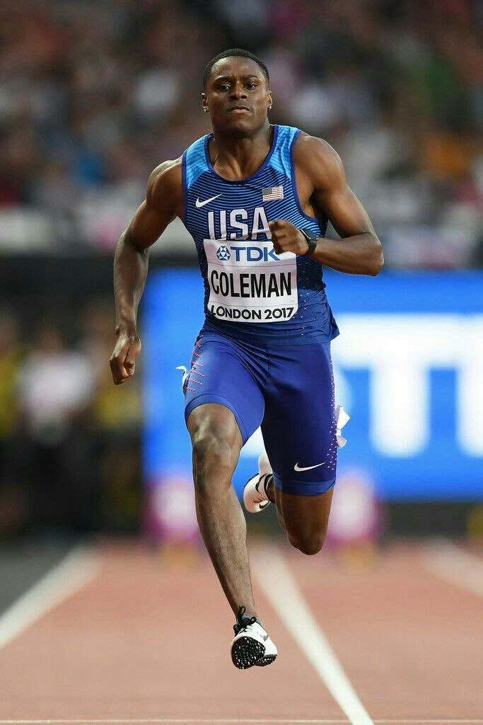
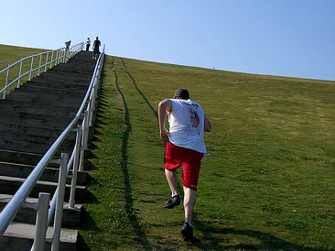
Sprinting
Hill-Sprinting

Slide 11
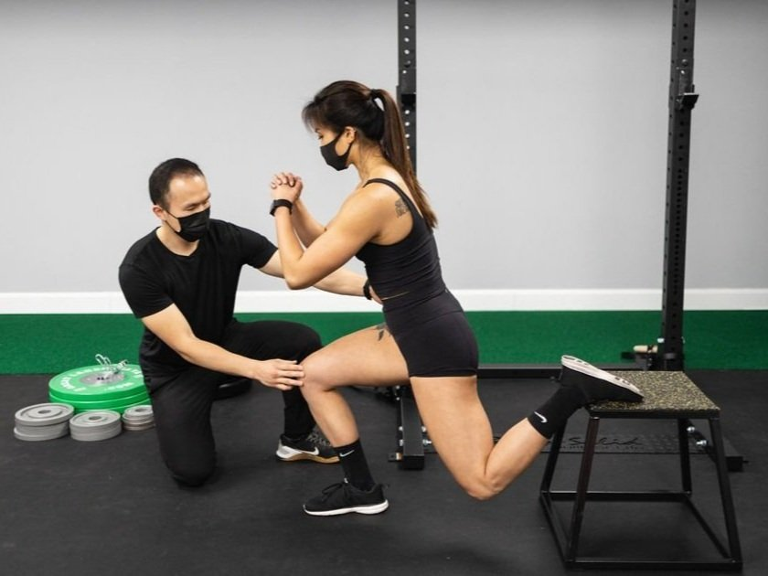
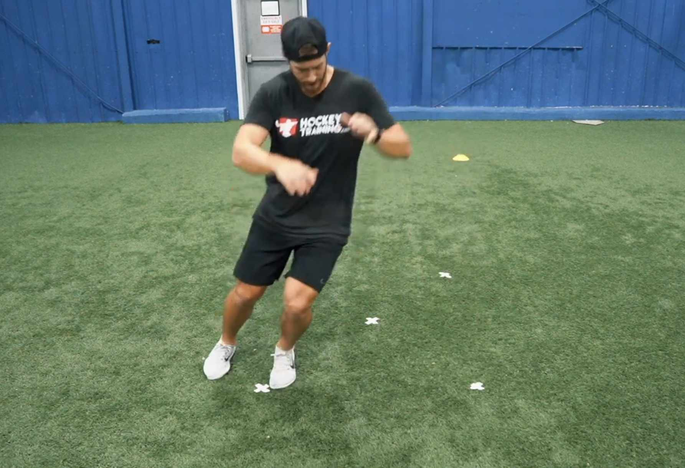
Plyometrics
Dot Drills

Slide 12
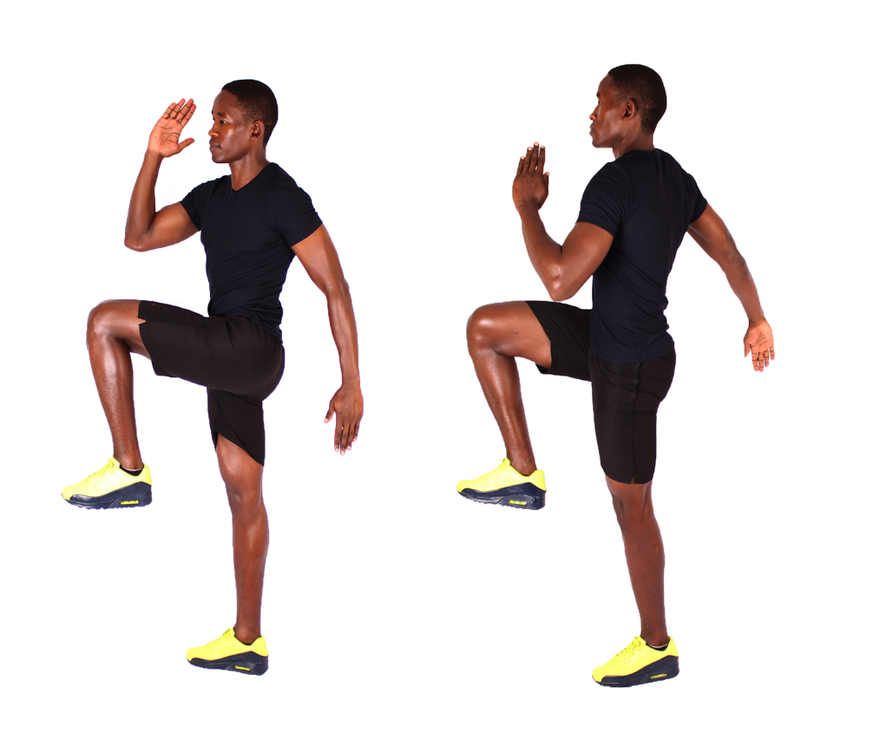
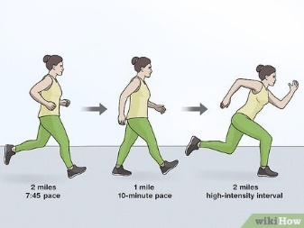
High knees
Interval Runs

Slide 13
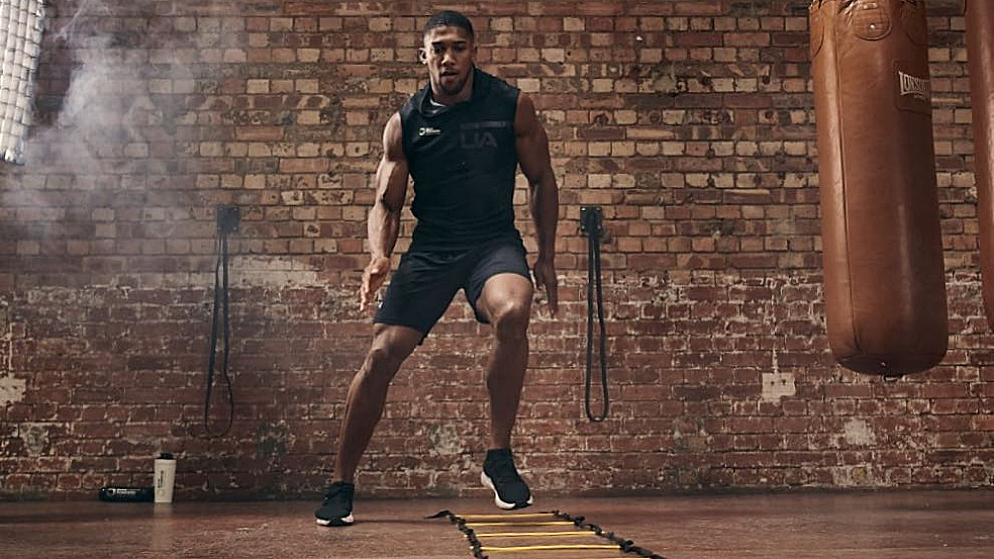
Agility ladder drills

Slide 14
9 benefits of speed training
1. A Stronger Stride
2. Muscle Growth
3. Better Fat Burn
4. Reduced Risk of Injury
5. Stronger Bones
6. Improved Running Economy
7. More Anaerobic Endurance
8. Better Balance and Proprioception
9. Improved Agility

Slide 15
Balance Training

Slide 16
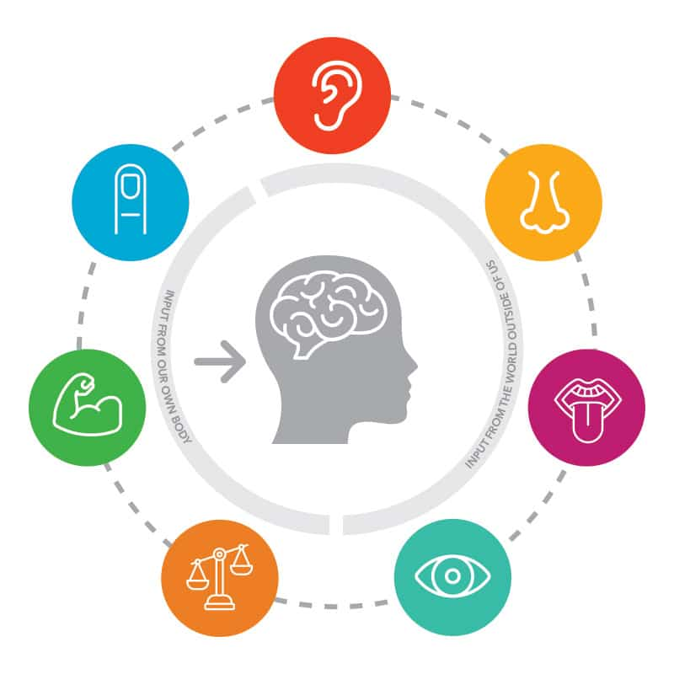
1. Sensory Integration
Utilizing the vestibular (inner ear), visual, and proprioceptive (muscle and joint) systems to gather information about body position and movement.

Slide 17
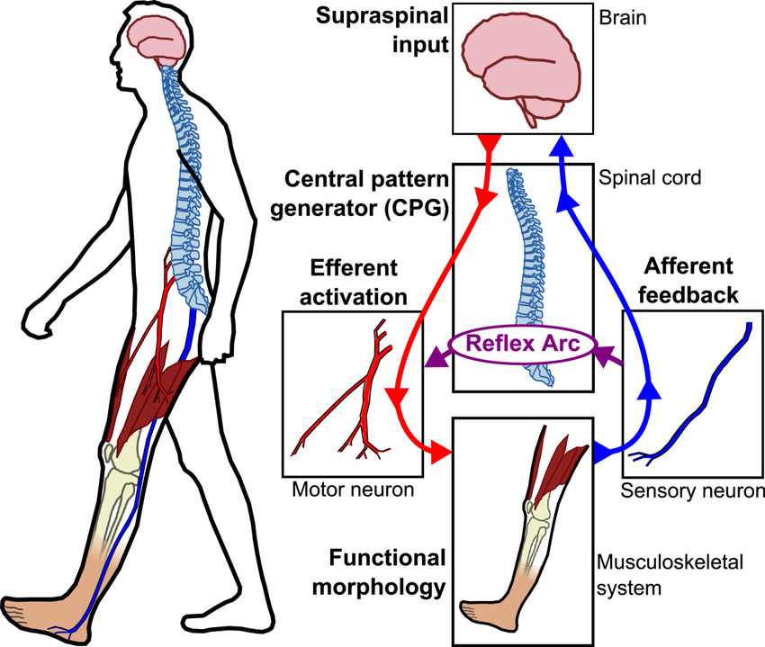
2. Motor Control
The brain coordinates muscle responses to maintain posture and stability.

Slide 18

3. Cognitive Processes
Attention, concentration, and higher-level functions contribute to effective balance management.

Slide 19
Examples of Balance

Slide 20
Static Balance
This involves maintaining equilibrium when not in motion. It requires the body to stay stable while the center of mass remains over the base of support. Examples include standing on one leg or holding a yoga pose.

Slide 21
Examples of static balance

Slide 22
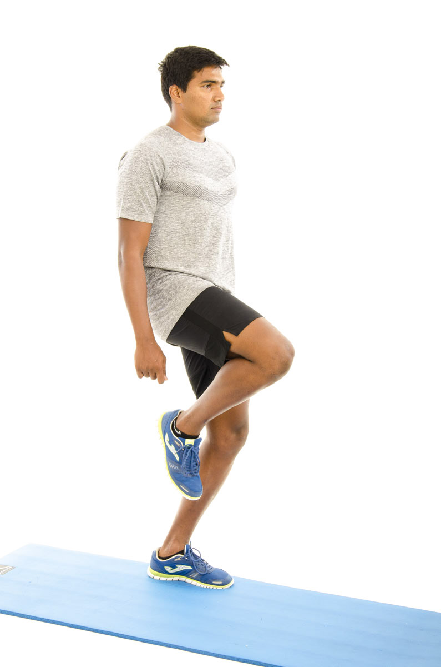
1.Single-Leg Stand
Standing on one leg to improve stability and balance.

Slide 23
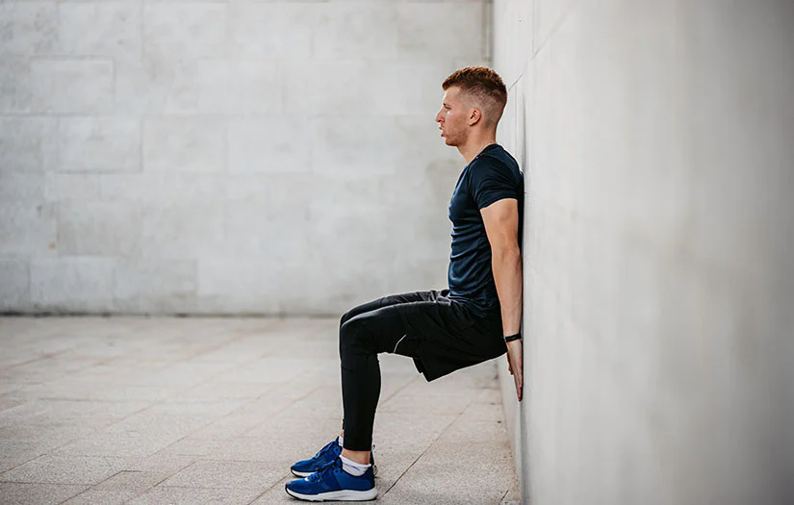
2. Wall Sits
Hold a seated position against a wall to strengthen legs and balance.

Slide 24
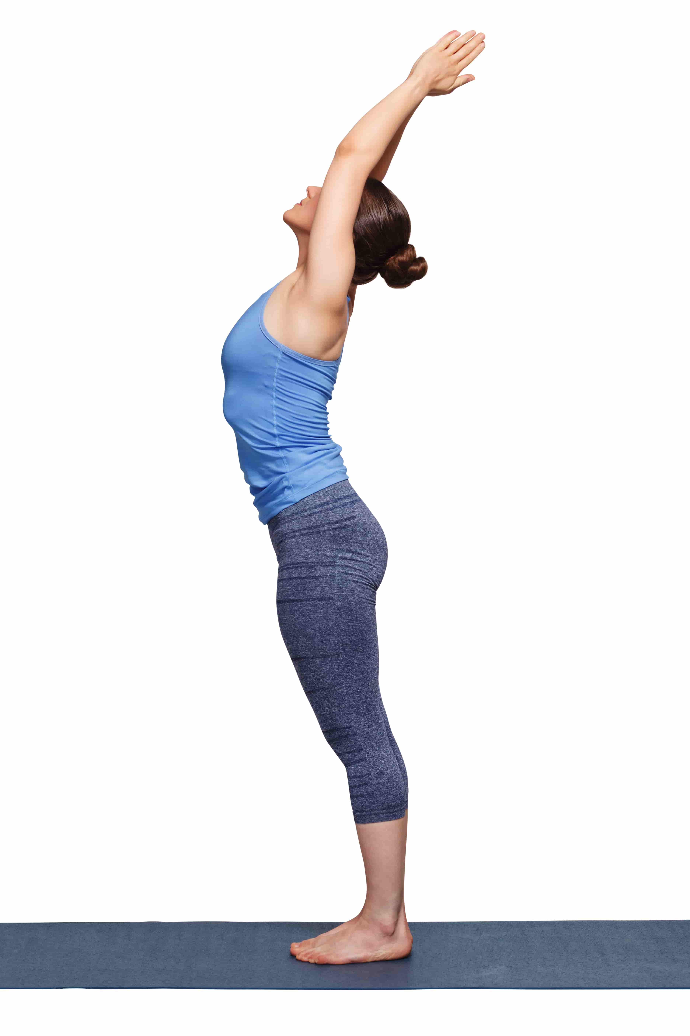
3. Mountain Pose (Tadasana)
Stand with proper posture to enhance balance and stability

Slide 25
Dynamic balance

Slide 26
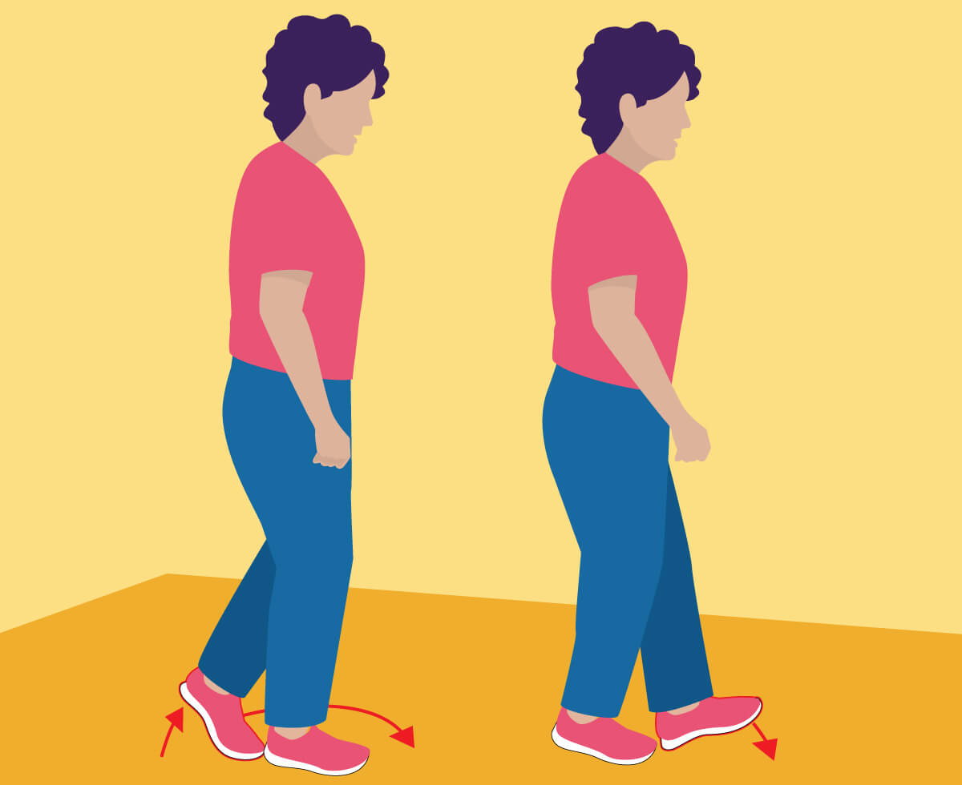
Walking Heel-to-Toe
Walk in a straight line with heel-to-toe placement to challenge balance.

Slide 27
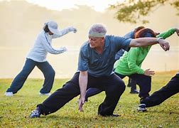
Tai Chi
Perform slow, controlled movements to improve coordination and stability.

Slide 28
Agility Ladder Drills
Use an agility ladder for footwork exercises to enhance dynamic balance.

Slide 29
Balance training with equipment

Slide 30
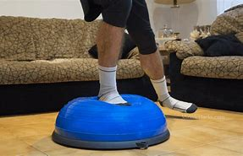
BOSU Ball Exercises
Perform exercises on a BOSU ball to engage stabilizing muscles.

Slide 31

Balance Board Exercises
Use a balance board for activities that challenge stability.

Slide 32
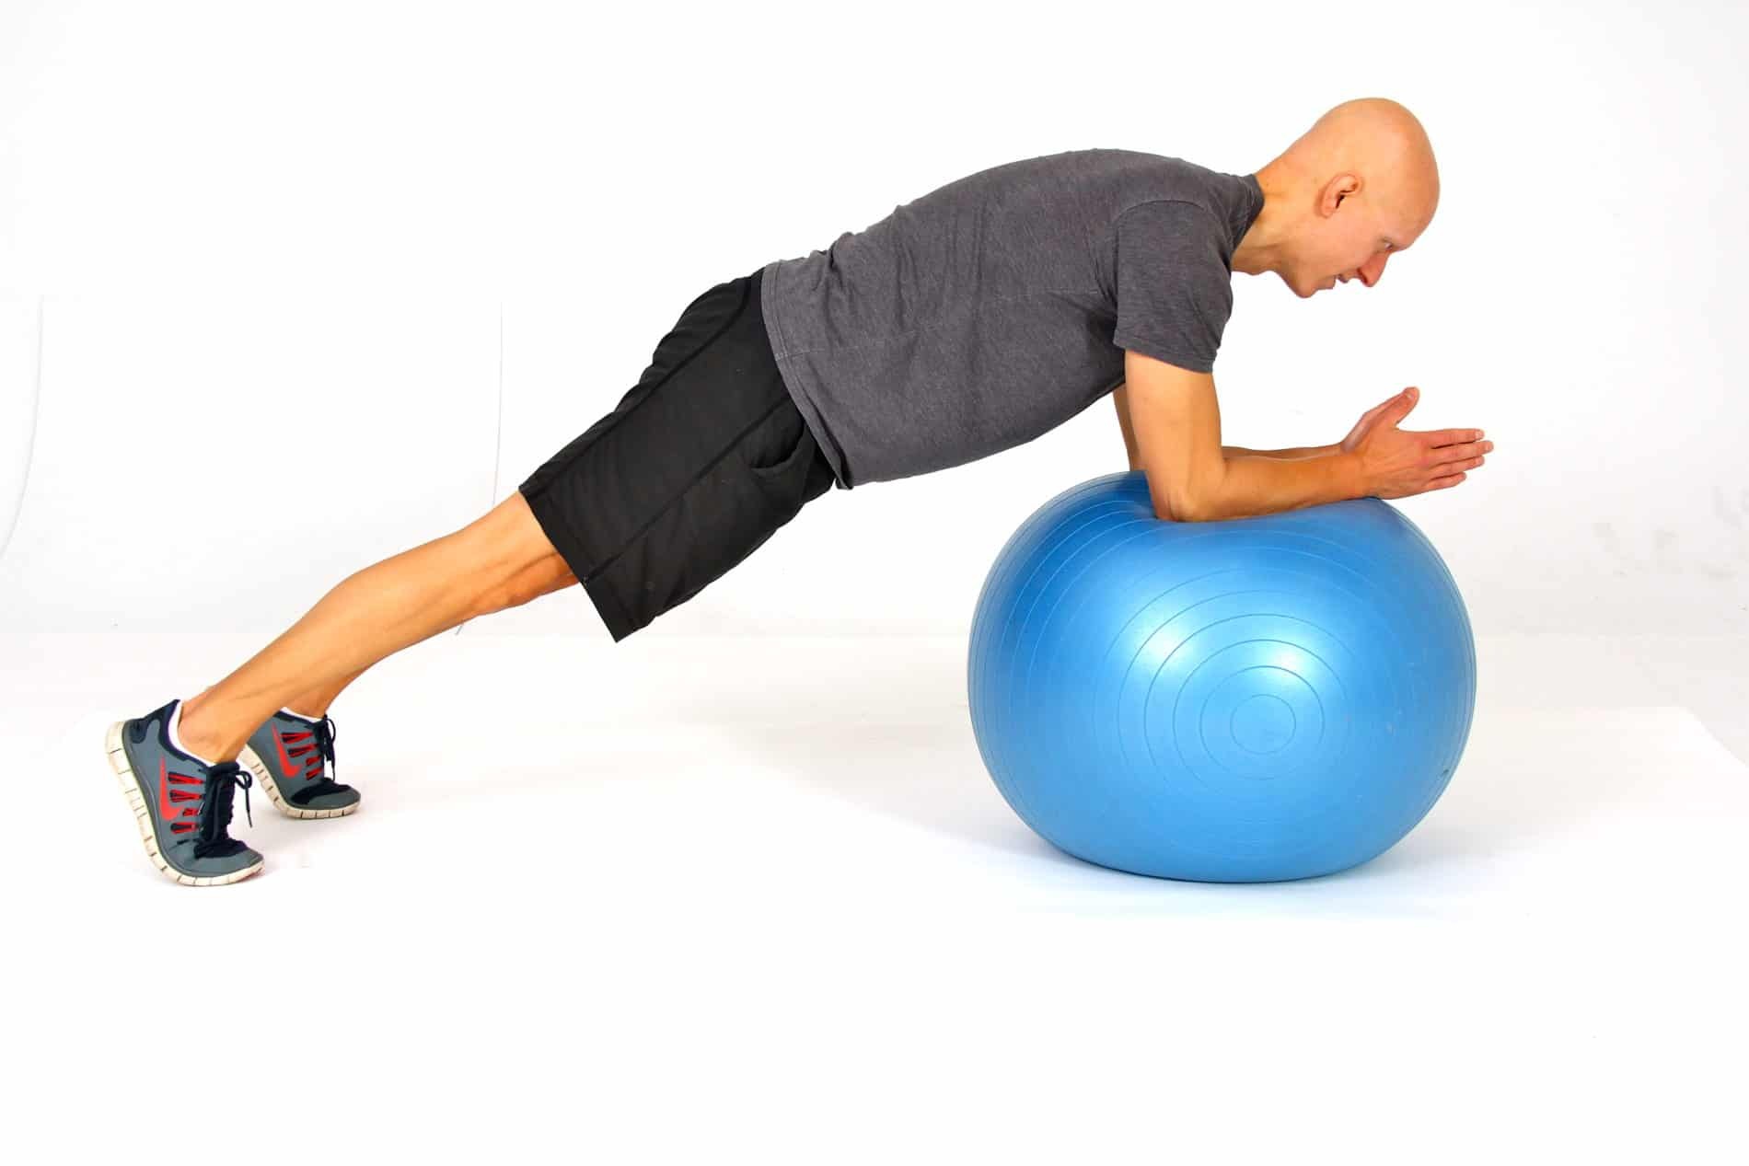
Stability Ball Exercises
Sit on a stability ball during exercises to engage core muscles.

Slide 33
Functional Balance

Slide 34
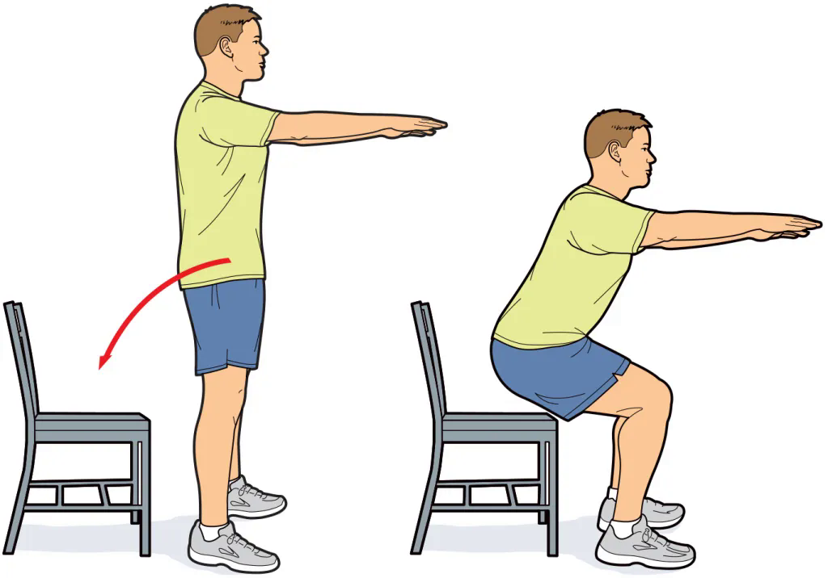
Chair Stand
Stand up from a seated position to mimic real-life movements.

Slide 35
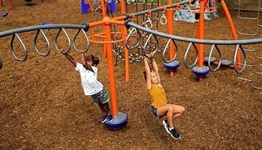
Obstacle Course
Navigate through a course with various elements to improve balance and coordination.

Slide 36
Benefits of Balance Training
1. Improved Stability and Coordination
Strengthens core muscles and enhances neuromuscular coordination.
2. Fall Prevention
Increases proprioception and strengthens lower body muscles to reduce fall risk.
3. Support for Aging
Helps older adults maintain independence and reduces the risk of falls.

Slide 37
4. Enhanced Athletic Performance
Boosts agility, posture, and overall performance in sports.
5. Increased Functional Independence
Eases daily activities and improves mobility.
6. Cognitive Benefits
Enhances mental focus and stimulates brain areas involved in coordination.
7. Better Postural Control
Promotes proper alignment, reducing back and neck pain.

Slide 38
Thank you for listening!!

Slide 39
Group members:
Abdul Mohammad Macadatu (Leader)
Aaron Walter Selga Cyrus Troy Bazar
Dreiko Alvarado Edzhel Caniedo
Ej Tolentino Hays Marayag Jr.
Jay Lloyd Duque Reagan Rhodes
Renz Joshua Serrano Ruben De Vera
Seb Salamin Vince Christoper Sumawang

