Slide 1
Speed and Balance Training
By Abdul and others

Slide 2
Introduction
In this topic, we will discuss speed training, which involves various exercises aimed at helping athletes and Individuals develop explosive power in the lower body. These drills enhance quickness, acceleration, and overall athletic performance. By focusing on proper technique and muscle strength, athletes can improve their speed and agility effectively.

Slide 3
Speed Training
speed training can help you level up your athletic ability by making you faster, stronger, and more agile. There are many different types of speed training, so you can find one that’s right for you.

Slide 4
Velocity based training
Velocity based training is a modern approach to strength training and power training which utilises velocity tracking technology to provide rich objective data as a means to motivate and support real-time adjustments in an athlete's training plan. Typical strength and power programming and periodisation plans[1][2] rely on the manipulation of reps, sets and loads as a means to calibrate training stressors in the pursuit of specific adaptations.

Slide 5
Reaction time
Reaction time is the time taken for a human to respond to an incoming sensory signal.

Slide 6
seven step approach to increase playing speed
brain power
body composition
aerobic speed
overreaching
Muscle function
balance
strenght
Footforce
Nutrition

Slide 7
Techniques for Increasing Playing Speed
1. Gradual Progression
2. Chunking
3. Focus on Accuracy
4. Use of Rhythmic Variations
5. Relaxation

Slide 8
Increase playing speed.
Increasing playing speed is a common goal for musicians, athletes, and other performers aiming to enhance their skill and proficiency. This report explores strategies to effectively increase playing speed, focusing on techniques, practice methods, and considerations for maintaining quality.

Slide 9
Examples of speed Training exercises

Slide 10
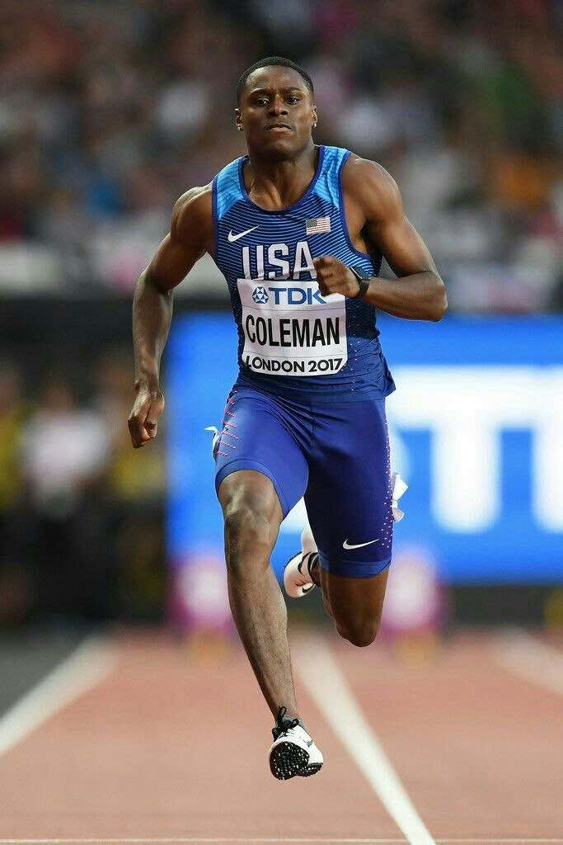
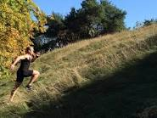
Sprinting
hill-Sprinting

Slide 11
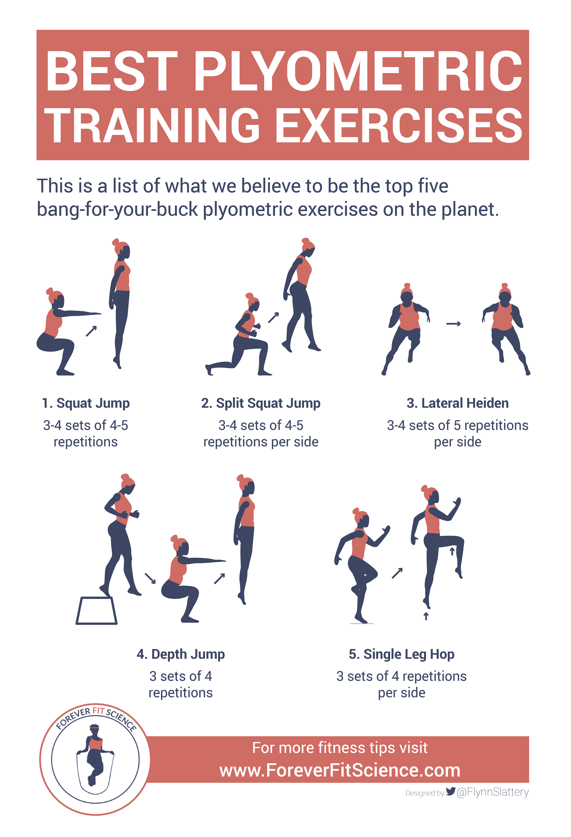
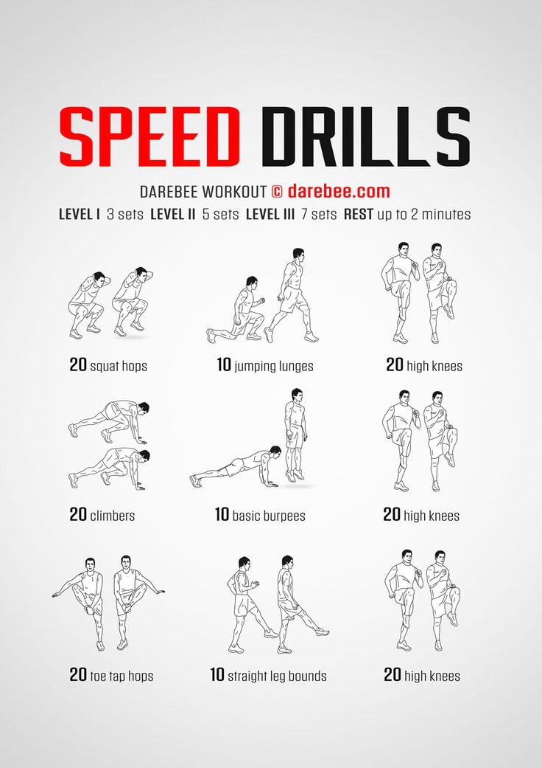
Plyometrics-
Dot Drills

Slide 12
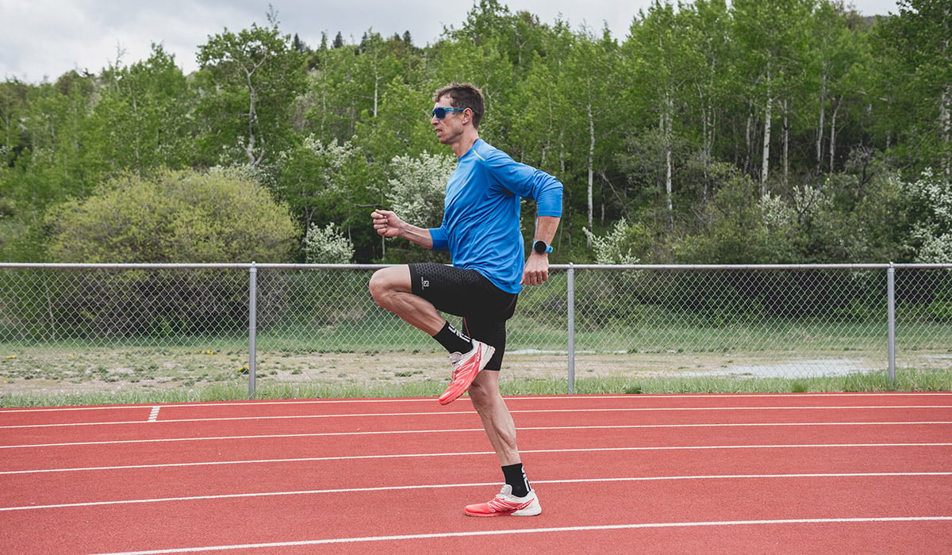
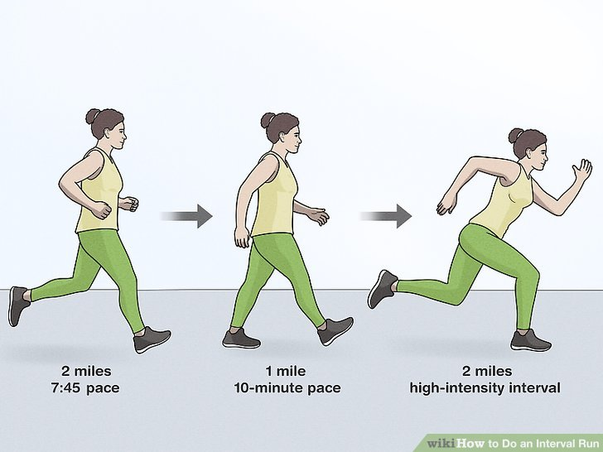
High knees- workout.
Interval Runs-

Slide 13
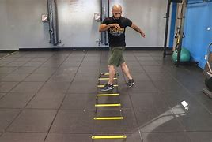
Agility ladder drills

Slide 14
these are the 10 benefits of speed training
1.A Stronger Stride
2.More Muscle
3. Better Fat Burn
4.Reduced Risk of Injury
5. Stronger Bones
6.Improved Running Economy
7.More Anaerobic Endurance
8.Better Balance and Proprioception
9.Improved Agility
10. Easier Strides

Slide 15
so what are the benefits of speed training?
1.A Stronger Stride
Your running speed is determined by stride—specifically, by how far each stride carries you and how fast you can complete it.
2.More Muscle
We begin to lose muscle mass around age 25. The good news is that slow-twitch muscle fibers (a science-y term for “muscle cells”), the ones you rely on most during distance runs, are highly resistant to age-related atrophy.
3. Better Fat Burn
At what pace do you get 100 percent of your energy from fat? It’s a trick question because the answer is this: You burn 100 percent fat while standing still after a sprint, resistance exercise, or other high-intensity effort. When you jog, only about 70 percent of your energy comes from fat. During a distance run, it’s about 50 percent. At mile pace and faster, you use 100 percent carbs for energy. But after those high-intensity efforts, your body spares carbs by using 100 percent fat to resupply your first-response anaerobic system and to fuel recovery.
4.Reduced Risk of Injury
That’s right. Training for speed doesn’t increase the risk of injury; it reduces it—if you do it right. Speed training puts your muscles through a fuller range of motion, improving flexibility. It trains more muscles (and more muscle fibers within muscles), leading to better muscle balance.
5. Stronger Bones and Other Connective Tissues Just like muscle, bones and tendons are living tissue so they respond to training by getting stronger.

Slide 16
Balance Training

Slide 17
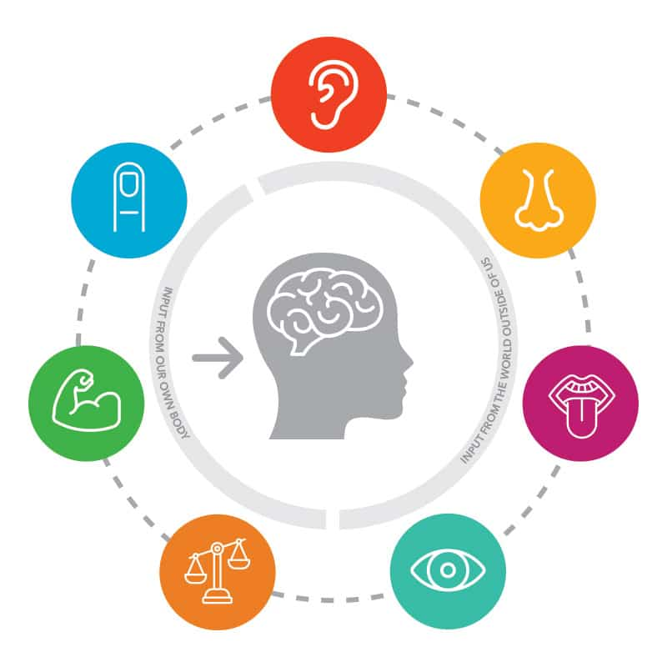
1. Sensory Integration
Utilizing the vestibular (inner ear), visual, and proprioceptive (muscle and joint) systems to gather information about body position and movement.

Slide 18
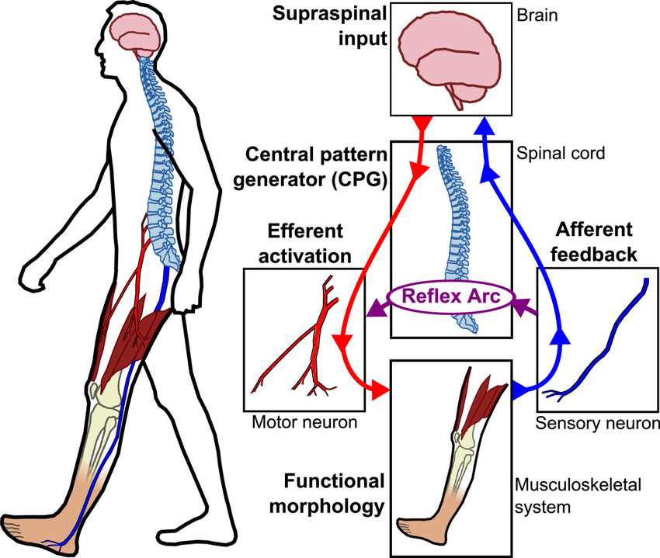
2. Motor Control:
The brain coordinates muscle responses to maintain posture and stability.

Slide 19

3. Cognitive Processes
Attention, concentration, and higher-level functions contribute to effpective balance management.

Slide 20
Static Balance

Slide 21
This involves maintaining equilibrium when not in motion. It requires the body to stay stable while the center of mass remains over the base of support. Examples include standing on one leg or holding a yoga pose.

Slide 22
examples

Slide 23
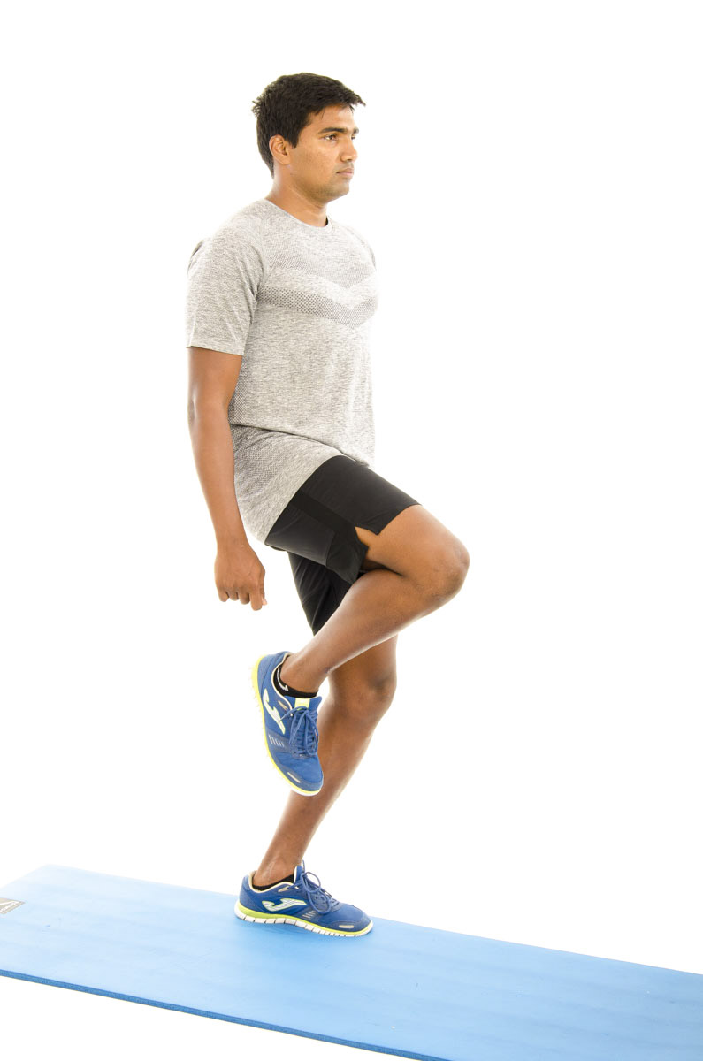
Single-Leg Stand
Stand on one leg to improve stability.

Slide 24
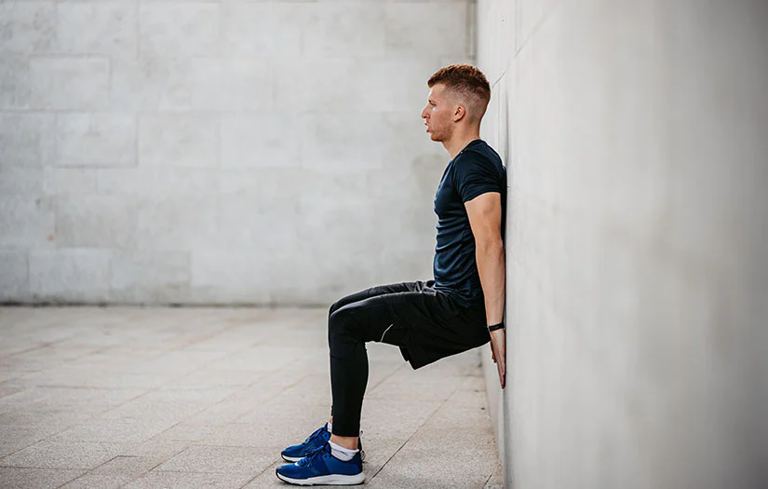
Wall Sits:
Hold a seated position against a wall to strengthen legs and balance.

Slide 25
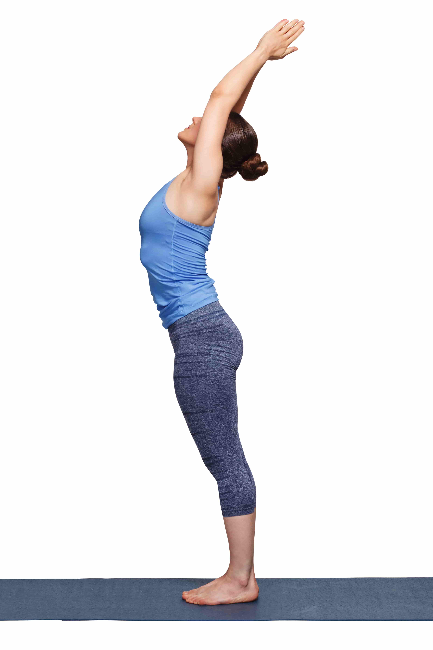
Mountain Pose (Tadasana)
Stand with proper posture to enhance balance and stability

Slide 26
Next: Dynamic balance

Slide 27
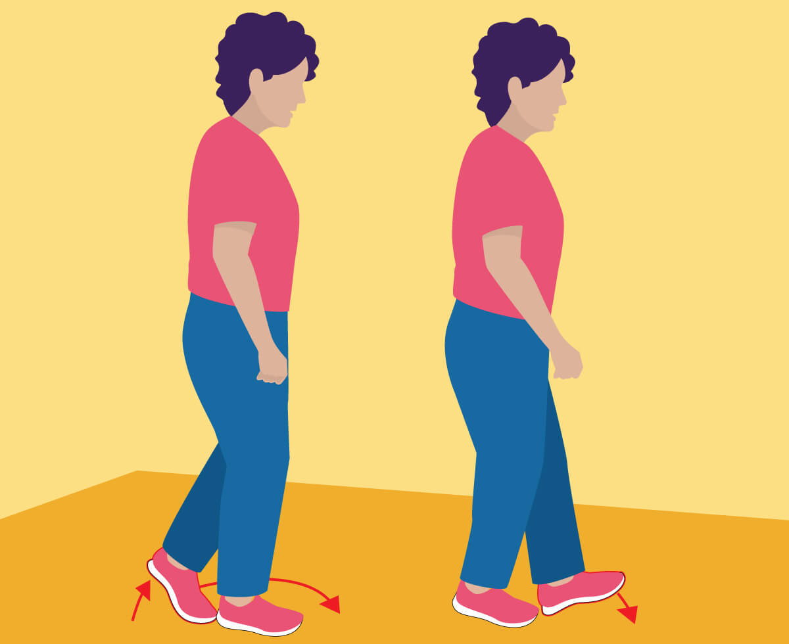
Walking Heel-to-Toe
Walk in a straight line with heel-to-toe placement to challenge balance.

Slide 28
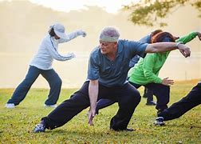
Tai Chi
Perform slow, controlled movements to improve coordination and stability.
example of tai Chi Exercise

Slide 29
Agility Ladder Drills
Use an agility ladder for footwork exercises to enhance dynamic balance.

Slide 30
Next: Balance training with equipment

Slide 31
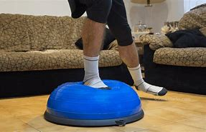
BOSU Ball Exercises:
Perform exercises on a BOSU ball to engage stabilizing muscles.

Slide 32

Balance Board Exercises
Use a balance board for activities that challenge stability.

Slide 33
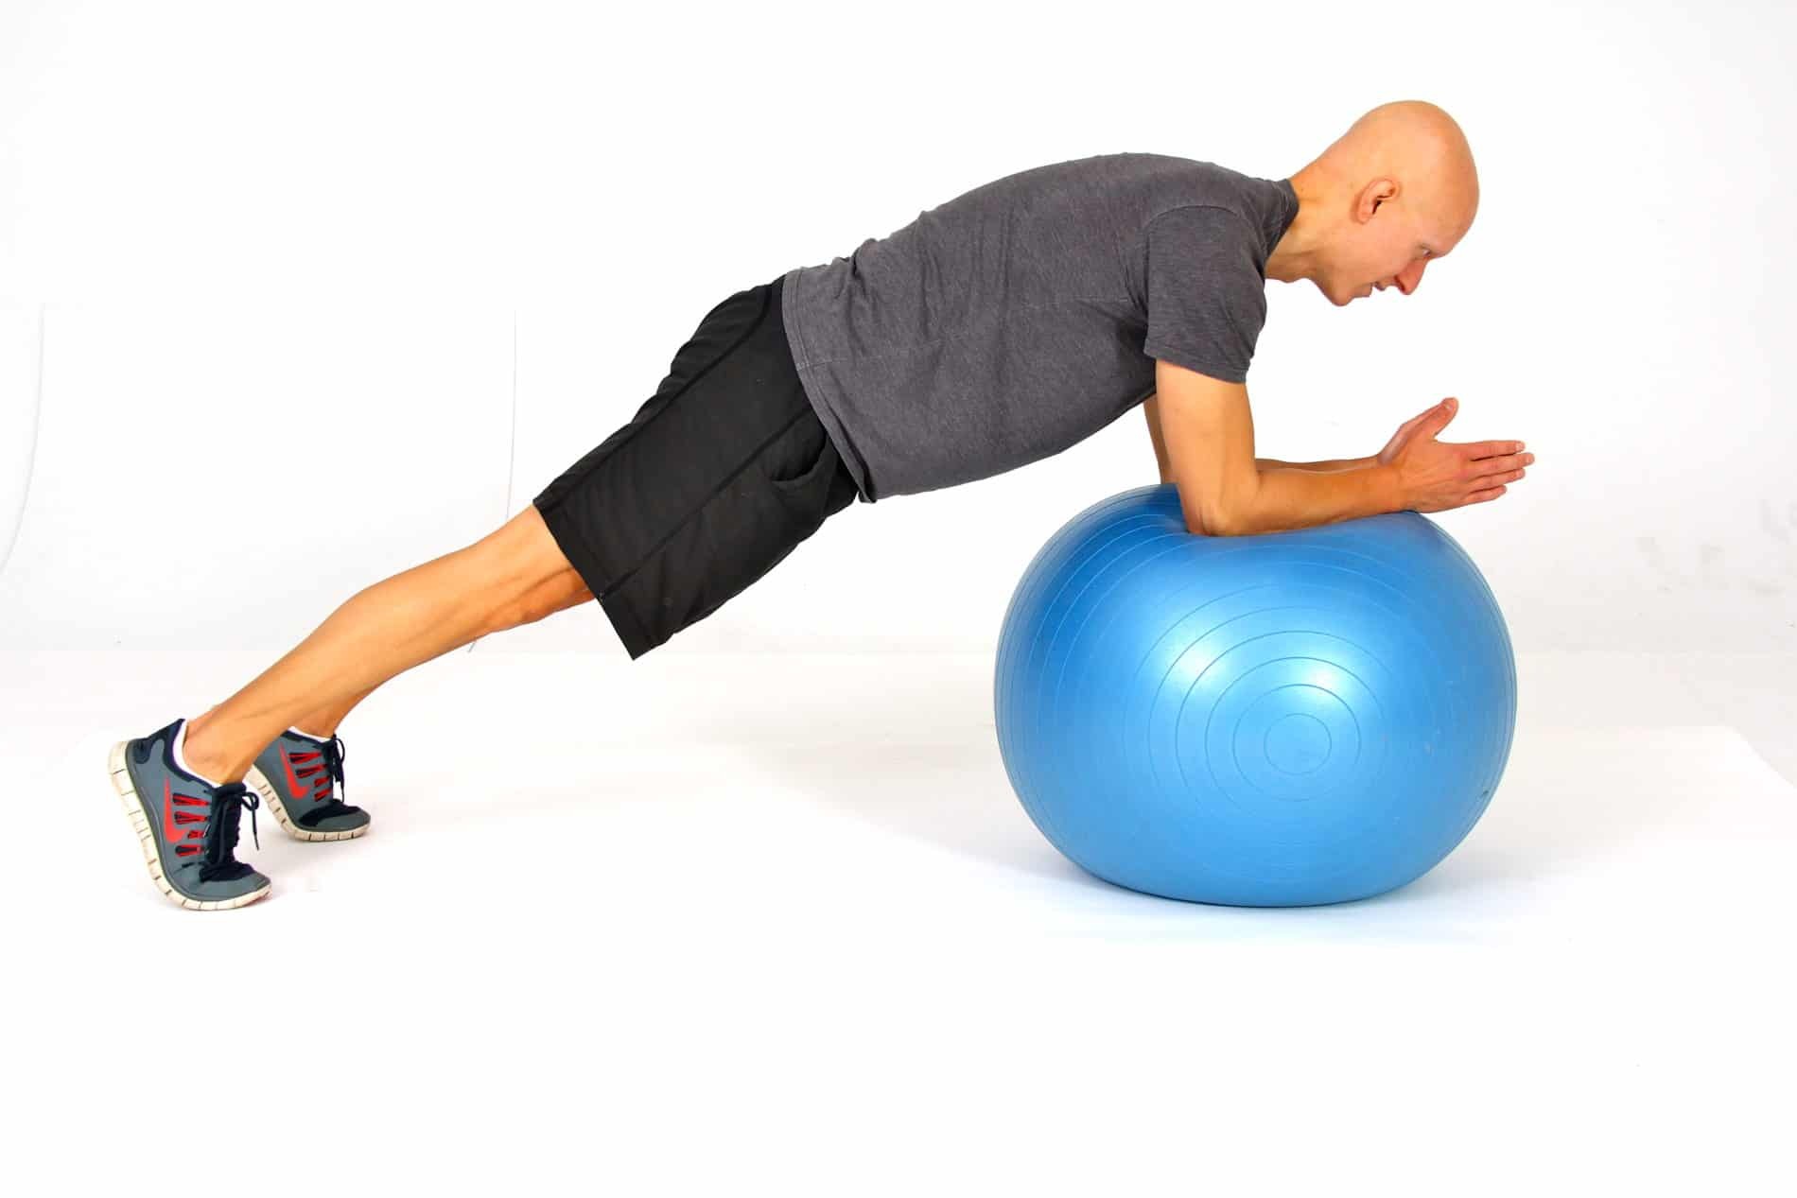
Stability Ball Exercises
Sit on a stability ball during exercises to engage core muscles.

Slide 34
Next: Functional Balance

Slide 35
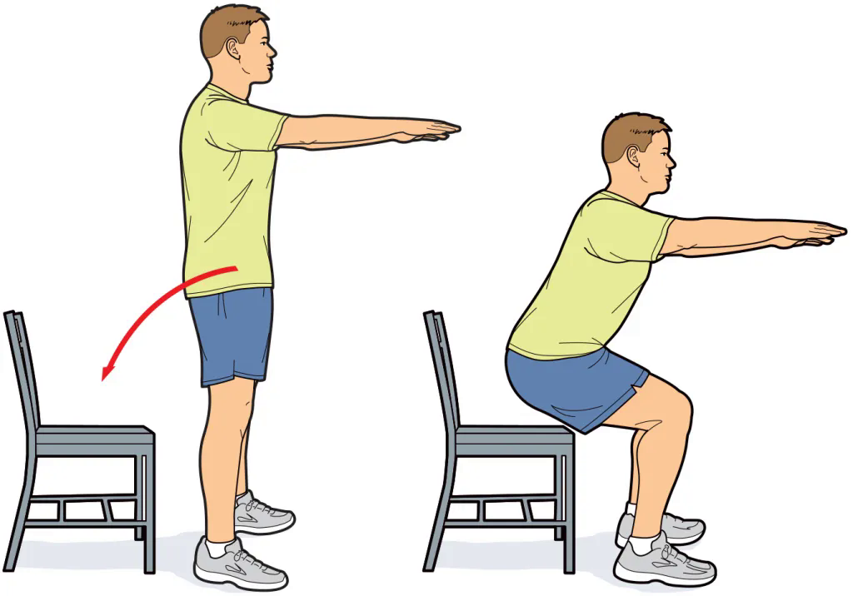
Chair Stand
Stand up from a seated position to mimic real-life movements.

Slide 36
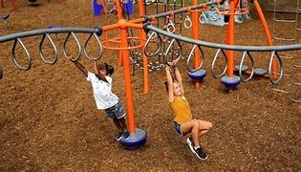
Obstacle Course
Navigate through a course with various elements to improve balance and coordination.

Slide 37
Benefits of Balance Training:
1. Improved Stability and Coordination: Strengthens core muscles and enhances neuromuscular coordination.
2. Fall Prevention: Increases proprioception and strengthens lower body muscles to reduce fall risk.
3. Support for Aging: Helps older adults maintain independence and reduces the risk of falls.

Slide 38
Benefits of Balance Training:
4. Enhanced Athletic Performance: Boosts agility, posture, and overall performance in sports.
5. Increased Functional Independence: Eases daily activities and improves mobility.
6. Cognitive Benefits: Enhances mental focus and stimulates brain areas involved in coordination.
7. Better Postural Control: Promotes proper alignment, reducing back and neck pain.

Slide 39
thank you for listening!!
Members:
Aaron Walter Selga
Cyrus Troy Bazar
Dreiko Alvarado
Edzhel Caniedo
Ej Tolentino
HAyst Marayag Jr.
Jay Lloyd Duque
Mohammed Macadatu - Abu sayaf
Reagan Rhodes
Renz Joshua Serrano
Ruben De Vera
Seb Salamin
Vince Christoper Sumawang

Slide 40
thank you for listening!!
https://github.com/troy600/DSA/blob/main/speedandtraining.pptx
(reviewer)
/\
/ \
/\ \
/ > ω < \
/ __ \
/ __| |__ -\
/_-'' ''-_\

