Slide 1

Best Buy Project Week
Team Name: Randy’s Angels
Team Members: Troy Allen, Sam Courson, Andrew Crawford, Mark Ramirez

Slide 2
The Power of AutoML
AutoML: The process of applying machine learning models to real-world problems using automation (TechTarget.com)
Microsoft Azure Automated ML
"From $346.2 million in 2020, the automated machine learning market is predicted to reach $14,830.8 million by 2030." (BusinessWire.com)

Slide 3
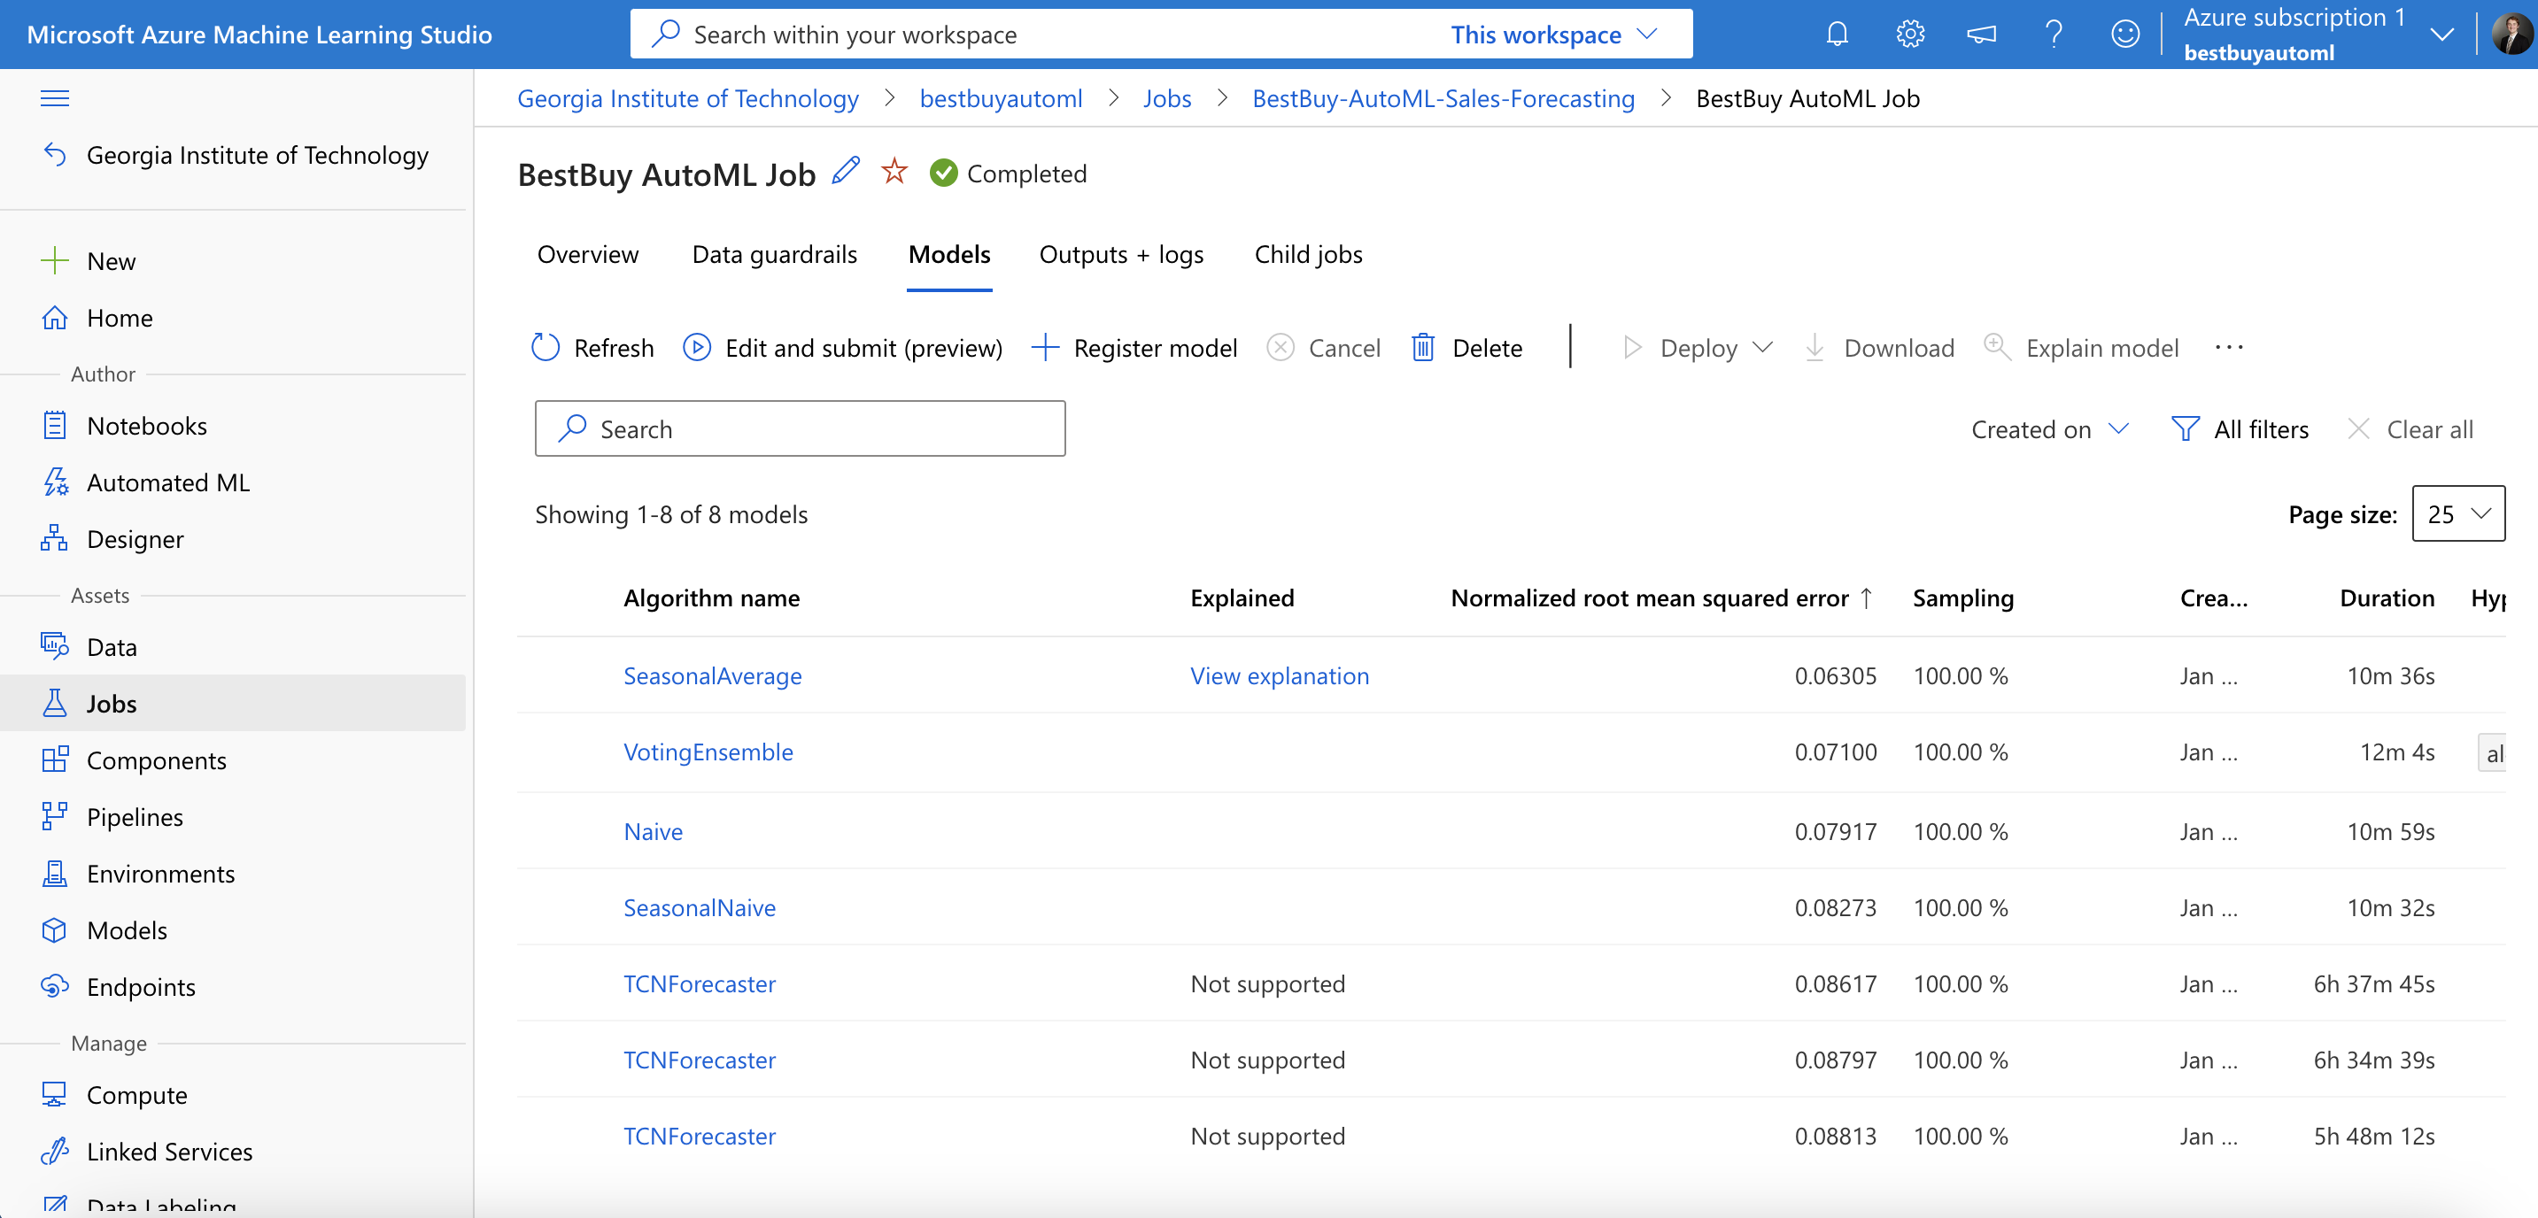
Azure’s Automated ML Interface

Slide 4
An Attempt at SARIMA Modeling
As informed by AutoML, first attempt to model the data was a SARIMA model
SARIMA is an extension of ARIMA that handles seasonality in time-series data
SARIMA’s library (statsmodels) was causing our code to error out due to lack of memory or a bug in the library

Slide 5
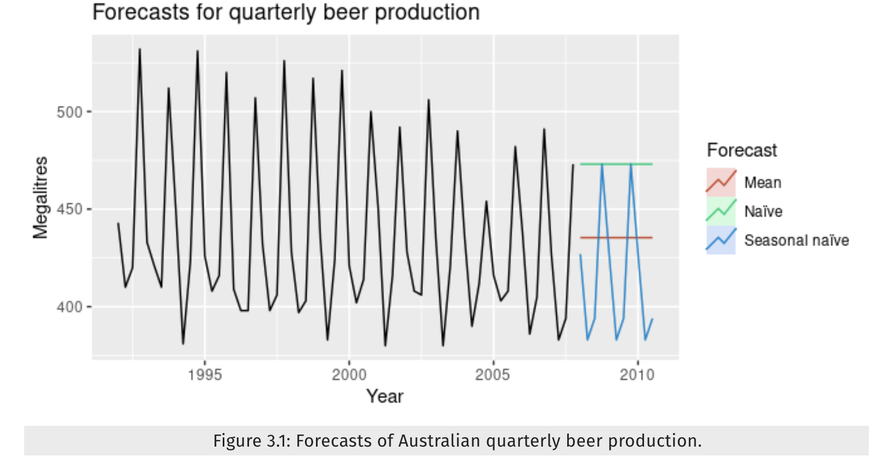
A Maneuver to Naïve Modeling
Seasonal Naïve modeling sets each forecast to be equal to the last observed value from the same season

Slide 6
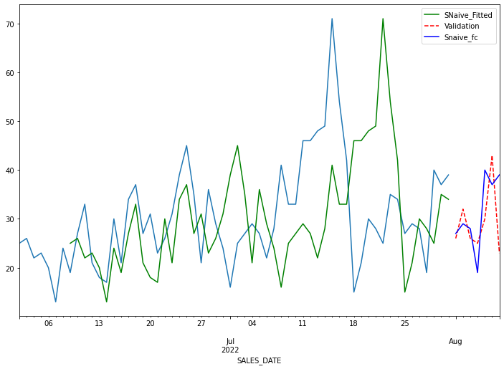


Seasonal Naïve Results
Total RMSE: 1367.19 units
Average RMSE: 2.53 per SKU
Runtime: 128 seconds
SKU 144

Slide 7
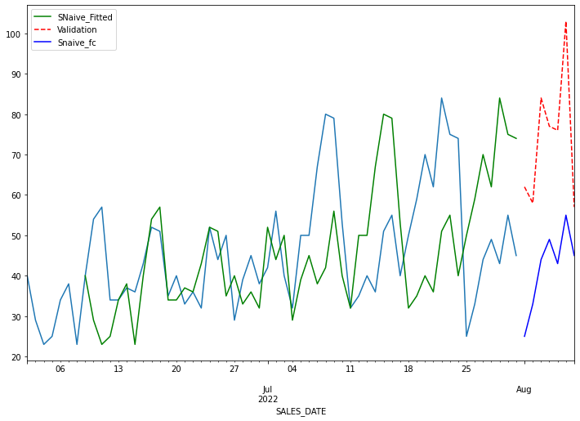
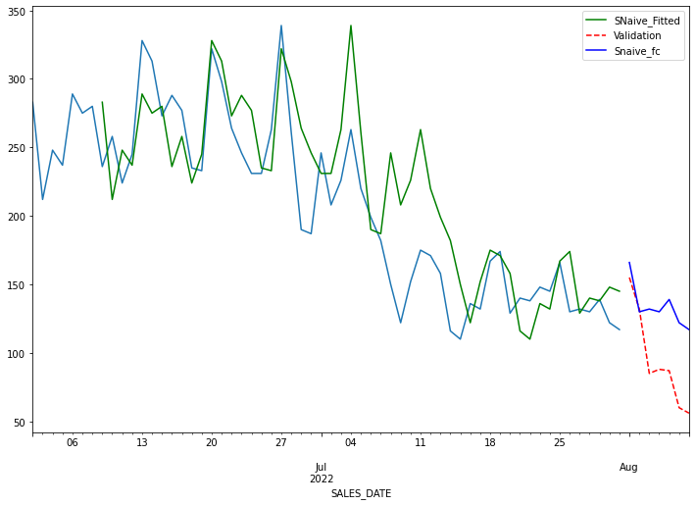
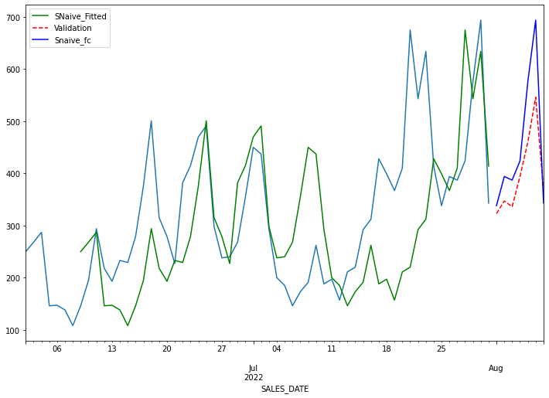
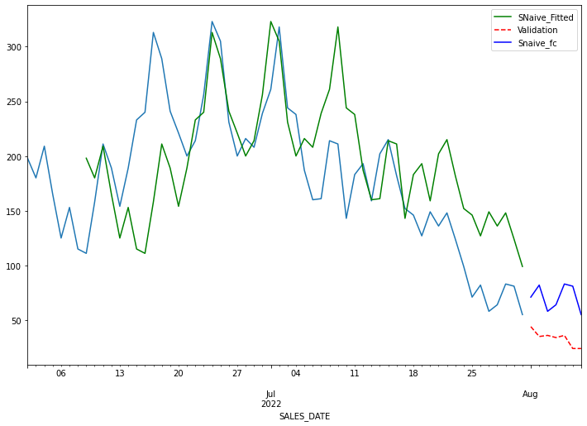

Drivers of Error
Naïve Fitted
Validation
Forecasted
SKU 50
SKU 430
SKU 469
SKU 557
Notes:
.

Slide 8

Conclusion
Computing power restrictions and the switch to a Seasonal Naïve model
Taking a more high-level approach
Heteroskedasticity across the SKU's
Variance or lack of data within DAILY_UNITS
Insights related to RMSE
Promotions and competitor pricing information leading to increases in RMSE
Value in utilizing the validation set

Slide 9
References
Kperry2215. (2020, January 4). Time Series Forecasting Using a Seasonal ARIMA Model: A Python Tutorial. Tech Rando. https://techrando.com/2020/01/04/time-series-forecasting-using-a-seasonal-arima-model/
Pawar, S. (2020, April 21). Time series Forecasting in Python & R, Part 2 (Forecasting ). GitHub. https://pawarbi.github.io/blog/forecasting/r/python/rpy2/altair/fbprophet/ensemble_forecast/uncertainty/simulation/2020/04/21/timeseries-part2.html#Seasonal-Naive
Notes:
Needs to be reformatted

Slide 10

Questions?

Slide 11
Thank you!
Contributors
Troy Allen | tallen94@gatech.edu
Samuel Courson | scourson6@gatech.edu
Andrew Crawford | acrawford65@gatech.edu
Mark Ramirez | mramirez65@gatech.edu

