Slide 1
ERSPAN
Troy D. Hanson
22 Feb 2019
101

Slide 2
What is ERSPAN?
A way to send a tap over an IP-routed network
ERSPAN: Encapsulated Remote SPAN
The switch puts an extra triple-header on each packet
The receiver can decode the ERSPAN header to get extra packet context

Slide 3
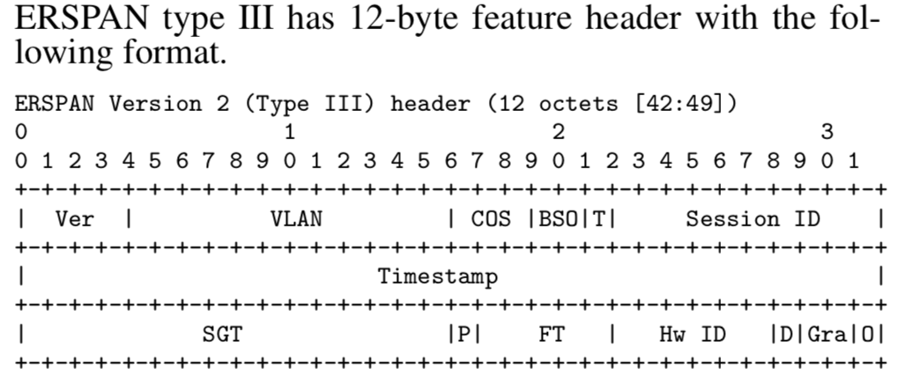
Encapsulation adds a new triple header…
An IP header… then a GRE header … then an ERSPAN header
20+ bytes
8+ bytes
12+ bytes
Two versions,
Version 1 ←→ Type II
Version 2 ←→ Type III

Slide 4
1) IP header
Source: IP of the sending switch
Destination: IP of the recipient host
The source IP will be on a specific non-management interface on the switch

Slide 5
2) GRE header
GRE min header size is 4 bytes. ERSPAN requires Sequence Number option, so 8+ bytes
For ERSPAN type II, the GRE’s next protocol type is 0x88BE with 8-byte ERSPAN header size, and for ERSPAN type III, the GRE’s next protocol type is 0x22EB with 12-byte ERSPAN header size, if no optional subheader enabled

Slide 6
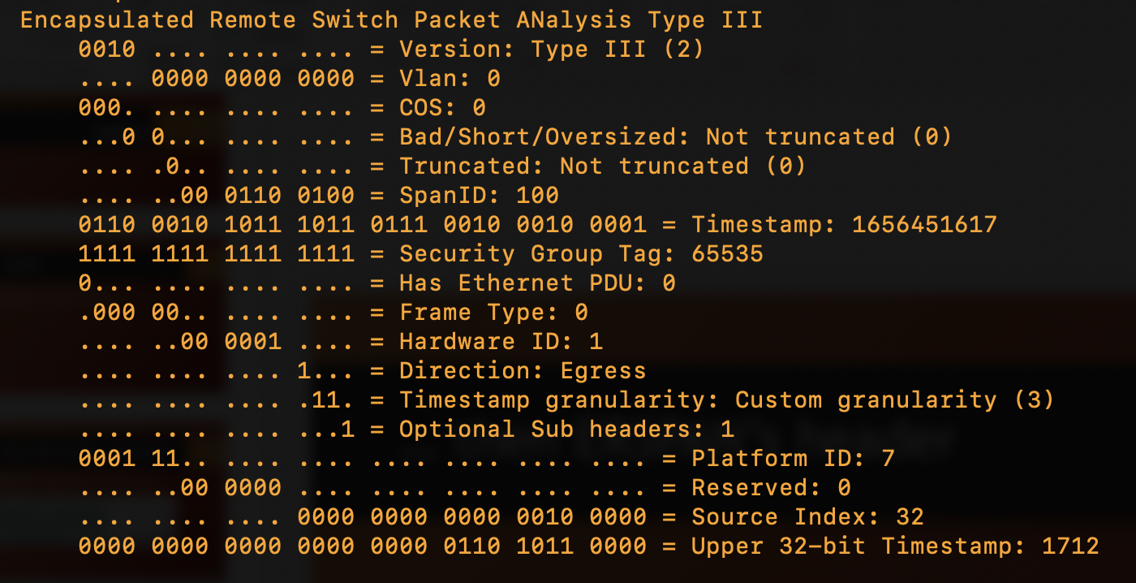
3) ERSPAN header
The purpose of the ERSPAN header
is to convey extra context about the packet
Wireshark/tshark displays these fields
giving extra context for analysis

Slide 7
Test rig
Two hosts “A” and ”B” talking on an isolated VLAN
A
B
enp5s0f1
10.0.0.1
Eth1/1
Eth1/2
enp1s0f0
10.0.0.2
Switch
Eth1/64
10.10.10.1
ERSPAN
enp1s0f1
10.10.10.2
With ERSPAN on a separate interface

Slide 8
Setup ERSPAN on Cisco: VRF
First, set up VRF to establish an L3 domain on the switch
And assign the egress NIC to that VRF with the desired IP
nexus9k(config)#
vrf context lab-erspan
exit
nexus9k(config)#
int Eth1/64
no switchport
vrf member lab-erspan
ip address 10.10.10.1/24
no shut
exit

Slide 9
Setup ERSPAN on Cisco: monitor session
Set up ERSPAN
nexus9k(config)# mon ses 2 type erspan-source
nexus9k(config-erspan-src)# erspan-id 100
nexus9k(config-erspan-src)# vrf lab-erspan
nexus9k(config-erspan-src)# destination ip 10.10.10.2
nexus9k(config-erspan-src)# source int Eth1/1 both
nexus9k(config-erspan-src)# header-type 3
nexus9k(config-erspan-src)# no shut
nexus9k(config-erspan-src)# end
nexus9k(config)# monitor erspan origin ip-address 10.10.10.1 global

Slide 10
Setup ERSPAN on Cisco: check success
nexus9k# sh mon ses all
session 2
---------------
type : erspan-source
version : 3
state : up
erspan-id : 100
vrf-name : lab-erspan
acl-name : acl-name not specified
ip-ttl : 255
ip-dscp : 0
destination-ip : 10.10.10.2
origin-ip : 10.10.10.1 (global)
source intf :
rx : Eth1/1
tx : Eth1/1
both : Eth1/1
source VLANs :
rx :
tx :
both :
filter VLANs : filter not specified
source fwd drops :
marker-packet : disabled
packet interval : 100
packet sent : 0
packet failed : 0
egress-intf : Eth1/64

Slide 11
ERSPAN: Receiving system
Is it arriving at all?
tcpdump –i enp1s0f1 “proto gre”

Slide 12
ERSPAN: Receiving system
Inspect it using tshark to decode ERSPAN header
tshark –i enp1s0f1 -VVV

Slide 13
ERSPAN: Receiving system - Decapsulation
CAVEAT: this method is not yet producing expected output on Ubuntu 18 test system
Decapsulate it using Linux kernel with iproute2
sudo ip link add dev ers1 type erspan seq \
local 10.10.10.2 remote 10.10.10.1 \
erspan_ver 2 erspan 100 key 0
ip link set dev ers1 up
Requires kernel 4.14
See http://vger.kernel.org/lpc_net2018_talks/erspan-linux.pdf
Creates a netdev called ers1
Now try tcpdump –i ers1

Slide 14
ERSPAN: Decapsulation using respan
”respan” is part of fluxcap repository
http://github.com/troydhanson/fluxcap
respan –-from erspan –-to pcap:/dir
It wild cards all the incoming fields (key, version, remote sender)

