Slide 1
AetherMail
the highly simplified mailing system

Slide 2
AetherMail WebApp is essentially a simplified version of a mailing system.
As in the case of any other mailing service, it has the Inbox, Sent and Trash folders and allows the user to quickly compose and send mails.
The user can easily set up an account and start conversing with fellow AetherMail users.

Slide 3
The AetherMail WebApp can be found at
http://hotwingsfromtroy.pythonanywhere.com/

Slide 4
Individual contributions
Jayadev :
- Created the Django backend
- Created UI based on pre-existing code
- Got final application hosted on pythonanywhere

Slide 5
A look at the UI...

Slide 6
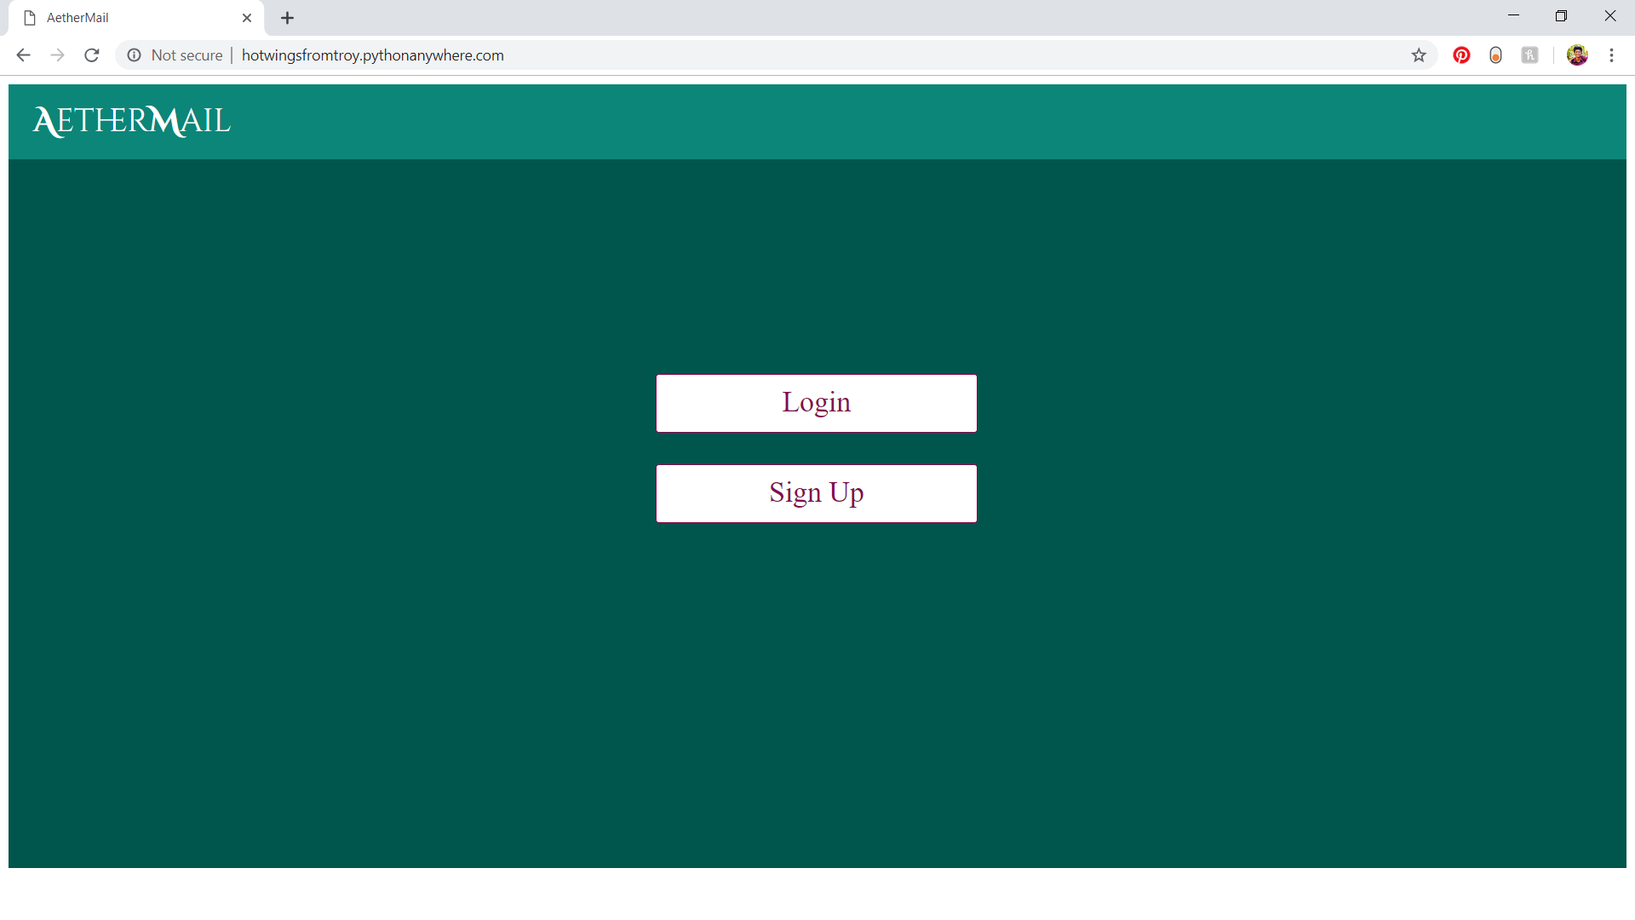

Slide 7
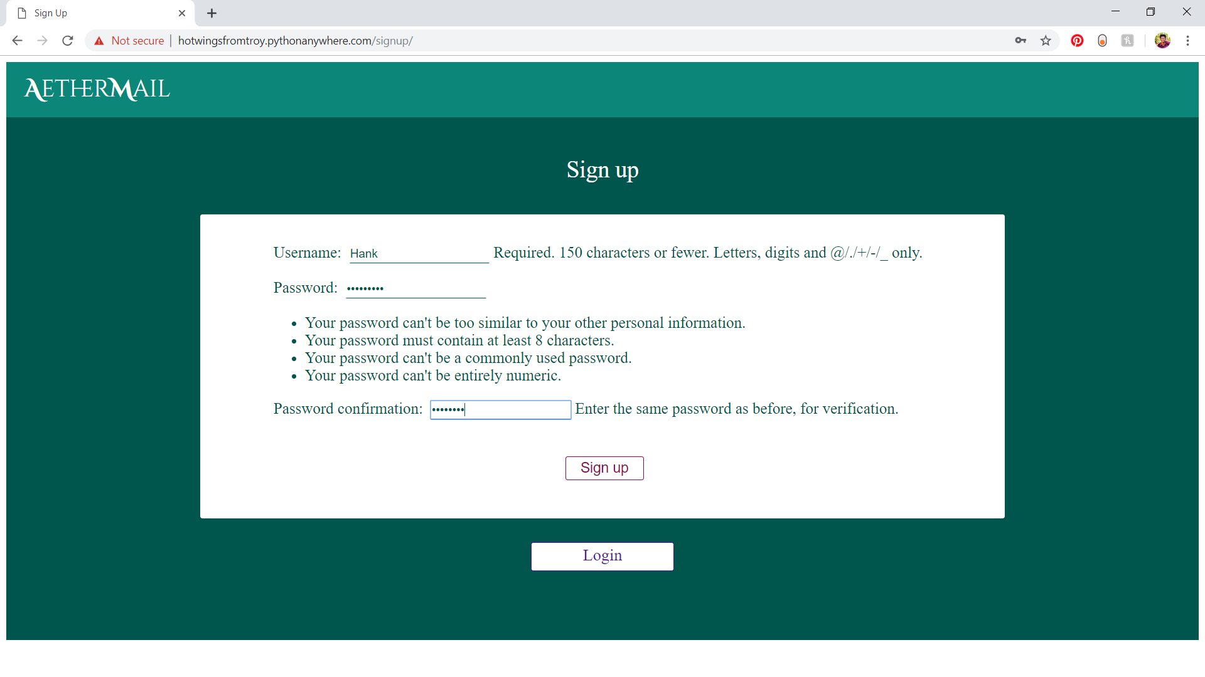

Slide 8
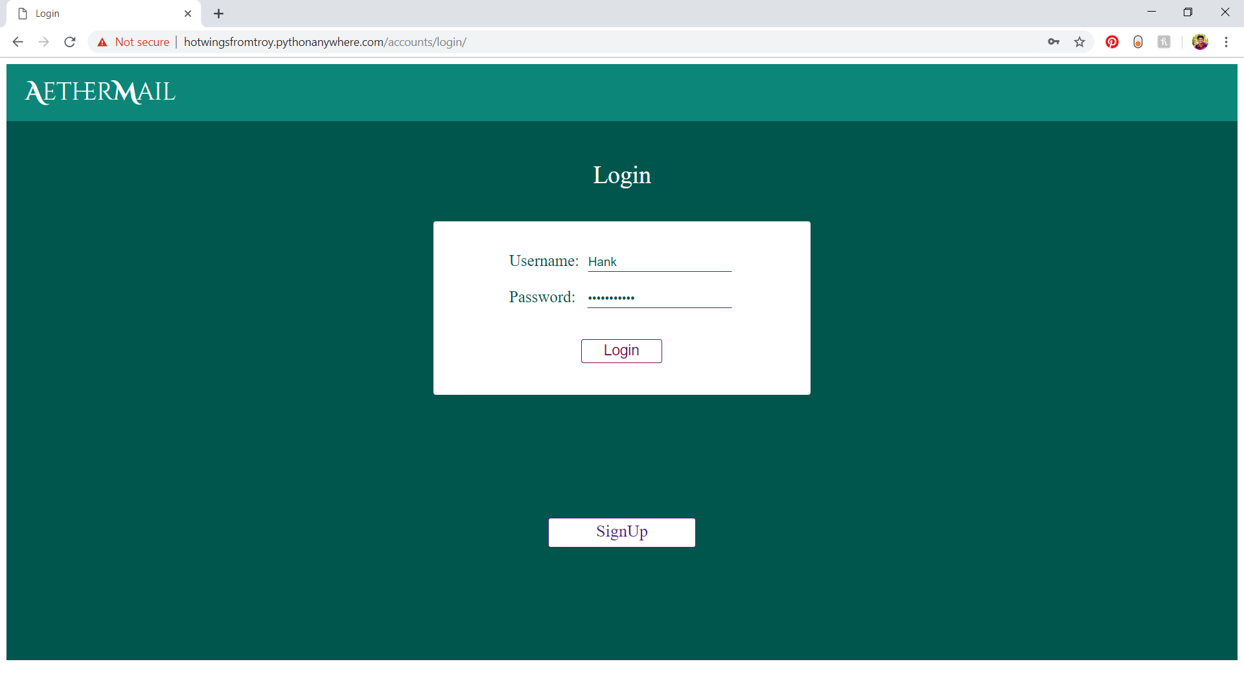

Slide 9
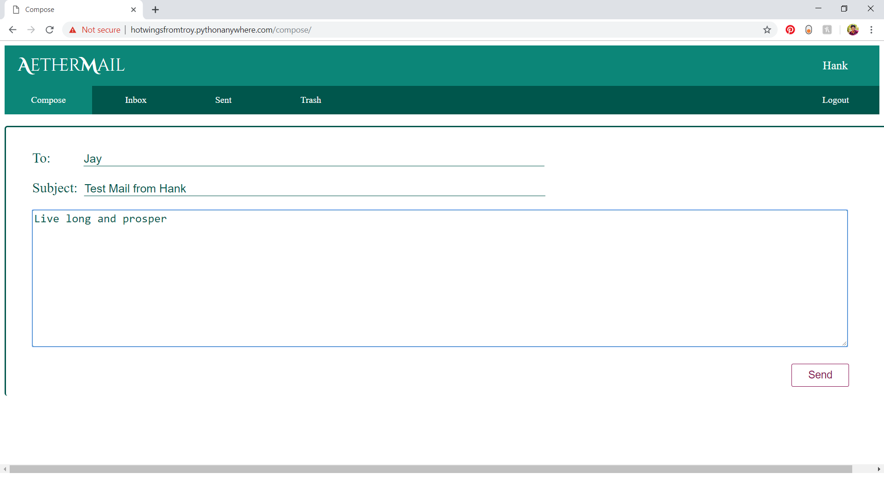

Slide 10
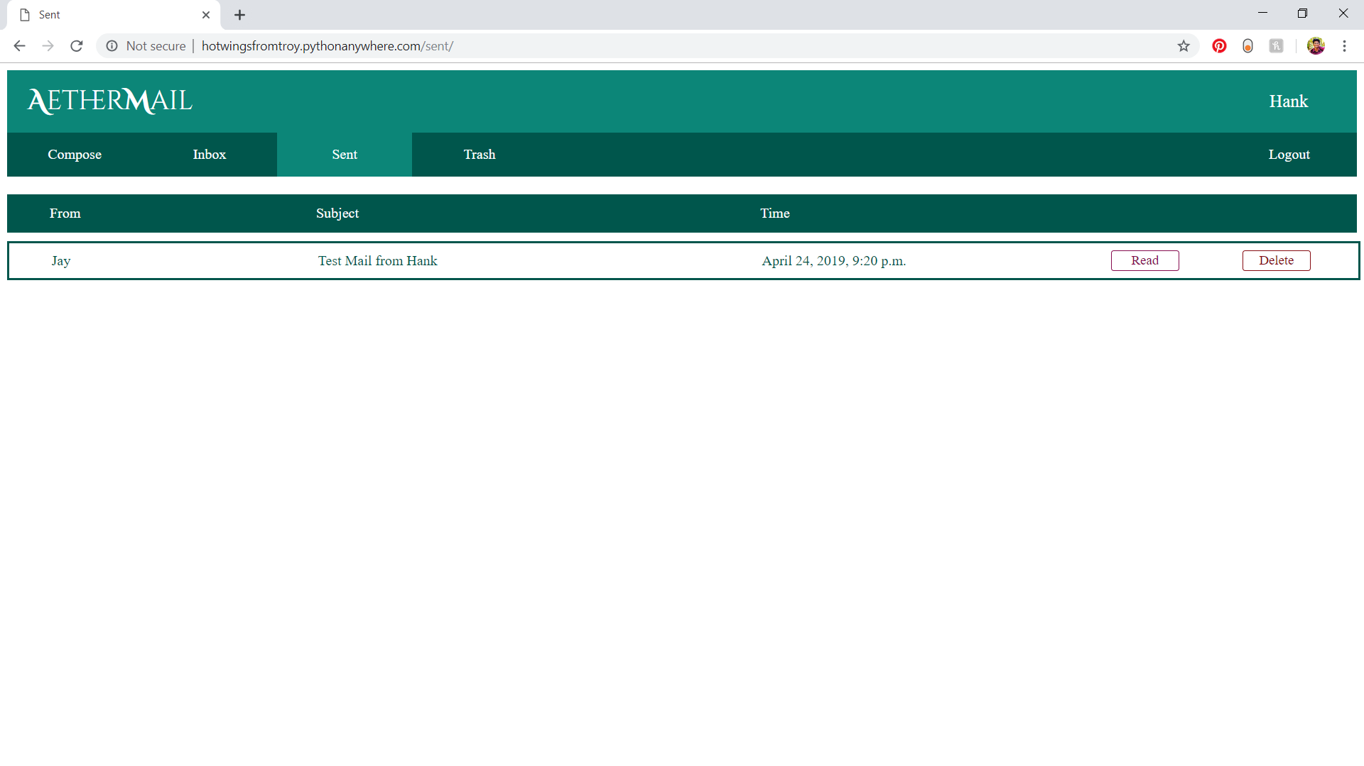

Slide 11
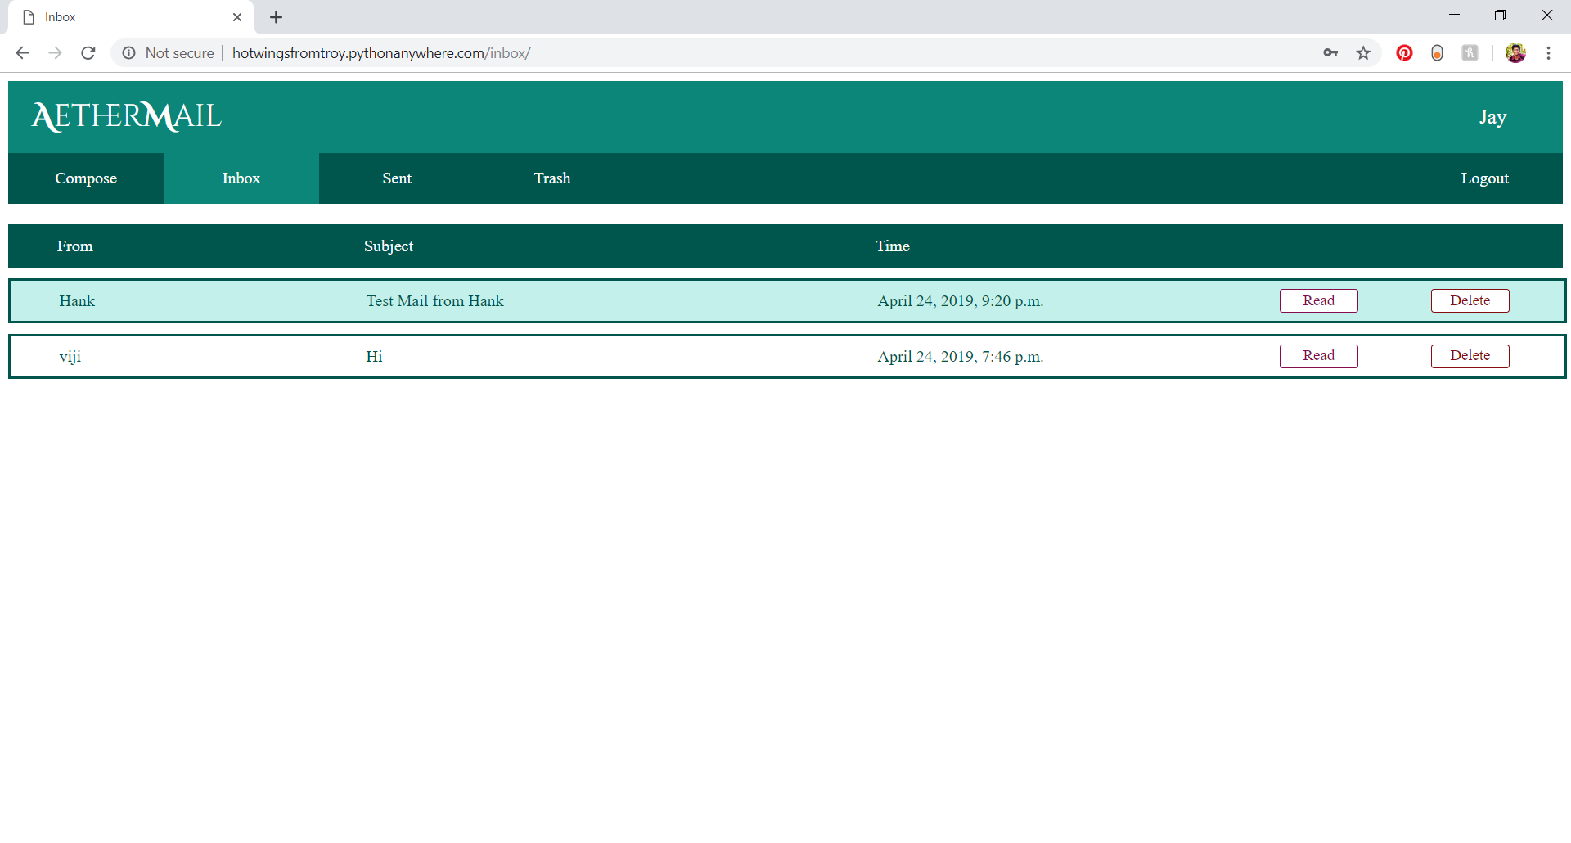

Slide 12
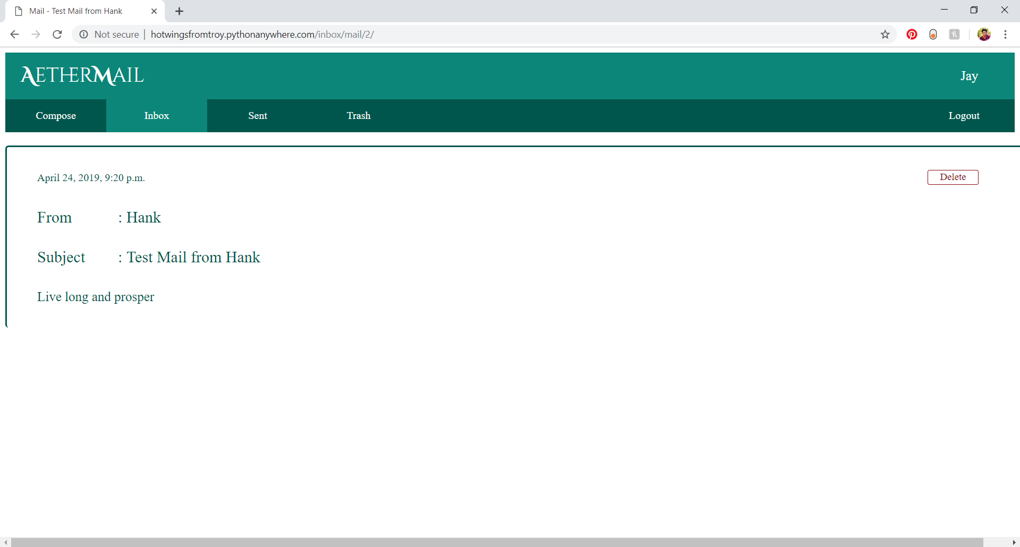

Slide 13
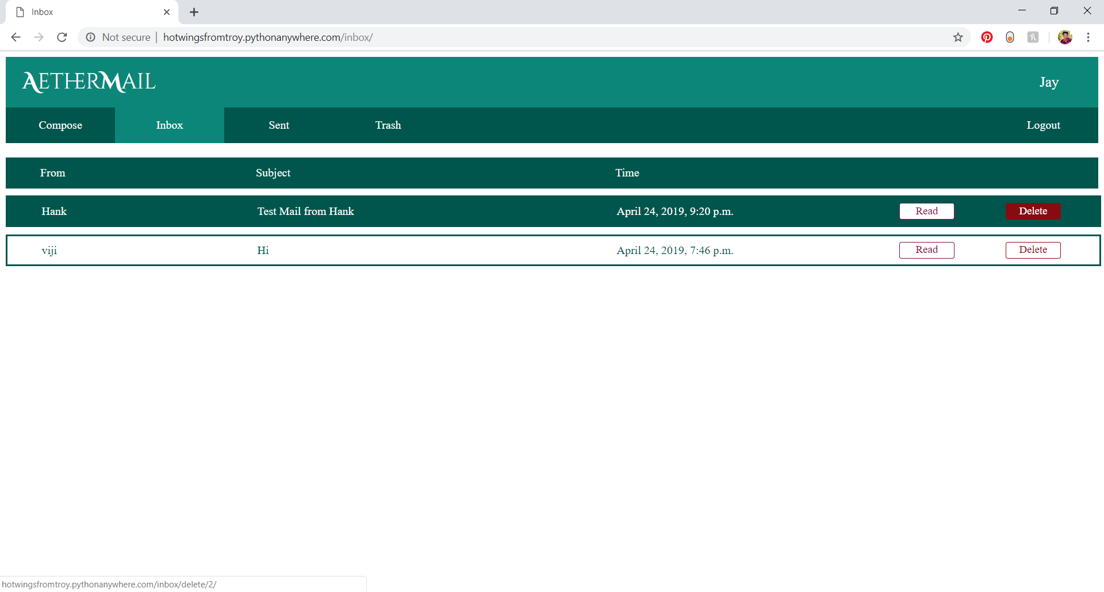

Slide 14
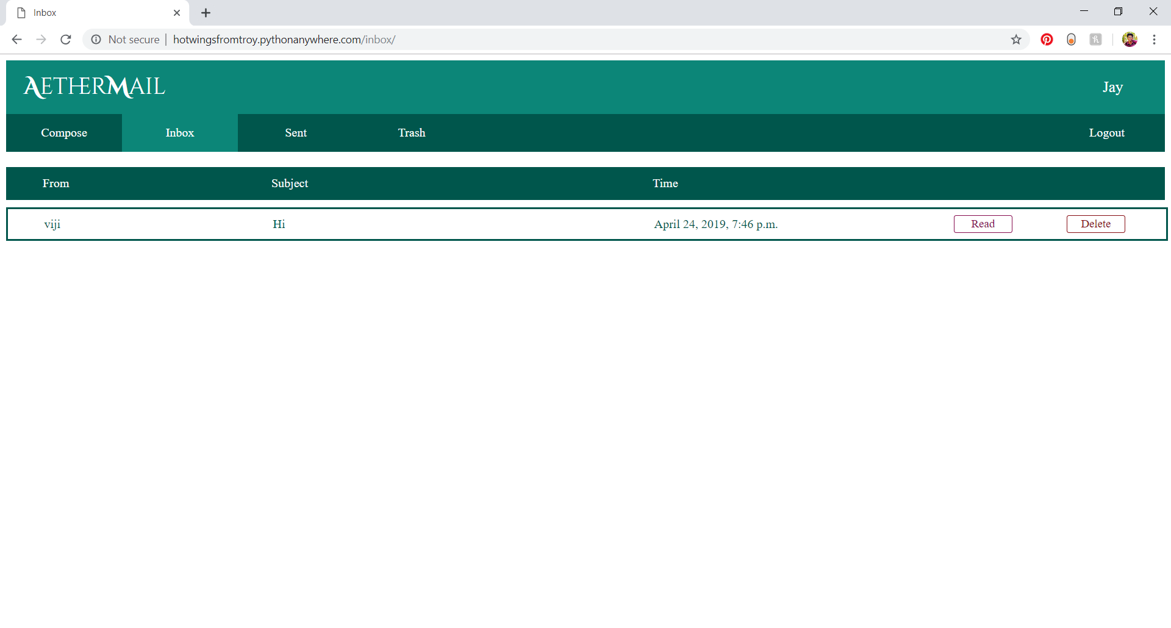

Slide 15
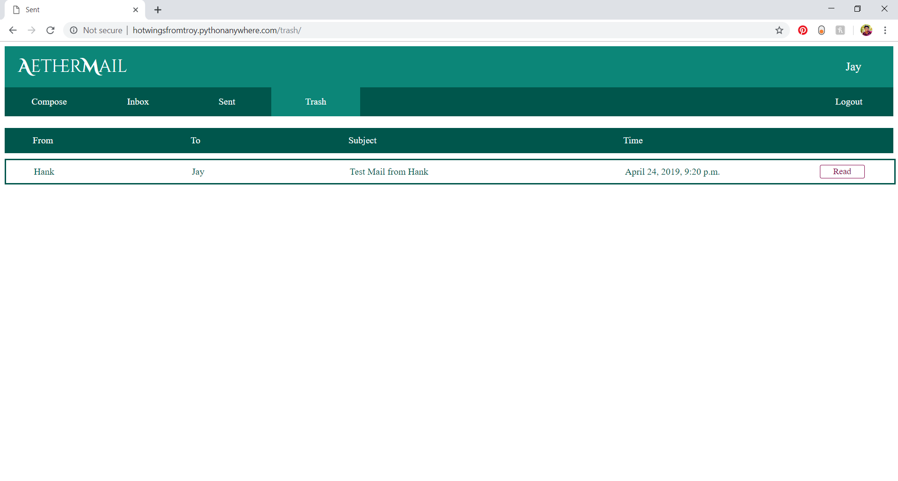

Slide 16
Takeaways
It was extremely interesting to work with Django. After the initial hiccups(see next slide) it was easy to quickly move from views to urls to template, making changes here and there, knowing what kind of an output you’re going to get. It was an interesting rush. The community was also very helpful. Nearly every question was asked previously by someone else. Another thing learnt was that it is not advisable to develop the UI keeping in mind only the display of the system on which the development takes place. It is something that needs to be rectified in future projects.

Slide 17
Challenges
The biggest challenge was getting comfortable with Django. The DjangoGirls site was of immense help. Numerous other sources were also referenced to get the app running. The inbuilt forms also gave some trouble.
Learning to use github and pythonanywhere was relatively simple but still had a few issues.

Slide 18
Project was done by :
Jayadev M
PES1201700166
jayadevmpillai@gmail.com

