Slide 1
Physics Art of Modeling

Slide 2
Momentum

Slide 3
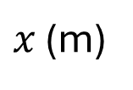
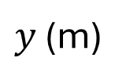

$y$ (m)
$t_{o}=0$ s
$x$ (m)
1
2
3
4
5

Slide 4










$y$ (m)
$t=0$ s
$1$ s
$2$ s
$3$ s
$4$ s
$5$ s
$6$ s
$7$ s
$8$ s
$9$ s
$x$ (m)
1
2
3
4
5

Slide 5
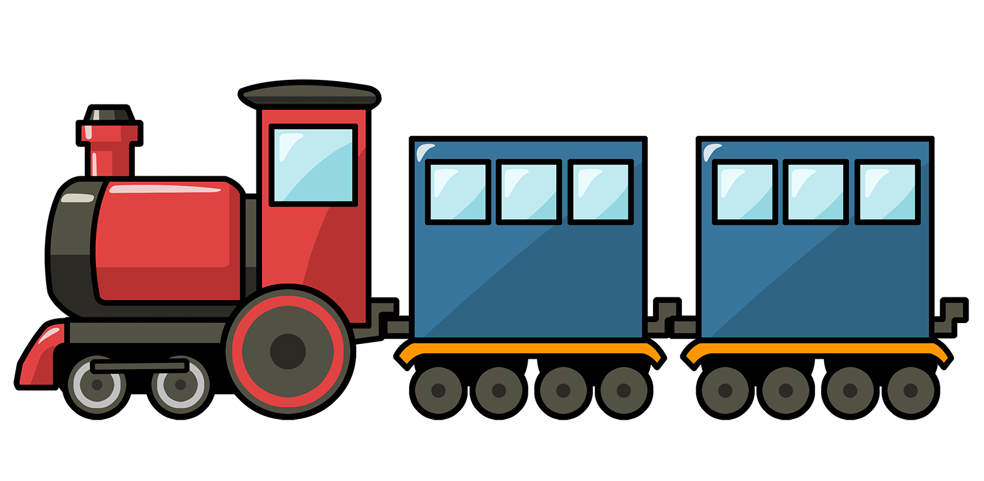


$$\hat{y}$$
$$\hat{x}$$
100 km
Train B: 750 000 kg
Train A: 500 000 kg
200 km

