Slide 1

Group 5
Docker Project
Yongxu Li
Yongze Quan
Linjun Wan
Haiyun Mao

Slide 2
CONTENTS
01.
Why Docker
02.
What we do
03.
A better way(Docker-Compose)
04.
Challenges

Slide 3
PART 01
Why Docker

Slide 4


Why Docker
Solve enviroment problem
Sometime when others download the version of jdk or node.js that have conflict with the packages. The app wont start for no reason.
Easy to deploy
Basically, docker doesnt need you to write the config file, check the port, or even change some codes when deploying. All you need to do is run the image.

Slide 5

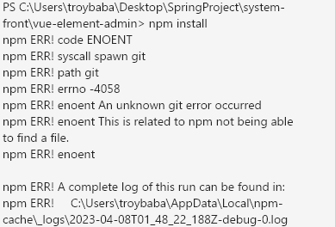

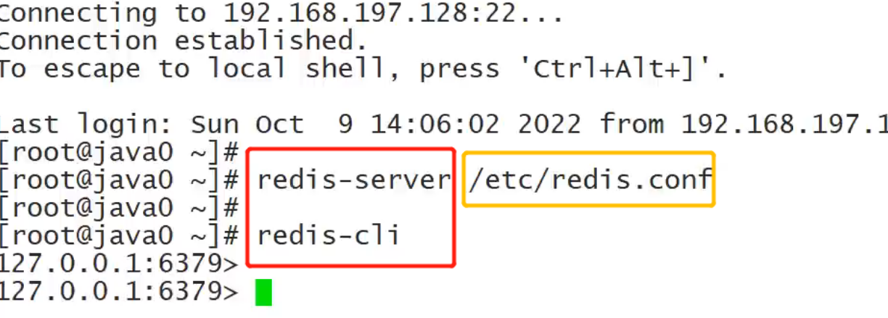
Why Docker

Slide 6
PART 02
What we do

Slide 7


What we do
Learn Docker Concepts
Deploy with images
Make it easier

Slide 8
What we do
Install Docker
Run Mysql Image
Run Nginx Image
Run Redis Iamge
Build Jar file with Dockerfile and run

Slide 9
PART 03
A better way(Docker-Compose)

Slide 10




A better way(Docker-Compose)
Docker-Compose
docker-compose.yml
A script file to tell what image to pull and run
no more sudo docker...
By reading the yml file docker-compose will run each line to pull images and run the service
easy to use
All you need to do is upload the deployment file to the instance and run “docker-compose up -d”

Slide 11
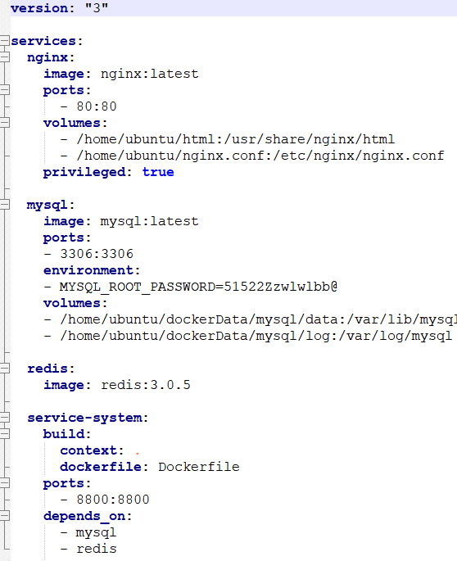
A better way(Docker-Compose)

Slide 12
PART 04
Challenges

Slide 13
Challenges
1. Cross-region
2. Nginx config file
Since we used Vue.js and Springboot, we need to connect from front-end to back-end because there is cross-region problem.
Using nginx for reverse-proxy so that front-end send APIs to springboot server.
3. docker-compose.yml
4. Mount volume
Carefully set up the service installation process especially handling the version of the images to make sure no conflicts
Find the correct folder to get mounted from outside of the container in order to make data persistence

Slide 14

What can we do next?
Setup back-up server
Using docker-compose to setup multiple server using master-slave structure to enhance the performance and security of our project
By using docker-compose.yml, we can easily deploy more services based our present structure
Add more services

Slide 15
Want to see our source code?
https://github.com/troyquan/authorities-project-docker
Front-end：https://github.com/troyquan/EmployeeManagement-frontend.git
Back-end：https://github.com/troyquan/EmployeeManagement-springboot.git
Notes:
模板来自于 http://www.ypppt.com

Slide 16
THANK YOU
Yongxu Li
Yongze Quan
Linjun Wan
Haiyun Mao

