Slide 1
Texas Crime Analysis
Members:
Forrest Collier
Cade Culver
Jonathan Ezeugo
Troy Youngblood

Slide 2
Data Sources
Texas Counties : Land Area
https://txcip.org/tac/census/morecountyinfo.php?MORE=1005
Texas County Population
https://demographics.texas.gov/data/TPEPP/Projections/
Texas Department of Public Safety – Offense Codes
https://www.dps.texas.gov/administration/crime_records/pages/appndxKOffenseCodes.htm
Texas Department of Criminal Justice Offender List : October 28, 2020 Update
https://www.dps.texas.gov/administration/crime_records/pages/appndxKOffenseCodes.htm
As a note – there were 120,707 individuals listed in the offender list (in the prison system) for the October 28, 2020 update
Texas County Seat Coordinates
https://data.texas.gov/dataset/Texas-Counties-Centroid-Map/ups3-9e8m

Slide 3
Project Description and Question Basis
Original Project Description
Analyze trends in Texas crime data by utilizing CSV files on crime, population, and land area
Amended Project Description
Analyze trends in Texas crime data by utilizing CSV files on crime and population
Land area was removed from the current evaluation criteria because overall county population was identified as a more descriptive value when identifying rates of offenses. Land area could be added in future evaluations.
Project Question Basis
The information collected and presented provides a high-level look at some of the general demographics of individuals and/or their crimes in the Texas Department of Criminal Justice (TDCJ) system. The challenge of the effort was to remain at a high level and not dive deeper into a specific case or a county for this first pass on the data. There are many stories which could be investigated during a later evaluation of the data. For the first pass on the data, the questions presented in the following slides were investigated.

Slide 4
Question 1

Slide 5
Question 2 - Cade Culver
Part 1: What are the top 5 highest-sentencing offenses in Texas?
-find the average sentence in years for all offense categories
-display results in a data frame and the top 5 in a bar graph
Part 2: How does murder-sentencing around the major Texas cities compare to murder-sentencing in Texas as a whole?
-look at murder sentencing in 5 Texas counties containing major cities (Harris, Dallas, Tarrant, Bexar, Travis)
-obtain total count of murder offenses per county
-compare each county’s average murder sentence with Texas state average

Slide 6
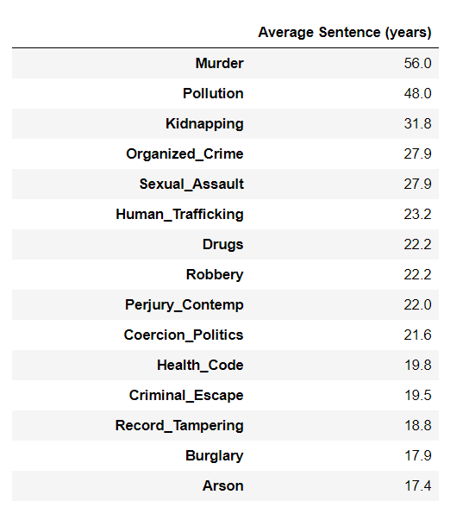
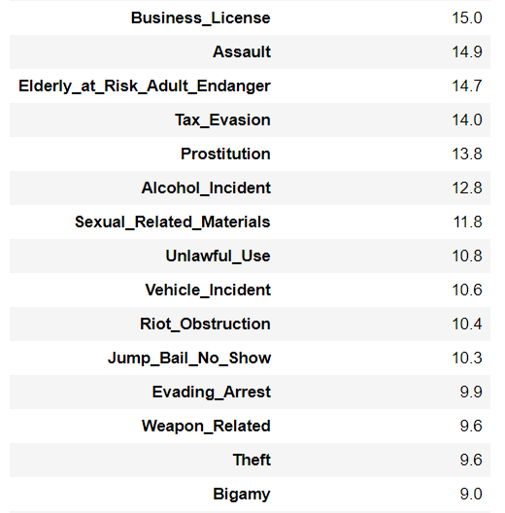
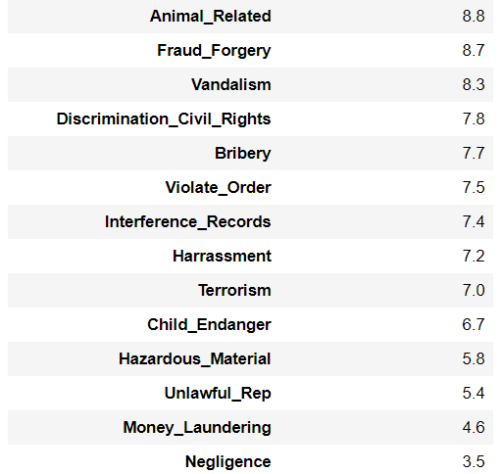
Part 1: Final Data Frame

Slide 7
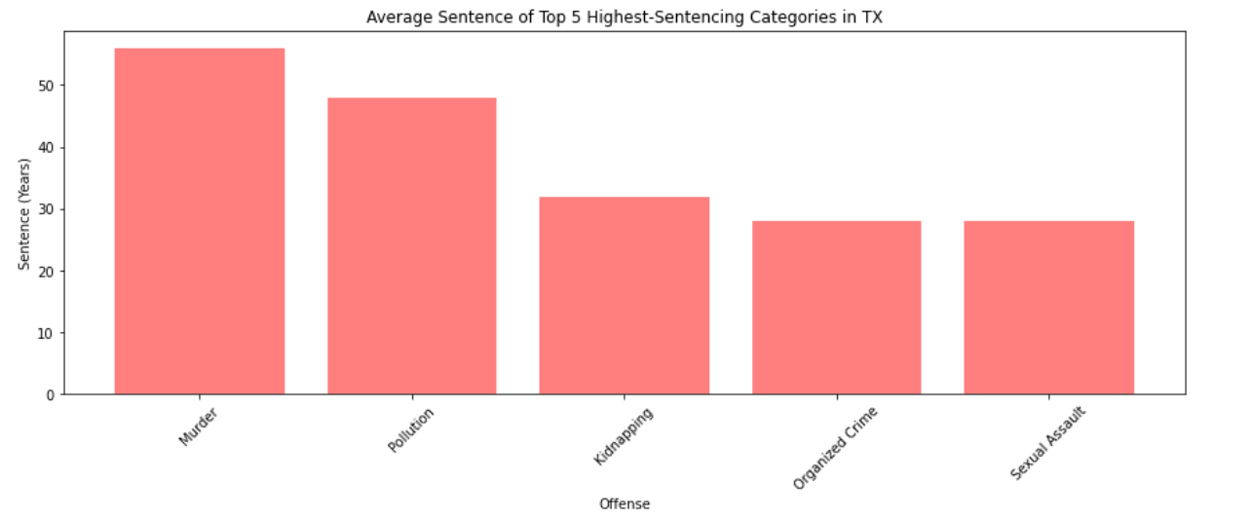
Part 1: Top 5 Highest-Sentencing Offenses in Texas

Slide 8
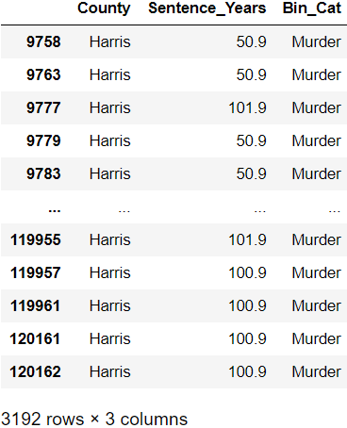
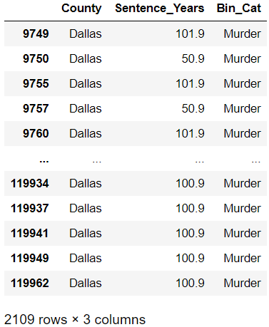
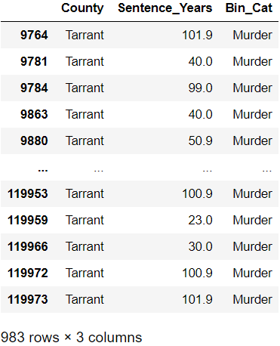
Part 2: Major County Data Frames

Slide 9
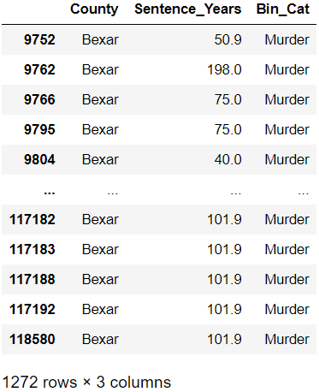
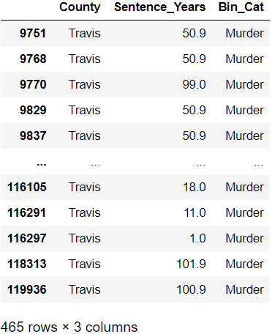
Part 2: Major County Data Frames, cont.

Slide 10
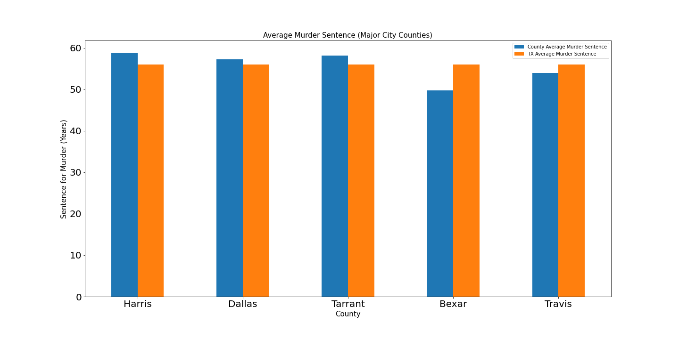
Part 2: Murder Sentencing Averages (Major Counties vs. Texas)

Slide 11
Q2 - Conclusions
The top 5 highest-sentencing offenses in Texas are: Murder, Pollution, Kidnapping, Organized Crime, and Sexual Assault. The odd offense in the data is Pollution. Two of these individuals had multiple violations and were given high sentences (about 48 years average) for “unauthorized disposal” of toxic waste and materials, in violation of an environmental act. This resulted in a big increase in the average sentence years. Other examples in this offense category are pollution of waterways, underground tank violations (causing leakage into groundwater), and disposal on government property such as state parks.
Murder was the highest-sentencing crime in Texas. Murder sentences in five counties containing the major cities: Harris (Houston), Dallas (Dallas), Tarrant (Fort Worth), Bexar (San Antonio), and Travis (Austin) counties were evaluated. The average murder sentence in Texas is 56 years, and Harris, Dallas and Tarrant county are all above that state average at 58.8, 57.2 and 58.1, respectively. Bexar and Travis are below the state average at 49.8 and 54. When comparing the number of murder offenses for each county with the average sentence, Bexar county has a high number of offenses (1,272) and a lower-than-average sentence rate. Tarrant county only has 983 murder offenses but has an above average sentence rate at 58.1 years.

Slide 12
Question 3

Slide 13
Question 4 – Troy Youngblood
Are there any county outliers?
Use heat maps to present offenses per county; filter on offense
Baseline county population against offenses
Establish population bins to present the data on a relative county population basis

Slide 14
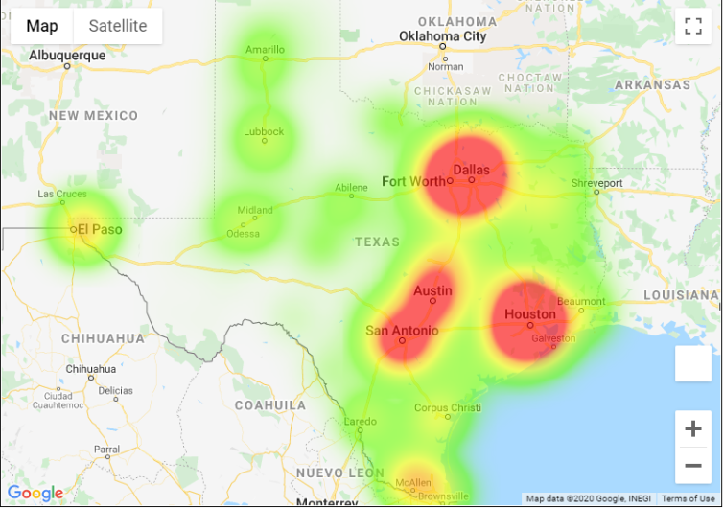
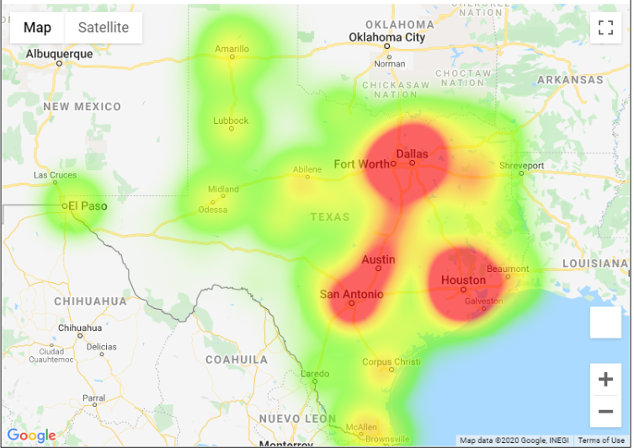
Comparison of Baseline Population Heatmap by County vs Offense location
Baseline population heat map by county
Location of offense by county - total counts
Comparison of the two heatmaps infers there is a higher number of offenses occurring in major population centers or along major paths of travel (interstates or state highways) between those locations. Offense heatmap weighting was adjusted to best match the population in the Dallas / Fort Worth area for comparison purposes.

Slide 15
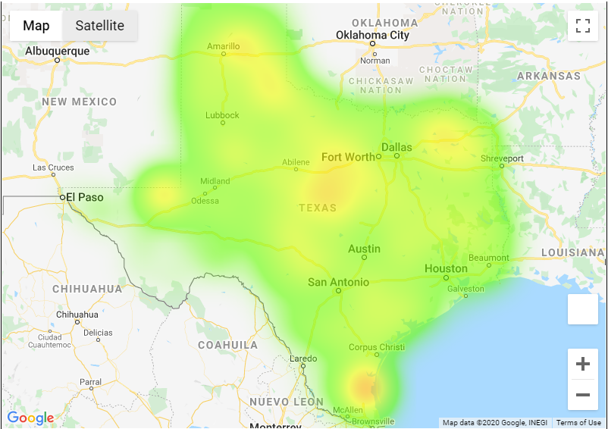
Comparison of Baseline Population Heatmap by County vs Offense location per 1,000 population
Baseline population heat map by county
Location of offense by county – per 1,000 pop
Comparison of the two heatmaps infers there is a higher concentration of offenses occurring per 1000 population in the counties adjacent to major population centers or along major paths of travel (interstates or state highways). Offense heatmap weighting was adjusted to best match the population along the Rio Grande river and Big Bend area for comparison purposes.

Slide 16
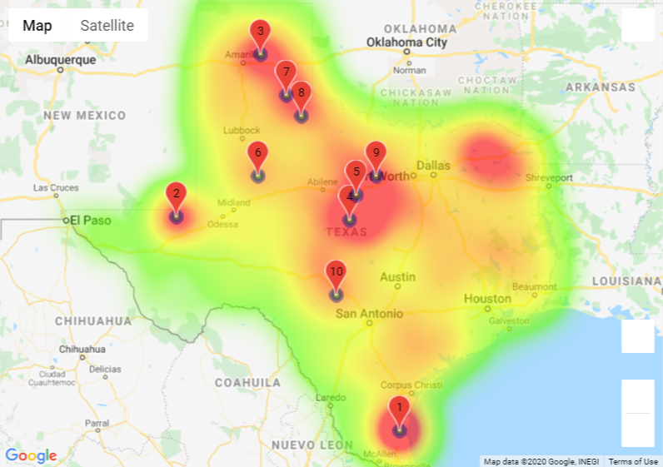
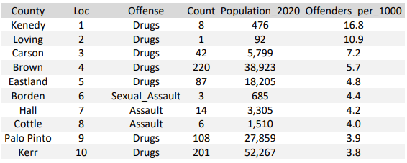
Counties with the highest Offender rates per 1,000 population – independent of total county population
Heat map with county locations
County Statistics
An interesting trend is identified in the above heat map. The majority (6 out of 10) of the counties in the table fall along or near either US 287 going from Fort Worth to Amarillo or US 281 going from San Antonio to Wichita Falls. US 281 and US 287 meet in Wichita Falls. Four of the counties are listed for Drug related charges and 2 are listed for Assault. Kerr county is just northwest of San Antonio and if included in the count it would make 7 out if 10 counties from the table in the general location discussion.

Slide 17
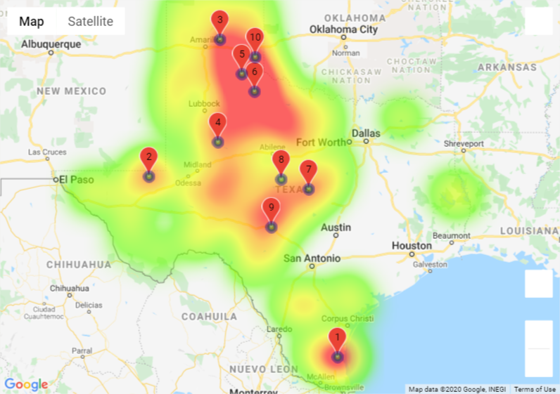
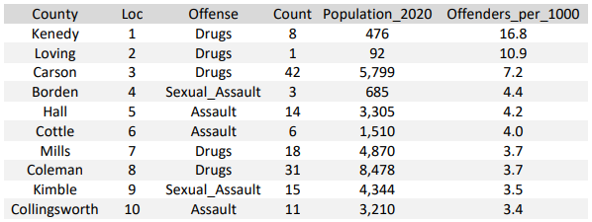
Counties with population less than 10,000 - sorted by Offenders per 1,000 population
Heat map with county locations
County Statistics
Data indicates most of the counties with population less than 10,000 are in west Texas. The data was sorted to present the highest rate of Offenders per 1,000 population. A secondary sort was conducted to remove counties that were listed more than once in the ranking to obtain a view of multiple counties and their rates. Drugs and a form of assault are the primary offense categories in the smallest counties.

Slide 18
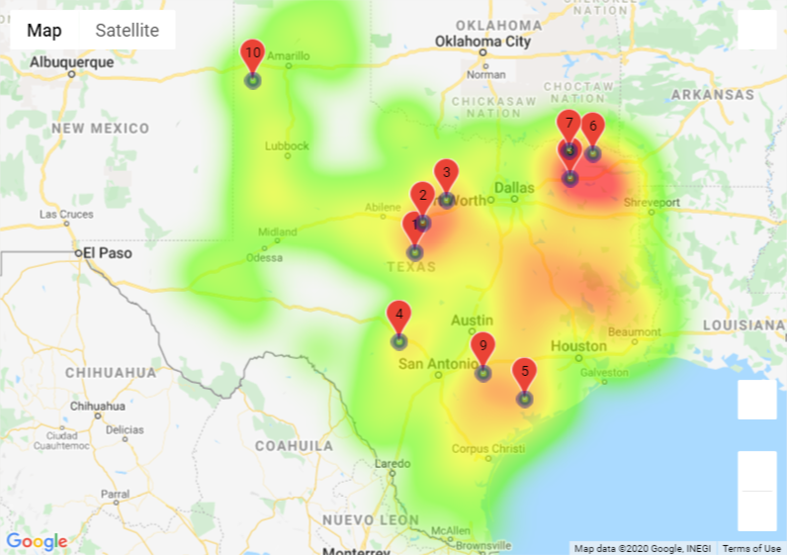
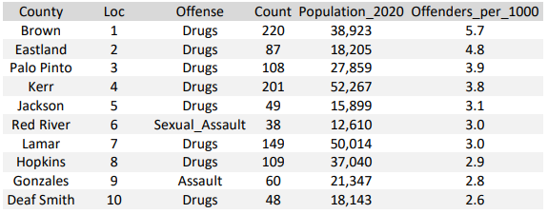
Counties with population between 10,000 and 100,000 - sorted by Offenders per 1,000 population
Heat map with county locations
County Statistics
Data indicates most of the counties with population in the sort range are in central and east Texas. The data was sorted to present the highest rate of Offenders per 1,000 population. A secondary sort was conducted to remove counties that were listed more than once in the ranking to obtain a view of multiple counties and their rates. Drugs are the highest percentage of offenses, followed by a form of assault.

Slide 19
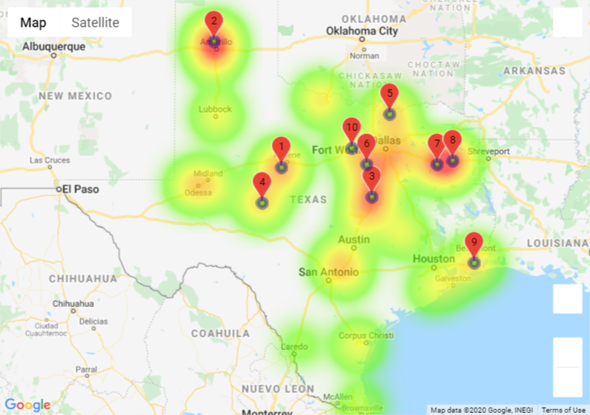
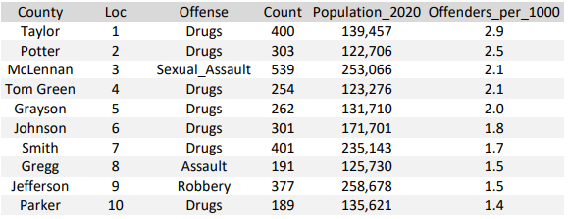
Counties with population between 100,000 and 500,000 - sorted by Offenders per 1,000 population
Heat map with county locations
County Statistics
Data indicates most of the counties with population in the sort range are on or north of I10. The data was sorted to present the highest rate of Offenders per 1,000 population. A secondary sort was conducted to remove counties that were listed more than once in the ranking to obtain a view of multiple counties and their rates. Drugs are the highest percentage of offenses, followed by a form of assault.

Slide 20
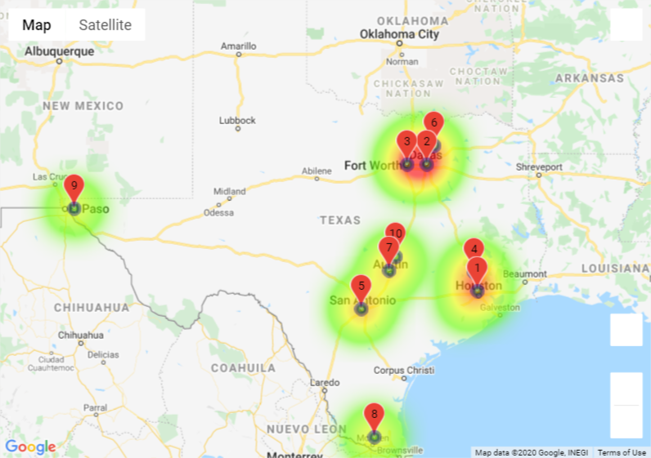
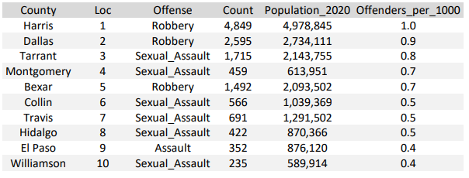
Counties with population greater than 500,000 - sorted by Offenders per 1,000 population
Heat map with county locations
County Statistics
Data indicates most of the counties with population in the sort range are the major population centers along major travel arteries. The data was sorted to present the highest rate of Offenders per 1,000 population. A secondary sort was conducted to remove counties that were listed more than once in the ranking to obtain a view of multiple counties and their rates. Crimes against a person are the primary offense categories.

Slide 21
Q4 - Conclusions
The majority of the counties adjacent to metroplex locations and further out had drug related crimes as their primary offense. The counties with the metroplex locations have crimes against a person as their primary offense.
Also noted, there is an interesting trend identified in the heat map that only presented Offense ratios per 1,000 and did not filter for population bin. The majority (6 out of 10) of the counties listed in the table fall along or near either US 287 going from Fort Worth to Amarillo or US 281 going from San Antonio to Wichita Falls. US 281 and US 287 meet in Wichita Falls. Four of the counties are listed for Drug related charges and 2 are listed for Assault. Kerr county is just northwest of San Antonio and if included in the count, it would make 7 out if 10 counties from the table in the general location discussion.

