Slide 1
Forecasting Stock Prices Using Stock Correlation Graph
Xingkun Yin (University of),
Da Yan (The University of Alabama at Birmingham),
Abdullateef Almudaifer (University of Alabama at Birmingham),
Sibo Yan (Freddie Mac),
Yang Zhou (Auburn University)
Notes:
My name is Xingkun Yin, I am from the University of Toronto. I am presenting our paper “Forecasting Stock Prices Using Stock Correlation Graph.”

Slide 2
Target Problem
Stock Price Forecasting
Sequential information and models
Notes:
Let’s start with the problem this paper is trying to address. With the advancement of AI in Fintech applications, various deep learning models have recently been developed for stock price forecasting. However, these models focus on designing sequence models to capture the temporal dependence from a stock’s historical prices data.

Slide 3
Target Problem
Stock Price Forecasting
Sequential information and models
-----------------------------------------------------------
-----------------------------------------------------------
Relationships between stock
Notes:
This leave the relationship between the different stock underexplored.

Slide 4
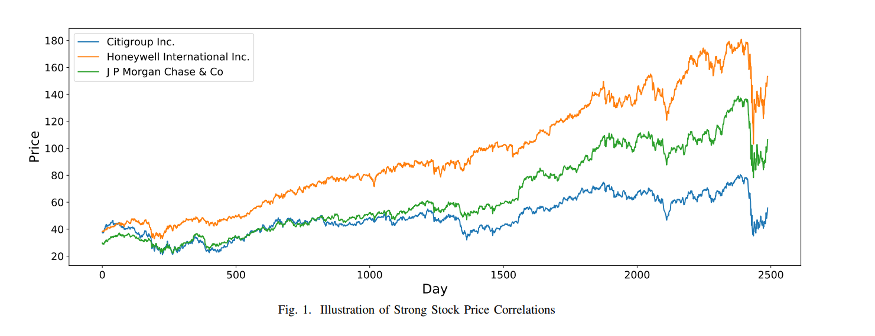
Target Problem
Notes:
However, strong correlation between stocks of similar fields are often significant as shown in the image figure above. The 3 lines in the graph represent Citigroup, Honeywell International and J P Morgan respectively. The 3 investment cooperation stocks show very similar patterns of growth and fall. It might be a good idea if we incorporate the rise and fall of related stocks into consideration when prediction a specific stock.

Slide 5
Target Problem
Stock Price Forecasting
Sequential information and models
+
Relationships between stock
Notes:
Our model filled the gap by incorporating the correlation between different stocks into the design of the model with the combination of GCN and GRU.

Slide 6
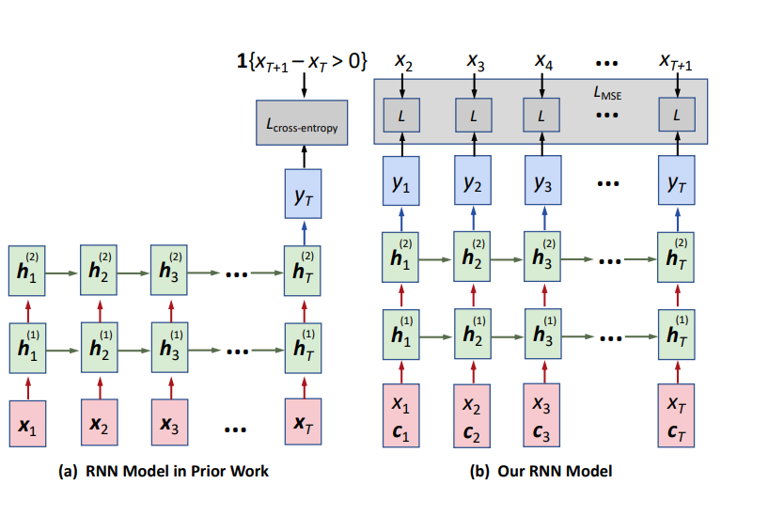
Target Problem

Slide 7
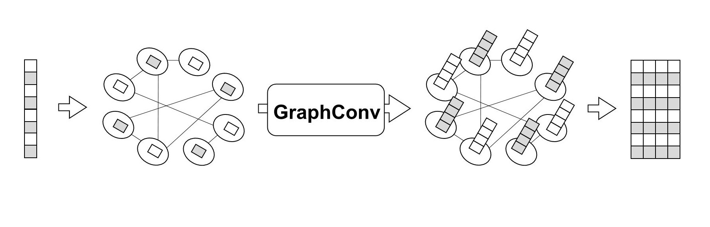
Model
Notes:
This is the overview of our network architecture. To achieve the goal of incorporating correlation of stocks into the model, we start by creating a correlation graph based on historical data. In this graph, each stock as the vertex and an edge would exist between 2 stocks if these 2 stocks have strong correlation. The inputted data will enter a shared graph convolutional layer, and then each stock will have their own RNN layer. The resulting output would be used for prediction.

Slide 8
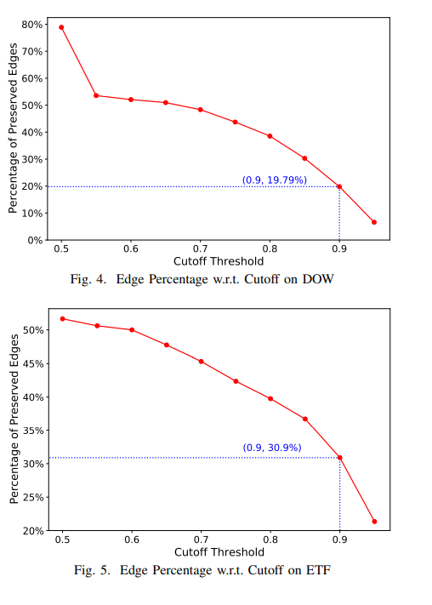
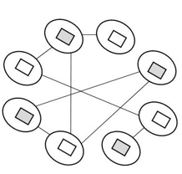
Model
Notes:
We start with creating a correlation graph among different stocks. This is done by first calculating the correlation between every stocks base on past trading price. A cutoff is set and edges between stocks with correlation lower than that would be dropped. After extensive testing, the optimized cut off is shown here.

Slide 9
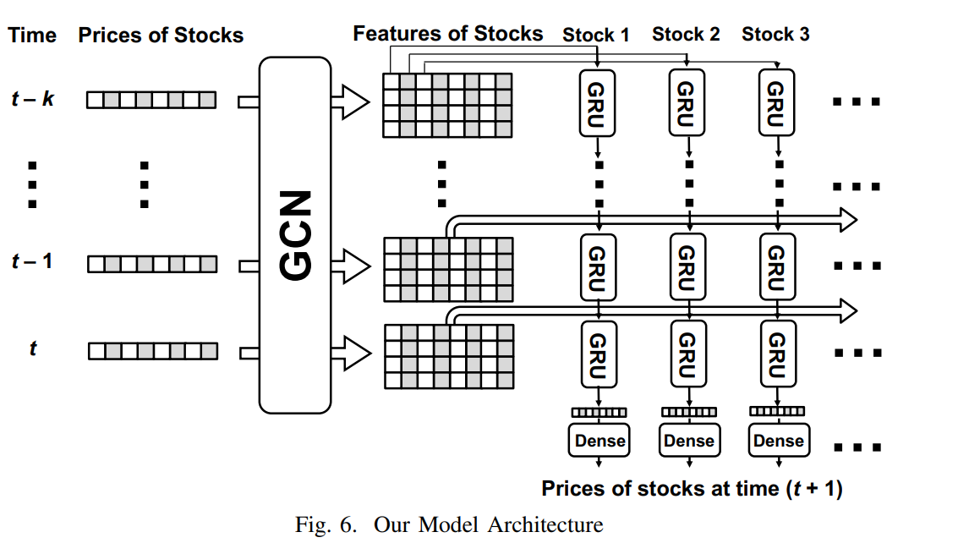
Model
Notes:
This an illustration of a detailed process at time t. Initially, the prices of these 8 stocks are fed to our backbone stock correlation graph, where each node corresponds to a stock and has a feature vector of size 1 which contains the stock’s price at time t.

Slide 10
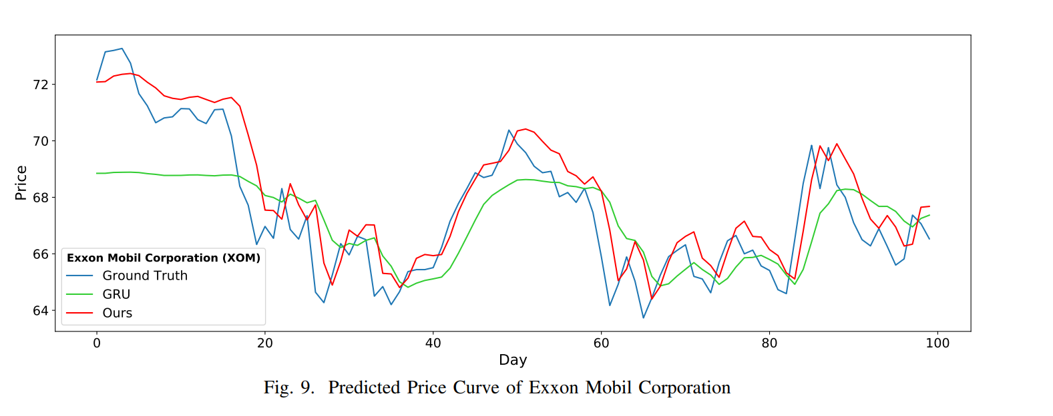
Stock Data Format
Notes:
The dataset consists of the daily transactions when the market opens,
and each transaction keeps its price of buying or selling, the number of shares traded, and the timestamp of the trade

Slide 11
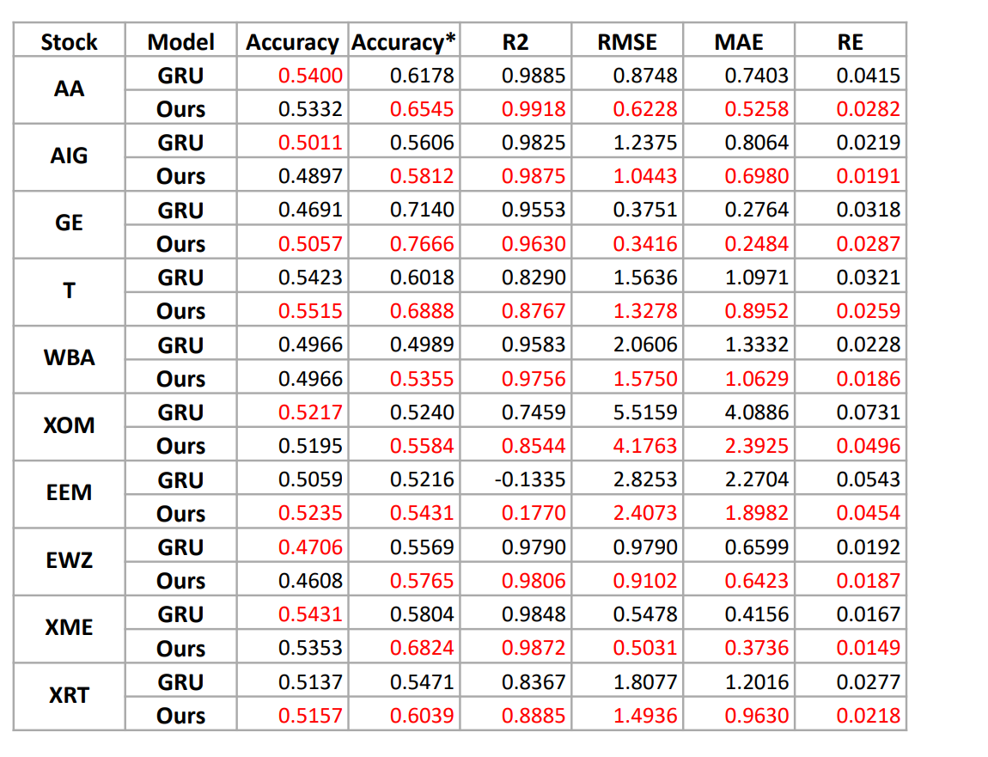
Result
Notes:
However, due to the existence of market microstructure noises, it is a common practice to down-sample the stock price sequence to avoid unstable analysis.
The necessity of down-sampling price data has been established by a pioneering the work as shown in this slide, titled “A tale of two time scales: determining integrated volatility with noisy high-frequency data.”

Slide 12
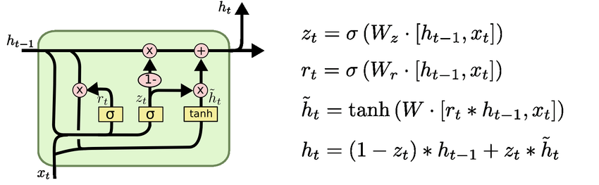
Model
GRU: Recurrent Neural Network with Mitigated Vanishing Gradient Problem
Notes:
Next, we describe our model. We predict the median share-price of the next time block using the median share-prices of the previous k time blocks, where k is a user-defined model hyperparameter
For this purpose, we use a backbone recurrent neural network model that takes a sequence of k feature vectors, and emits an output at the end.
We use GRU as the recurrent unit, which mitigates the vanishing gradient problem and allows us to look backwards for more time blocks.

Slide 13
Our Model Choices
1{x_{T+1} – x_{T} > 0}
Regression v.s. Classification
L_{cross-entropy}
Prediction of x_{T+1}
y_{T}
₍₂₎
₍₂₎
₍₂₎
...
₍₂₎
h₁
h₂
h₃
h_{T}
₍₁₎
₍₁₎
₍₁₎
...
₍₁₎
h₁
h₂
h₃
h_{T}
x₁
x₂
x₃
...
x_{T}
Notes:
In this slide, we take a sequence of T input vectors, x1 to xT, as the input, and emits an output yT which is a label indicating whether the price will rise in time T+1
The actual price direction is then compared with the predicted label using a cross-entropy loss.
This model basically trains a binary classifier, and it is the adopted model by most existing studies on price movement prediction.
Note that each input vector xi can contain not only the median share-price at time block i, but also other features extracted from that time block. In this work, we use the technical indicators which we will explain in later slides.
[click]
We remark, however, that modeling the problem as a binary classification problem does not fully utilize the price data, because as long as the predicted direction is correct, the loss does not further penalize the difference between the predicted price and the actual price in time block (i+1)

Slide 14
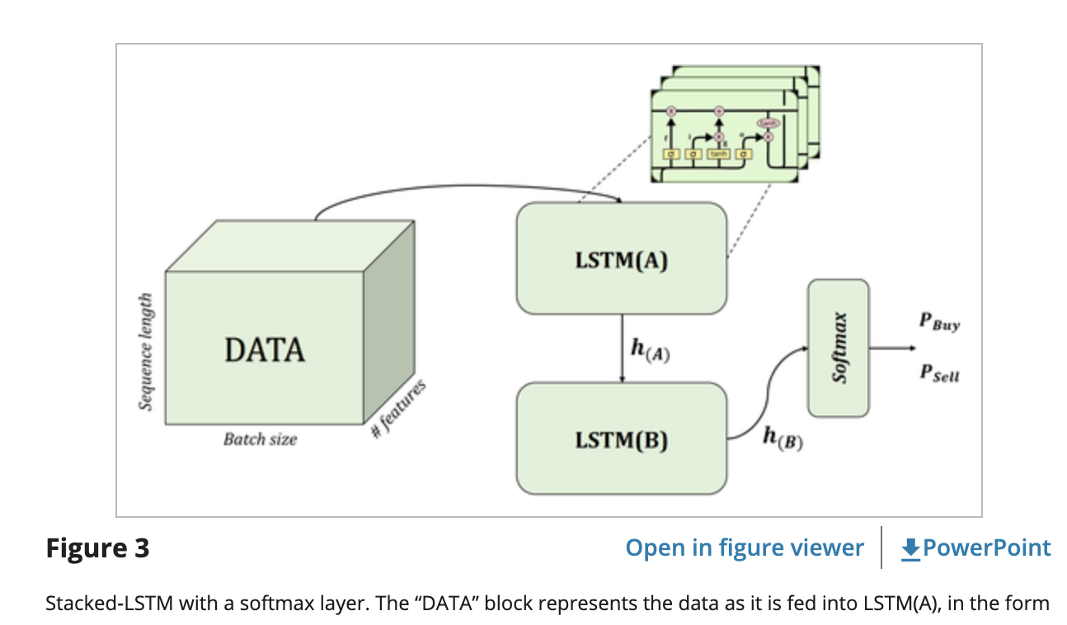
Related Work
Regression v.s. Classification
Notes:
As we can see from this diagram taken from their paper, their work is still modeling the problem as classification.

Slide 15
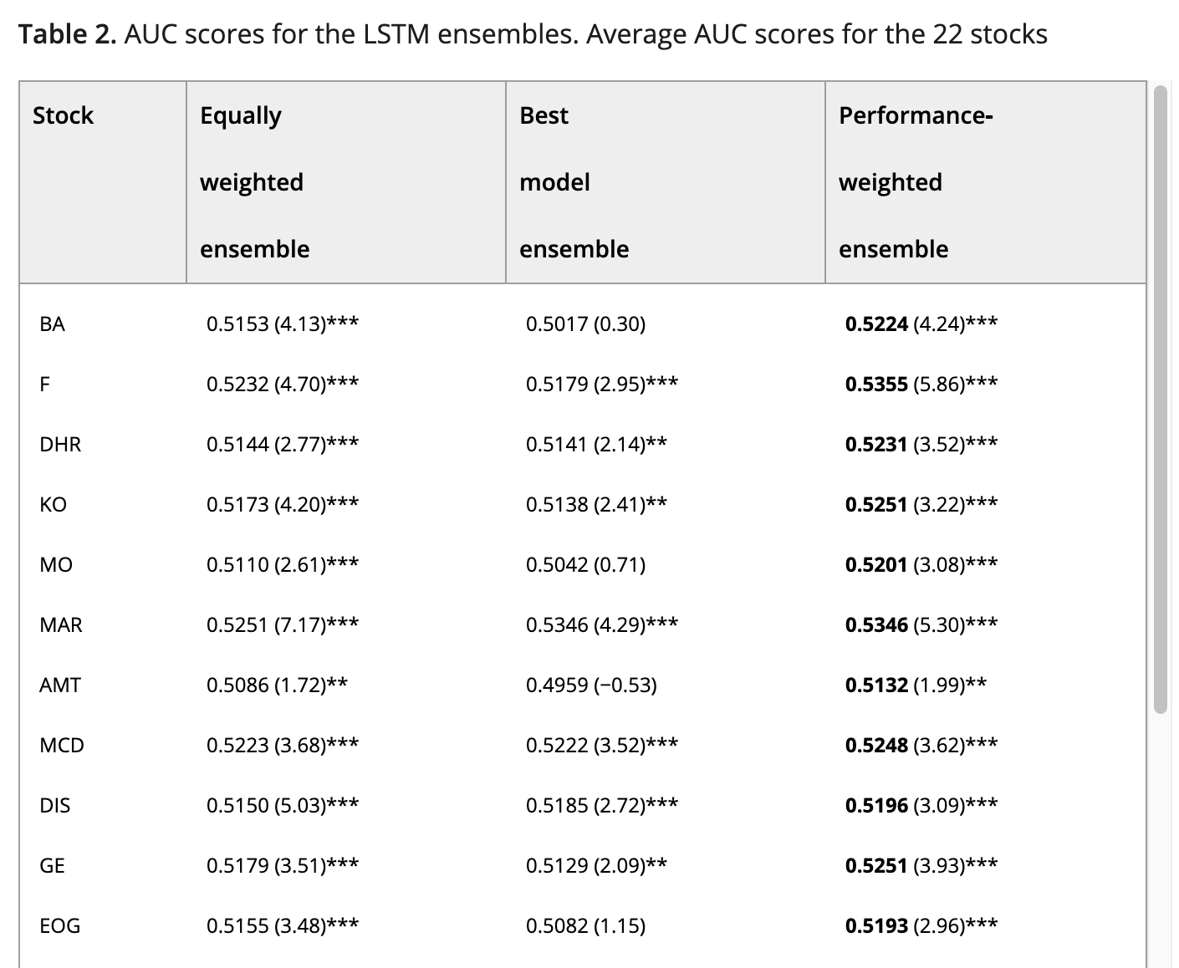
Notes:
The table in this slide is also taken from their paper, and we can see that the AUC scores are low for various stocks, just passing the 50% bar
If we model the problem as regression, the performance will improve

Slide 16
Our Model Choices
Many-to-Many v.s. Many-to-One
y₁
y₂
y₃
y_{T}
h₀
h₁
h₂
h₃
. . .
h_{T}
f_{W}
f_{W}
f_{W}
x₁
x₂
x₃
W
Notes:
Another problem with the existing works is that they all adopt a many-to-one model scheme.
In some applications like sentiment analysis from an entire sentence, we have to completely input the sentence in order to emit a sentiment label.
[click]
But for price prediction, a many-to-many model is more appropriate. Specifically, in each time step, we can emit a prediction of the median share-price of the next time step, and the difference between the predicted price and the actual price can be used in backpropagation to tune the LSTM parameters.
Since we have the entire price sequence, providing error feedback at every step will train our model better.

Slide 17
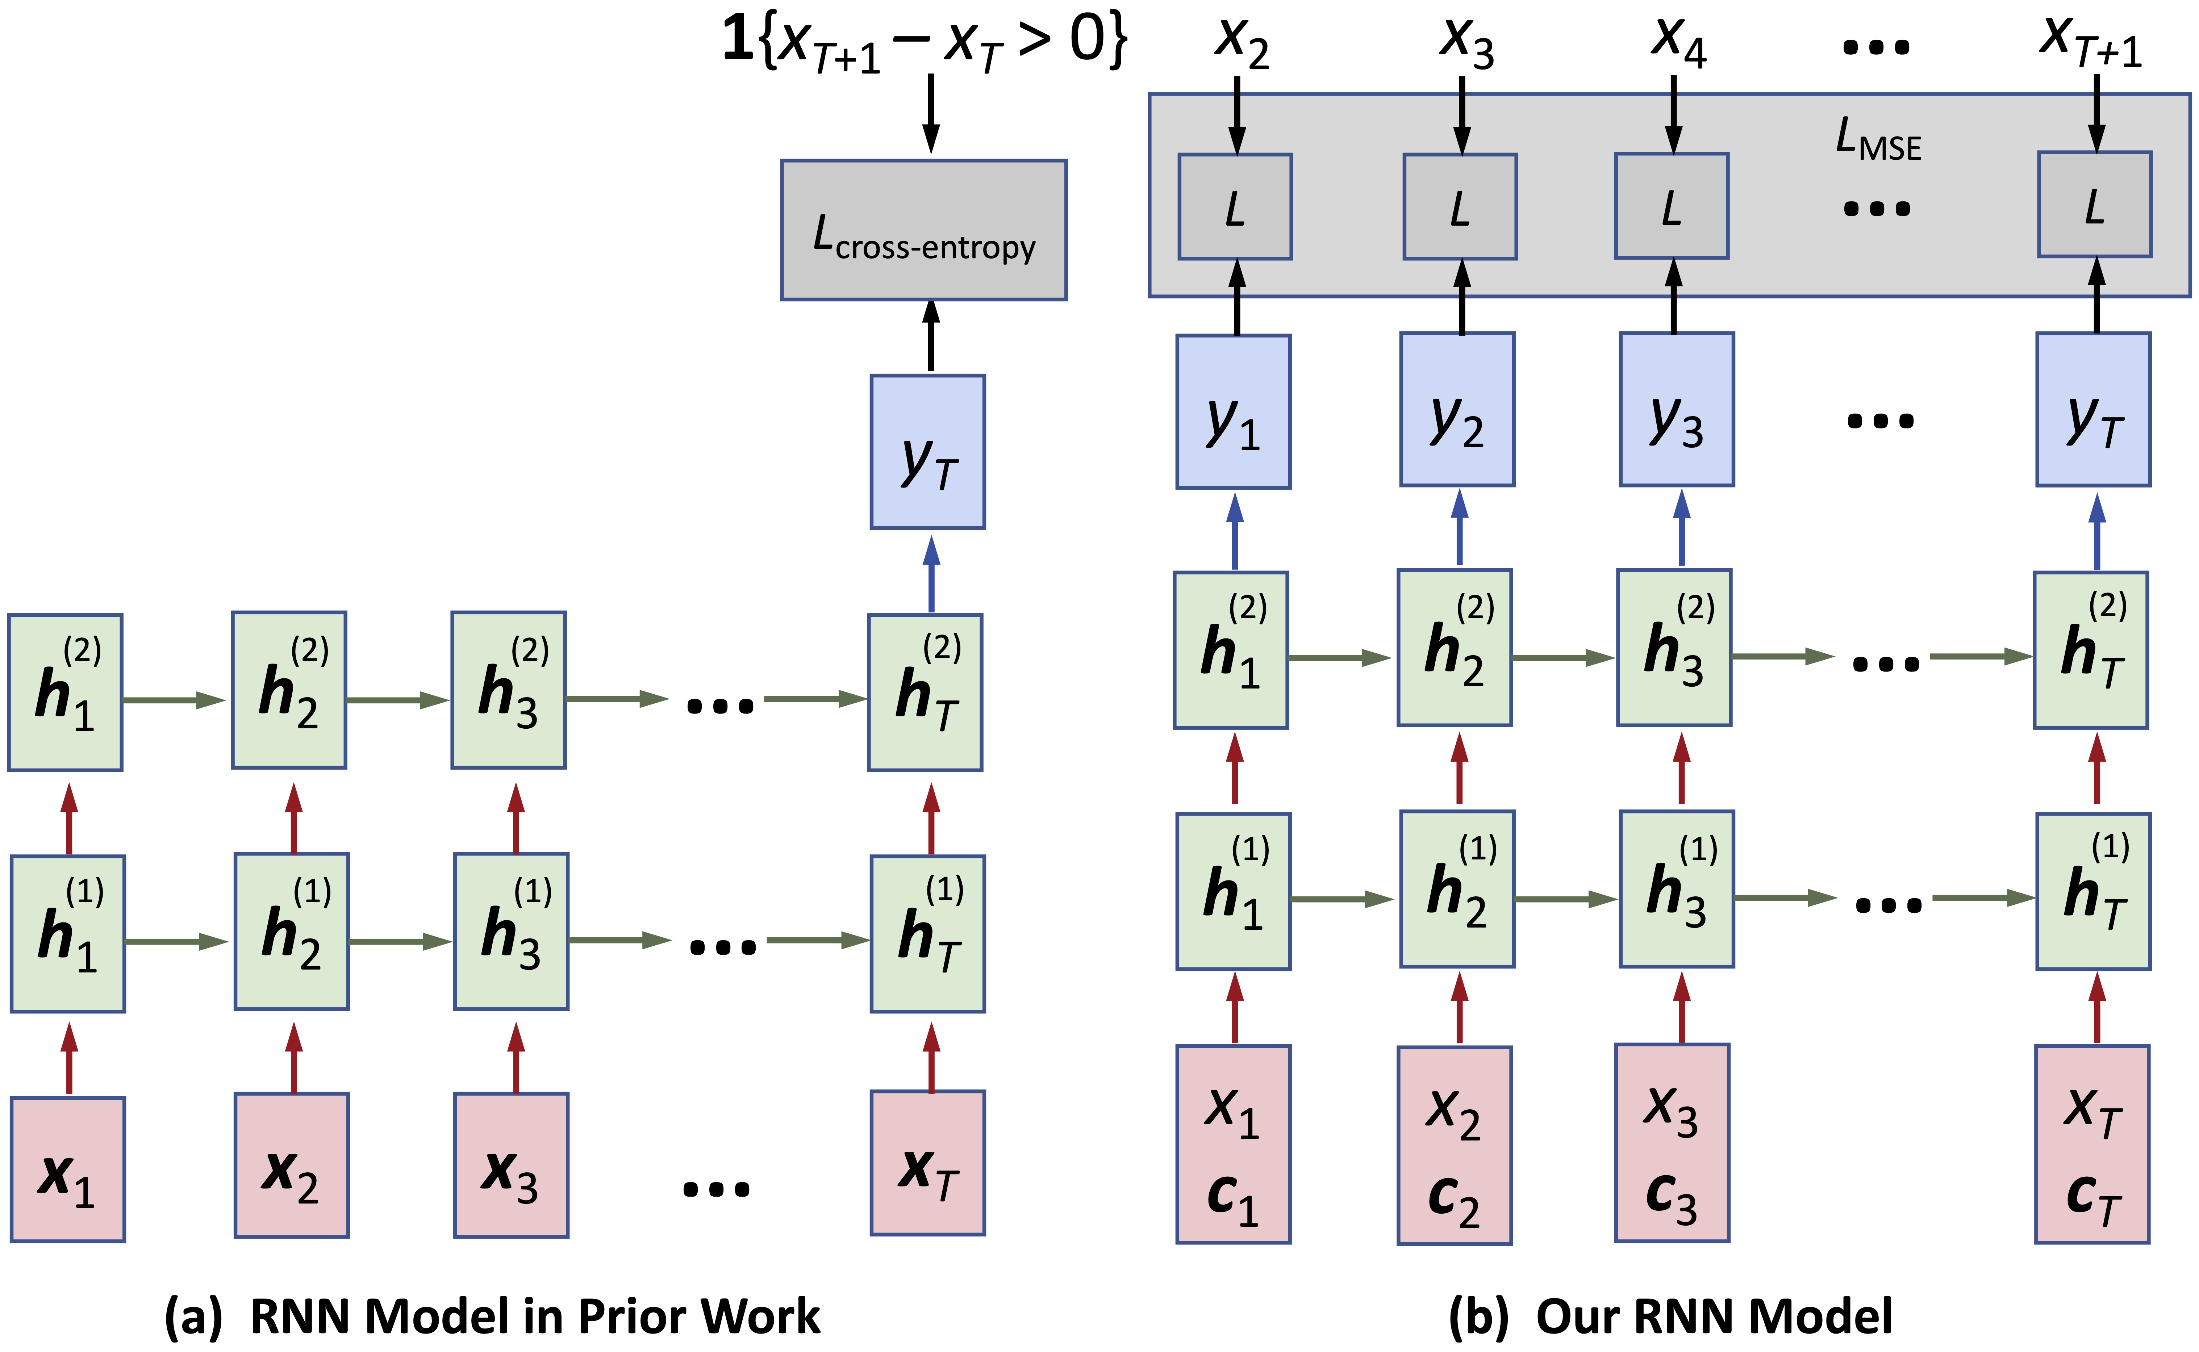
Our Model Choices
Many-to-Many v.s. Many-to-One
Autoregressive
Notes:
Here’s a comparison between existing works and our model.
[click]
You can see that our model is autoregressive where each time step has an error feedback to train our model better, and our outputs, y1 to yT, are the actual predicted median share-price, not a directional label on the price rise or fall

Slide 18
Our Model Choices
Technical indicators are over longer periods
Technical Indicators
Step length is relatively short
Notes:
We remark that the technical indicators are usually computed over a much longer time period, such as hours or even days,
While our LSTM network only has a limited step length.
We use 7 steps in our model which performs the best in our test, and 7 time blocks just amount to 35 minutes in time.
Therefore, our technical indicator features are complementary to LSTM and captures the stock features over a much longer period of time.

Slide 19
If you have any questions, please email Yuechun Gu at 329352129@qq.com
Thanks !
YAN, Da
Contact Info:
Email: yanda@uab.edu
Webpage: https://yanlab19870714.github.io/yanda
Notes:
This ends our presentation and thanks for your attention!
If you have any questions regarding this work, please feel free to contact Yuechun Gu who is the first author of this work, though his email shown here.

