Slide 1
PYTHON:Matplotlib
2019.11.28
~/PPT/11.28.Matplotlib.pptx

Slide 2
Matplotlib
http://bigsec.net/b52/scipydoc/matplotlib_intro.html
教程1
https://liam.page/2014/09/11/matplotlib-tutorial-zh-cn/
教程2
https://matplotlib.org/gallery.html
大量例子
https://matplotlib.org/api/_as_gen/matplotlib.pyplot.html
查询函数用法
课上讲到的东西大概只占全部功能的10%，细节功能在实际运用中根据需求从实例查找

Slide 3
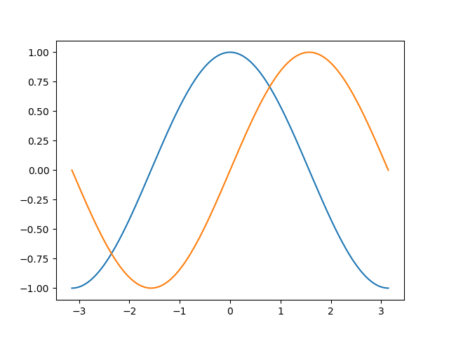
快速开始
from pylab import *
import numpy as np
import matplotlib.pyplot as plt
#建立数组
X = np.linspace(-np.pi, np.pi, 256,endpoint=True)
C,S = np.cos(X), np.sin(X)
#画图
plt.plot(X,C)
plt.plot(X,S)
#显示图片
plt.show()
https://matplotlib.org/3.1.1/api/_as_gen/matplotlib.pyplot.plot.html?highlight=plot#matplotlib.pyplot.plot

Slide 4
脚本运行
#firstpic.py
import numpy as np
import matplotlib.pyplot as plt
#建立数组
X = np.linspace(-np.pi, np.pi, 256,endpoint=True)
C,S = np.cos(X), np.sin(X)
#画图
plt.plot(X,C)
plt.plot(X,S)
#保存图片
plt.show()
plt.savefig(‘mypic’)
终端：python firstpic.py
python 命令行：run firstpic.py
plt.show会打开一个图片窗口，关闭后就关闭了图片随后的savefig会保存一个空图像
默认存为.png，也可以指定为.jpg或.pdf文件

Slide 5
互动模式
from pylab import *
import numpy as np
import matplotlib.pyplot as plt
#建立数组
X = np.linspace(-np.pi, np.pi, 256,endpoint=True)
C,S = np.cos(X), np.sin(X)
#画图
plt.ion()
plt.plot(X,C)
plt.plot(X,S)
#显示图片
plt.show()
plt.ioff()
打开互动模式
不需要plt.show()显示图像
关闭互动模式

Slide 6
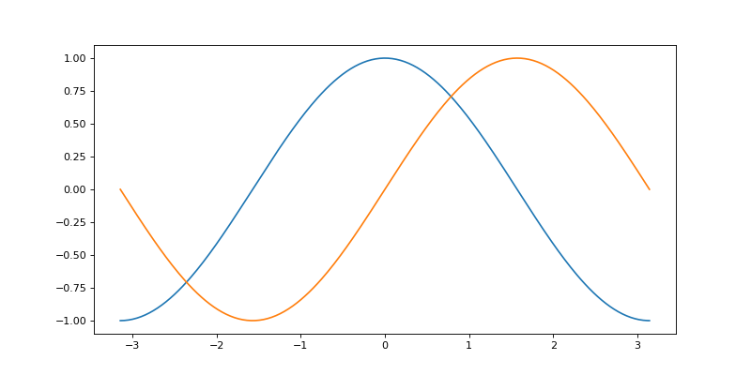
改变图片尺寸
import numpy as np
import matplotlib.pyplot as plt
X = np.linspace(-np.pi, np.pi, 256,endpoint=True)
C,S = np.cos(X), np.sin(X)
plt.figure(figsize=(10,5), dpi=80)
plt.plot(X,C)
plt.plot(X,S)
plt.show()
单位inch

Slide 7
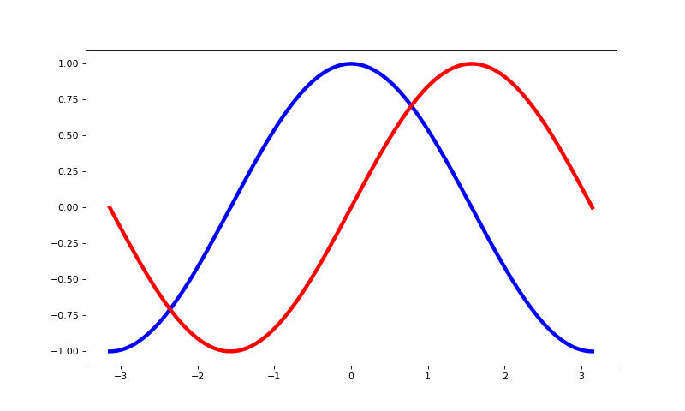
改变线型
import numpy as np
import matplotlib.pyplot as plt
X = np.linspace(-np.pi, np.pi, 256,endpoint=True)
C,S = np.cos(X), np.sin(X)
plt.figure(figsize=(10,6), dpi=80)
plt.plot(X,C,color="blue",linewidth=4,linestyle="-")
plt.plot(X,S,color="red",linewidth=4,linestyle="-")
plt.show()
颜色，c
线宽，lw
线型，ls

Slide 8
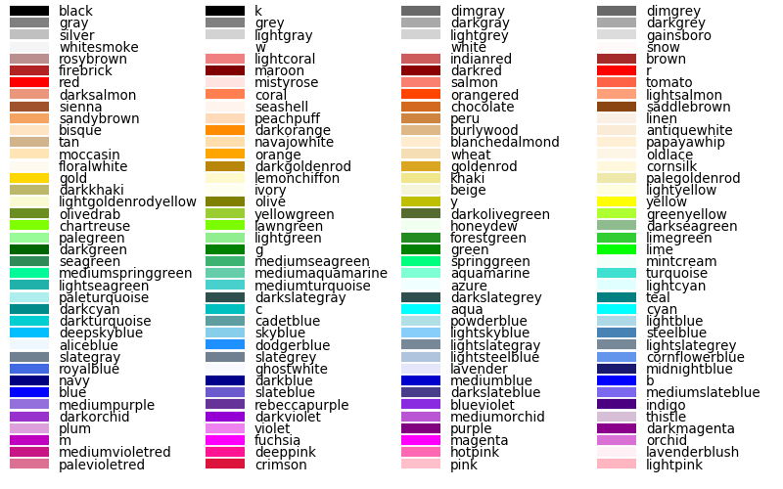
颜色
还可以用：1.RGB值, (0.1,0.2,0.5), #0f0f0f ；2.'C0','C1'表示当前颜色循环值中的第1,2,…个颜色
color 或 c
缩写 | 颜色
'b' | blue
'g' | green
'r' | red
'c' | cyan
'm' | magenta
'y' | yellow
'k' | black
'w' | white

Slide 9
线型列表
linestype 或 ls
marker
markersize 或 ms: 点的大小
组合字符串
 | description
'-' | solid line style
'--' | dashed line style
'-.' | dash-dot line style
':' | dotted line style
character | description
'.' | point marker
',' | pixel marker
'o' | circle marker
'v' | triangle_down marker
'^' | triangle_up marker
'<' | triangle_left marker
'>' | triangle_right marker
'1' | tri_down marker
'2' | tri_up marker
'3' | tri_left marker
'4' | tri_right marker
's' | square marker
'p' | pentagon marker
'*' | star marker
'h' | hexagon1 marker
'H' | hexagon2 marker
'+' | plus marker
'x' | x marker
'D' | diamond marker
'd' | thin_diamond marker
'|' | vline marker
'_' | hline marker
'b' # blue markers with default shape
'or' # red circles
'-g' # green solid line
'--' # dashed line with default color
'^k:' # black triangle_up markers connected by a dotted line
plt.plot(X,Y,'--or')

Slide 10
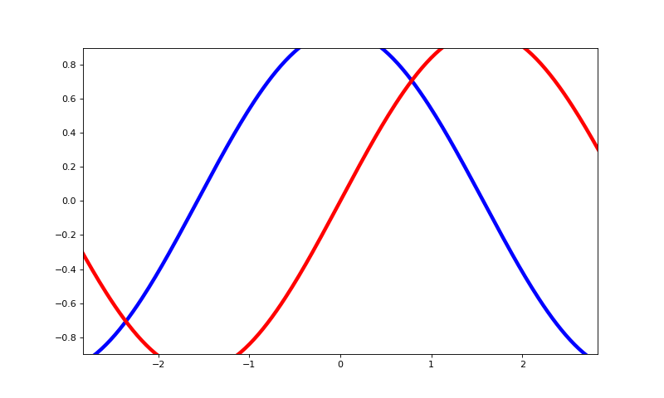
改变边界
import numpy as np
import matplotlib.pyplot as plt
X = np.linspace(-np.pi, np.pi, 256,endpoint=True)
C,S = np.cos(X), np.sin(X)
plt.figure(figsize=(10,6), dpi=80)
plt.plot(X,C,color="blue",linewidth=4,linestyle="-")
plt.plot(X,C,color="red",linewidth=4,linestyle="-")
plt.xlim(X.min()*0.9, X.max()*0.9)
plt.ylim(C.min()*0.9, C.max()*0.9)
plt.show()

Slide 11
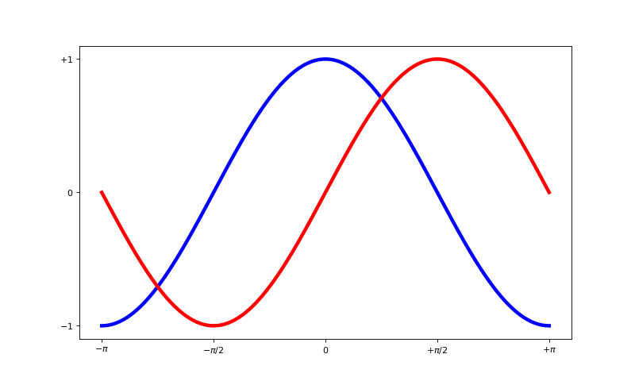
改变刻度
import numpy as np
import matplotlib.pyplot as plt
X = np.linspace(-np.pi, np.pi, 256,endpoint=True)
C,S = np.cos(X), np.sin(X)
plt.figure(figsize=(10,6), dpi=80)
plt.plot(X,C,color="blue",linewidth=4,linestyle="-")
plt.plot(X,C,color="red",linewidth=4,linestyle="-")
plt.xticks([-np.pi, -np.pi/2, 0, np.pi/2, np.pi],
[r'$-\pi$', r'$-\pi/2$', r'$0$', r'$+\pi/2$', r'$+\pi$'])
plt.yticks([-1, 0, +1],
[r'$-1$', r'$0$', r'$+1$’])
plt.show()
刻度位置
刻度对应标签，可忽略
text字符串支持LaTex的公式输入
xticks(ticks=None, labels=None, **kwargs)
尝试输入：plt.text(0, 0, "$\Theta=\pi r^2/\sqrt{x}$")
fontsize, rotation, ……
LaTex的公式输入语法自行网上查找

Slide 12
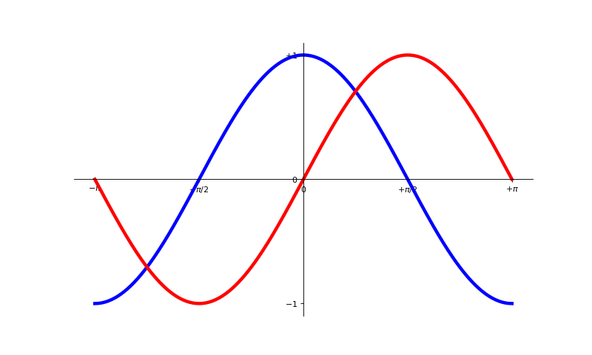
改变轴线(spine)位置
import numpy as np
import matplotlib.pyplot as plt
X = np.linspace(-np.pi, np.pi, 256,endpoint=True)
C,S = np.cos(X), np.sin(X)
plt.figure(figsize=(10,6), dpi=80)
plt.plot(X,C,color="blue",linewidth=4,linestyle="-")
plt.plot(X,C,color="red",linewidth=4,linestyle="-")
xticks([-np.pi, -np.pi/2, 0, np.pi/2, np.pi],[r'$-\pi$', r'$-\pi/2$', r'$0$', r'$+\pi/2$', r'$+\pi$'])
yticks([-1, 0, +1],[r'$-1$', r'$0$', r'$+1$’])
ax = plt.gca()
ax.spines['right'].set_visible(False)
ax.spines['top'].set_visible(False)
ax.xaxis.set_ticks_position('bottom')
ax.spines['bottom'].set_position(('data',0))
ax.yaxis.set_ticks_position('left')
ax.spines['left'].set_position(('data',0))
plt.show()
获取当前axes容器
上方和右边的轴线设为不可见
下方x轴刻度可见
把下方x轴线移动到数据的0处
左方y轴刻度可见
'outward', 'axes', 'data'
把左方y轴线移动到数据的0处

Slide 13
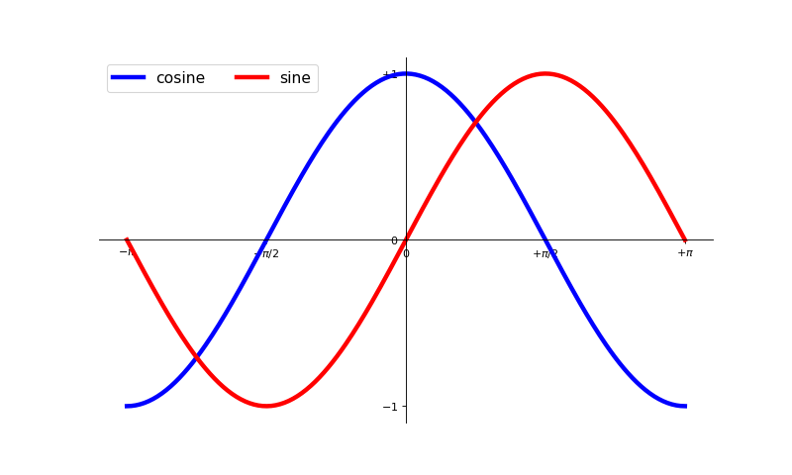
加上图例
import numpy as np
import matplotlib.pyplot as plt
X = np.linspace(-np.pi, np.pi, 256,endpoint=True)
C,S = np.cos(X), np.sin(X)
plt.figure(figsize=(10,6), dpi=80)
plt.plot(X,C,color=“blue”,linewidth=4,linestyle=“-”, label="cosine")
plt.plot(X,C,color="red",linewidth=4,linestyle="-", label="sine")
……
plt.legend(loc='upper left', fontsize=16, ncol=2)
全不写就采用默认值

Slide 14
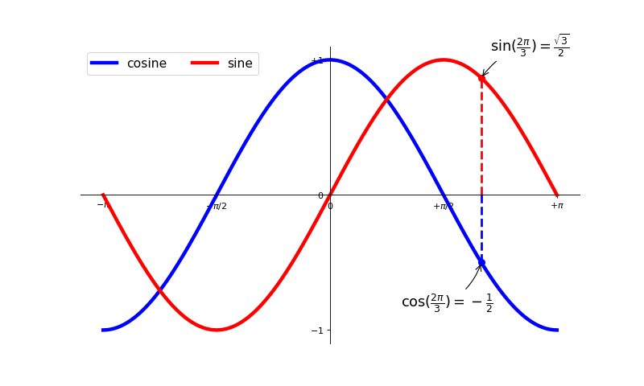
加上注释
...
t = 2*np.pi/3
plt.plot([t,t],[0,np.cos(t)], color ='blue',
linewidth=2.5, linestyle="--")
plt.scatter([t,],[np.cos(t),], 50, color ='blue')
plt.annotate(r'$\sin(\frac{2\pi}{3})=\frac{\sqrt{3}}{2}$',
xy=(t, np.sin(t)),
xycoords='data',
xytext=(+10, +30),
textcoords='offset points',
fontsize=16,
arrowprops=dict(arrowstyle="->",
connectionstyle="arc3,rad=.2"))
...
Value | Description
'figure points' | Points from the lower left of the figure
'figure pixels' | Pixels from the lower left of the figure
'figure fraction' | Fraction of figure from lower left
'axes points' | Points from lower left corner of axes
'axes pixels' | Pixels from lower left corner of axes
'axes fraction' | Fraction of axes from lower left
'data' | Use the coordinate system of the object being annotated (default)
'polar' | (theta,r) if not native 'data' coordinates
https://matplotlib.org/3.1.1/api/_as_gen/matplotlib.pyplot.annotate.html?highlight=annotate#matplotlib.pyplot.annotate
plt.text() 在图上任意位置添加文本

Slide 15
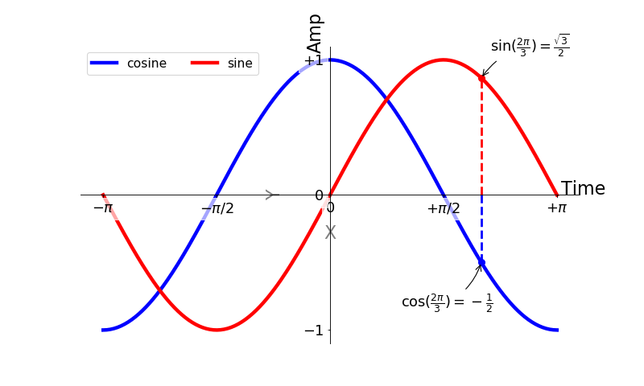
坐标轴标签
plt.xlabel("X axis", fontsize=20)
plt.ylabel("Y axis", fontsize=20)
labelpad
plt.text(3.2, 0, "Time", fontsize=20)
plt.text(-0.2, 1.2, "Amp", fontsize=20, rotation=90)
text字符串支持LaTex的公式输入
尝试输入：plt.text(0, 0, "$\Theta=\pi r^2/\sqrt{x}$")
LaTex的公式输入语法自行网上查找

Slide 16
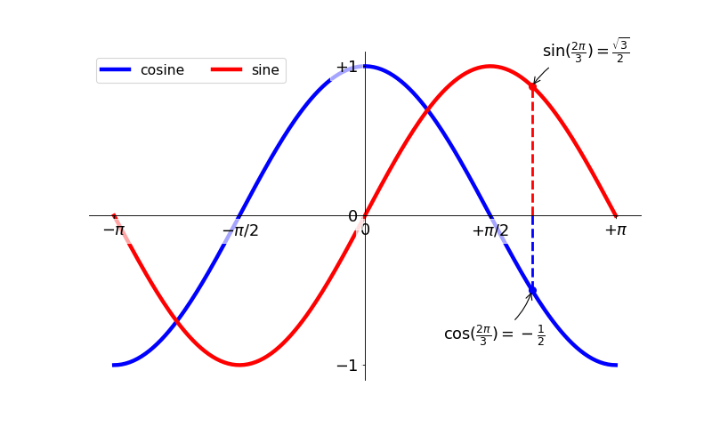
调整刻度外观
...
for label in ax.get_xticklabels() + ax.get_yticklabels():
label.set_fontsize(16)
label.set_bbox(dict(facecolor='white', edgecolor='None', alpha=0.65 ))
...

Slide 17
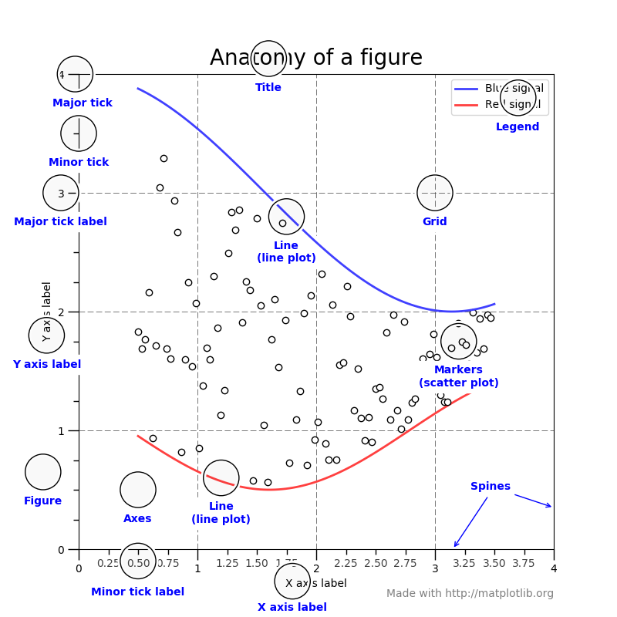
matplotlib对象
pyplot :
state-machine environment
用对象控制图中的每个元素
pylab提供了快速接口
不推荐

Slide 18
对象、容器
matplotlib API包含有三层
Artists分为简单类型和容器类型两种。简单类型的Artists为标准的绘图元件，例如Line2D、 Rectangle、 Text、AxesImage 等等。而容器类型则可以包含许多简单类型的Artists，使它们组织成一个整体，例如Axis、 Axes、Figure等。
backend_bases.FigureCanvas
backend_bases.Renderer
artist.Artist
Figures
Axes
axes
artists
Artist
Artist.set_***
Artist.get_***
patch
patch
Rectangle
Circle
pyplot.getp(Artist, “atriname”)
pyplot.setp(Artist, “atriname”)
images
images
FigureImage
AxesImage
legends
legends
Legend
lines
lines
Line2D
patches
patches
patch
texts
texts
Text
xaxis
XAxis
yaxis
YAxis

Slide 19
显式控制作图流程
import matplotlib.pyplot as plt
fig=plt.figure()
ax1 = fig.add_axes([0.1,0.1,0.8,0.8])
ax2 = fig.add_subplot(111)
ax1.plot(…)
ax2.plot(…)
fig.savefig(“name.png”)
plt.show()
plt.close(fig)
不需要对figure, Axes对象进行控制时这步可以省略
1.新建一张图
2.建立坐标轴（子图）
Axes.func()方法基本都有简便作图函数pyplot.func()
3.画图
4.保存或直接显示

Slide 20
Figure容器
1.新建一张图
pyplot.figure()
matplotlib.pyplot.figure(num=None,
figsize=None,
dpi=None,
facecolor=None,
edgecolor=None,
frameon=True,
FigureClass=<class'matplotlib.figure.Figure’>,
clear=False,
**kwargs)

Slide 21
Axes容器
2.建立一个/多个“图轴”
figure.add_axes()
figure.add_subplot()
Parameters: | rect : sequence of floatThe dimensions [left, bottom, width, height] of the new axes. All quantities are in fractions of figure width and height. projection : {None, 'aitoff', 'hammer', 'lambert', 'mollweide', 'polar', 'rectilinear', str}, optionalThe projection type of the Axes. str is the name of a custom projection, see projections. The default None results in a 'rectilinear' projection. polar : boolean, optionalIf True, equivalent to projection='polar’. sharex, sharey : Axes, optionalShare the x or y axis with sharex and/or sharey. The axis will have the same limits, ticks, and scale as the axis of the shared axes. label : strA label for the returned axes.
add_subplot(nrows, ncols, index, **kwargs)
add_subplot(pos, **kwargs)
add_subplot(axes)

Slide 22
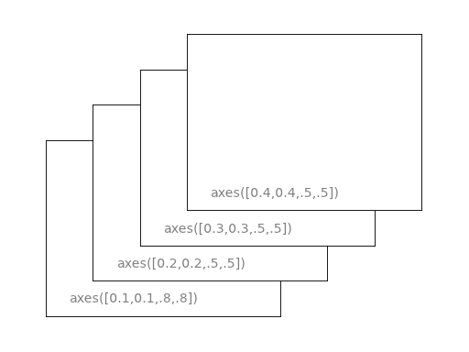
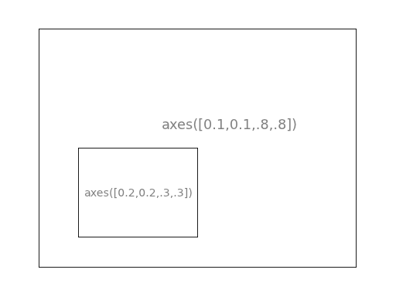
add_axes(left, bottom, width, height)
尺寸以figure的长宽为单位
后画的在上，zorder大的在上

Slide 23
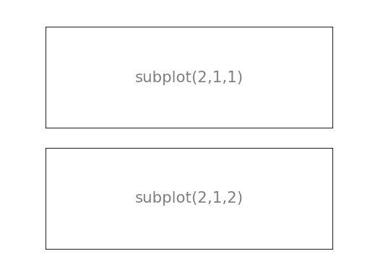
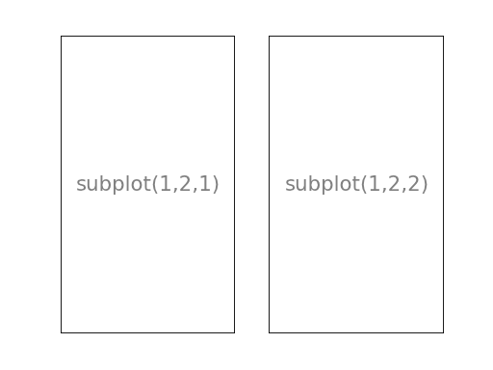
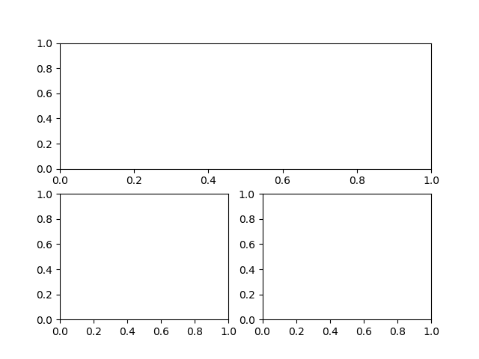
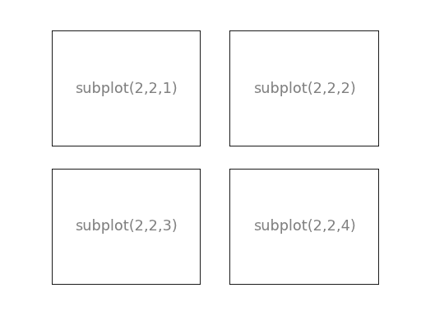
add_subplot(nrows, ncols, index)
fig.add_subplot(2,1,1)
(2,2,3)
(2,2,4)

Slide 24
Axes方法（画图函数）
3.画图
Axes.xxx
Axes的方法 | 所创建的对象 | 添加进的列表 | 描述
annotate | Annotate | texts | 添加注释
bars | Rectangle | patches | 柱状图
errorbar | Line2D, Rectangle | lines,patches | 带error bar的折线图
fill | Polygon | patches | 填充折线与x轴之间空间的图
hist | Rectangle | patches | 直方图
imshow | AxesImage | images | 给定二维坐标和相应颜色后画图
legend | Legend | legends | 显示图例
plot | Line2D | lines | 折线图
scatter | PolygonCollection | Collections | 散点图
text | Text | texts | 添加文字

Slide 25
全局默认参数
matplotlibrc文件
当前目录
用户配置目录
系统配置目录
matplotlib.rcdefaults()
import matplotlib
matplotlib.get_configdir()
恢复缺省配置（默认配置文件的配置）
查看当前用户配置目录路径
matplotlib.matplotlib_fname()
查看当前用户配置文件路径
matplotlib.rcParams
载入在本次运行中的配置参数
matplotlib.rcParams["lines.marker"] = "o"
将默认折线标志点设为圆圈
组名
控制变量名
matplotlib.rc("lines", marker="x", linewidth=2, color="red")
将默认折线标志点设为×，线宽设为2，颜色设为红色

Slide 26
参数控制：刻度样式
Axes.tick_params(self, axis='both', **kwargs)
…
fig = plt.figure()
ax = fig.add_subplot(111)
ax.tick_params(axis='x', labelsize=24, color='C4')
Parameters: | axis : {'x', 'y', 'both'}, optionalWhich axis to apply the parameters to.
Other Parameters: | axis : {'x', 'y', 'both'}Axis on which to operate; default is 'both'. reset : boolIf True, set all parameters to defaults before processing other keyword arguments. Default is False. which : {'major', 'minor', 'both'}Default is 'major'; apply arguments to which ticks. direction : {'in', 'out', 'inout'}Puts ticks inside the axes, outside the axes, or both. length : floatTick length in points. width : floatTick width in points. color : colorTick color; accepts any mpl color spec. pad : floatDistance in points between tick and label. labelsize : float or strTick label font size in points or as a string (e.g., 'large'). labelcolor : colorTick label color; mpl color spec. colors : colorChanges the tick color and the label color to the same value: mpl color spec. zorder : floatTick and label zorder. bottom, top, left, right : boolWhether to draw the respective ticks. labelbottom, labeltop, labelleft, labelright : boolWhether to draw the respective tick labels. labelrotation : floatTick label rotation grid_color : colorChanges the gridline color to the given mpl color spec. grid_alpha : floatTransparency of gridlines: 0 (transparent) to 1 (opaque). grid_linewidth : floatWidth of gridlines in points. grid_linestyle : stringAny valid Line2D line style spec.
把x轴的刻度文字大小设为24，刻度颜色设为当前颜色循环中的第四个颜色
from matplotlib.ticker import (MultipleLocator,
FormatStrFormatter,
AutoMinorLocator)
ax.xaxis.set_minor_locator(MultipleLocator(0.1))
设置副刻度间隔为0.1
ax.set_xscale("log")
设置x轴刻度以log均匀分布
plt.xscale("log")

Slide 27
参数控制：线段对象
fig = plt.figure()
ax = fig.add_subplot(111)
line = ax.plot([1,2])
本页的功能基本不会在实际操作中用到，只是作为认识matiplotlib中对象元素的示例
在图轴ax中添加了一条线段，并把该线段的入口返回给line变量
c = line.get_color()
返回线段对象的颜色
ax.spines['right'].set_visible(False)
ax.spines['top'].set_visible(False)
ax.xaxis.set_ticks_position('bottom')
ax.spines['bottom'].set_position(('data',0))
c = line.set_color('red')
把线段颜色设为红色
ax.lines[0].set_lw(5)
把线段宽度设为5，可以直接调用图轴中lines列表中的对象操作

Slide 28
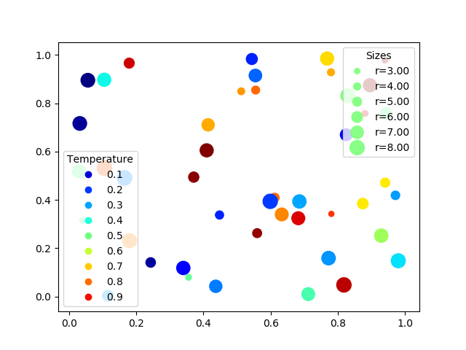
散点图
N = 45
x, y = np.random.rand(2, N)
c = np.random.rand(N)
s = np.random.rand(N)*100
fig, ax = plt.subplots()
scatter = ax.scatter(x, y, c=c, s=s, cmap='jet')
legend1 = ax.legend(*scatter.legend_elements(),
loc="lower left", title="Temperature")
ax.add_artist(legend1)
kw = dict(prop="sizes", num=5, color=scatter.cmap(0.5), fmt="r={x:.2f}", func=lambda s: np.sqrt(s / np.pi), alpha=0.9)
handles, labels = scatter.legend_elements(**kw)
legend2 = ax.legend(handles, labels, loc="upper right", title="Sizes")
如果不添加进axes中，第二个legend会覆盖第一个

Slide 29
scatter.legend_elements
用于生成散点图的图例：返回图例句柄（handle）和文字（label）
参数:
prop : string, optional, default "colors"
Can be "colors" or "sizes". In case of "colors", the legend handles will show the different colors of the collection. In case of "sizes", the legend will show the different sizes.
num : int, None, "auto" (default), array-like, or Locator,
optional Target number of elements to create. If None, use all unique elements of the mappable array. If an integer, target to use num elements in the normed range. If "auto", try to determine which option better suits the nature of the data. The number of created elements may slightly deviate from num due to a Locator being used to find useful locations. If a list or array, use exactly those elements for the legend. Finally, a Locator can be provided.
fmt : string, Formatter, or None (default)
The format or formatter to use for the labels. If a string must be a valid input for a StrMethodFormatter. If None (the default), use a ScalarFormatter.
func : function, default lambda x: x
Function to calculate the labels. Often the size (or color) argument to scatter() will have been pre-processed by the user using a function s = f(x) to make the markers visible; e.g. size = np.log10(x). Providing the inverse of this function here allows that pre-processing to be inverted, so that the legend labels have the correct values; e.g. func = np.exp(x, 10).
kwargs : further parameters
Allowed kwargs are color and size. E.g. it may be useful to set the color of the markers if prop="sizes" is used; similarly to set the size of the markers if prop="colors" is used. Any further parameters are passed onto the Line2D instance. This may be useful to e.g. specify a different markeredgecolor or alpha for the legend handles.

Slide 30
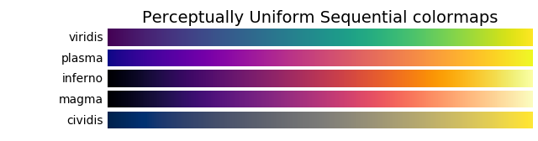
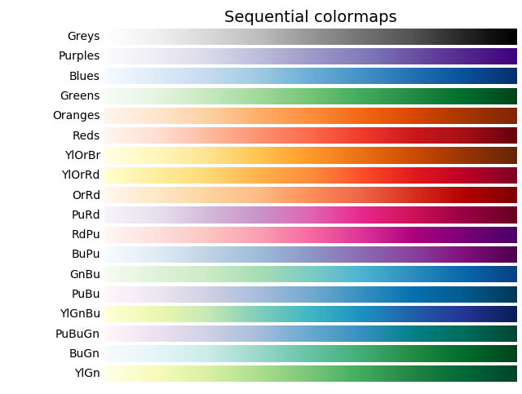
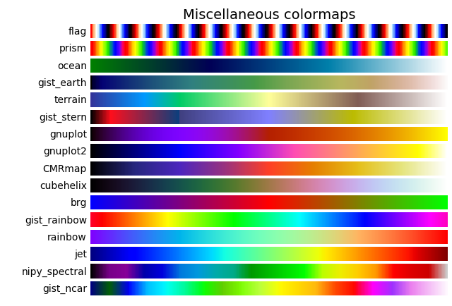
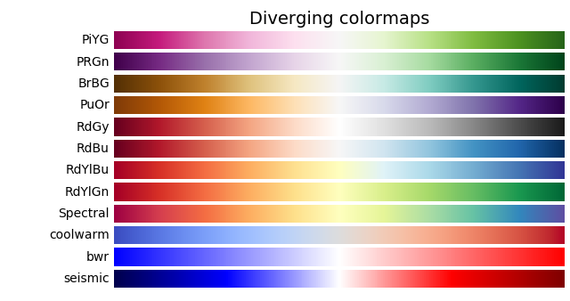
cmap

Slide 31
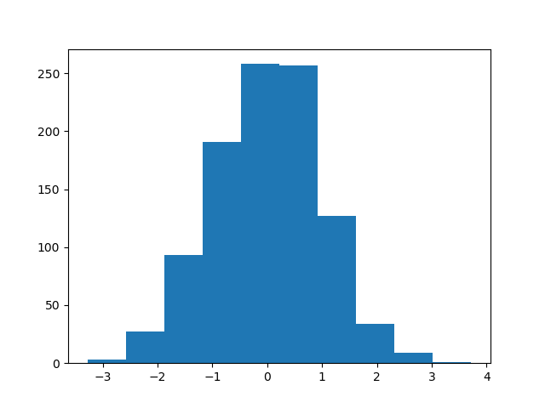
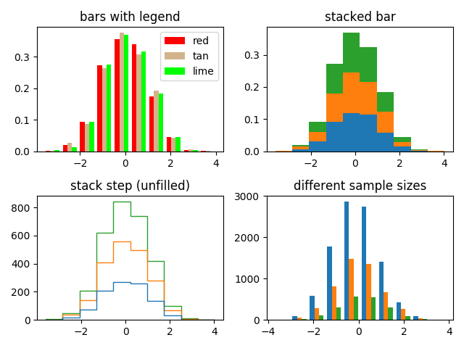
直方图
Axes.hist(self, x,
bins=None,
range=None,
density=None,
weights=None,
cumulative=False,
bottom=None,
histtype='bar',
align='mid',
orientation='vertical',
rwidth=None,
log=False,
color=None,
label=None,
stacked=False,
data=None,
**kwargs)
x=np.random.randn(1000)
fig,ax=plt.subplot(111)
ax.hist(x)
plt.show()
x : 输入数组，一维或二维。如果时N*M的二维数组，则对每一行的的M个数分布计算一次hist并一次性画出直方图
bins : 整数或数组。整数时表示分bin的数量，数组时表示bin的边界。默认为10。
denstiy : True时画出概率密度。默认为False。
log : True时Y轴刻度以log增长。等效于axes.set_yscale('log')。
cumulative : True时画数量累积图。
histtype : 柱状图的形式。'bar', 'barstacked', 'step', 'stepfilled'
rwidth : 每个柱子占bin宽度的比例，范围0-1，默认为1
align : 每个柱子与bin的对齐位置，'left', 'right', 'mid'，默认为'mid'
label : 图例标签

Slide 32
等高线图
Axes.contour([X, Y,] Z, [levels], **kwargs)
delta = 0.025
x = np.arange(-3.0, 3.0, delta)
y = np.arange(-2.0, 2.0, delta)
X, Y = np.meshgrid(x, y)
Z = np.sin(X)**10 + np.cos(10+X*Y) * np.cos(X)
X坐标矩阵
Y坐标矩阵
Z值矩阵
等高线的划分数量（整数）或位置（递增数组）
Axes.contourf([X, Y,] Z, [levels], **kwargs)
y[4]
Y[1,1]=y[1]
fig = plt.figure()
ax = fig.add_subplot(111)
CS = ax.contour(X, Y, Z,cmap='jet')
ax.clabel(CS, inline=1, fontsize=10)
fig.colorbar(CS, ax=ax, [cax=…])
ax.set_title('Simplest default with labels')
X[1,1]=x[1]
y[3]
Z[1,1]
y[2]
y[1]
在等高线上标记线高
y[0]
ax:依附的图轴；cax：画在该图轴内
x[0]
x[1]
x[2]
x[3]
x[4]
Z[3,2]
X[3,2]=x[3]
Y[3,2]=y[2]

Slide 33
contour方法的其他参数
cmap : 渐变颜色表
colors : 单一颜色或者颜色数组
想要更加细节设置，自行搜索图例读代码
vmin,vmax : 与渐变色标的0,1相对应的z值
ax.contour(X, Y, Z, cmap='jet', vmin=0, vmax=1)
linewidths : 线宽，可以是单个数字，也可以是数组
linestyles : 线型

Slide 34
色彩混合图（color mesh)
Axes.pcolormesh([X, Y,] Z, **kwargs)
delta = 0.025
x = np.arange(-3.0, 3.0, delta)
y = np.arange(-2.0, 2.0, delta)
X, Y = np.meshgrid(x, y)
Xmid = X[:-1,:-1]+delta/2
Ymid = Y[:-1,:-1]+delta/2
Zmid = np.sin(Xmid)**10 +\
np.cos(10+Xmid*Ymid) * np.cos(Xmid)
x边界矩阵
Y边界矩阵
Z值矩阵
y[4]
fig = plt.figure()
ax = fig.add_subplot(111)
PS = ax.pcolormesh(X, Y, Zmid,cmap='gist_rainbow')
fig.colorbar(PS, orientation='horizontal')
Z[1,1]
y[3]
y[2]
y[1]
X[1,2]=x[1]
y[0]
x[0]
x[1]
x[2]
x[3]
x[4]
Y[1,2]=y[2]
X[1,1]=x[1]
X[2,2]=x[2]
Y[1,1]=y[1]
Y[2,2]=y[2]
X[2,1]=x[2]
Y[2,2]=y[1]

Slide 35
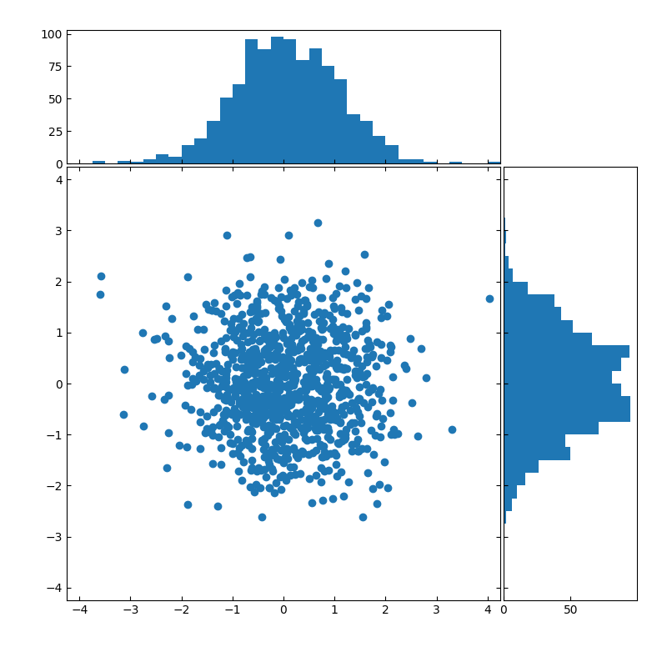
作业
做以下模拟
有10000个粒子，每个粒子质量为1，初始在一个100x100的二维方形范围内均匀分布。
粒子在二维平面内运动，运动方式为 随机位置变化+中心引力势场下的加速运动 。
每个粒子在下一秒的位置为以其目前位置为中心，向随机方向移动（0,1）之间的随机距离。随机运动不会使粒子增加速度。
在盒子中心有一个质量为10的黑洞，会对粒子施加引力。粒子之间没有引力。
请计算经过10000秒后各个粒子的位置。
时间，质量，长度单位都为1，G也设为1。粒子运动没有边界。
X方向的分布
粒子位置的散点图，如果画图速度慢的画可以从10000个粒子中随机取1000个粒子画
Y方向的分布
采用最终的粒子信息，画以下两幅图（X,Y方向的范围限制在原始的100x100区域内）
1.粒子位置分布的散点+直方图。示意图在右侧，注意调整图中的样式（如散点大小，透明度）来改进图片的视觉效果。如何画横向直方图请自行搜索资料。
2.画出平面上粒子平均动能分布的等高线+color mesh图，画出color mesh图的color bar。
交所有的.py文件(用jupyter notebook画的把对应的代码导出到.py文件)。上交前务必测试程序能正常运行。
No+Name+p2

