Slide 1
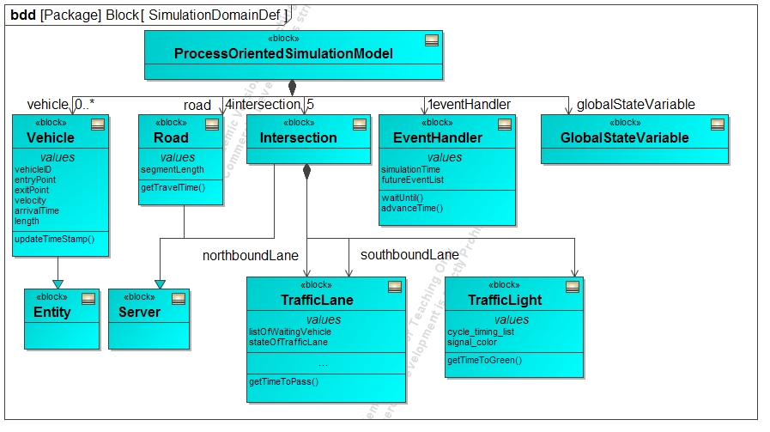
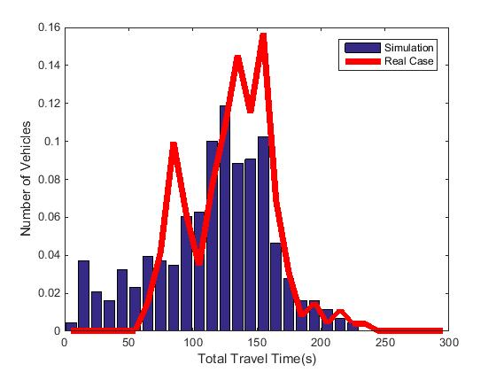
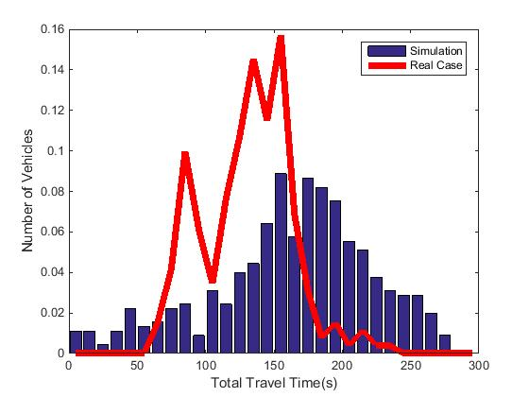
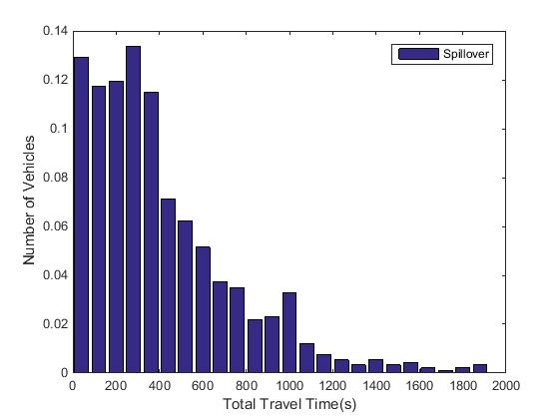
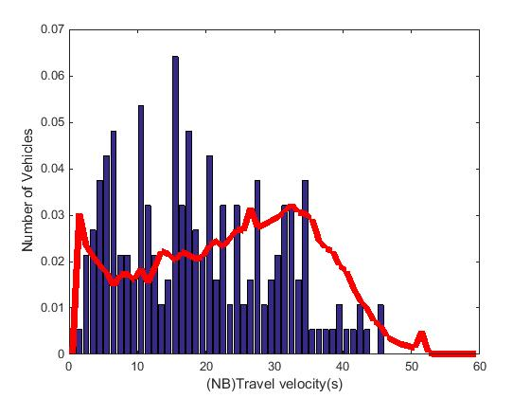
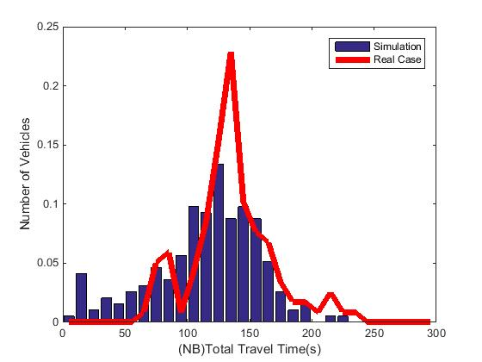
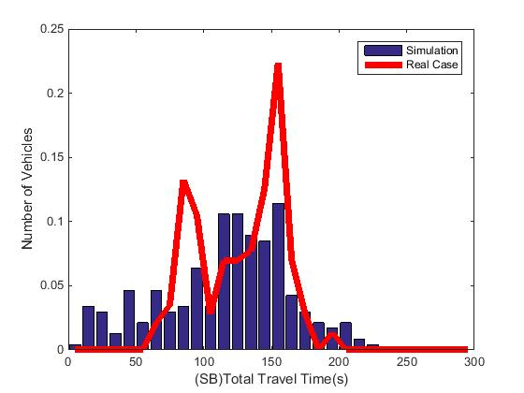
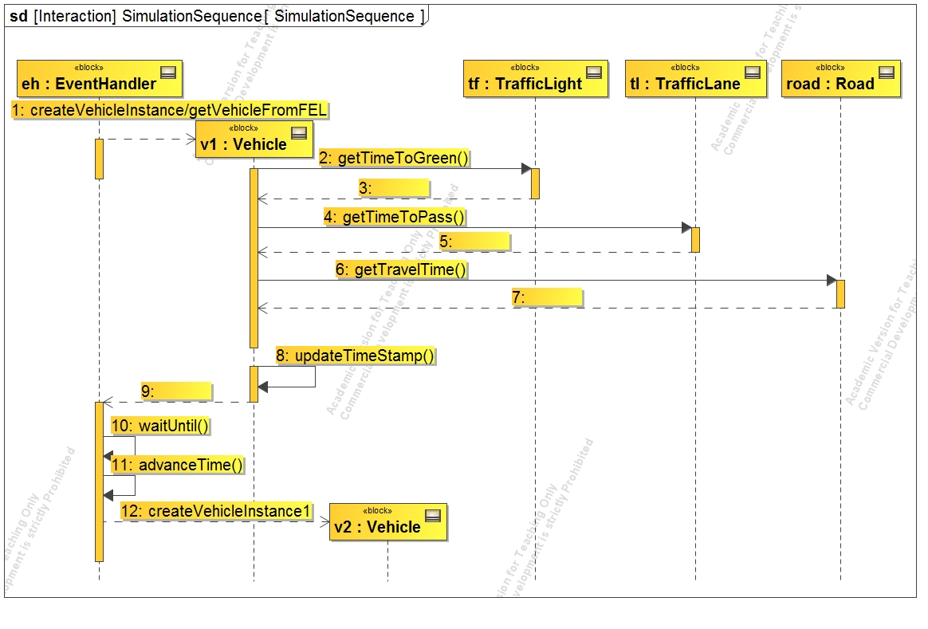
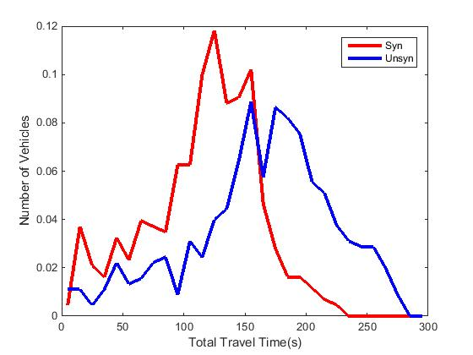
Group 24: “Process Oriented Traffic Simulation: Synchronized vs. Unsynchronized Traffic Signals”
Conceptual Model
Synchronized , Unsynchronized & Spillover-Unsynchronized
Average Travel time: Synchronized vs. Real Average from given data
Average Travel time: Unsynchronized vs. Real Average from given data
Average Travel time: Spillover Unsynchronized
Simulation Architecture
Validation, Verification & Statistical Tests
Validation:
Velocity: Simulation Model vs. Real data
Travel time: Synchronized North Bound
Travel time: Synchronized South Bound
Hypothesis
Testing:
Student Two sample t-test: Reject the hypothesis that Sync. and Unsync. are from same distribution. 95% CI: 47.8 - 48.25
Observations:
Best offset value for Synchronized Signals is 4 and worst is 15
Obtained same percentage of total number of vehicles/segment and total and side turns

