Slide 1



Introduction to Audio Power of Feeling

Slide 2


Topic
Why using sound in our projects?
How to improve your projects with Audio
Audio source.
2D Audio vs 3D Audio.
Audio listener.
Coding with Sound Effects.
Sound Managers.

Slide 3
What benefit of using Audio?
There exist sounds and melodies in video games that are nearly impossible to forget or fail to recognize, owing to the profound impact they have had on the technology experience and the industry as a whole.
Consider the familiar, everyday sounds that one can instantly discern: the approach of a nearby car on the street, a text message notification chiming from a mobile phone, the rapping of a door signaling someone's desire to enter a room or engage with the occupant. We are inherently attuned to comprehending events and forthcoming situations solely through auditory cues.

Slide 4



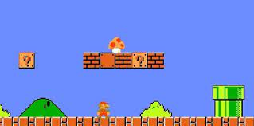
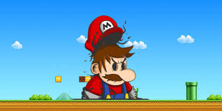


Examples
The mushroom powerup sound effect in Mario games has remained virtually unchanged since its introduction in 1985, exemplifying one of many iconic game sounds recognizable even to non-gamers.
But why hasn't this sound evolved to suit modern technology capabilities? The reason lies in its effectiveness. Despite its origins in limited technology, this sound still effectively conveys its message.

Slide 5
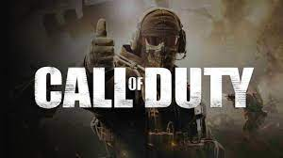

Examples
The Call of Duty series excels at conveying online match status through sound, a crucial feature given the cluttered HUD in this fast-paced game. An announcer issues team call-outs for mid-game events, such as enemy power-ups, offering immediate cautionary alerts. Furthermore, intense background music signals crucial moments, prompting players to step up their efforts to secure victory or prevent the enemy team from winning.

Slide 6

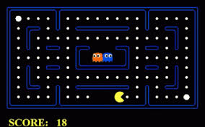
Examples
Recognizing whether something sounds favorable or unfavorable is relatively straightforward. How do the auditory cues of acquiring health or points compare to the sound of sustaining damage from an adversary or encountering a Game Over screen?
If you've played Pac-Man, you'll recognize its sound design. Losing a life is accompanied by a "disappointed" melody, conveying a sense of failure. Conversely, eating a ghost results in a powerful, rewarding note. This escalation in pitch with each subsequent ghost eaten not only signals success but also provides satisfaction, motivating players to strive for more ghost-eating feats, enhancing their gaming experience.

Slide 7
Feeling
Music should also be used to create a feeling within the player, whether there is a story involved or not. Am I adventuring through a brightly lit jungle filled with whimsical creatures to battle and interact with, or am I fighting for survival in a run-down city taken over by zombies? Use music to complement the tone of your gameplay and setting to create a mood for the player.

Slide 8

Wilhelm scream
Comments

Slide 9
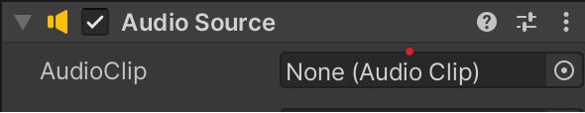
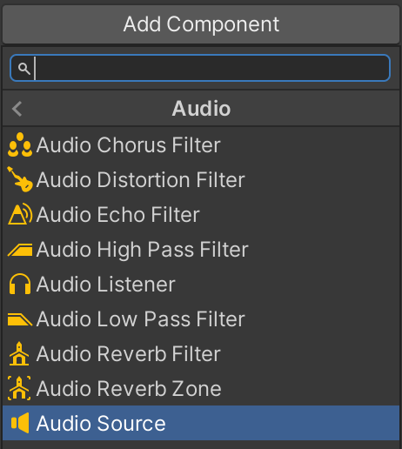


Audio Source
Go to GameObject -> Create Empty Attach an Audio Source component to this newly created object within the Inspector window.
Add Component -> Audio -> Audio Source Select a song from the Unity package we've imported and set it as the Audio Clip for the Audio Source.
Audio Clip : sound file we want to directly attach to this Audio Source to be able to play right away with ease.
In the Audio Source component, you'll see that "Play On Awake" is enabled, indicating that it will automatically start playing the attached Audio Clip when the scene begins. When you enter Play Mode, make sure to listen, but be cautious of your computer's volume since the Audio Source is initially set to maximum volume.
By default, the Loop option in a new Audio Source will always be unchecked. So, remember to check this box when adding music to your games. While you can experiment with sound effects, it's not the ideal choice for them.

Slide 10

Spatial Blend
2D sounds are universally audible, regardless of your location within the game world. This feature is particularly useful for elements like music and player feedback, such as hit markers and narration.
In contrast, 3D sounds are position-sensitive and can vary in volume based on their distance from your character. This characteristic is well-suited for 3D games that include dynamic elements like vehicles, adversaries, and bustling environments.
If you want to get really specific with your proximity sounds, you can tweak the 3D Sound Settings.

Slide 11
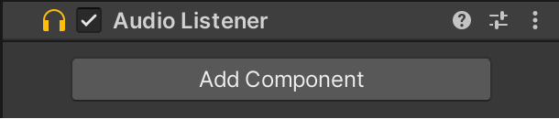
Audio Listener
The Audio Listener is the essential component that enables us to audibly experience our game. Without it, the game would be completely devoid of sound.
It's important to note that only one Audio Listener can exist within a scene at any given time; otherwise, Unity will prioritize one over the other. Wherever this component is placed within our scene, that's where 3D Audio Sources will have their loudest presence.
This component doesn't offer any configurable settings or properties in the Inspector; its sole purpose is to facilitate our ability to hear the game. However, you have the freedom to detach it from the Main Camera and attach it to a different game object if needed.

Slide 12

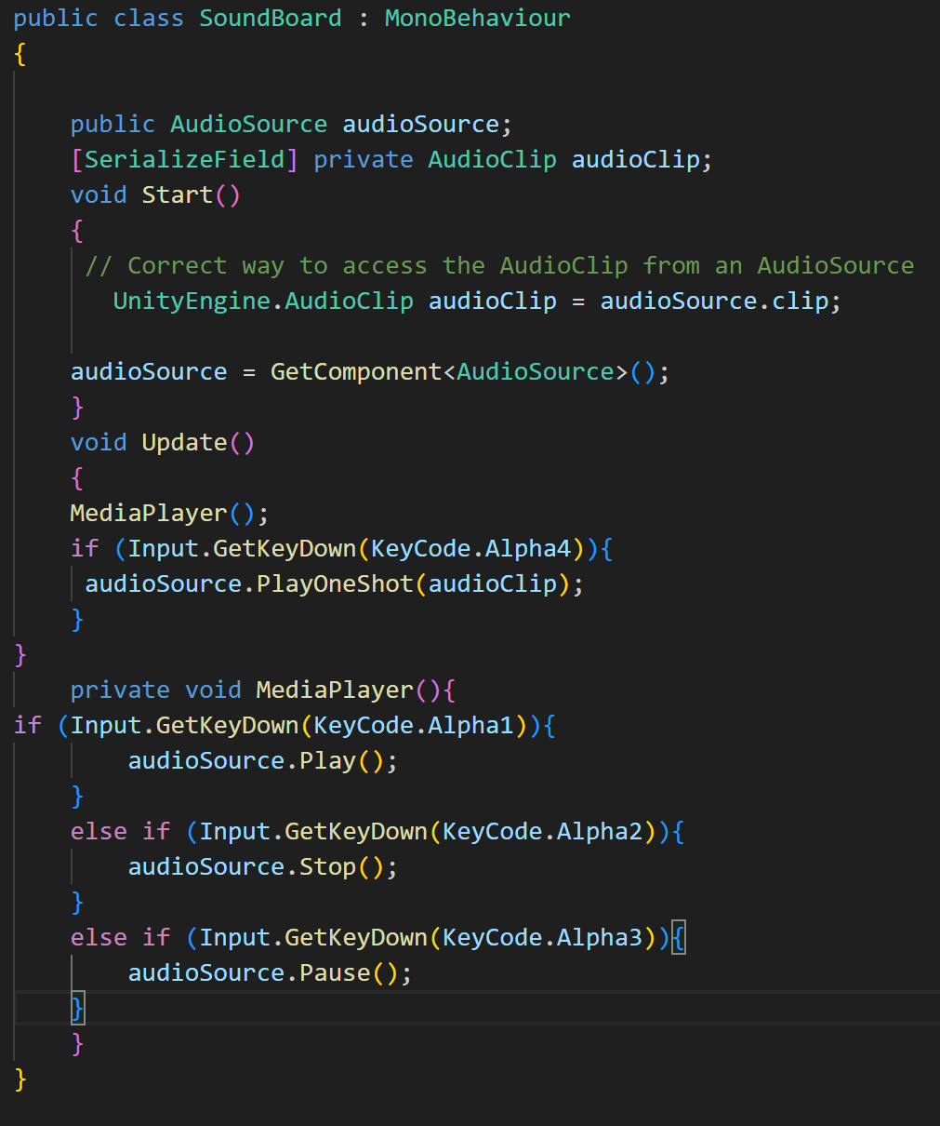
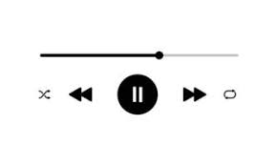

Coding in Audio
recognize and code Audio Source variables
script Audio Sources to play, pause, and stop

Slide 13
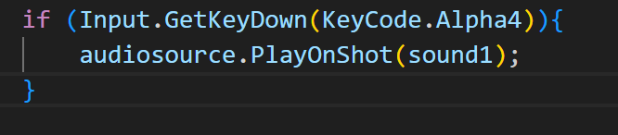
Coding Sound Effects
Audio Source is not just a single sound clip for us to play, it is where many different sounds can be played from on command. The Audio Clip we plugged into our Audio Source acts as the main track for that component and is mainly used for musical purposes.
If we press our 4 key, then play our AudioClip.

Slide 14
Think
What is the difference between these tow mothed ?

Slide 15
Sound Managers
Returning to the topic of sound coding, Sound Managers will become your primary resource for integrating audio into your gameplay. Sound Managers are script components that store various sounds for multiple other scripts to access and trigger. Think of them as the central hub for sound-related code, where different objects and scripts can reach out to play sounds.
For instance, player sound effects, enemy sound effects, and item sound effects can all be managed and played from a single Sound Manager, eliminating the need to clutter your scene with multiple Audio Sources
try catch and finally

Slide 16
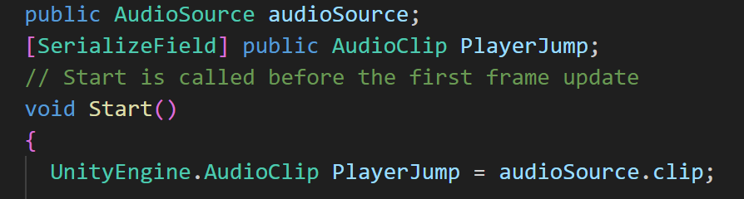
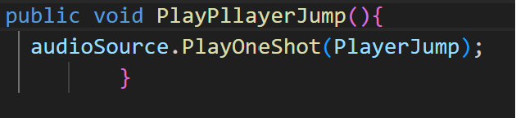
Sound Managers
Now, let's create our Sound Manager. Begin by creating an empty game object named "SoundManager" and attach a new script to it, also named "SoundManager."

Slide 17
Player Jump Sound
Now that we have a Sound Manager set up, let's have our player make a sound when jumping, like that of Mario or Sonic.
Open up the PlayerJump script, and let's make these edits.
Where the player jumps, we reference the Sound Manager and call the method that plays the jump sound effect.

Slide 18
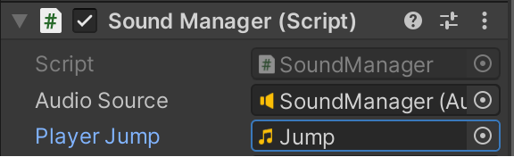
Player Jump Sound
Return to the Unity Editor and select your Sound Manager game object. Now look at its SoundManager script component.
Drag and drop the SoundManager game object into Audio Source. The script will recognize that this game object has an Audio Source component attached to it.
Drag and drop the appropriate sound file from your Project window into Player Jump. This is what sound will play when we jump.

Slide 19
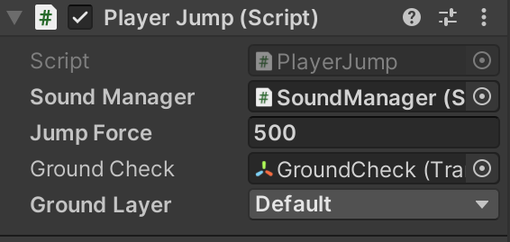
Player Jump Sound
Don’t forget this ….

Slide 20
Is the Sound Manager Necessary?
At first glance, it might appear that we're adding unnecessary steps to play a sound effect when we could simply code and attach the Audio Source directly to the player object. However, it's essential to consider the long-term perspective here. This Sound Manager is intended to manage a multitude of distinct sound effects. To illustrate, imagine if we programmed an enemy to play sounds from its own script, but later, we decided to destroy that enemy. In such a scenario, it would be problematic because the script responsible for playing its sounds would also be destroyed.
By using Sound Managers, we streamline the process and avoid potential complications in sound effect management. These managers help us circumvent tedious coding challenges that could arise when dealing with sound effects, ultimately enhancing the efficiency of our project.

Slide 21
Let’s listen more
Now , we can add more Audio clip to our Sound Manager ,lets started with win sound.

Slide 22
Tips…
Something important to note is what type of audio files we should work with in Unity. Although both WAV and MP3 files work just fine, WAV files are what you want really. WAV files are best optimized for Unity and maintain the best quality of that sound. Once you're actually searching and downloading sound effects, you'll know what type of audio file they are.
Free source website :
https://freesouwhand.org/
https://www.purple-planet.com/
take a look on Audacity

Slide 23
Any Question !

