Slide 1
TIME SERIES DATA PREDICTION BY SENTIMENT ANALYSIS
Department of Computer Science and Engineering
Project Viva Voce
Team Members
715514104021 KaushikKumar TRS
715514104039 Sanjay B
715514104306 Vignesh D
715514104055 Vasanth S
Guided By
Dr. T Hamsapriya
Head of the department(CSE)

Slide 2
Objective
To create a high accuracy model for predicting the bitcoin price and to find the right time for buying or selling a bitcoin by analyzing the predicted time series data.
CS6811 Project Work

Slide 3
Bitcoin
Decentralized digital Crypto currency
Peer -to-Peer
1BTC = 8036.35 USD
Enabled by:
Blockchain : distributed immutable ledger
Mining : record-keeping service
Wallet : stores informations to transact bitcoins
Privacy : funds are tied to bitcoin addresses not real world entities
Reliability : distributed immutable ledger
CS6811 Project Work

Slide 4
Why bitcoin price prediction
Bitcoin users has increased by 10 times this year.
Highly volatile in nature.
Very high returns than conventional financial trading.
Many new users want to join everyday.
CS6811 Project Work

Slide 5
Problem Statement
Is there a correlation between Twitter sentiment and BTC price fluctuation?
Can a deep learning prediction model be used to predict the future bitcoin price with high accuracy?
By analyzing the sentiments of tweets regarding bitcoin and comparing with Bitcoin’s price.
CS6811 Project Work

Slide 6
Existing Solution
Predicting Bitcoin price fluctuation with Twitter sentiment analysis
  By EVITA STENQVIST [2017]
METHOD : To identify the correlation between Bitcoin price change and Twitter sentiment change, two temporal aspects were taken into account; frequency length and shift. Short term predictions were made on discrete time intervals
DISADVANTAGE : No machine learning model was used. Only a naive prediction model was presented, based on the intensity of sentiment fluctuations from one time interval to the next
CS6811 Project Work

Slide 7
Literature Survey
Twitter mood predicts the stock market
By Johan Bollena, Huina Maoa, Xiaojun Zeng
Investigation of whether measurements of the collective mood states derived from large-scale Twitter feeds are correlating with the value of the Dow Jones Industrial Average (DJIA) were done. The daily Twitter feeds were analyzed by two mood tracking tools, namely OpinionFinder that measures positive vs. negative mood and Google-Profile of Mood States (GPOMS) that measures mood in terms of 6 dimensions.
CS6811 Project Work

Slide 8
Literature Survey
Sentiment Analysis of Twitter Data: A Survey of Techniques
By Vishal A. Kharde, S.S. Sonawane
Sentiment analysis of twitter data was made to analyze the information in the tweets where opinions are highly unstructured, heterogeneous and are either positive or negative, or neutral in some cases. The comparative analyses of existing techniques for opinion mining like machine learning and lexicon-based approaches, together with evaluation metrics was made.
CS6811 Project Work

Slide 9
Literature Survey
Sentiment Analysis of Twitter Data for Predicting Stock Market Movements
by Venkata Sasank Pagolu, Kamal Nayan Reddy Challa
Sentiment analysis and supervised machine learning principles were applied to the tweets extracted from twitter and the correlation between stock market movements of a company and sentiments in tweets was analyzed for predicting the stock market movements.
CS6811 Project Work

Slide 10
Proposed Methodology
Tweets
Stemming
Tokenization Embedding
Sentiment Extraction
Coin Desk API
Bitcoin Price
Merge
Model
LSTM
Feature Vector
CS6811 Project Work

Slide 11
IMPLEMENTATION
CS6811 Project Work

Slide 12
DATA PREPARATION
Data is fetched from a 3rd party source, cleaned and split into training and testing. Data is loaded and Unused fields are removed.Pandas is used to read the .csv file and less significant columns are removed.
Data is Split into training and testing sets (usually 70%, 30%).
70% of the data is used for training the model and remaining 30% is used for
validation.
A function to create a new dataset with a look_back is defined.
Data is Normalized and prepared for training.
MinMaxScaler pre-processing class from scikit-learn library is used to normalize the data.
CS6811 Project Work

Slide 13
TRAINING MODEL
The Sequential model which stacks all layers (input, hidden and output) is defined. The sequential model is used to add sequence of layers in the recurrent neural network
The LSTM cell is added to our sequential model.
The number of units (dimension of the output state) used for the LSTM cell. The dimensionality of the LSTM is chosen as 100.
Sigmoid activation function used for the LSTM cell.
Adam Optimizer is used to minimize the loss function.
The loss function that is necessary to minimize while adjusting the
weights and biases of the network is selected.
CS6811 Project Work

Slide 14
TRAINING MODEL
Neural networks are typically trained on batches which mean that on
every iteration a number of examples from the training set is picked and used for training. Batch size of 100 is used
The number of epochs determines how many iterations are necessary
make to train the model. Epochs is set to 300.
The output layer is finally added to the sequential model. It is a
simple Dense with default linear activation function of dimension 1.
This is the last step before the actual training. The optimizer and the
loss function specified above are defined.
The model is trained using inputs x_train and labels y_train.

Slide 15
PRICE PREDICTION
Once the model is trained now the trained model is used to predict the price of the test dataset. Dataset preparation is exactly the same as we done for training data.
Fit_transform is used to scale the data and then reshaped for prediction.
Prices of test dataset is predicted
The predicted data is rescaled to match its real values (prices in USD)
Results are now visualized using matplot.
CS6811 Project Work

Slide 16
RESULTS
CS6811 Project Work

Slide 17
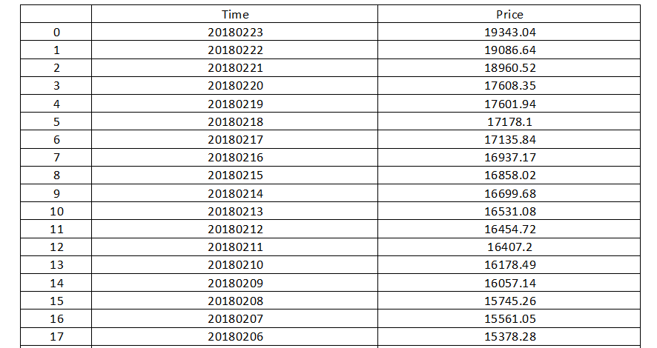
HISTORICAL BITCOIN PRICE
CS6811 Project Work

Slide 18
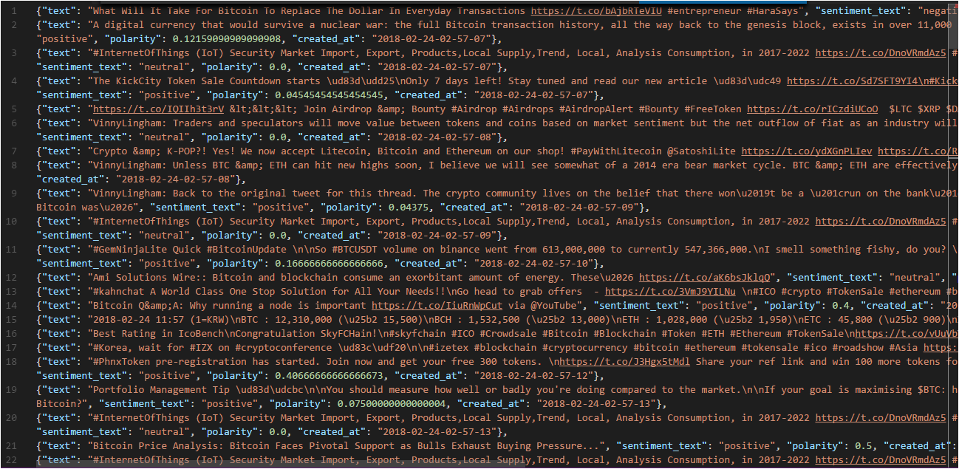
LIVE TWEET COLLECTION
CS6811 Project Work

Slide 19
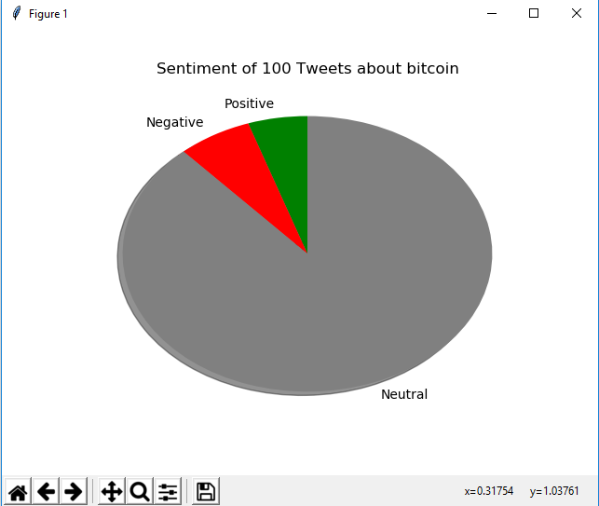
SENTIMENTS ABOUT BITCOIN
CS6811 Project Work

Slide 20
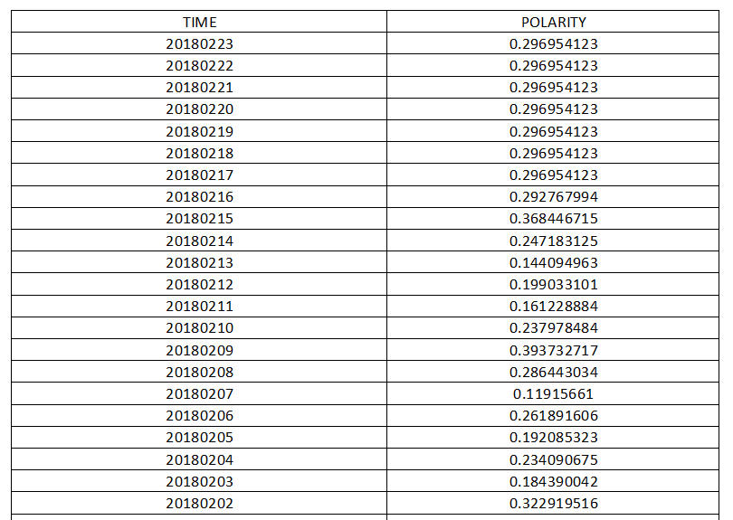
POLARITY OF HISTORICAL TWEETS
CS6811 Project Work

Slide 21
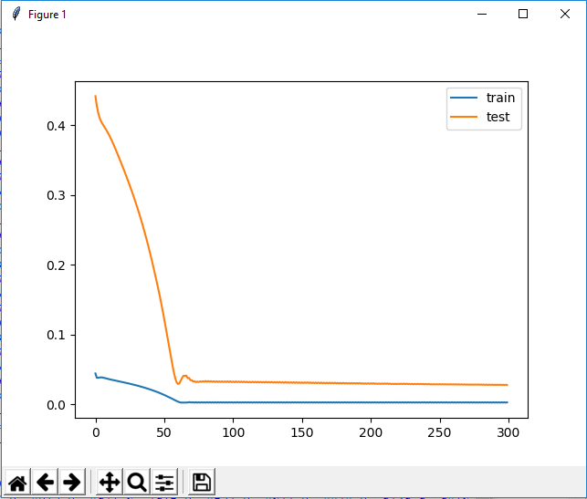
LOSS VS EPOCH
CS6811 Project Work

Slide 22
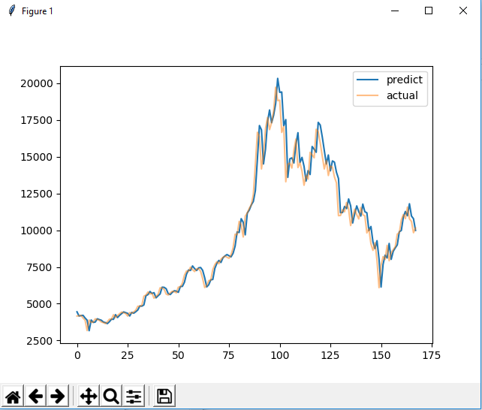
MODEL PREDICTION
CS6811 Project Work

Slide 23
Validation / Testing
Dataset consist two years of average tweet polarity score and bitcoin closing price for each day . Average tweet polarity for a day is found by gathering all bitcoin related tweets on that day .
The dataset is divided into 70-30. 70 % is used for training the model and remaining 30% is used for testing the model .
Loss in training and testing data set is used to determine the number of epochs.
Dataset with different look back is created to analyze the model performance.
CS6811 Project Work

Slide 24
Conclusion and Future Enhancements
The decision to buy or sell the bitcoin can be made by using the predicted bitcoin price on the next day.
The sentiments on the bitcoin price is used to train a Recurrent Neural Network and to develop a model that predicts the future bitcoin price.
Using a Domain Specific Lexicon would improve the sentiment analysis process and thus could improve the quality of the model developed.
Only tweet sentiments are analyzed in 2 dimension positive or negative. By analyzing sentiments in higher dimension better predictions results can be obtained.
CS6811 Project Work

Slide 25
References
[1] Using sentiment analysis to predict interday Bitcoin price movements, Niels Degrandea, Vytautas Karaleviciusa, Jochen De Weerdta, KU Leuven, Faculty of Economics and Business, Research Centre for Management Informatics (LIRIS).
[2] An Empirical Study on Modelling and Prediction of Bitcoin Prices with
Bayesian Neural Networks Based on Blockchain Information, Huisu Jang
and Jaewook Lee Department of Industrial Engineering, Seoul National
University, Seoul 151742, South Korea.
[3] Predicting Bitcoin price fluctuation with Twitter sentiment analysis, Evita
Stenqvist.
[4] Twitter mood predicts the stock market, by Johan Bollena, Huina Maoa,
Xiaojun Zeng.
CS6811 Project Work

Slide 26
[5] Sentiment Analysis of Twitter Data: A Survey of Techniques, by Vishal
A. Kharde, S.S. Sonawane.
[6] Predicting the Time series data using LSTM Recurrent Neural Network,
by machine learning mastery.
[7] Sentiment Analysis of Twitter Data for Predicting Stock Market
Movements, by Venkata Sasank Pagolu, Kamal Nayan Reddy Challa.
[8] Predicting the price of Bitcoin using Machine Learning, by Sean
McNally.
CS6811 Project Work

Slide 27
Thank you
CS6811 Project Work

