Slide 1
Bitcoin price prediction using sentimental analysis
Department of Computer Science and Engineering
First Review
Team Members
715514104021 Kaushik Kumar TRS
715514104039 Sanjay B
715514104306 Vignesh D
715514104055 Vasanth S
Guided By
Dr.Hamsa Priya
Head of the department(CSE)

Slide 2
MOTIVATION
“[Bitcoin] is a remarkable cryptographic achievement… The ability to create something which is not duplicable in the digital world has enormous value…Lot’s of people will build businesses on top of that.”
Bitcoin price has increased by 2700% in two years .
Right now there are 21 million bit coin stakeholders world wide.
BTC ∝ demand ∝ people opinion
Total number of Bitcoin user has increased by 210 percentage over the last two years
Highly volatile in nature

Slide 3
OBJECTIVE
To create a high accuracy model for predicting the bit coin price .
To find the right time for buying or selling a bitcoin .

Slide 4
PROBLEM STATEMENT
While analyzing sentiments of people on bitcoin and bitcoin price
Is there any correlation between bitcoin price and people opinion on BTC?
can a prediction model based on sentiments give better prediction results than a prediction models based on historical BTC price?

Slide 5
LITERATURE SURVEY
Title:
Twitter Sentiment Analysis: Lexicon Method, Machine Learning Method and Their Combination by Olga Kolchyna, Th´arsis T. P. Souza, Philip C. Treleaven and Tomaso Aste.
Method :
This paper covers the two approaches for sentiment analysis: i)lexicon based method; ii) machine learning method. A new ensemble method that uses a lexicon based sentiment score as input feature for the machine learning approach and was proved to produce more precise classifications.

Slide 6
LITERATURE SURVEY
Title :
Algorithmic Trading of Crypto currency Based on Twitter Sentiment Analysis by Colianni .
Method :
The authors used supervised machine learning techniques like Naive Bayes, logistic regression, and support vector machines that yielded a final accuracy of above 90% hour-by-hour and day by- day. The authors point out that the 90% accuracy was yielded through error analysis on the input data, which on average yielded a 25% better accuracy

Slide 7
LITERATURE SURVEY
Title :
Trading on Twitter: Using Social Media Sentiment to Predict Stock Returns by Sul .
Method :
2.5 million tweets about S&P firm sentiment values are found and compared to the stock values. The results showed that sentiment through a social network quickly is anticipated to be reflected in a stock price on the same trading day

Slide 8
PROPOSED METHODOLOGY
Step 1:
Analyzing the sentiments of tweets by implementing Textblob.
Step 2:
Predicting the BTC price using the sentimental scores of the tweets and bitcoin price by implementing Long short- term memory(LSTM).

Slide 9
PROPOSED METHODOLOGY
DATA COLLECTION :
Tweets referencing bitcoin are collected from Twitter API, GitHub and stored for analyzing the sentiment values.
BTC time series data are fetched from CoinDesk,Coinbase.
DATA PREPROCESSING :
Data pre-processing allows to produce higher quality of text classification and reduce the computational complexity.
Some of the data preprocessing steps are part-of-speech(POS) tagging , stemming and lemmatisation, stop-words removal negations Handling and tokenisation into N-grams.

Slide 10
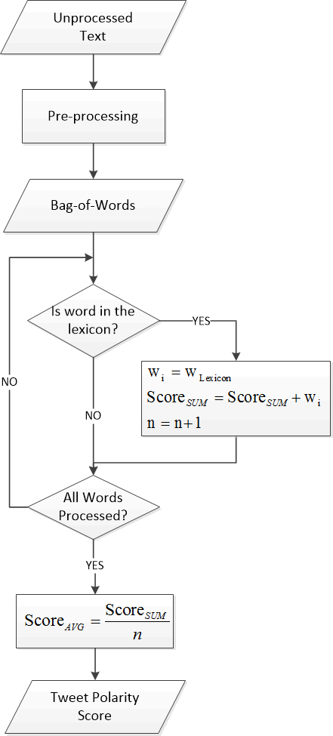
LEXICON BASED APPROACH

Slide 11
PREDICTION METHODOLOGY
Reddit / Tweets
Stemming, Tokenization, Embedding
Sentiment Extraction
CoinDesk API
Bitcoin Price
Merge
LSTM
Feature Vector

Slide 12
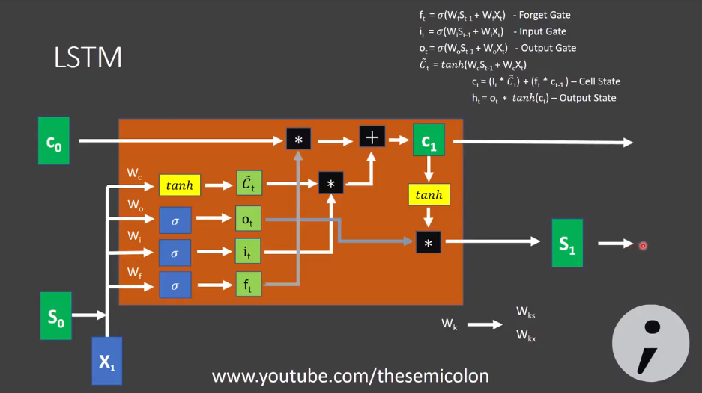
PREDICTION METHODOLOGY

Slide 13
TIMELINE

Slide 14
PROGRESS MADE
Gathered live tweets from Twitter and by performing sentiment analysis on the tweets a pie chart has been plotted.
Collected live bitcoin price and historical bitcoin price by using Coindesk and Coinbase API.

Slide 15
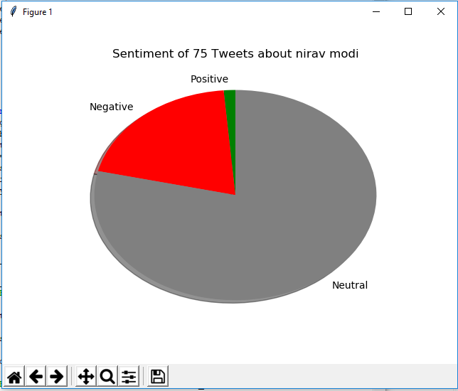
PARTIAL RESULT

Slide 16
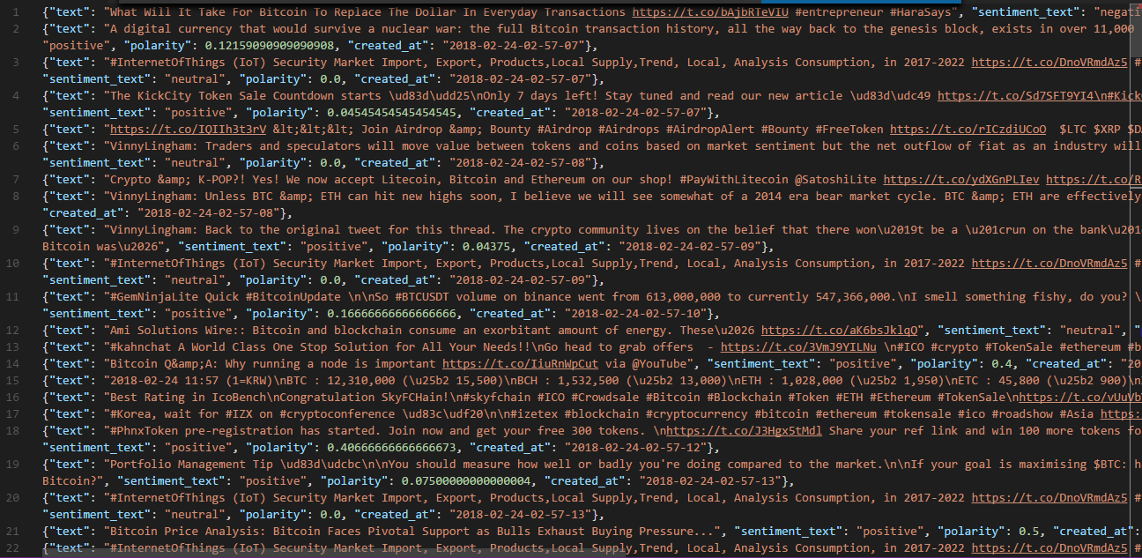
PARTIAL RESULT

Slide 17
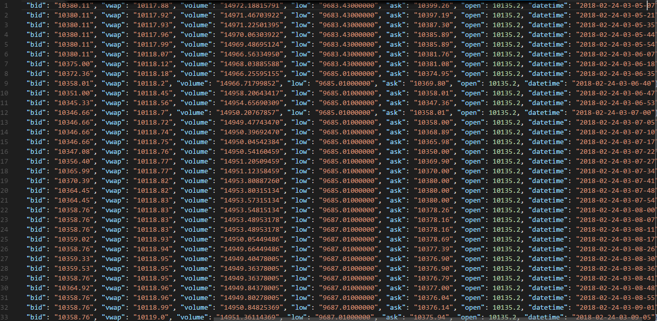
PARTIAL RESULT

Slide 18
REFERENCES
Using sentiment analysis to predict interday Bitcoin price movements. Niels Degrandea, Vytautas Karaleviciusa, Jochen De Weerdta, KU Leuven, Faculty of Economics and Business, Research Centre for Management Informatics (LIRIS).
An Empirical Study on Modelling and Prediction of Bitcoin Prices With Bayesian Neural Networks Based on Blockchain Information, HUISU JANG AND JAEWOOK LEE Department of Industrial Engineering, Seoul National University, Seoul 151742, South Korea.
Predicting the price of Bitcoin using Machine Learning, Sean McNally.
Predicting Bitcoin price fluctuation with Twitter sentiment analysis, EVITA STENQVIST.

