Slide 1
ONLINE SHOPPERS INTENTION
Guided by - Mr. Srikar Muppidi
Group Members:
- AMIT KUMAR
- VINAY KUMAR
- KAUSHIK KUMAR TRS
- SANDESH G KINI
- SUSHMA RAMESH

Slide 2

CONTENTS
PROBLEM STATEMENT
ABOUT THE DATA
PROBLEM WITH THE DATA
. DATA EXPLORATION
BASE MODEL SELECTION
FUTURE PROSPECTS

Slide 3
Problem Statement
.
Predict whether a user will generate revenue based on the information from one user session.
Since ecommerce business wants increase the revenue and target relevant users for the their campaigns and promotions.Business wants to analyse the users' session and parmeters like Bounce Rate,Exit Rates and Page Values provided by Google Analytics.
By Classifying users' sessions using relevant statistical techinques and appropiate Machine Learning methods after data preprocessing.

Slide 4
About the Data
Features | Description
Administrative | This is the number of pages of this type (administrative) that the user visited.
Administrative Duration | This is the amount of time spent in this category of pages.
Informational | This is the number of pages of this type (informational) that the user visited.
Informational Duration | This is the amount of time spent in this category of pages.
Bounce Rates | The percentage of visitors who enter the website through that page and exit without triggering any additional tasks.
Exit Rates | The percentage of pageviews on the website that end at that specific page.
Page Values | The average value of the page averaged over the value of the target page and/or the completion of an eCommerce.
The data that we use has details of 12330 sessions for different users provided by the Google analytics.

Slide 5
About the Data
Categorical | Details
Special Day | This value represents the closeness of the browsing date to special days or holidays.
Month | Contains the month the pageview occurred, in string form.
Operating Systems | operating system that the user was on when viewing the page.
Browser | browser that the user was using to view the page
Region | An integer value representing which region the user is located in.
Traffic type | An integer value representing what type of traffic the user is categorized into
Visitor Type | whether a visitor is New Visitor, Returning Visitor, or Other.
Weekend | A boolean representing whether the session is on a weekend.
Revenue | A boolean representing whether or not the user completed the purchase.

Slide 6
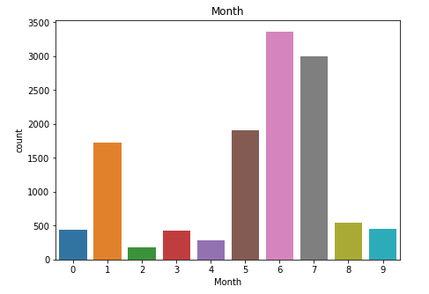
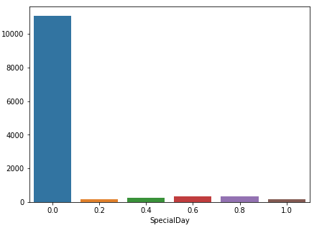
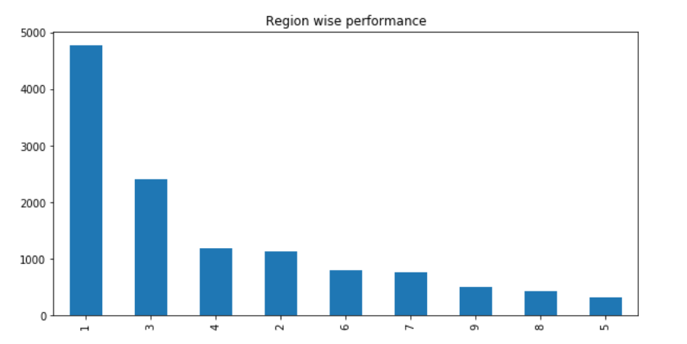
UNIVARIATE ANALYSIS

Slide 7
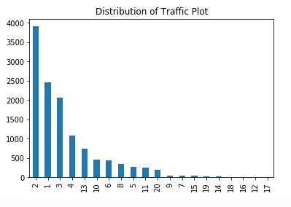
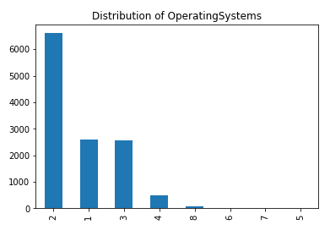
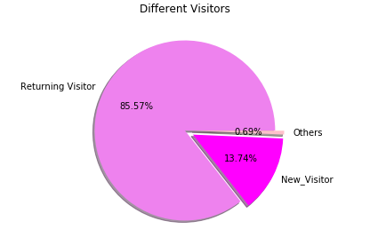
UNIVARIATE ANALYSIS

Slide 8
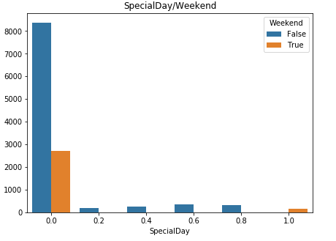
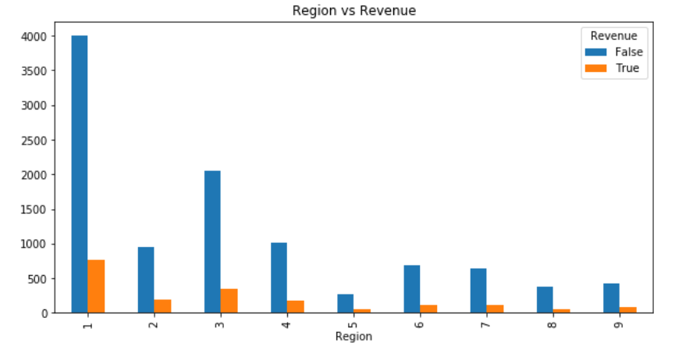
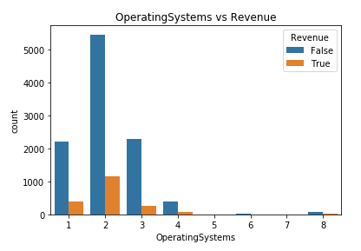
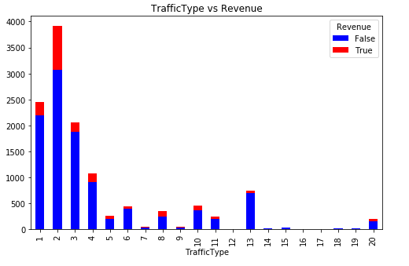
BI-Variate Analysis

Slide 9
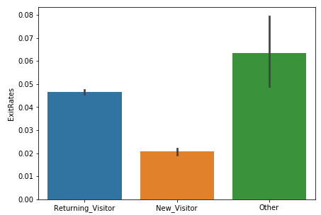
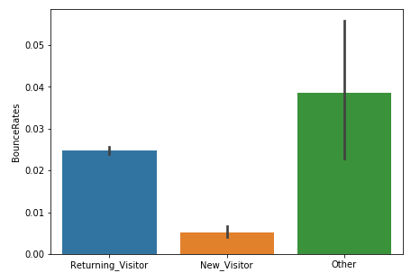
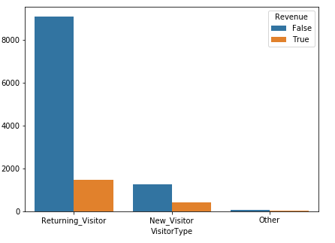
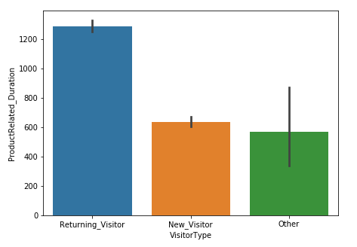
BI-Variate Analysis

Slide 10
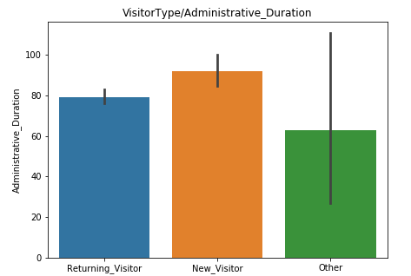
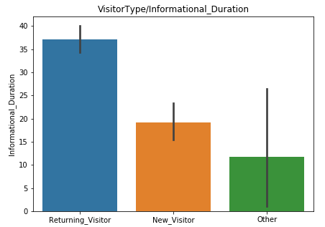
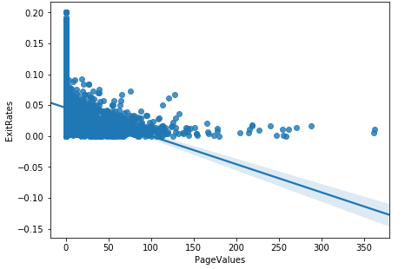
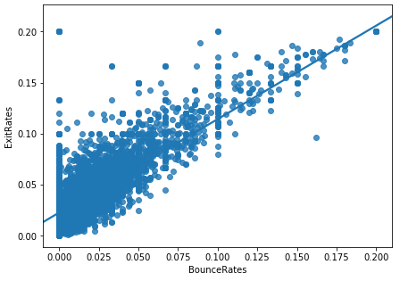
BI-Variate Analysis

Slide 11
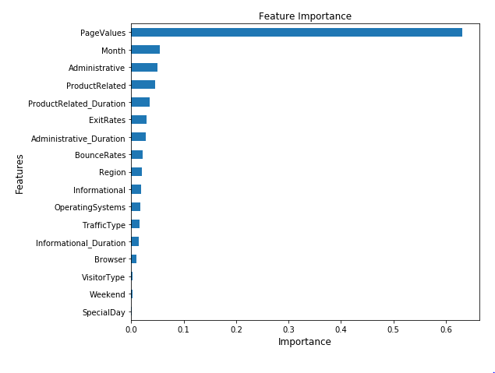
FEATURE IMPORTANCE

Slide 12
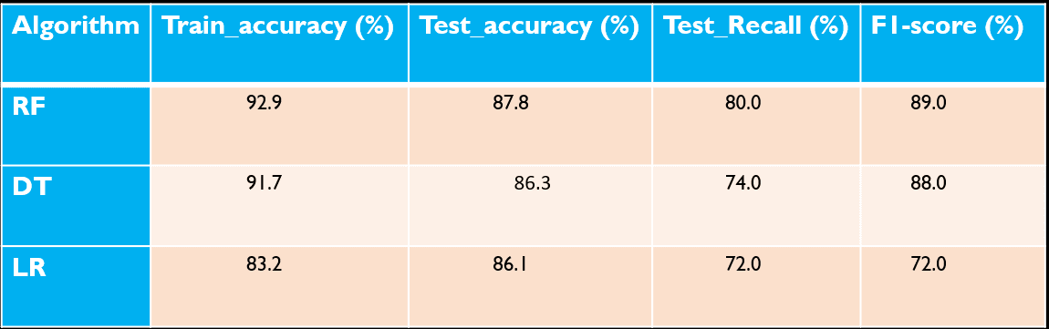
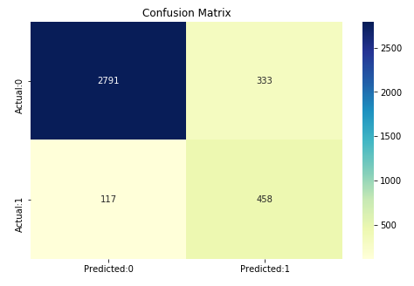
SELECTION OF BASE MODEL

Slide 13

Future Prospects and Improvements.
Analysis on different models.
Clustering techniques.
Classification as per the user’s session activities .
Hyperparameter tuning.
Time series analysis.

