Slide 1
MALIGNANT COMMENT CLASSIFICATION
SOCIAL MEDIA DATA MINING PROJECT PRESENTATION
By: Trapti Dubey

Slide 2
INTRODUCTION
The proliferation of social media enables people to express their opinions widely online.
Social media platforms are the most prominent grounds for such expressions.
However, at the same time, this has resulted in the emergence of conflict and hate, making online environments uninviting for users.
Goal is to build a prototype of online hate and abuse comment classifier which can be used to classify hate and offensive comments so that it can be controlled and restricted from spreading hatred and cyberbullying.

Slide 3
OBJECTIVE
Internet comments are bastions of hatred and vitriol. While online anonymity has provided a new outlet for aggression and hate speech, machine learning can be used to fight it.
The problem we sought to solve was the tagging of internet comments that are aggressive towards other users. This means that insults to third parties such as celebrities will be tagged as unoffensive, but “u are an idiot” is clearly offensive.
Objective is to build a prototype of online hate and abuse comment classifier which can be used to classify hate and offensive comments so that it can be controlled and restricted from spreading hatred and cyberbullying.

Slide 4

DATA EXTRACTION
1. train.csv: This contain the dataset on which will be working upon
2. test.csv: I have to predict the output for this data through the best model

Slide 5
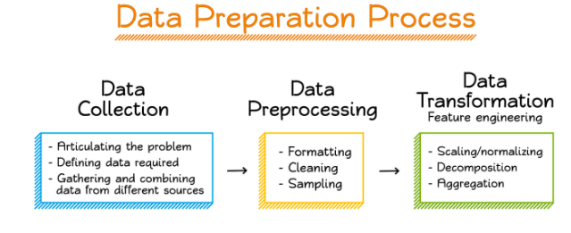
PREPROCESSING OF THE DATA
I have performed the following preprocessing on the data:
Removed punctuations
Removed the stop words
Stemming and lemmatization
Applied counter vectorizer

Slide 6

DATA MODELLING
I have used the Multinomial Naïve Bayes classifier for classification.
As it is suitable for classification with discrete features.
The algorithm estimates the conditional probability of a particular word given a class.
The variation takes into account the number of occurrences

Slide 7
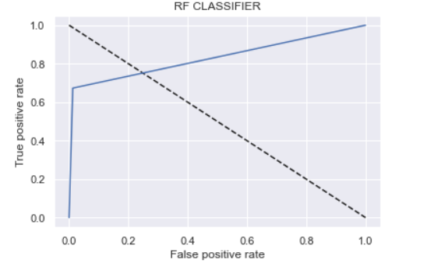
DATA MODELLING
I have trained 5 different models:
Logistic Regression,
Random Forest,
Decision Tree Classifier
AdaBoost Classifier.
I have started modifying model parameters, perform feature engineering and balancing data strategies to improve the performance of the models.
Tried with more trees in the Random Forest model, include new variables, penalize wrong predictions from the minority class until I beat the performance of my current best model.

Slide 8
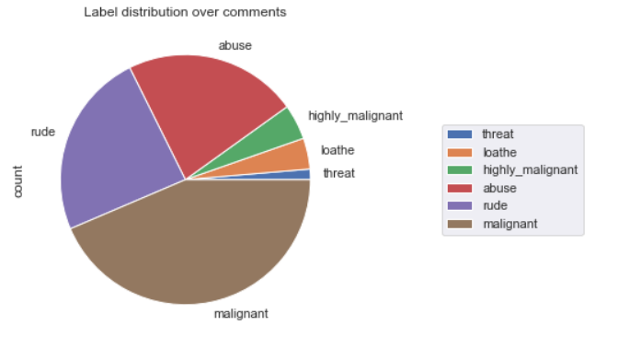
DATA VISUALIZATIONS

Slide 9
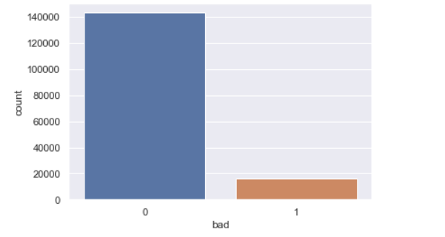
DATA VISUALIZATIONS

Slide 10
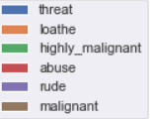
ANALYSIS OF RESULTS
Upon testing the models, on the malignant data I have analyzed the following:
The highest percentage of comments is in below order
Malignant
Rude
Abuse
Highly Malignant
Loathe
Threat

Slide 11
FUTURE SCOPE
The current project predicts the malignant comment in the dataset.
We can add the following features in the future:
Predicted which age group is showing toxic behaviour to a particular group or person .
Add feature to automatically sensitize words which are classified as malignant.
Automatically send alerts to the concerned authority if threats are classified as severe.
Handle mistakes and short forms of words to get better accuracy of the result.

Slide 12
THANK YOU

