Slide 1
Video Analytics - SBI
Powered By - Microsoft Corporation Pvt Ltd.

Slide 2


Problem Being Solved
An alert system to prevent
ATM Theft/ Burglary/ Dacoit (Fire / Theft related incident taking place)
ATM Skimming (Suspicious Activities)
15 minutes video to command center upon alert

Slide 3
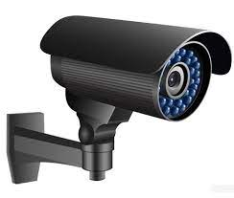
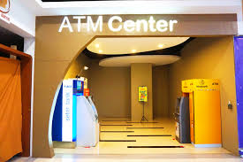
Fact analysis to create the model
1
2
3
No of persons involved
ATM theft
ATM Burglary
ATM Dacoit
Reasons to commit
Easy money
Isolated place
Absence of security guard
Majority night time (12 to 4 AM)
Tampering evidences
Late reporting and arrests
Delayed punishment
Distinct modus operandi:
ATM breaking with Gas cutter
ATM breaking with Rod / Digging bar
ATM breaking by human force
ATM by Key/ any other device
ATM lifting with Chain / Excavator
Any other unknown method
4
5
7
6
2017 – 18 :
18.63 Crs
Average time for a successful theft/ Burglary/ Dacoit:
3 to 15 minutes
CCTV issues:
Captures light
Numerous resolutions
Multiple angles
15/20/25/30/60 frames per second (FPS)
Black & White / Colour
ATM centre issues:
Artificial light in ATM
Natural Day / Night Light
Subject / Object behaviour

Slide 4
Behaviour
Subject: Non-stationary
Object: Stationary
Approach taken to create the model
Live stream: Alerts in real time
Recorded: grabs the historical events
8
6
7
Red: 0-255
Green: 0-255
Blue: 0-255
Live stream / Recorded Video
11
12
Simplifying the problem
Naming the object
10
Objective / Problem
13
9
Object detection using Azure.ai
a. ATM Theft/ Burglary/ Dacoit
Video Acquisition
Image Conversion
30 FPS
Image pre-processing
Subject is not in the purview of the study
b. ATM Skimming
Cropping the object
16
17
15
16
14
15
If actual is within the specifications of predicted, then “No alert” else “alert”
Continuously predicts the results by trained ML model
Upon alert, 15 minutes of video to command centre
Compare Actual v/s Predict
Development of Time series ML model
Feature selection
Continuously recording the actual values
Point 16 in detail: The model predicts the RGB value of each pixel for the detected object under study and sum up the all the predicted pixel values.
Addressing the misconceptions
Huge memory
High end processors
Expensive investments
Point 17 in detail: the sum of RGB predicted values is compared with actual value. If the sum of the actual value falls out of the sum of predicted values, then this change will generate an alert

Slide 5
Prerequisites
Azure Ai or similar object detection technology
Python
Normal computer
CCTV live stream or recordings

Slide 6
Any supporting assumptions, functional requirements(FR) and non-functional requirements(NFR)

Slide 7
Reason why your solution should be considered
100% efficient & accurate
Alerts the command center at the time of commencement of theft, during theft or after theft

Slide 8
Source code (Github Repository Link)
NOT APPLICABLE

Slide 9
Demonstration Video showing the functionalities/ working of the solution.
WORK IN PROGRESS

Slide 10

Submitted By : T R SUNIL KUMAR
Email : trsunil.kumar@sbi.co.in / trskumar19@sbi.co.in
Mobile No: 9967777849

