Slide 1
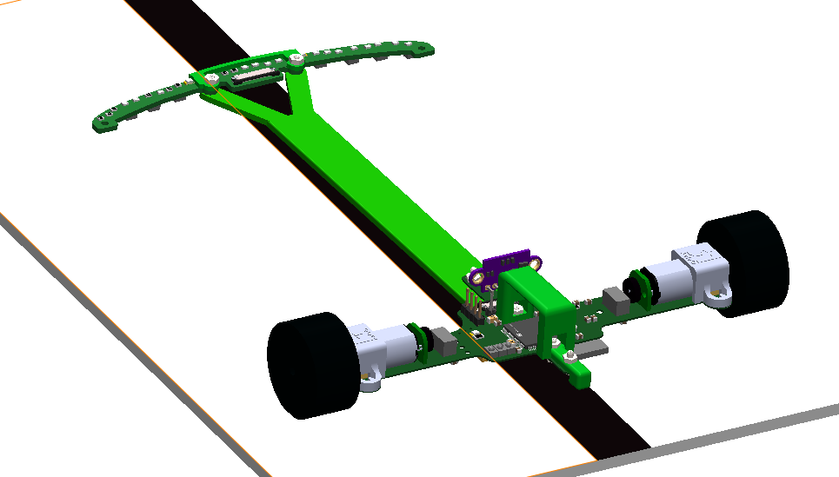
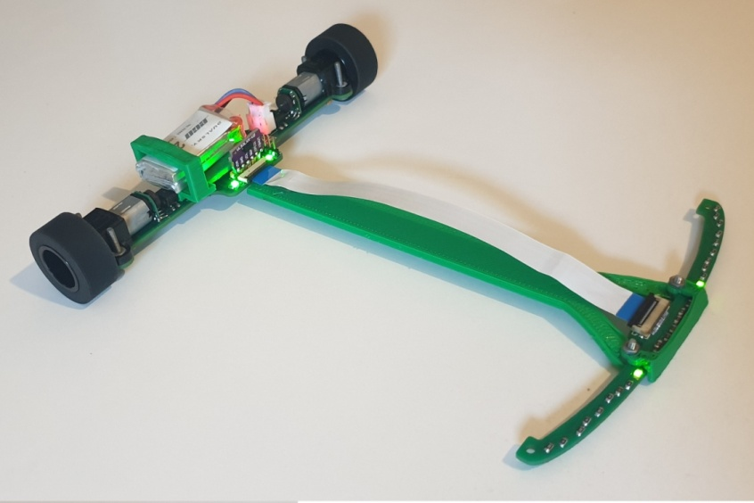
My Construction of Line Follower robot

Slide 2
Demo video:
Experiments in house environment
https://www.youtube.com/watch?v=5hosZAXFKjE
Robot competition „X_Challange 2023, Rzeszow”:
https://www.youtube.com/watch?v=OcwFzTCTTZQ

Slide 3
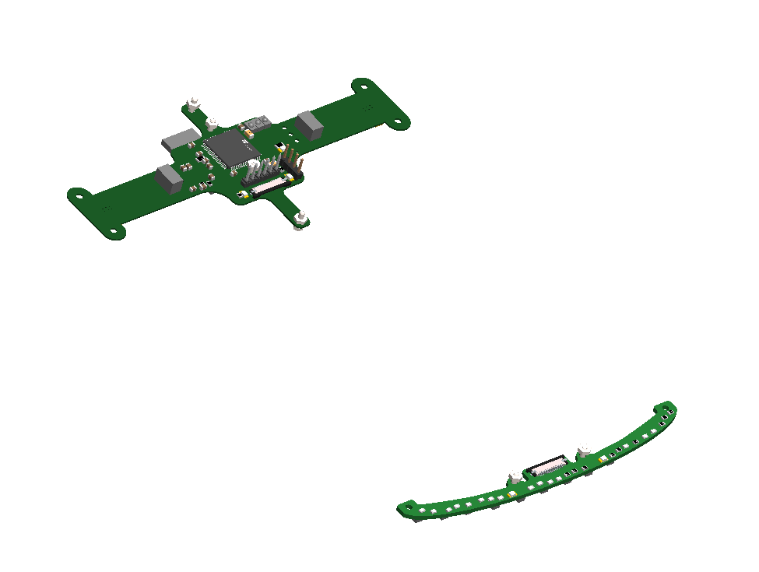
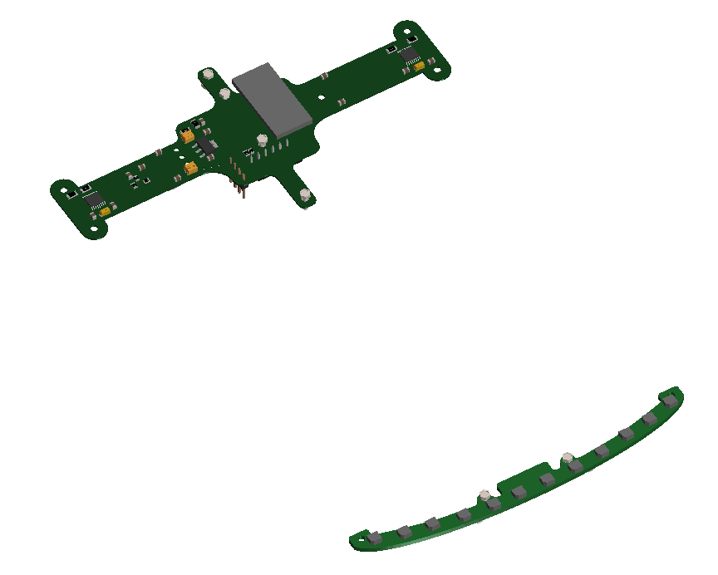
Electrical structure:
The electrical structure of the vehicle model is made from designed printed circuits in Altium Designer:

Slide 4
Skeleton and connection
The 3D model of robot has been designed using Solidworks
In the next step – designed parts were printed on 3D Printer.

Slide 5
High level overview, hardware blocks
IMU
MPU6050
MCU STM32 -H743VIT6
LQFN
Line Detection module
KTIR-0711S Sensors
Motor driver
H-Bridge
DRV8833
Motor pololu
HPCB 1:10
Enkoder,
Pololu 3018
Motor driver
H-Bridge
DRV8833
Motor pololu
HPCB 1:10
Enkoder,
Pololu 3018
Distance sensor
VL53L0
Bluetooth
HC-06
Receiver IR-
TSOP2236

Slide 6

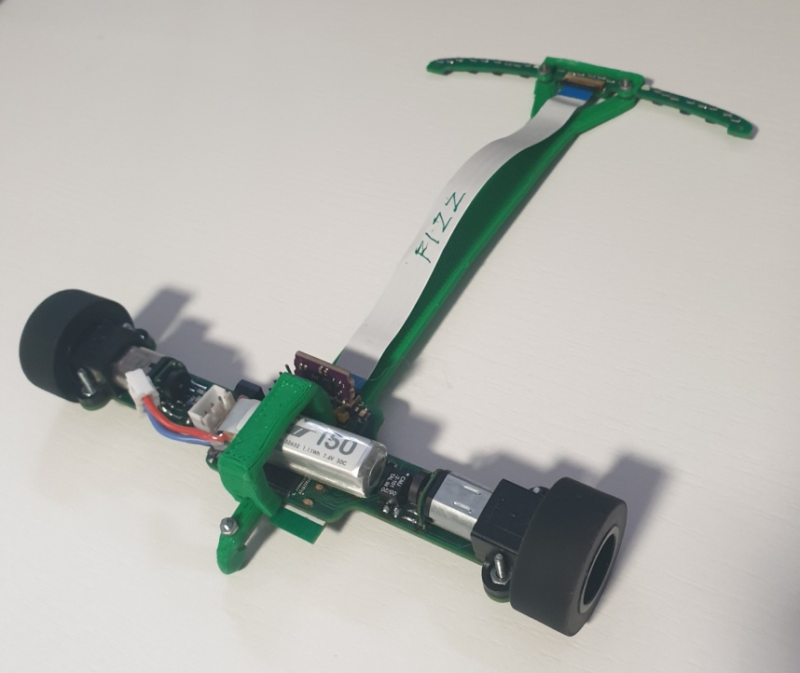
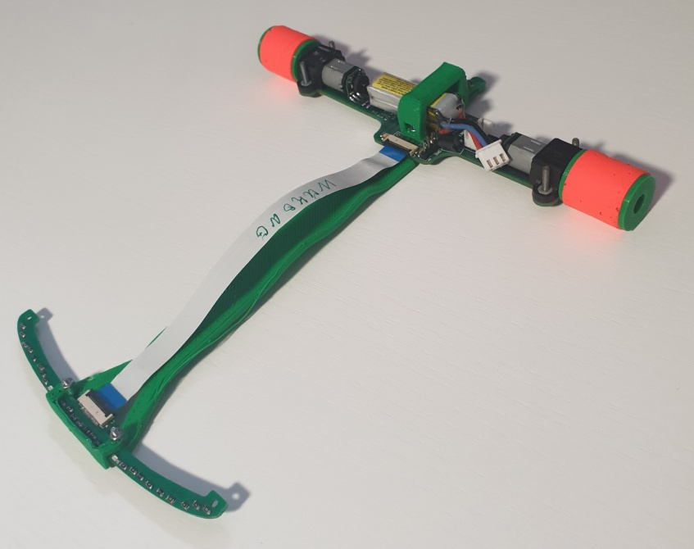
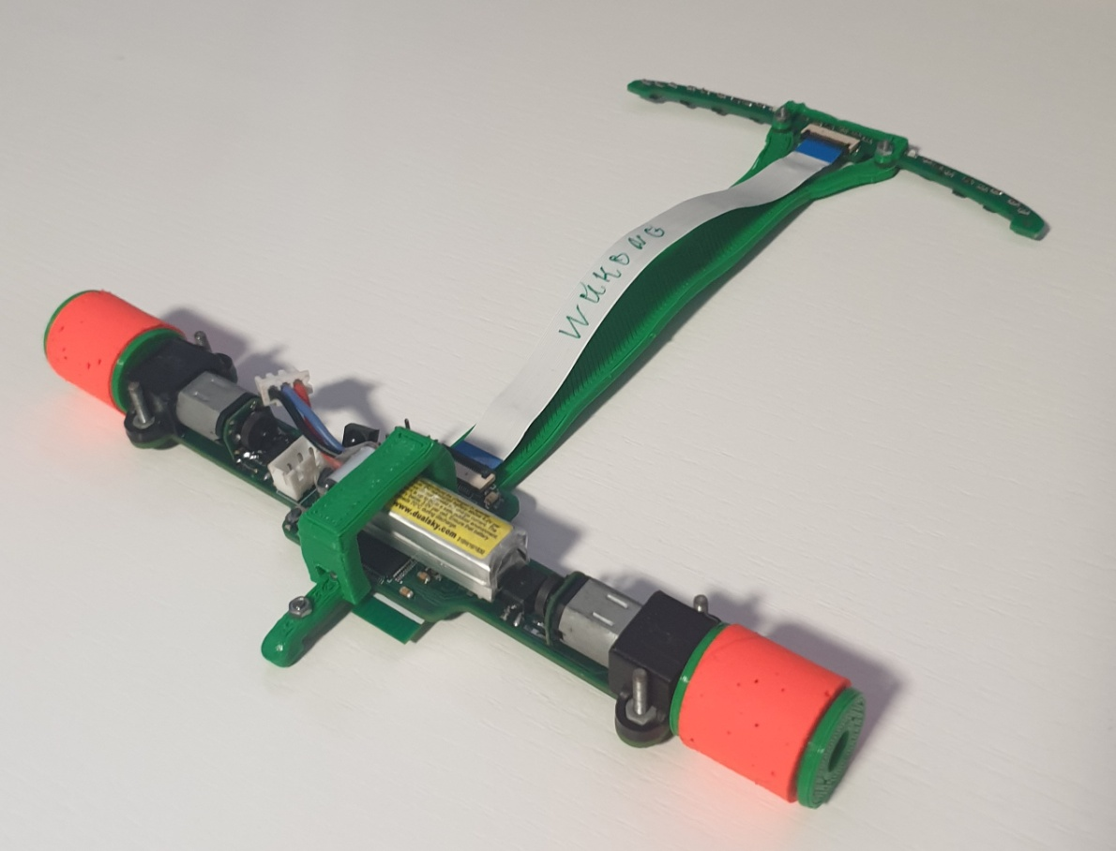
Practical realization:
Solarbotics wheels:

Slide 7
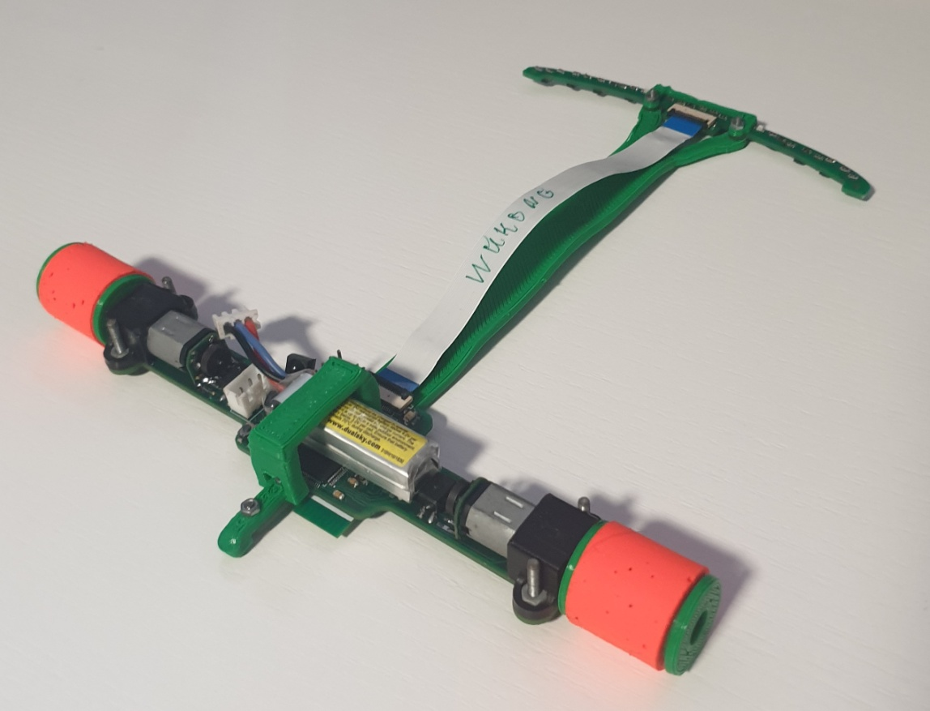
Practical realization:
Jsumo wheels:

Slide 8
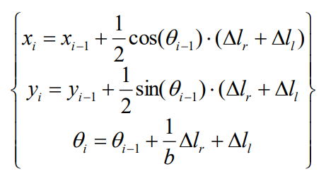
Digital representation of the route
Using the equation below, it is possible to create digital representation of the route.

Slide 9
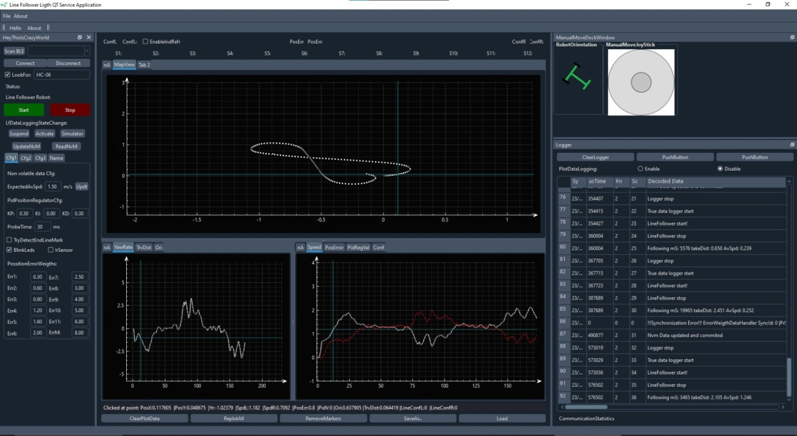

Data visualisation, wireless calibration – Windows Desktop App:
Designed in QT
The app, maybe simply installed:

Slide 10
It is open source project!
https://github.com/trteodor/LineFollower_Light
The repository consist:
MCU Source,
Schematics, PCB,
Skeleton(3D elements),
Documentation,
- everything what is needed to re-create the design/robot.
If you liked the project, please leave a "star" in the repository ☺

