Slide 1
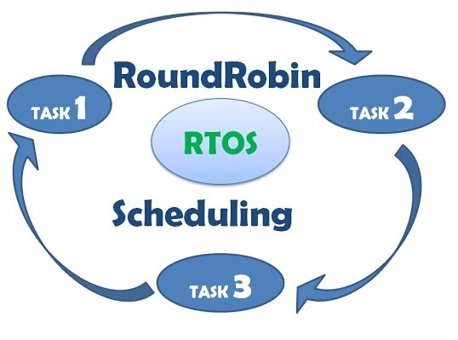
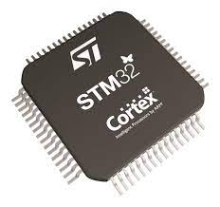
Zaimplementujmy własnego RTOS’a! OD ZERA!
STM32 Cortex-M4 Own RTOS!

Slide 2
Real-time operating systems (RTOS) ? What it is?
The goal of an RTOS is to allow each sub-function to be executed within a defined time frames.
When specific tasks will be executed depends on the scheduling algorithm used
Main components and concepts in real-time systems:
Task
Scheduler
Synchronization and Inter-thread communication
semaphores, mutexes, queues, events

Slide 3
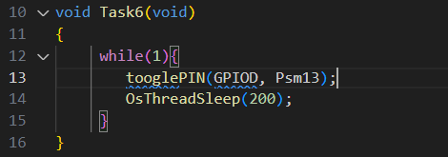
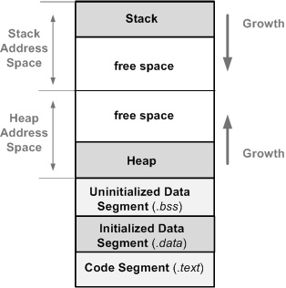
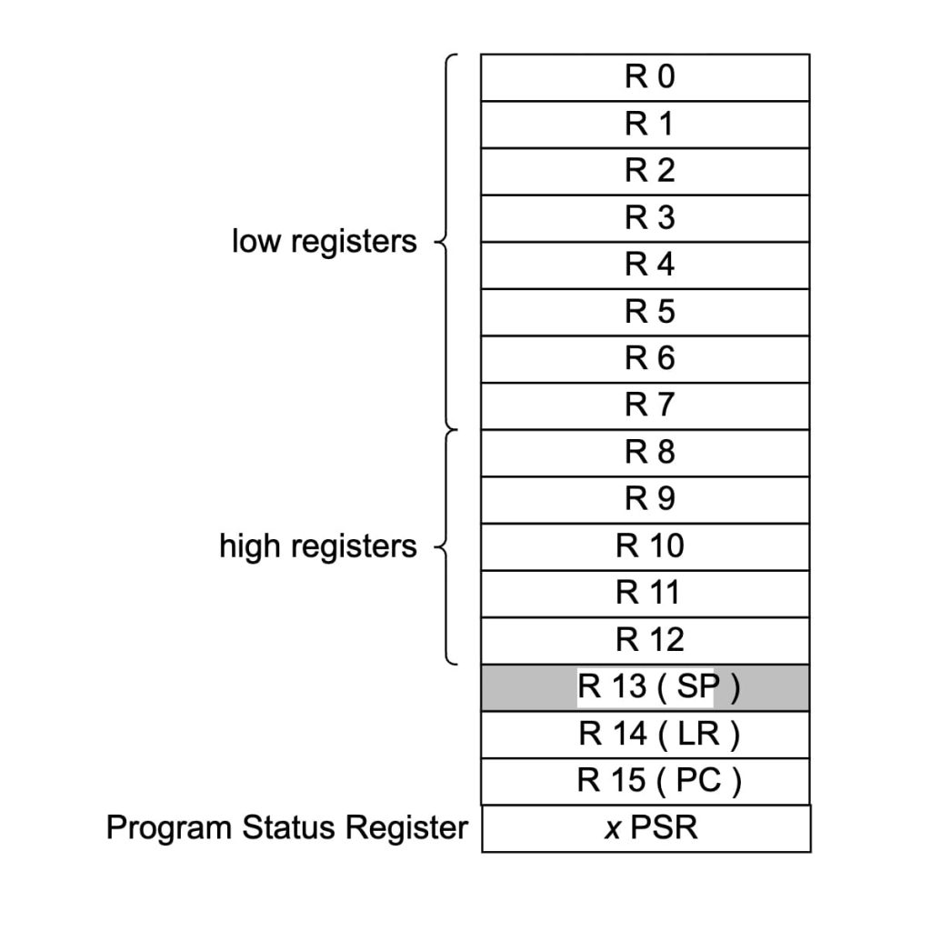
RTOS Task
Task can be compared to a small program that implements a specific functionality in an infinite loop.
Each task has its own stack and a set of processor registers, which makes it seem like it has the processor exclusively.
The size of the stack for each task can be adjusted to its needs.
When a task is switched, the current context (the state of registers, stack) in which it is located is saved and the context of the task that will be started is restored, thanks to that, the task continues working from the place where it was interrupted.
Stack
https://open4tech.com/memory-layout-embedded-c-programs/
Free space
Stack
Heap
Task3
Free space
Task2
Task1
Static

Slide 4
Most Popular Scheduling Algorithms
Priority Scheduling
Each task has a priority level assigned to it. The task with the highest priority will be executed.
In the preemptive version, a running task can be stopped if a task with a higher priority enters the ready state.
In the non- preemptive version, a running task cannot be interrupted by a task with a higher priority.
Round-Robin Scheduling
Round-robin is a preemptive type of scheduling algorithm.
There are no priorities assigned to the tasks.
Each task is put into a running state for a fixed predefined time.
This time is commonly referred to as time-slice (aka quantum).
A task can not run longer than the time-slice.
In case a task has not completed by the end of its dedicated time-slice, it is interrupted, so the next task from the scheduling queue can be run in the following time slice.
Pre-emptied task has an opportunity to complete its operation once it’s again its turn to use a time-slice.
Advatage of this type of scheduling is its simplicity and relatively easy implementation.
Task
Prio
Preemptive priority scheduling
Task1
Task2
T3
Round-Robin Scheduling
T2
T2
T1
T1
Task3
time

Slide 5
Contex switch?
„When a task is switched, the current context (the state of registers, stack) in which task is located is saved and the context of the task that will be started is restored, thanks to that, the task continues working from the place where it was interrupted. „
The RTOS itself, or the core and RTOS scheduler executes its tasks like schedulling typically, in a hardware interrupt with lowest priority.
In ARM it will be „ IRQ PendSV - Pending Supervisor Call„. As we can implement ISR(IRQ service routine) in a way that the ISR will be executed only if all other hardware interrupts are not handled.
The RTOS runtime is measured and the cyclic scheduler calls are usually made in the hardware interrupt with the highest priority. Typically, by calling the interrupt with the lowest priority (PendSV), but it can also be done directly in the same interrupt.
This is a slight simplification, but in general, we can manage IRQ requests in RTOS.
https://www.freertos.org/Documentation/02-Kernel/02-Kernel-features/11-Deferred-interrupt-handling

Slide 6
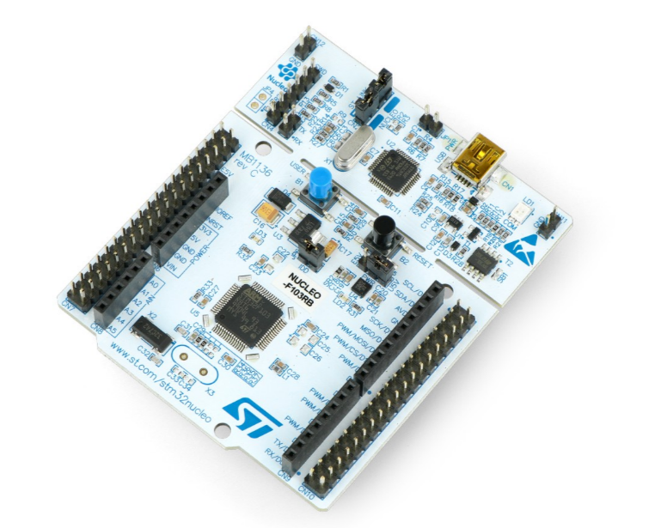
Practice - Implementation of RTOS system
To simplify our implementation, we will not consider FPU (floating point unit)
Contex switch will be implemented in system tick IRQ.
The ECU on which we will run our RTOS:
STM32 NUCLEO-F103RB
MCU- STM32F103RBT6 with ARM Cortex M3
Debugger ST-Link/V2
User LED
Development environment:
Visual studio code with following extensions:
Cortex-Debug
C/C++ (IntelliSense, debugging and code browsing)
In envionment variables(Path) added paths to following binaries(executive files):
Compiler: Arm-none-eabi-gcc
Loader/Debugger: Open On-Chip Debugger
Automatic compilation: GNU Make 3.81

Slide 7
The end
Thank you for your attention

