Slide 1

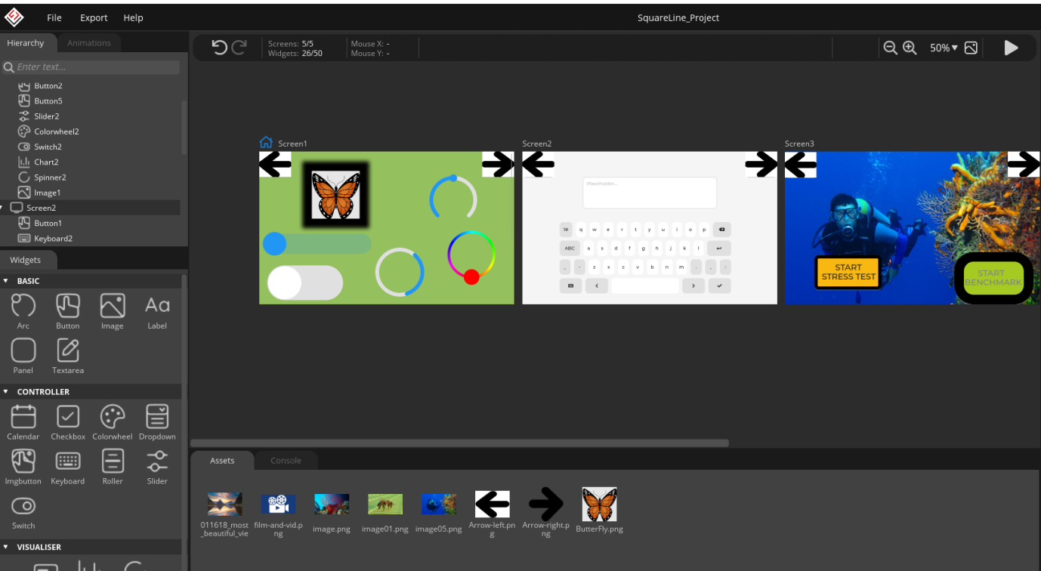
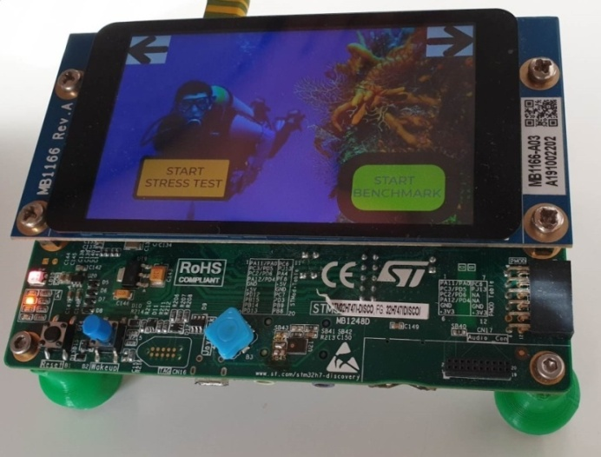
LVGL library + SQUARE LINE STUDIO + STM32H747-Discovery
LVGL – Genialny sposób na aplikacje graficzne w systemach wbudowanych!

Slide 2

Prepared Example based on STM32H747-Discovery
STM32H7
FMC
LVGL with GUI generated by SquareLine
SDRAM
DSI
Display
LTDC
QSPI
Touch Panel
Serial FLash
DSI
I2C
Cortex-M7
Github: https://github.com/trteodor/stm32h747_disco_lvgl_bare_metal
Free Icons: https://all-free-download.com/free-icon/pack-jpeg.html Benchmark video show: https://youtu.be/5MxftdVXUOgd

Slide 3
Light and Versatile Graphics Library
LVGL is the most popular free and open-source embedded graphics library to create beautiful UIs for any MCU, MPU and display type.
Use SquareLine Studio, our drag and drop UI editor to simplify the development, or Hire us to design and implement your next UI.
https://docs.lvgl.io/master/index.html
https://lvgl.io/

Slide 4

SQUARE LINE STUDIO
Most important properties:
Code generation for C compilers
Creating widgets, buttons etc. in simple GUI – calling external function for example to co-operating with HW
Very easy to start!
https://squareline.io/

Slide 5

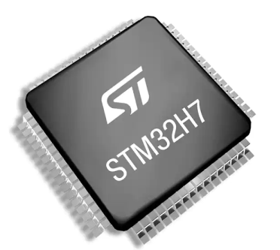
STM32H747-Discovery
Most important properties
MCU STM32H747XIH6
Flash -2 MB, RAM - 1 MB
4-inch LCD Display with touch panel
128 Mbytes Quad-SPI NOR Flash memory 32-Mbytes SDRAM memory
Embedded programmed and debugger ST-LINK/V3
Ethernet IEEE-802.3-2002 i POE
USB OTG HS
4 x LED
User and Reset Button

Slide 6
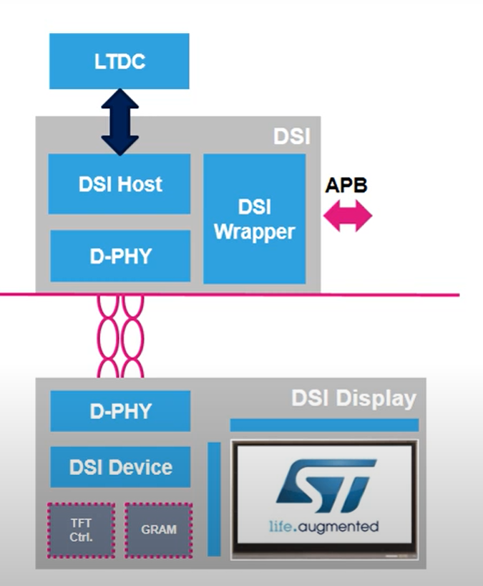
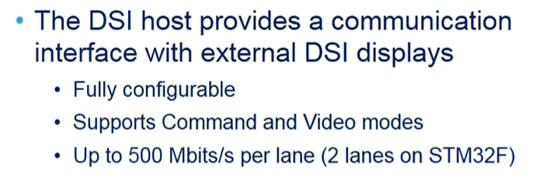
Display serial interface (DSI)
Allowed Operating modes
Video mode
APB Command Mode
Adapted Command Mode
DSI Presentation prepared by ST: https://youtu.be/3Juj9BAnd4g

Slide 7
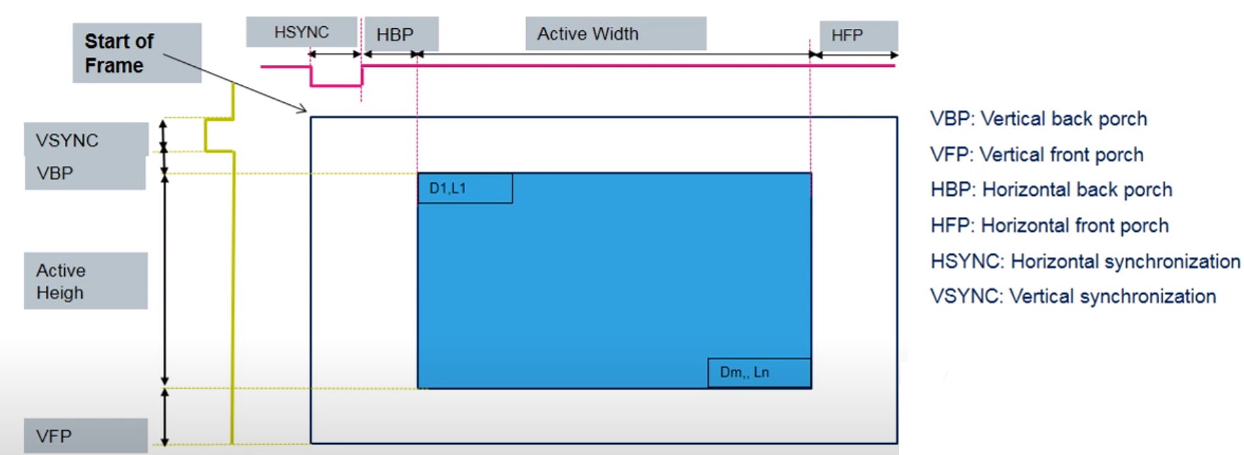
LCD-TFT display controller (LTDC)
LTDC Presentation prepared by ST: https://youtu.be/wPX9YAMbuZ8
https://fastbitlab.com/stm32-ltdc-lcd-tft-lvglmcu3-lecture-32-ltdc-configuration/

Slide 8
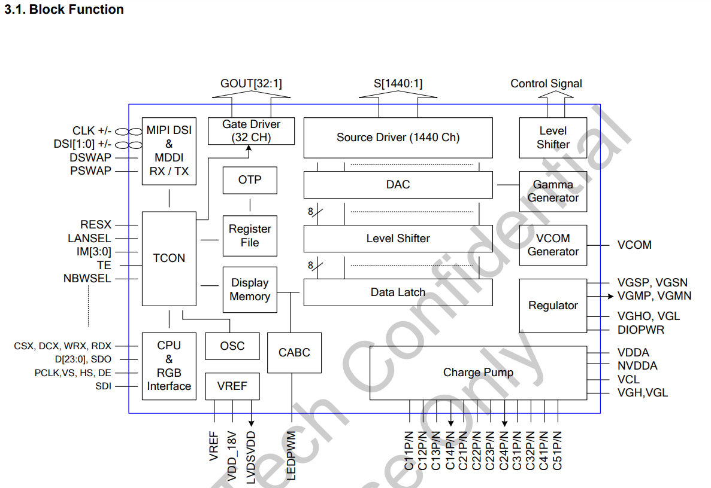
Display controller OTM8009A On-The-Board STM32H747-Discovery
https://www.orientdisplay.com/pdf/OTM8009A.pdf

Slide 9
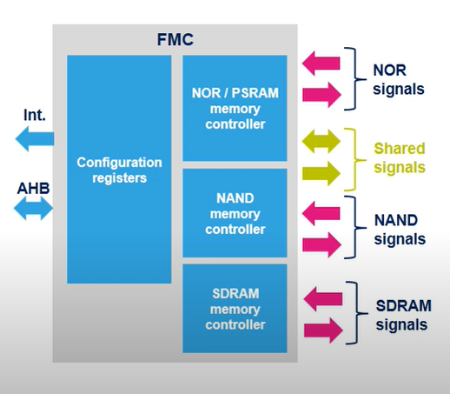
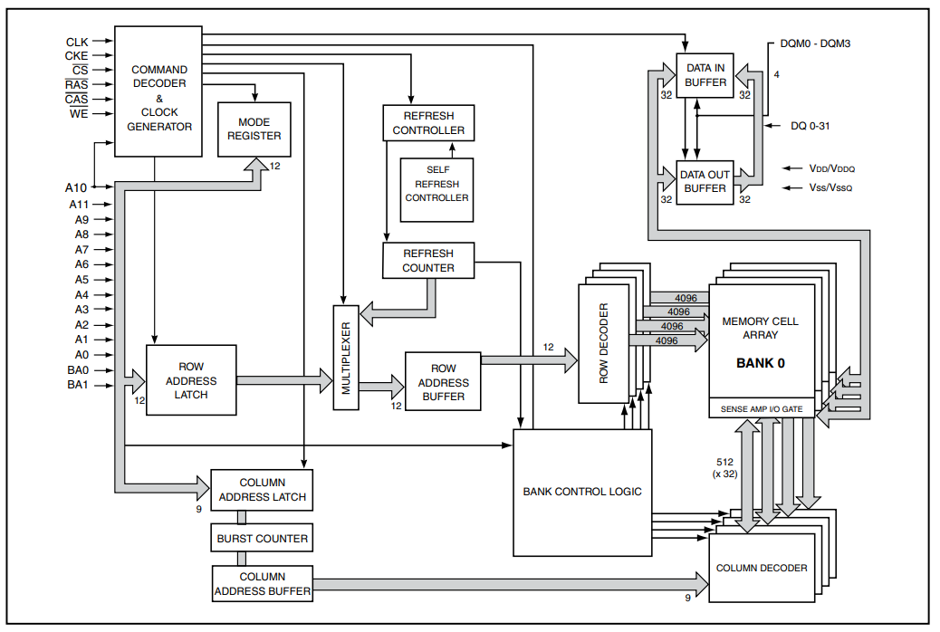
SDRAM – Through FMC is42s32800j
https://www.issi.com/WW/pdf/42-45S32800J.pdf

Slide 10
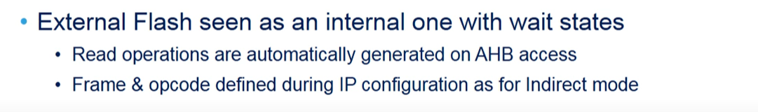
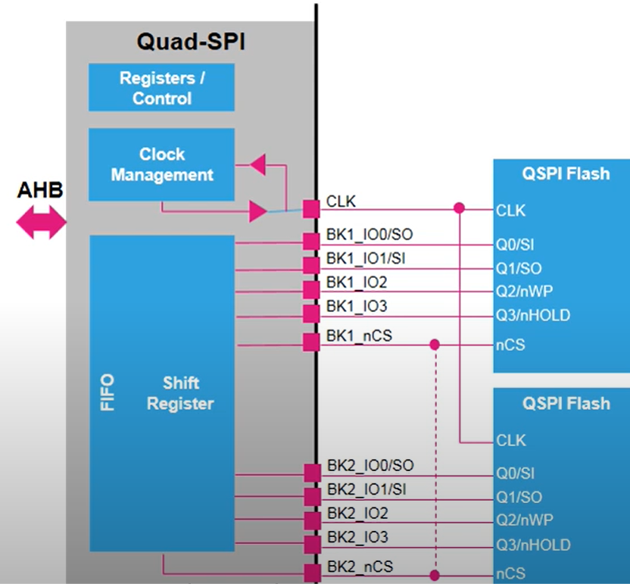
Quad Serial periph. Interface (QSPI) - Memory mapped mode

Slide 11
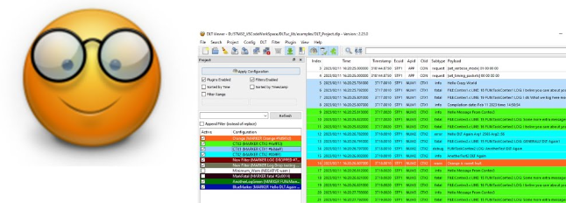
DLTuc Library
Simplifying the embedded software development process
https://youtu.be/WWnudktQlP0
https://github.com/trteodor/DLTuc_lib

Slide 12
Prepared example - compilation
Take care about following:
* arm-none-eabi-gcc 9.3.1
* OpenOCD 0.11.0
* make 4.2.1 / or 3.81
* STM32_Programmer_CLI
* Account Variable to STM32_CubeProgrammer: STM32_CubeProgrammerPATH eg. path: D:\STMicroelectronics\STM32Cube\STM32CubeProgrammer\bin

Slide 13
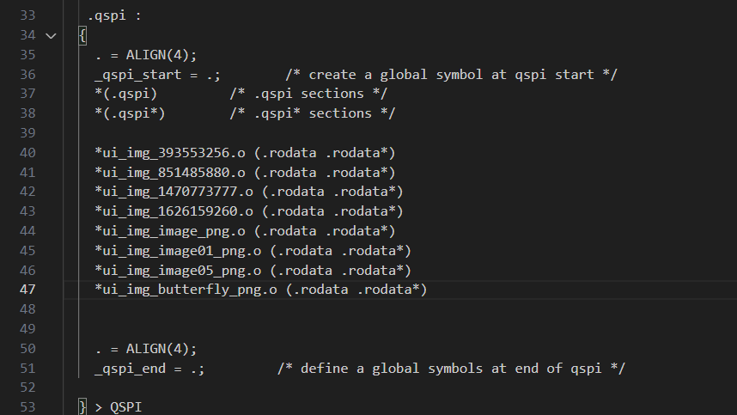
Prepared example – code framents in external serial memory acces though - QSPI

Slide 14

Prepared example – Programming and testing
Command: make CubeF

Slide 15
More examples STM32H747-Disco Board
STM32H7 Cube mcu package: https://www.st.com/resource/en/application_note/dm00393275-stm32cube-mcu-package-examples-for-stm32h7-series-stmicroelectronics.pdf
LVGL + Almost totally generated init code by CubeMX for the Display handling command mode and video. Some fixes is need but it work correctly! You can prepare very easy fixes based on the presented examples. https://github.com/trteodor/STM32H747_DISCO_LVGL_PORT_SIMPLE
Presented example https://github.com/trteodor/stm32h747_disco_lvgl_bare_metal

Slide 16
Summary
Display driven through DSI has been runned
Capabilities of LVGL has been shown
The GUI generator - SquareLine has been present
Mentioned about: SDRAM, QSPI, LTDC, DSI, DLT Viewer

