Slide 1
Introduction
husseinnasser
Welcome
Who this course is for?
Course Outline

Slide 2

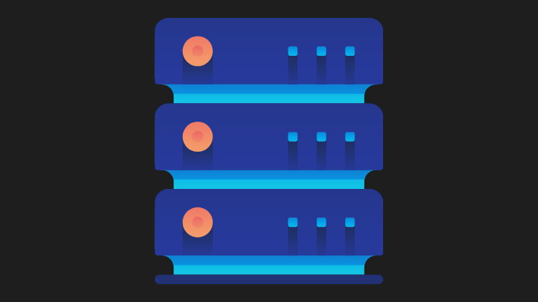
Client-Server Architecture
A revolution in networking

Slide 3
Client-Server Architecture
Machines are expensive, applications are complex
Seperate the application into two components
Expensive workload can be done on the server
Clients call servers to perform expensive tasks
Remote procedure call (RPC) was born

