Slide 1
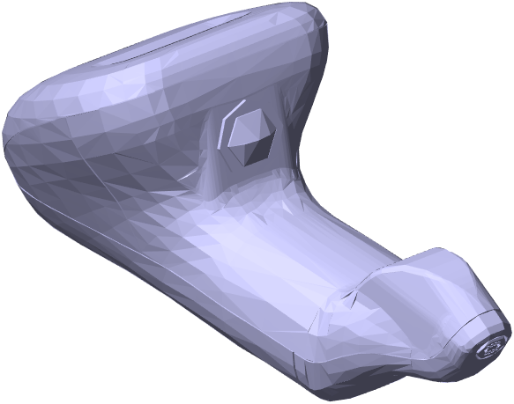
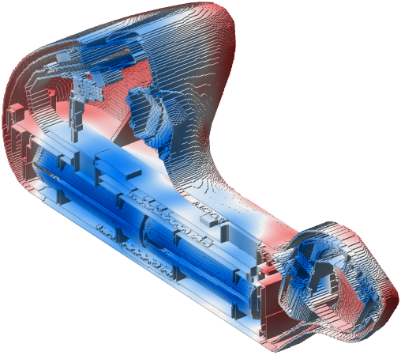
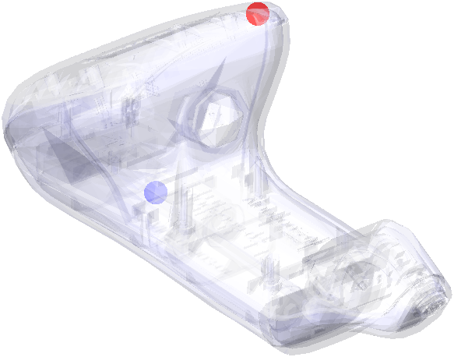
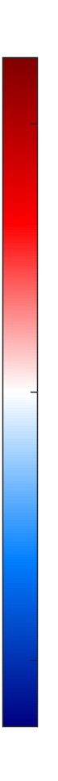
D_{max} = 35.2 ± 0.4 kGy
38
32
DUR prediction:
1.30 ± 0.02
Surface dose [kGy]
D_{min} = 27.2 ± 0.3 kGy
25

Slide 2




CAD files
Intro meeting
Cloud-based simulations
Dose report
Wrap up meeting
CAD files
Intro meeting
Dose Insight performs virtual dose mapping
Dose report
Wrap up meeting

Slide 3
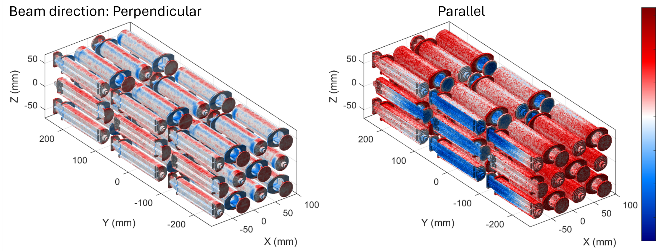
Perpendicular beam
DUR = 2.15 ± 0.07
Parallel beam
DUR = 3.09 ± 0.08
45
32
Surface dose [kGy]
19

