Slide 1
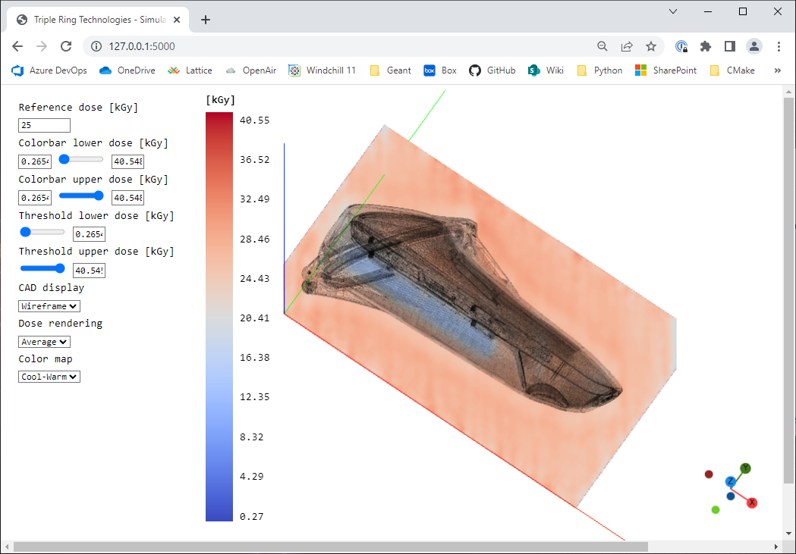

Slide 2


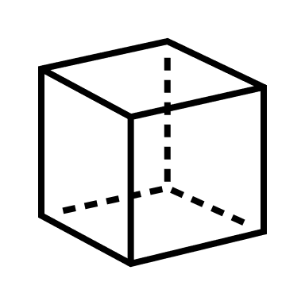







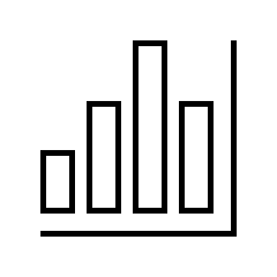


Export file with mesh and material info
Validated Monte Carlo simulations in the cloud
Location of min/max dose
Upload to web app
Dose Uniformity Ratio
$$\text{DUR}=1.5$$
Select sterilization vendor from list of validated source models
Dose histogram

