Slide 1
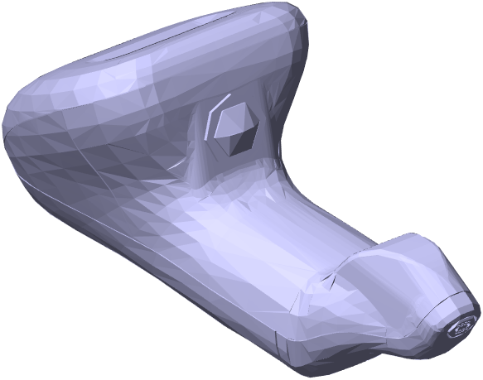
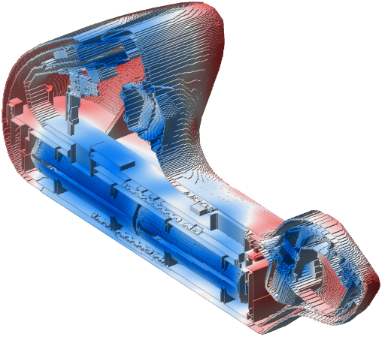
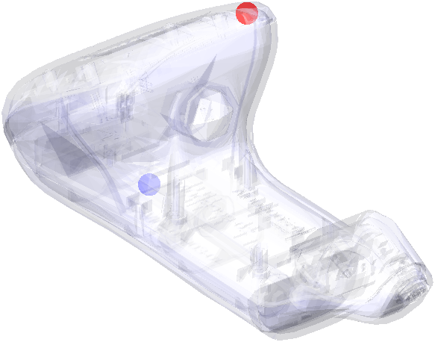
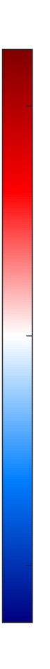
D_{max} = 35.2 ± 0.4 kGy
38
32
DUR prediction:
1.30 ± 0.02
Surface dose [kGy]
D_{min} = 27.2 ± 0.3 kGy
25

Slide 2



CAD files
Intro meeting
Cloud-based simulations
Dose report
Wrap up meeting

