Slide 1
Electron Framework Introduction
Quan Tran

Slide 2

Agenda
Introduction
What Electron?
Why Desktop Apps?
Why Electron?
Explore the Electron APIs.
Electron under the hood.

Slide 3

Introduction
Your role
Your background and experience in the subject
HTML, CSS, JavaScript

Slide 4
What is Electron?

Slide 5
What is Electron?
In brief, it's a framework for building cross platform desktop application with web technology.
Electron began in 2013 as the framework on.
Formerly knows as Atom Shell
A combination of:
Chromium
Node.js
C++
Two or more operating system level processes running concurrently
Multiple process decision originate from chromium
Notes:
framework created by Cheng Zhao

Slide 6
Why desktop App?
Offline.
Printers, devices, other local hardware.
Edit local files.
Internal.
Data security
Notes:
Chromium’s rendering library
The third component is a thick layer of C++, extending the usual set of available APIs with native implementations for common operating system operations such as sending native notifications, accessing system preferences, and creating native dialog

Slide 7
Why Electron?
You want desktop application are the simplification of packaging, installation.
you want your application to be available for all the platforms.
You want consistence native menus, notifications, dialogs.
You’re starting from web technologies.
You want your app silently automatic updates.

Slide 8
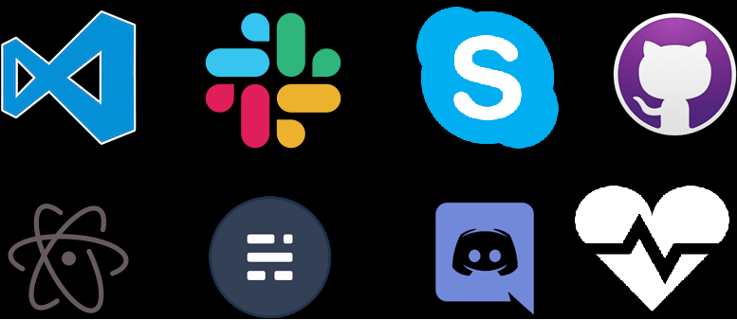
Built with Electron
Notes:
Chromium’s rendering library
The third component is a thick layer of C++, extending the usual set of available APIs with native implementations for common operating system operations such as sending native notifications, accessing system preferences, and creating native dialog

Slide 9
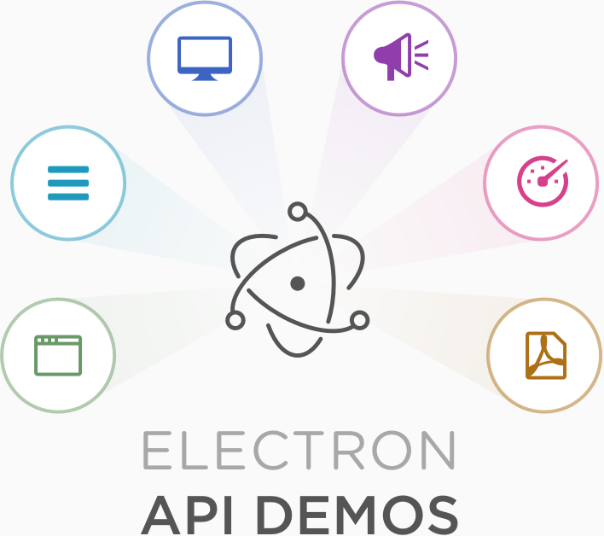
Explore the Electron APIs
Notes:
Chromium’s rendering library
The third component is a thick layer of C++, extending the usual set of available APIs with native implementations for common operating system operations such as sending native notifications, accessing system preferences, and creating native dialog

Slide 10
installation and preference
npm install --save-dev devtron
Prerequisites
Nodejs
Installing Electron
npm install electron –g
npm install electron --save-dev --save-exact
Preference
npm install --save-dev devtron
Notes:
Chromium’s rendering library
The third component is a thick layer of C++, extending the usual set of available APIs with native implementations for common operating system operations such as sending native notifications, accessing system preferences, and creating native dialog

Slide 11
Electron under the hood

Slide 12
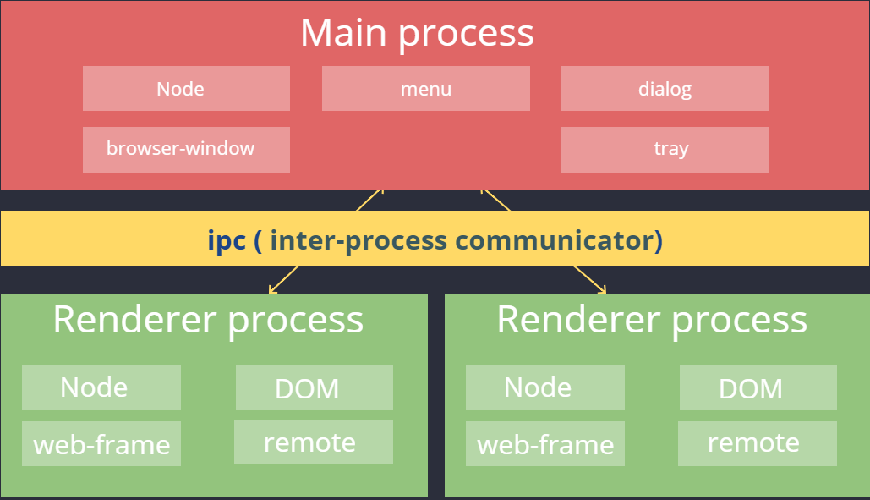
Notes:
Why? Impossible to build the rendering engine that never crashes or hangs, perfectly secure
Process -> instance of a computer program that is being executed.
Misbehaving: all it took is one browser or plug-in bug to bring down the entire browser and all of the currently running tabs
In a separate processes don't share memory or state so that if one tab runs into fatal error, it doesn't bring down the entire application
What? Protect the overall application from bug and glitches in the rendering engine
Processes' memory and resources are isolate from each other
How? Refer the main process that runs the UI and manages tab and plugin processes as the browser
The tab-specific process are called render processes
Process -> instance of a computer program that is being executed.
Processes' memory and resources are isolate from each other

Slide 13
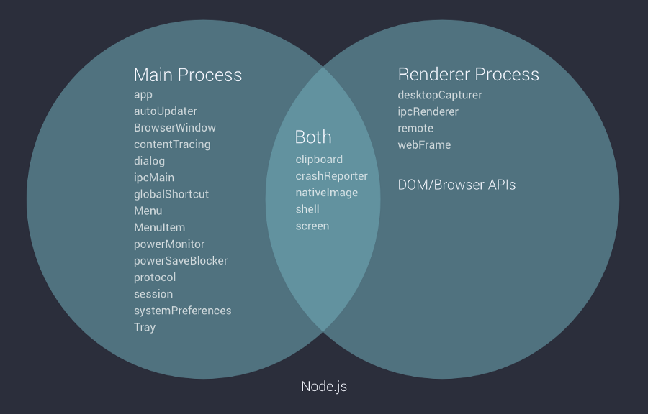
Notes:
Main Process: This is responsible to send and receive request, transfer data between different windows, you can think of it as a central exchange for all the windows. All the memory management like creation and destruction of windows are handled here.
exactly one main process aka “browser process”.
Main: native menu and dialogs, auto update event,Creating renderer processes instances to run web pages
Render: responsible for running the user-interface of your app

Slide 14
Greeting the world
Greeting the world

Slide 15
Demo Main and Renderer Process

Slide 16
IPC

Slide 17
Sync IPC
npm install --save-dev devtron
Main process:
ipc.on('sync-message', function (event, arg) {
event.returnValue = 'sync-reply';
})
Render process:
syncBtn.addEventListener('click', () => {
console.log('sync msg 1')
const reply = ipc.sendSync('sync-message');
console.log(reply);
console.log('sync msg 2')
})
Notes:
Chromium’s rendering library
The third component is a thick layer of C++, extending the usual set of available APIs with native implementations for common operating system operations such as sending native notifications, accessing system preferences, and creating native dialog

Slide 18
Questions & Answer

Slide 19
Thank You!

