Slide 1
Electron Framework Introduction
Quan Tran

Slide 2

Agenda
Introduction
What Electron?
Why Desktop Apps?
Why Electron?
Explore the Electron APIs.
Electron under the hood.

Slide 3

Introduction
Your role
Your background and experience in the subject
HTML, CSS, JavaScript

Slide 4
What is Electron?

Slide 5
What is Electron?
In brief, it's a framework for building cross platform desktop application with web technology.
Electron began in 2013 as the framework on.
Formerly knows as Atom Shell
A combination of:
Chromium
Node.js
C++
Two or more operating system level processes running concurrently
Multiple process decision originate from chromium
Notes:
Chromium’s rendering library (UI display)
JS engine for runtime enviroment
The third component is a thick layer of C++, extending the usual set of available APIs with native implementations for common operating system operations such as sending native notifications, accessing system preferences, and creating native dialog

Slide 6
Why desktop App?
Offline.
Printers, devices, other local hardware.
Edit local files.
Internal.
Data security
Notes:
Chromium’s rendering library
The third component is a thick layer of C++, extending the usual set of available APIs with native implementations for common operating system operations such as sending native notifications, accessing system preferences, and creating native dialog

Slide 7
Why Electron?
You want desktop application are the simplification of packaging, installation.
you want your application to be available for all the platforms.
You want consistence native menus, notifications, dialogs.
You’re starting from web technologies.
You want your app silently automatic updates.

Slide 8

Built with Electron
Notes:
Chromium’s rendering library
The third component is a thick layer of C++, extending the usual set of available APIs with native implementations for common operating system operations such as sending native notifications, accessing system preferences, and creating native dialog

Slide 9

Explore the Electron APIs
Notes:
Chromium’s rendering library
The third component is a thick layer of C++, extending the usual set of available APIs with native implementations for common operating system operations such as sending native notifications, accessing system preferences, and creating native dialog

Slide 10
Electron under the hood

Slide 11
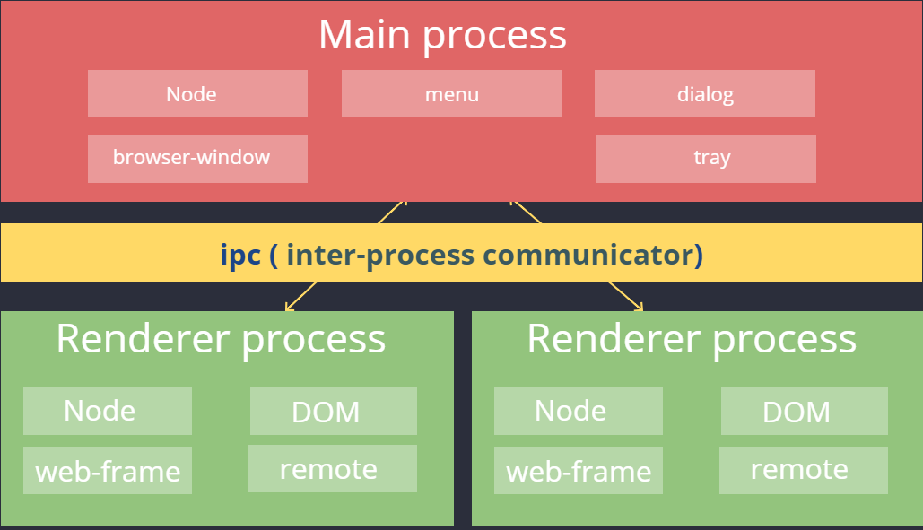
Notes:
Why? Impossible to build the rendering engine that never crashes or hangs, perfectly secure
Process -> instance of a computer program that is being executed.
Misbehaving: all it took is one browser or plug-in bug to bring down the entire browser and all of the currently running tabs
In a separate processes don't share memory or state so that if one tab runs into fatal error, it doesn't bring down the entire application
What? Protect the overall application from bug and glitches in the rendering engine
Processes' memory and resources are isolate from each other
How? Refer the main process that runs the UI and manages tab and plugin processes as the browser
The tab-specific process are called render processes
Process -> instance of a computer program that is being executed.
Processes' memory and resources are isolate from each other
Main: native menu and dialogs, auto update event, creates BrowserWindow instances to run web pages
Render: responsible for running the user-interface of your app

Slide 12
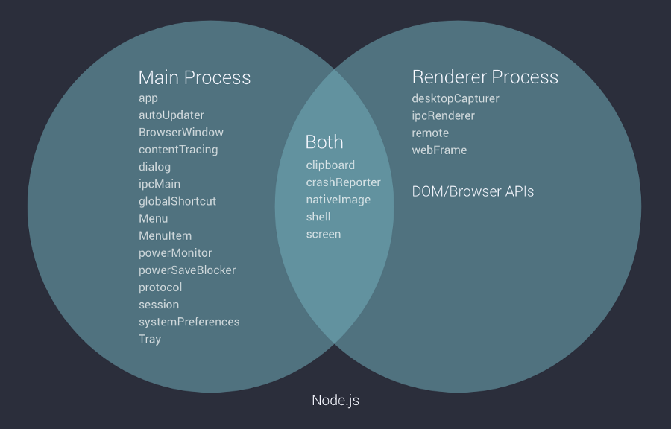
Notes:
Main Process: This is responsible to send and receive request, transfer data between different windows, you can think of it as a central exchange for all the windows. All the memory management like creation and destruction of windows are handled here.

Slide 13
Greeting the world
Greeting the world

Slide 14
Demo main and Renderer Process

Slide 15
Questions & Answer

Slide 16
Thank You!

