Slide 1
Raman Spectroscopy Analysis Report
Sample: Results/SW6_IPA_1

Slide 2
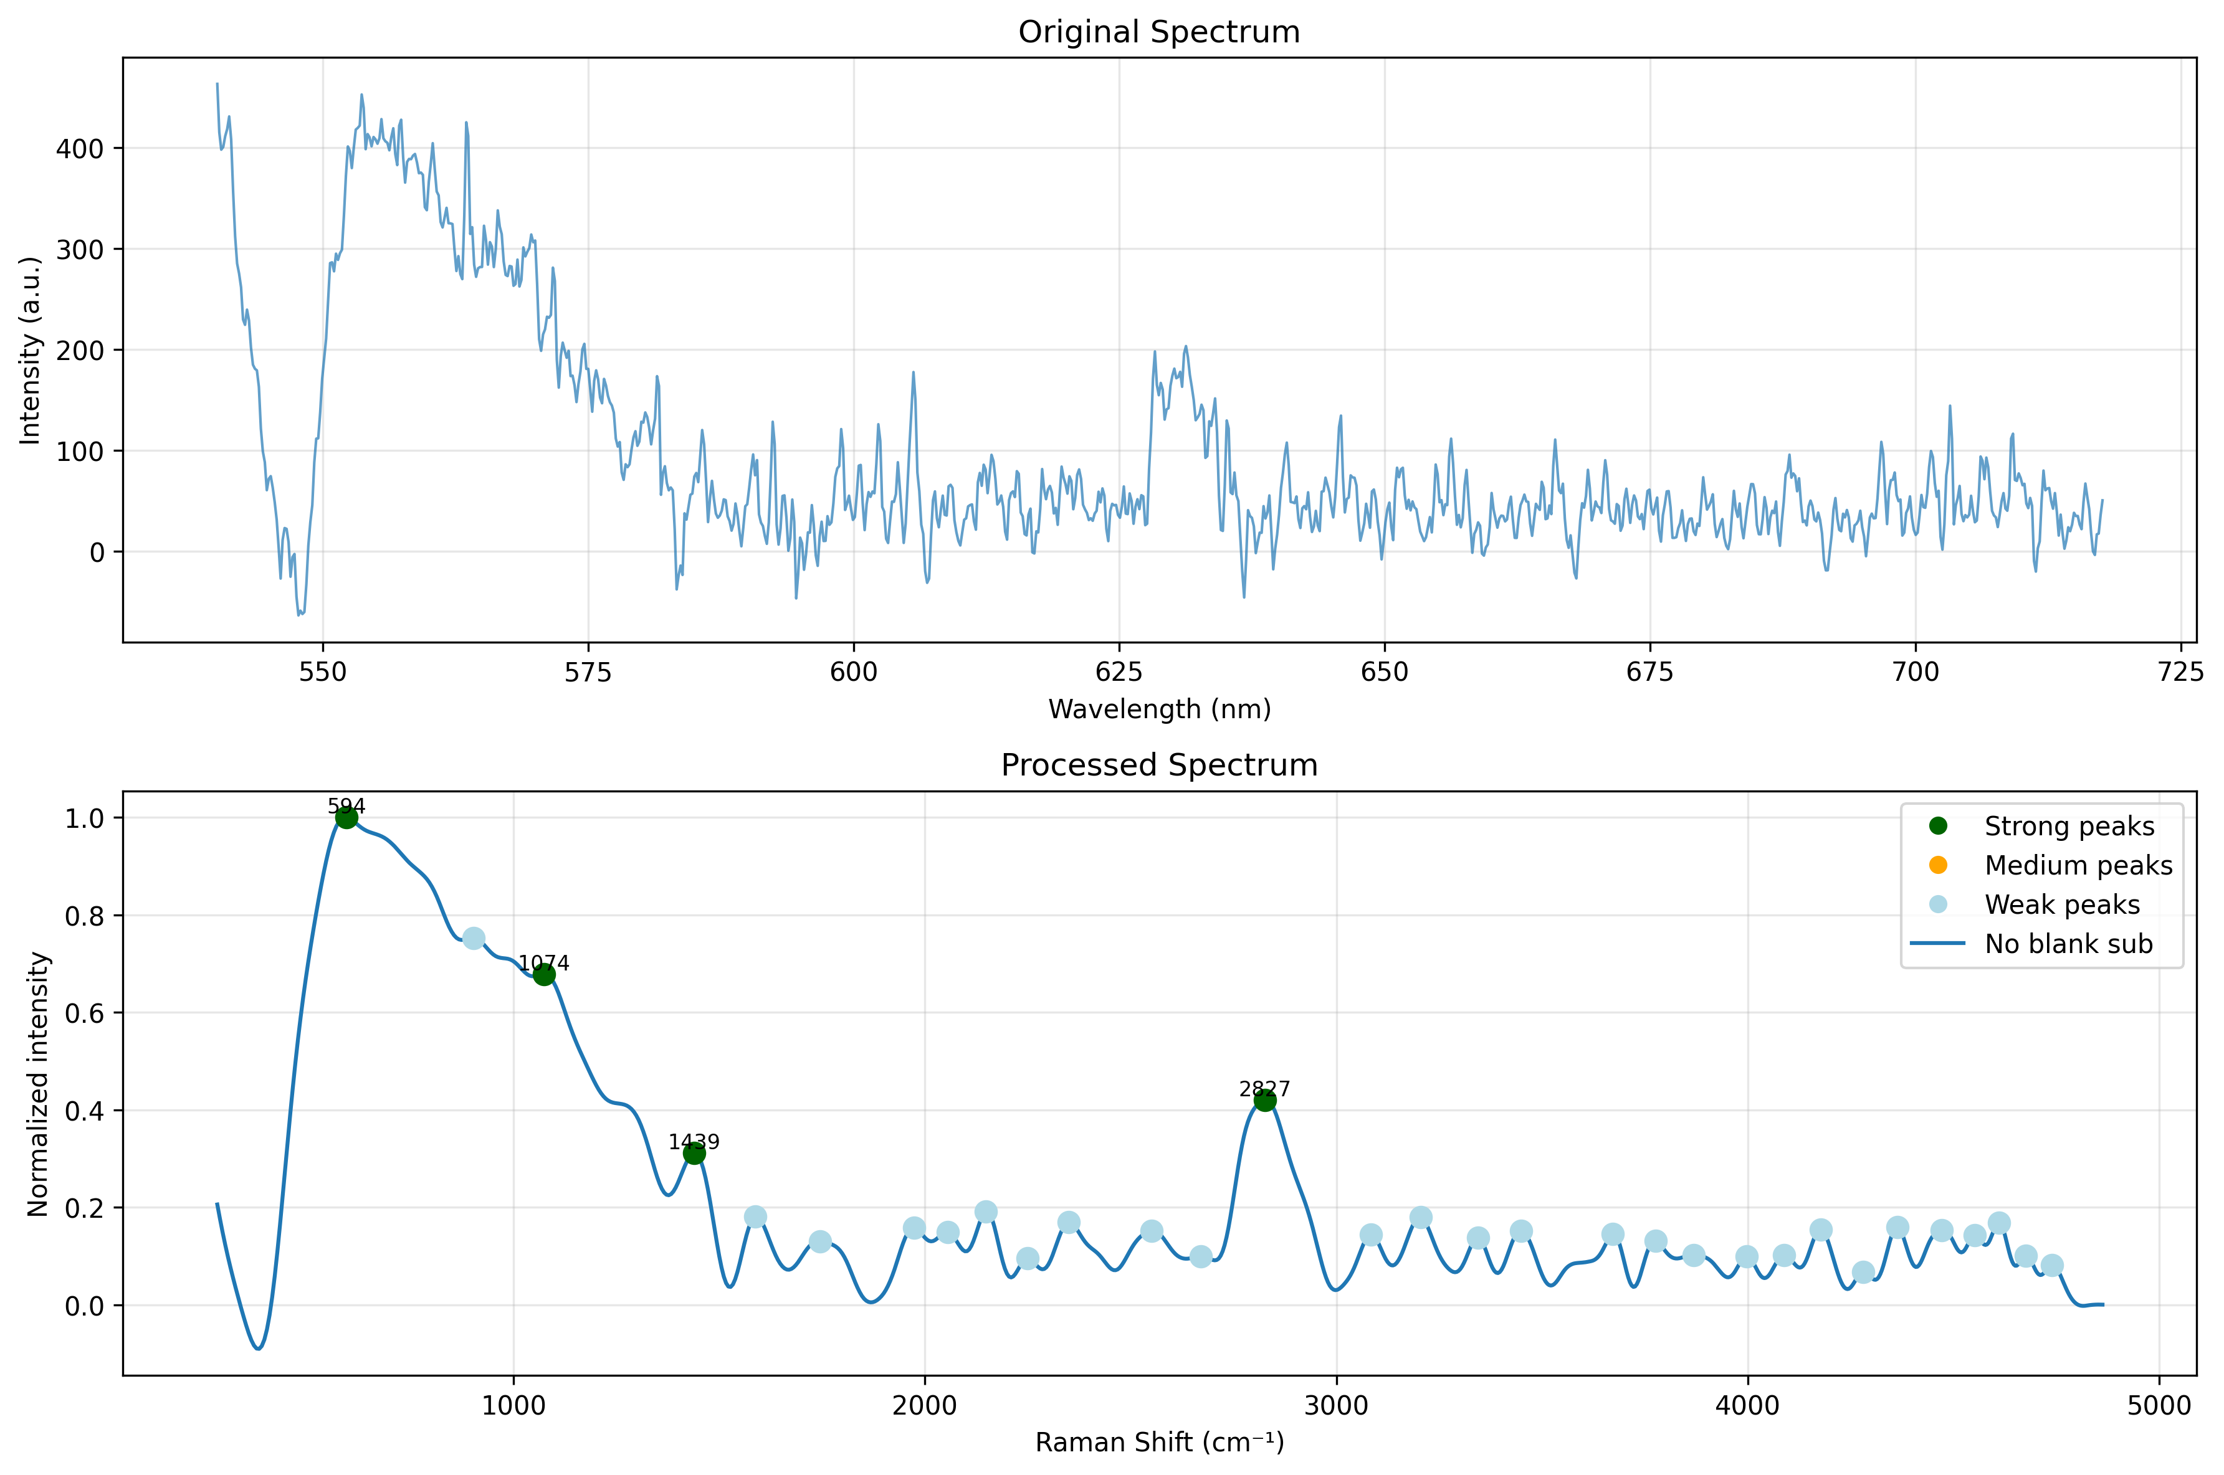
Standard Analysis: Spectrum Graph

Slide 3
Standard Analysis: Peak Data
Shift (cm⁻¹) | Intensity | Relative %
594.3 | 1.00 | 100.0%
2826.7 | 0.42 | 42.0%
1439.0 | 0.31 | 31.2%
2148.4 | 0.19 | 19.2%
1588.2 | 0.18 | 18.1%
3204.3 | 0.18 | 17.9%
2349.8 | 0.17 | 16.9%
4609.9 | 0.17 | 16.8%
4363.0 | 0.16 | 15.9%
1973.0 | 0.16 | 15.8%

Slide 4
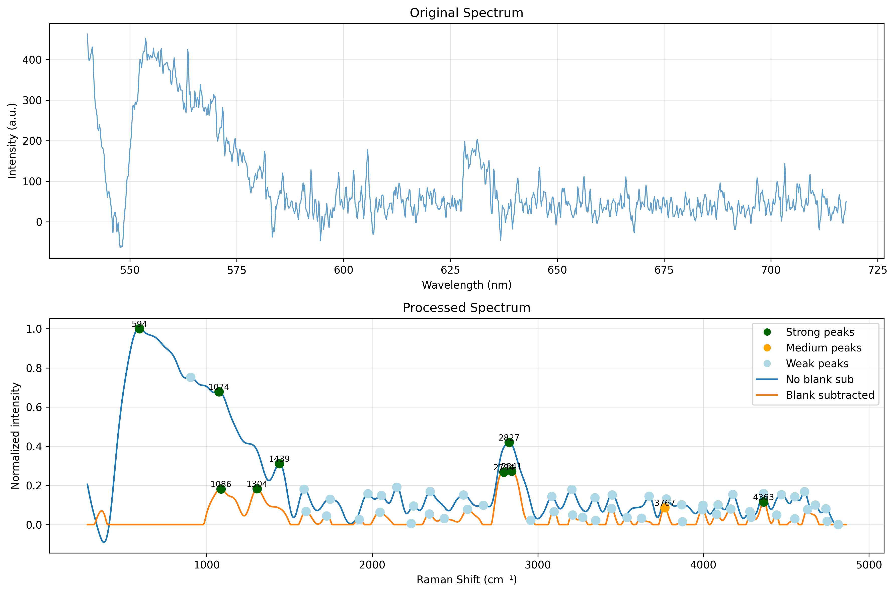
Blank Subtracted: Spectrum Graph

Slide 5
Blank Subtracted: Peak Data
Shift (cm⁻¹) | Intensity | Relative %
2840.7 | 0.27 | 100.0%
1304.0 | 0.18 | 67.0%
1085.7 | 0.18 | 66.8%
4363.0 | 0.12 | 42.2%
3766.9 | 0.09 | 31.6%
3444.1 | 0.08 | 30.3%
4164.9 | 0.08 | 29.1%
2575.2 | 0.08 | 28.7%
4628.0 | 0.08 | 28.2%
3992.6 | 0.08 | 27.8%

