Slide 1

Understanding Career Aspirations of Gen Z
- Trupti Naik

Slide 2
STEPS FOLLOWED IN THE PROJECT
1
2
5
3
4
Data Analysis
in Excel
(Using Pivot Tables
and MySQL)
Data Collection
and Survey
Understand Problem Statement
(Using 5W1H Framework
Data Cleaning &
Standardization
Dashboard
creation
and analysis
in POWERBI

Slide 3
Project Overview
This explores the career aspirations of Gen Z across different countries, offering valuable insights into their goals, work frustrations, aspirations job and motivations, etc. I worked on this real-world problem during my internship, using various data analysis tools to create an interactive and comprehensive dashboard. The process involved cleaning and analyzing the data, identifying trends, and offering actionable recommendations based on the findings. The aim is to understand the diverse career aspirations of Gen Z and how they vary globally.

Slide 4
STAGE 1: PROBLEM STATEMENT (using 5W1H Framework)

Slide 5
Problem Statement:
Gen Z struggles to pursue desired roles, with their aspirations often unheard by employers.
Employers face challenges in attracting, retaining, and managing Gen Z individuals.
Objective:
The objective of this analysis is to understand the career aspirations of Gen Z, identifying key trends and preferences and provide actionable recommendations for employers.

Slide 6
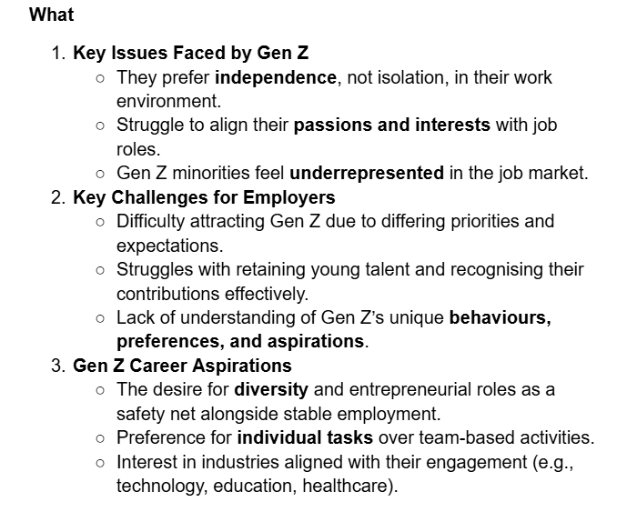
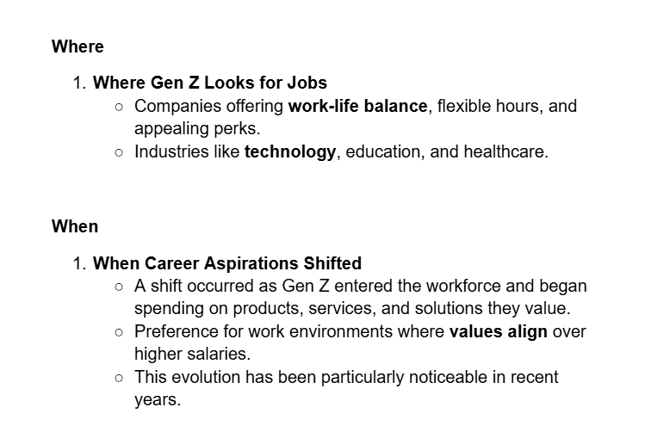

Slide 7
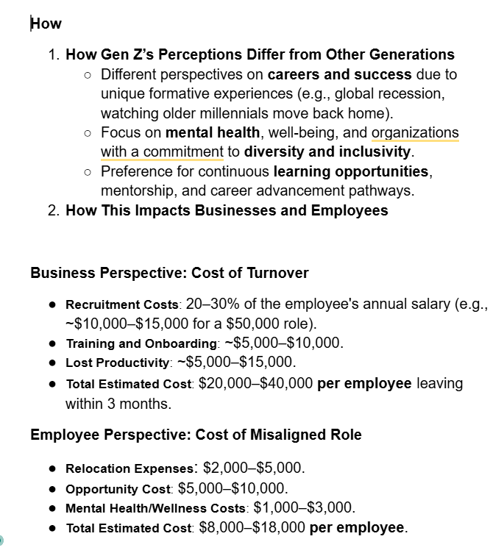

Slide 8
Tools and Technologies Used:
A google survey form was created to collect data and distributed the link across various platforms to gather response
Data was cleaned and standardized using Excel
Dashboard developed using Microsoft Excel
Data Analyzed using Pivot Tables
SQL was used for data extractions and analysis
PowerBI was used to create insightful Dashboards

Slide 9
STAGE 2: DATA COLLECTION

Slide 10
What are the top three values that influence your career choices?
Financial stability
Work-life balance
Growth opportunities
Creativity and innovation
Social impact
Flexibility in location/schedule
Other: ______________
What motivates you the most in a job?
Financial incentives and rewards
Recognition and appreciation
Growth and promotion opportunities
Making a meaningful impact
Developing new skills
Work-life balance
Other: ______________
What type of work environment do you prefer?
Fully remote
Hybrid
In-office
Flexible

Slide 11
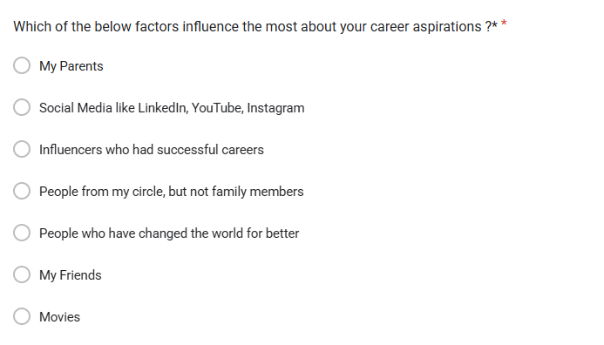
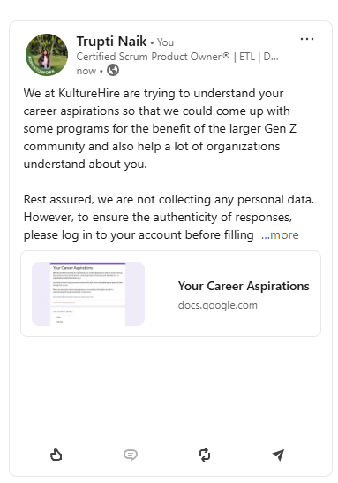
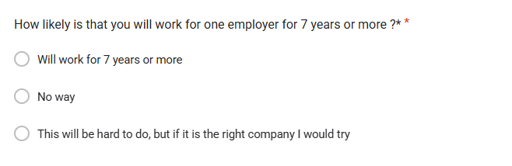

Slide 12
STAGE 3: CLEANING AND STANDARDIZING IN SQL

Slide 13
What is the gender distribution of respondents of India?
What industries are Gen-Z most interested in pursuing careers in?
What are the top factors influencing Gen-Z’s career choices?
What is the desired work environment for Gen-Z? (e.g., remote, hybrid, in-office)
How do financial goals, such as salary and benefits, impact career aspirations among Gen-Z?
What role do personal values and social impact play in career choices for Gen-Z?
What percentage of respondents from India are interested in education abroad and sponsorship?
How do career aspiration influences vary by gender in India?
What percentage of respondents are willing to work for a company for at least 3 years?
How does the preference for socially impactful companies vary by gender?
What is the distribution of minimum expected salary in the first three years among respondents?
What are the common work frustrations among respondents?

Slide 14
SELECT gender, COUNT(*) as count
FROM `my-db-project3010.Tl.CareerAsp`
WHERE country = 'IN'
GROUP BY gender
ORDER BY count;
SELECT preferredworkingenvironment,
COUNT(*) AS interest_count
FROM `my-db-project3010.Tl.CareerAsp`
WHERE country = 'IN'
GROUP BY preferredworkingenvironment
ORDER BY interest_count DESC
LIMIT 10;
SELECT preferredworkingenvironment,
COUNT(*) AS preference_count
FROM `my-db-project3010.Tl.CareerAsp`
WHERE country = 'IN'
GROUP BY preferredworkingenvironment
ORDER BY preference_count DESC;
SELECT influencingfactors,
SUM(case when gender='M' then 1 else 0 end) as male_count,
SUM(case when gender='F' then 1 else 0 end) as Female_count
FROM `my-db-project3010.Tl.CareerAsp`
WHERE country ='IN'
GROUP BY influencingfactors
ORDER BY Male_count, Female_count DESC;

Slide 15
STAGE 4: ANALYZING IN SQL

Slide 16
1. What is the gender distribution of respondents of India?
2. What industries are Gen-Z most interested in pursuing careers in?
3. What are the top factors influencing Gen-Z’s career choices?
4. What is the desired work environment for Gen-Z? (e.g., remote, hybrid, in-office)
5. How do financial goals, such as salary and benefits, impact career aspirations among Gen-Z?
6. What role do personal values and social impact play in career choices for Gen-Z?
7. What percentage of respondents from India are interested in education abroad and sponsorship?
8. How do career aspiration influences vary by gender in India?
9. What percentage of respondents are willing to work for a company for at least 3 years?
10. How does the preference for socially impactful companies vary by gender?
11. What is the distribution of minimum expected salary in the first three years among respondents?
12. What are the common work frustrations among respondents?
13. What percentage of respondents need sponsorship for education abroad?
14. What factors boost work happiness and productivity for respondents?
15. How does the need for work-life balance interventions vary by gender?
16. How many respondents are willing to work under an abusive manager?
17. What are the remote working preferences by gender?
18. What is the distribution of minimum expected salary after five years?
19. What is the preferred number of daily work hours?
20. What is the expected minimum monthly salary in hand?

Slide 17
SELECT gender, COUNT(*) AS count, (COUNT(*) * 100.0) / (SELECT COUNT(*)
FROM `my-db-project3010.Tl.CareerAsp` WHERE country = 'IN') AS percentage
FROM `my-db-project3010.Tl.CareerAsp`
WHERE country = 'IN' AND highereducation =’Yes’ AND highereducation = 'Needs a Sponsor'
GROUP BY gender
ORDER BY percentage DESC;
SELECT gender,
COUNT(CASE WHEN workforcompanywithoutsocialimpact <= 2 THEN gender END) AS socially_impactful_count,
(COUNT(CASE WHEN workforcompanywithoutsocialimpact <= 2 THEN gender END) * 100.0 / COUNT(gender)) AS percentage_social_impact
FROM `my-db-project3010.Tl.CareerAsp`
GROUP BY gender
ORDER BY percentage_social_impact DESC;
SELECT influencingfactors,
SUM(case when gender='M' then 1 else 0 end) as male_count,
SUM(case when gender='F' then 1 else 0 end) as Female count
FROM `my-db-project3010.Tl.CareerAsp`
WHERE country ='IN'
GROUP BY influencingfactors
ORDER BY Male_count, Female count DESC;

Slide 18
SELECT gender,
COUNT(CASE WHEN workforcompanywithoutsocialimpact <= 2 THEN gender END) AS socially_impactful_count,
(COUNT(CASE WHEN workforcompanywithoutsocialimpact <= 2 THEN gender END) * 100.0 / COUNT(gender)) AS percentage_social_impact
FROM `my-db-project3010.Tl.CareerAsp`
GROUP BY gender
ORDER BY percentage_social_impact DESC;
SELECT gender,
(COUNT(*) * 100.0) / (SELECT COUNT(*) FROM `my-db-project3010.Tl.CareerAsp`
WHERE gender = s.gender) AS percentage_willing
FROM `my-db-project3010.Tl.CareerAsp` s
WHERE x3yearsemployment = 'Yes'
GROUP BY gender
ORDER BY percentage_willing DESC;
SELECT gender, preferredworkingenvironment, COUNT(*) AS respondent_count
FROM `my-db-project3010.Tl.CareerAsp`
WHERE preferredworkingenvironment = 'Remote'
GROUP BY gender, preferredworkingenvironment
ORDER BY gender, respondent_count DESC;

Slide 19
STAGE 5: EXECUTIVE DASHBOARD IN EXCEL

Slide 20
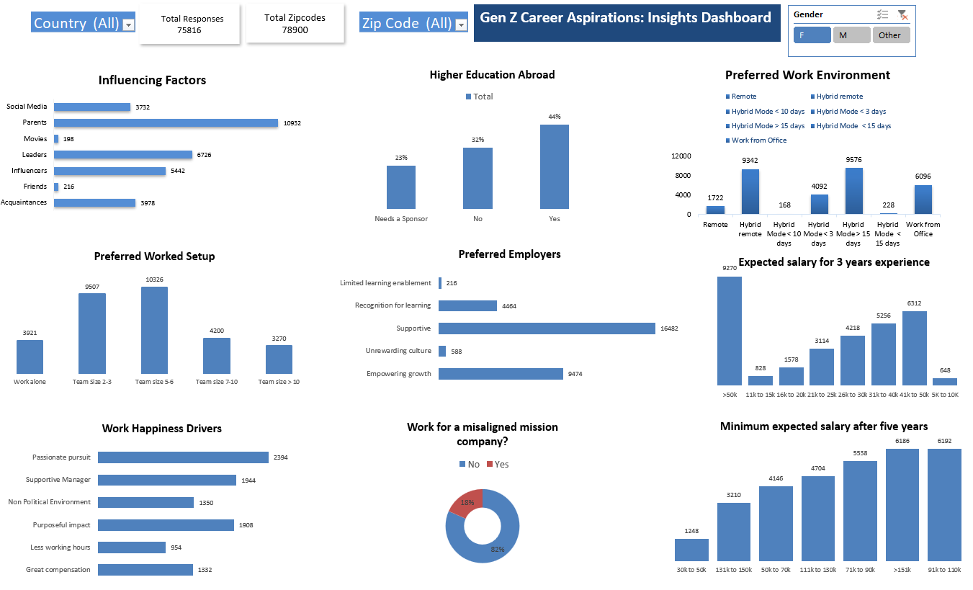

Slide 21
STAGE 6: FOCUS AREA DRIVEN POWERBI DASHBOARD

Slide 22
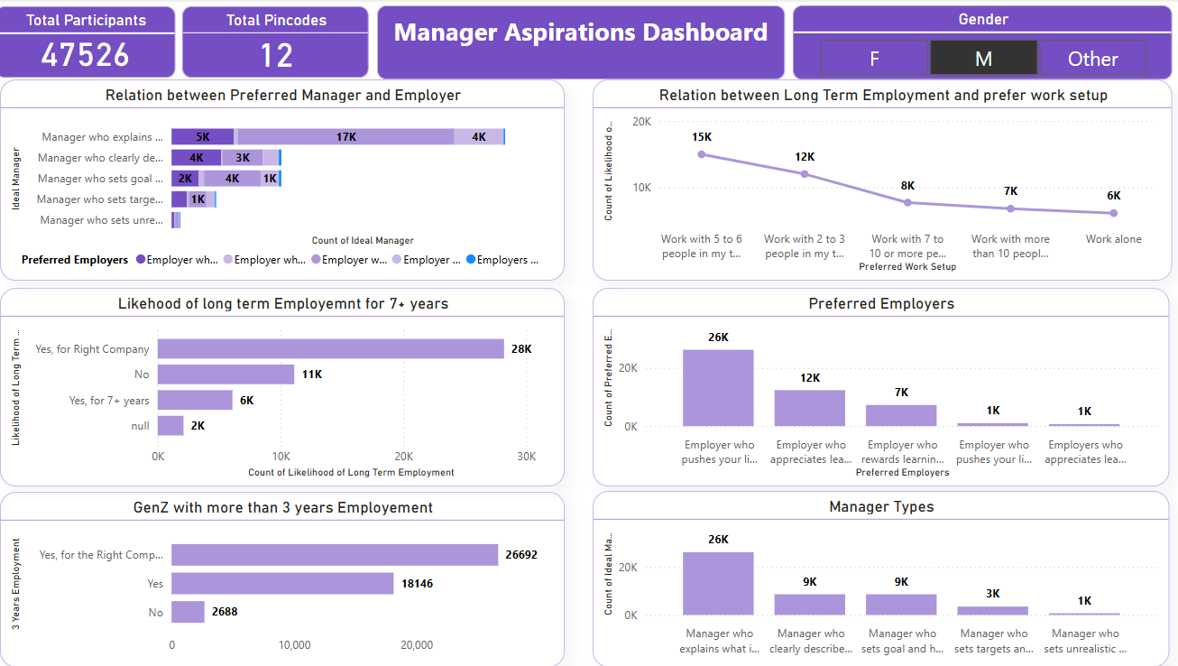
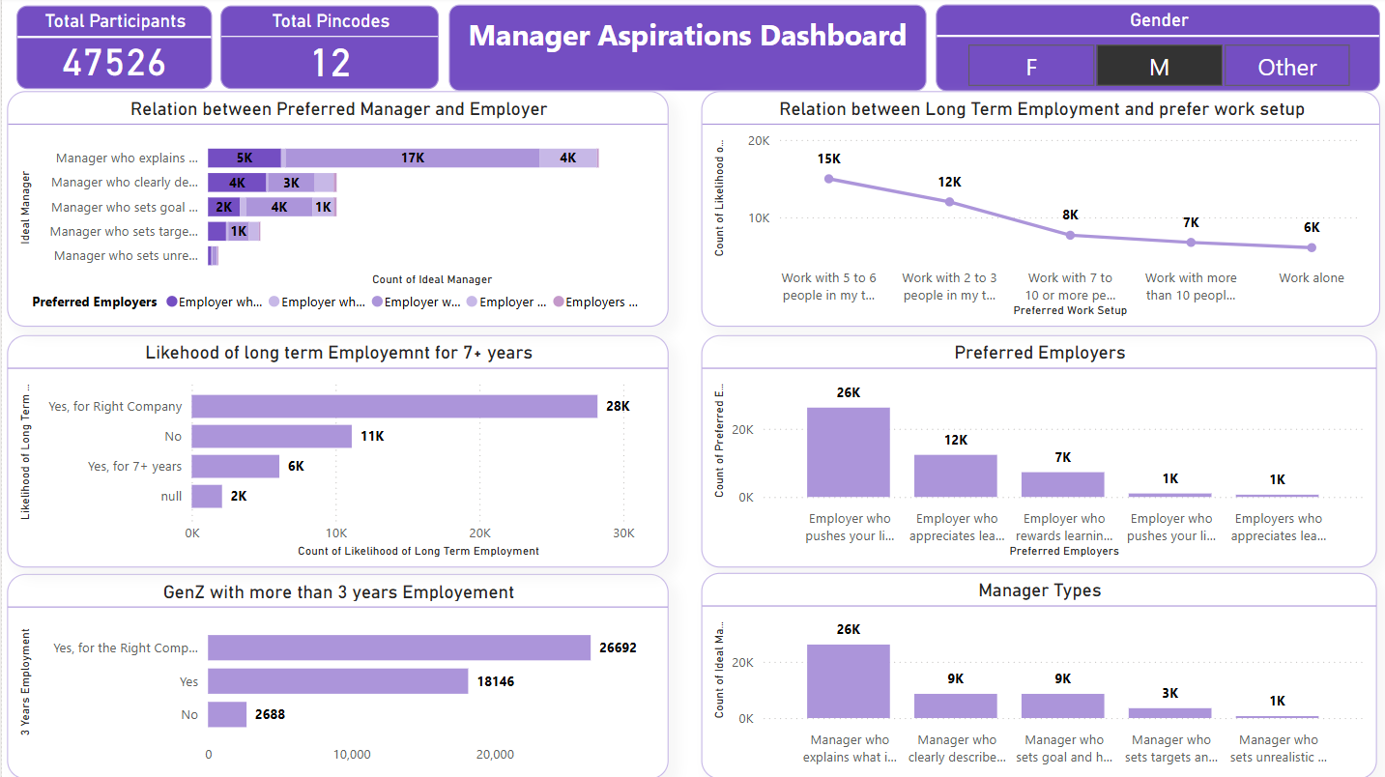

Slide 23
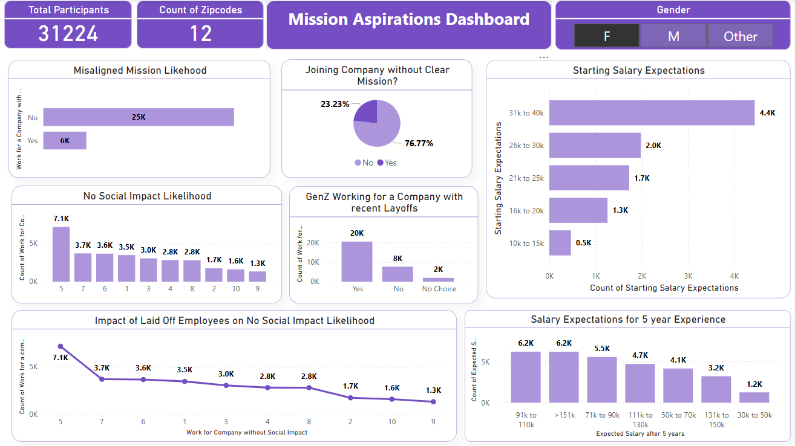

Slide 24
FINDINGS AND INSIGHTS

Slide 25
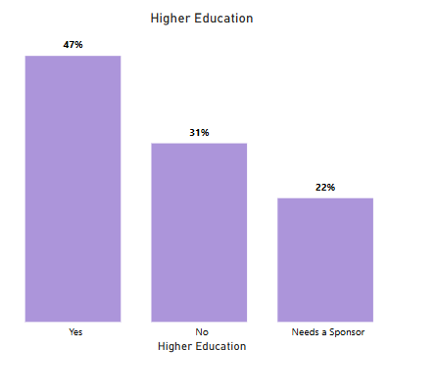
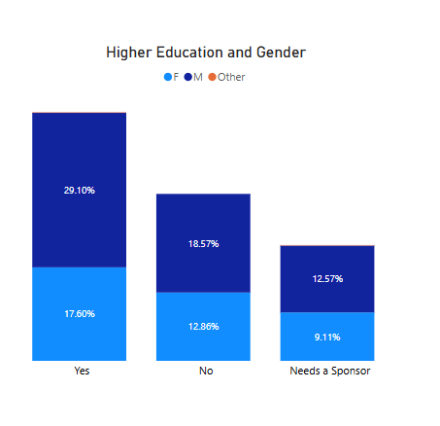
Out of the total 47%, 29.10% are males and 17.60% are females among Gen Z pursuing higher studies abroad.
INSIGHTS
47% of Gen Z plan to pursue higher education abroad.

Slide 26
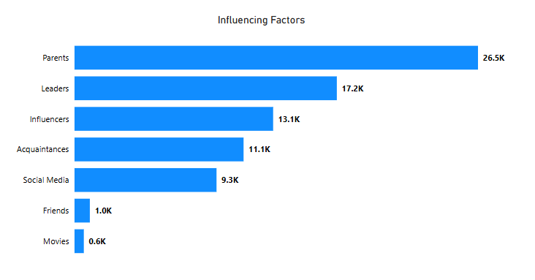
INSIGHTS
PROBLEM:
Influencing Factors
RECOMMENDATION:
Career counselling programs should involve parents and leverage media influences to align with Gen Z career aspirations
Promote Digital Literacy
Encourage Experiential Learning like internships, project, mentorship program

Slide 27
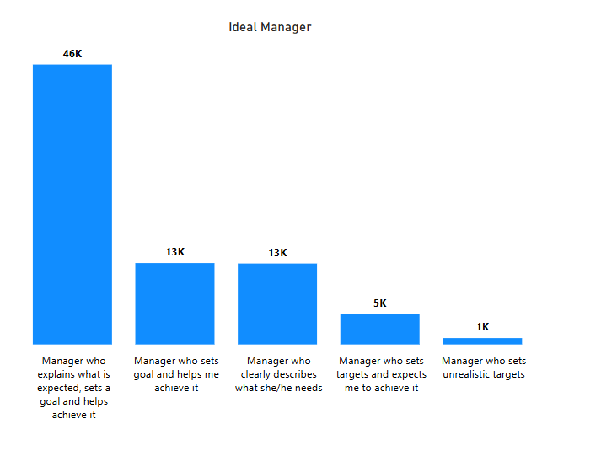
INSIGHTS
PROBLEM: Poor Managers
RECOMMENDATIONS:
Provide Leadership Training
Implement a feedback system
Encourage Self-Awareness & Feedback on leadership style
Link leadership performance to bonuses, promotions, or disciplinary actions if necessary

Slide 28
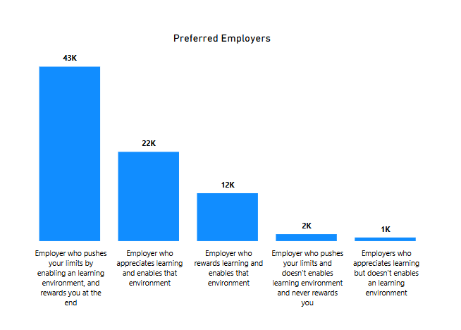
INSIGHTS
PROBLEM:
Static Growth
RECOMMENDATION:
Strengthen Learning & Career Growth Opportunities
Use transparent feedback loops and town hall meetings to ensure employees feel heard.
Redesign Work for Engagement & Collaboration
Align Compensation & Growth with Performance

Slide 29
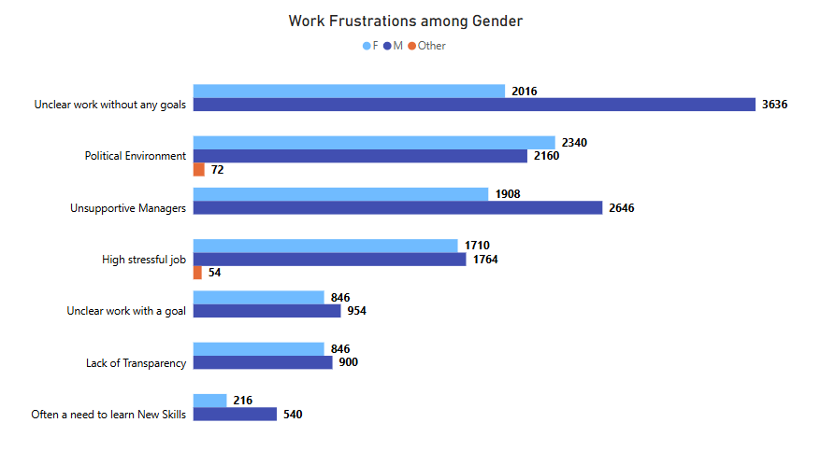
INSIGHTS
The most common work frustrations is ‘Unclear work without any goals ’.
Male – Unclear work without any goals
Female and other Gender – Political Environment

Slide 30
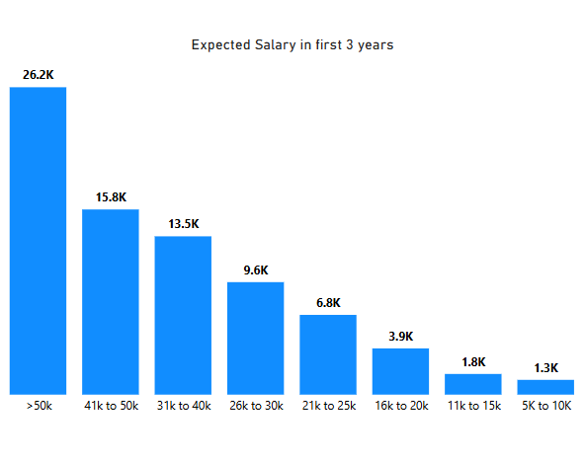
INSIGHTS
PROBLEM: Poor or Low salary
RECOMMENDATION:
Conduct Market Research & Benchmarking
Implement a Transparent Salary Structure
Offer Performance-Based Incentives
Promote internal mobility and upskilling programs to justify salary increases.
Enhance health insurance, paid leave, flexible work options, or stock options.

Slide 31
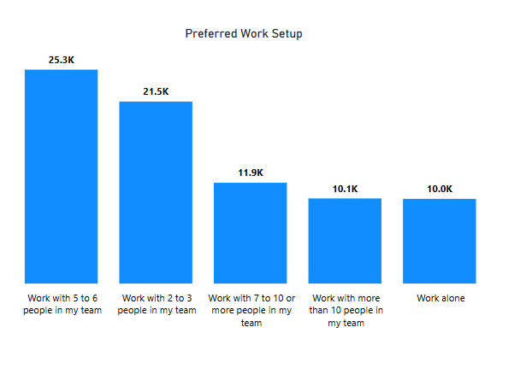
INSIGHTS
PROBLEM:
Team Dynamics
Gen Z prefer small teams
RECOMMENDATION:
Company should organize work projects around small teams of 2-3 people
Promote team building activities
Clarify Roles and Responsibilities
Promote a Positive Work Environment

Slide 32
THANK YOU

