Slide 1

Web Categorization Crawler
Mohammed Agabaria
Adam Shobash
Supervisor: Victor Kulikov
Winter 2009/10
Design & Architecture
Dec. 2009

Slide 2
Contents
Crawler Background
  Crawler Overview
  Crawling Problems
Project Goals
System Components
  Main Components
  Use Case Diagram
  API Class Diagram
  Worker Class Diagram
Schedule
Web Categorization Crawler

Slide 3
Crawler Background
A Web Crawler is a computer program that browses the World Wide Web in a methodical automated manner
Particular search engines use crawling as a means of providing up-to-date data
Web Crawlers are mainly used in order to create a copy of all the visited pages for later processing, such as categorization, indexing etc.
Web Categorization Crawler

Slide 4
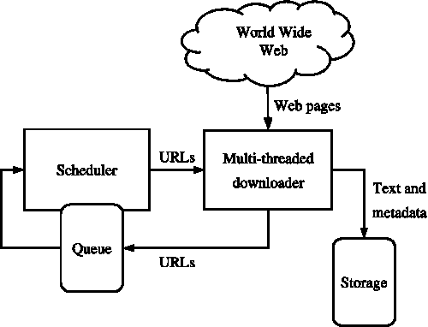
Crawler Overview
The Crawler starts with a list of URLs to visit, called the seeds list
The Crawler visits these URLs and identifies all the hyperlinks in the page and adds them to the list of URLs to visit, called the frontier
URLs from the frontier are recursively visited according to a predefined set of policies
Web Categorization Crawler

Slide 5
Crawling Problems
The World Wide Web contains a large volume of data
  Crawler can only download a fraction of the Web pages
  Thus there is a need to prioritize and speed up downloads, and crawl only the relevant pages
Dynamic page generation
  May cause duplication in content retrieved by the crawler
  Also causes a crawler traps
    Endless combination of HTTP requests to the same page
Fast rate of Change
  Pages that were downloaded may have been changed since the last time they were visited
  Some crawlers may need to revisit the pages in order to keep up to date data
Web Categorization Crawler

Slide 6
Project Goals
Design and implement a scalable and extensible crawler
  Multi-threaded design in order to utilize all the system resources
  Increase the crawler’s performance by implementing an efficient algorithms and data structures
  The Crawler will be designed in a modular way, with expectation that new functionality will be added by others
Build a friendly web application GUI including all the features supported for the crawl progress
Get familiar with the working environment
  C# programming language
  Dot Net environment
  Working with DB (MS-SQL)
Web Categorization Crawler

Slide 7
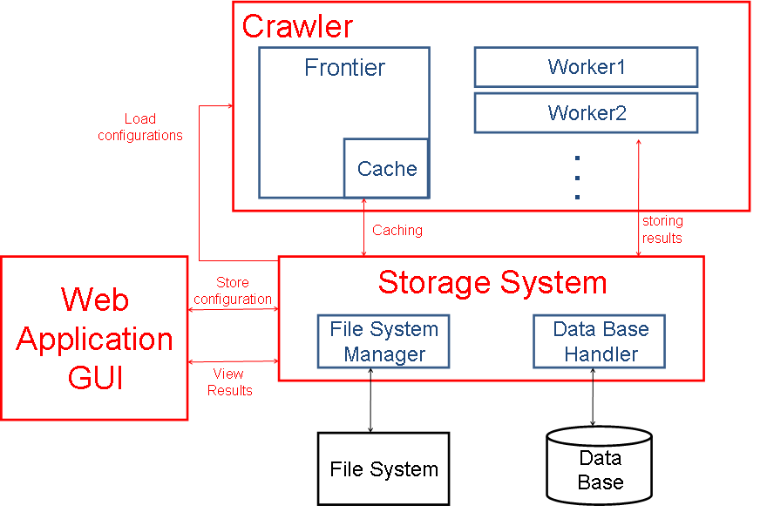
Main Components
Web Categorization Crawler

Slide 8
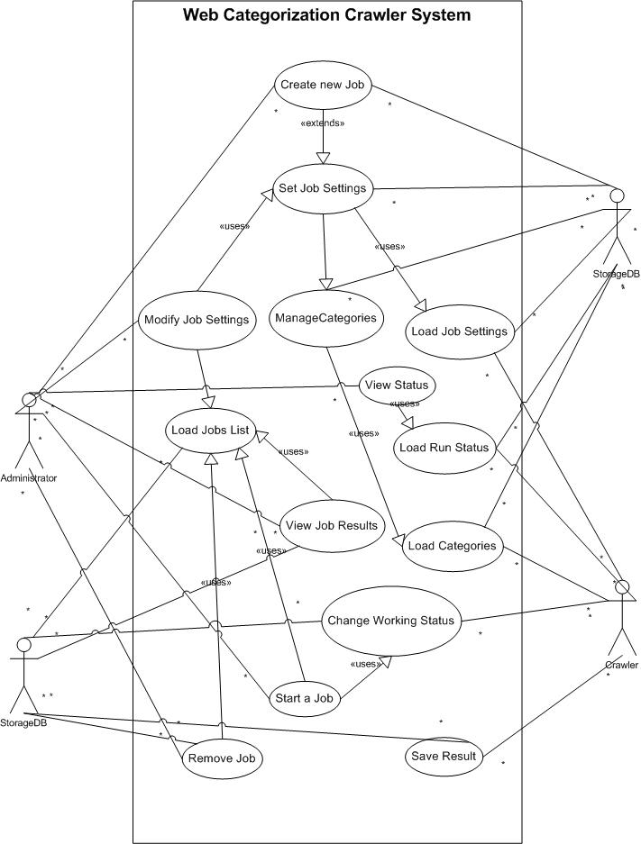
Use Case Diagram
Web Categorization Crawler

Slide 9
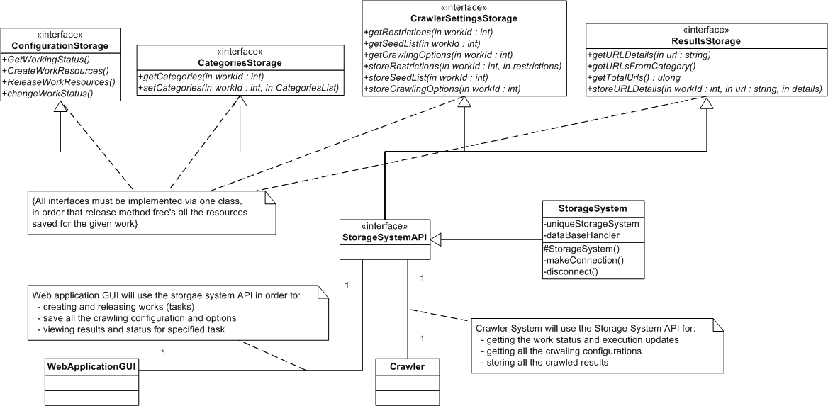
Overall System Diagram
Web Categorization Crawler

Slide 10
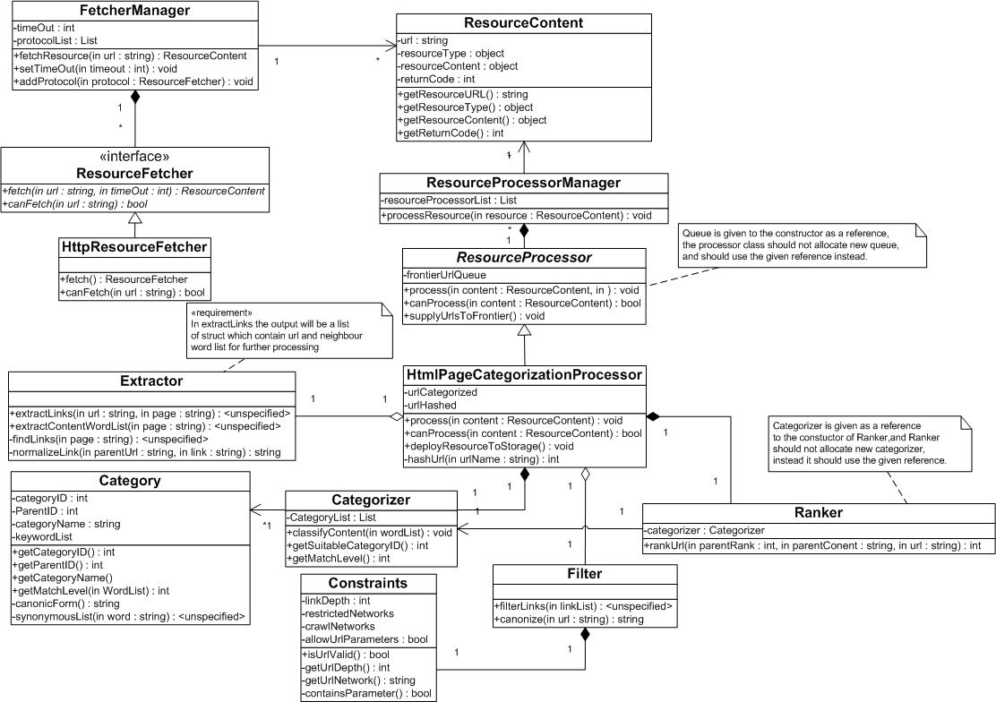
Worker Class Diagram
Web Categorization Crawler

Slide 11
Schedule
Until now:
  Getting familiar with:
    The Crawler and it’s basic idea
    C# programming language
    Asp.Net environment
  Setting features of the Crawler
  Start design and architecture of the Crawler
Next:
  Completing the design and architecture of the Crawler (2 weeks)
  Implement the Crawler (5 weeks)
  Implement the GUI Web Application (3 weeks)
  Write the report booklet and final presentation (4 weeks)
Web Categorization Crawler

Slide 12
Thank You!
Web Categorization Crawler

Slide 13
Appendix
Web Categorization Crawler

Slide 14
The Need for a Crawler
The main “core” for search engines
Can be used to gather specific information from Web pages (e.g. statistical info, classifications ..)
Also, crawlers can be used for automating maintenance task on Web site such as checking links
Web Categorization Crawler

Slide 15
Project Properties
Multi-threaded design in order to utilize all the system resources
Implements customized page rank algorithm in order determine the priority of the URLs
Contains categorizer unit that determines the category of a downloaded page
  Category set can be customized by the user
Contains URL filter unit that can support crawling only specified networks, and allow other URL filtering options
Working environment
  Windows platform
  C# programming language
  Dot Net environment
  MS-SQL data base system (extensible to work with other data bases)
Web Categorization Crawler

