Slide 1

Web Categorization Crawler II
Mohammed Agabaria
Adam Shobash
Supervisor: Victor Kulikov
Spring 2010
Design & Architecture
May. 2010

Slide 2
Contents
Crawler Overview
  Crawling Problems
System Components
  Main Components
Project Goals
Improvements
  Improvements in Categorizer
  Improvements in Ranker
  Improvements in Frontier
Schedule
Web Categorization Crawler II

Slide 3
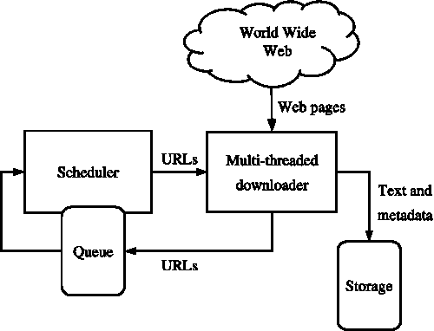
Crawler Overview
A Web Crawler is a computer program that browses the World Wide Web in a methodical automated manner
The Crawler starts with a list of URLs to visit, called the seeds list
The Crawler visits these URLs and identifies all the hyperlinks in the page and adds them to the list of URLs to visit, called the frontier
URLs from the frontier are recursively visited according to a predefined set of policies
Web Categorization Crawler II

Slide 4
Crawling Problems
The World Wide Web contains a large volume of data
  Crawler can only download a fraction of the Web pages
  Thus there is a need to prioritize and speed up downloads, and crawl only the relevant pages
Dynamic page generation
  May cause duplication in content retrieved by the crawler
  Also causes a crawler traps
    Endless combination of HTTP requests to the same page
Fast rate of Change
  Pages that were downloaded may have been changed since the last time they were visited
  Some crawlers may need to revisit the pages in order to keep up to date data
Web Categorization Crawler II

Slide 5
Main Components
Crawler
Frontier
Worker1
Load configurations
Worker2
.
.
.
storing results
Web Application
GUI
Store configuration
Storage System
Data Base Handler
View
Results
Data Base
Web Categorization Crawler II

Slide 6
Project Goals-Part II
Improve the current simple and naïve algorithms to a more efficient and sophisticated algorithms:
  Improve the Categorizer.
    Will examine the content of the page.
  Improve the Ranker.
    Will use algorithm similar to “Shark Search”
    Fetch first the pages that were ranked as preferred.
  Improve the frontier.
    Must be faster.
    Must spare more space.
Extend the Web Application GUI :
  User will have more options using the crawler.
  More user friendly.
Web Categorization Crawler II

Slide 7
Improvements In Categorizer
Part I Categorizer ascribed every web page only to “Web Page” category – dummy Categorizer.
Part II Categorizer will use a little “more sophisticated” algorithm:
  Will go over all the categories that have been defined by the user.
  Will compare the current web page to all the categories.
    Every category has a confidence level (CL).
    The match level of the current web page to certain category is evaluated.
    If evaluation bigger than CL of certain category.
      Current web page is ascribed to that category.
Eventually the current web page will be ascribed to all the categories it is belonged to (hopefully) .
Web Categorization Crawler II

Slide 8

Improvements In Ranker
Part I Ranker gives all the urls a rank of zero – dummy ranker.
Part II ranker will replace the recent “algorithm” to a better one.
Will use an algorithm close to the Shark Search algorithm:
  Will take into consideration the following:
    The nearby text of the extracted.
    The rank of the parent web page.
  Will use formula to calculate the rank of a url
      Were
Web Categorization Crawler II

Slide 9
Improvements In Frontier
Part I frontier – FIFO
  Not efficient enough
Part II frontier –Trie + Hash map
  Every url that has been extracted will be passed to Trie
    Will use less memory
    Much more easier to search for certain url
      To check If url has been visited before
        If so don’t visit again!
  Every url will have priority level (rank)
    Next url to be fetched is the one with highest rank.
Web Categorization Crawler II

Slide 10
Schedule
Part I project:
  Still in progress
    Crawler part is almost finished.
      All the units of it has been finished
      Including the testing for all units
    Remained: Storage part, Primitive GUI, Report book
Part II project:
  Study in more details the shark search algorithm
  Explore the algorithm of categorizer
  Apply both algorithms to the project
  Built the improved Frontier
  Built improved and more friendly GUI
Web Categorization Crawler II

Slide 11
Thank You!
Web Categorization Crawler

Slide 12
Appendix
Web Categorization Crawler

Slide 13
The Need for a Crawler
The main “core” for search engines
Can be used to gather specific information from Web pages (e.g. statistical info, classifications ..)
Also, crawlers can be used for automating maintenance task on Web site such as checking links
Web Categorization Crawler

Slide 14
Project Properties
Multi-threaded design in order to utilize all the system resources
Implements customized page rank algorithm in order determine the priority of the URLs
Contains categorizer unit that determines the category of a downloaded page
  Category set can be customized by the user
Contains URL filter unit that can support crawling only specified networks, and allow other URL filtering options
Working environment
  Windows platform
  C# programming language
  Dot Net environment
  MS-SQL data base system (extensible to work with other data bases)
Web Categorization Crawler

Slide 15
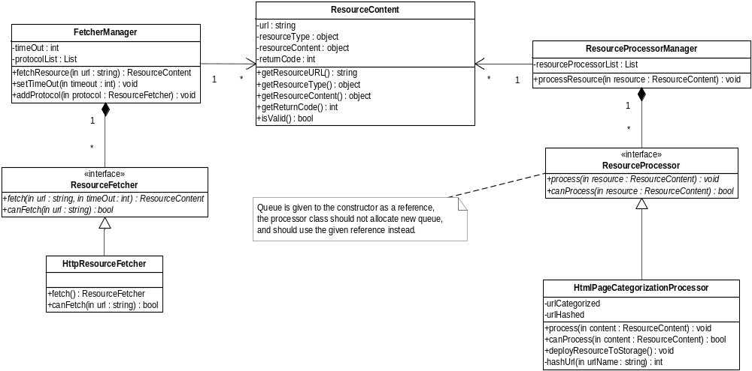
Worker Class Diagram
Web Categorization Crawler

Slide 16
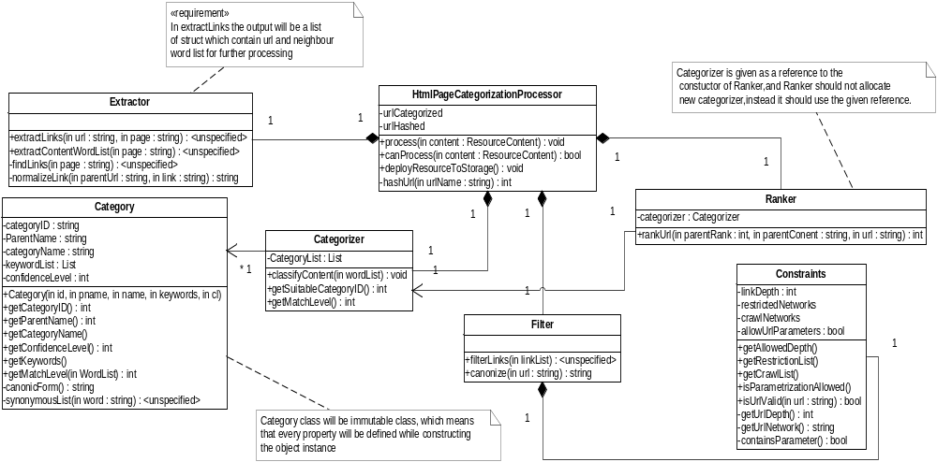
Worker Class Diagram-cont.
Web Categorization Crawler

