Slide 1
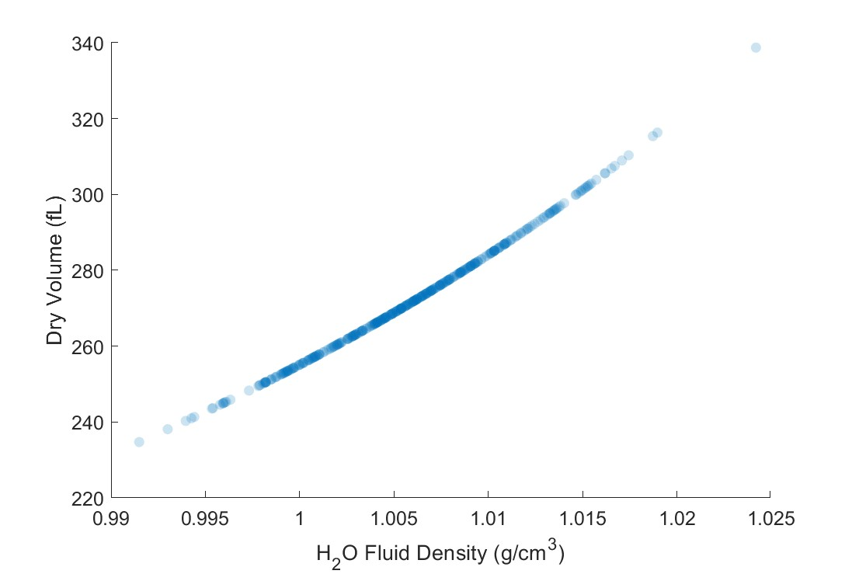
H2O fluid density vs. WC/dry properties

Slide 2
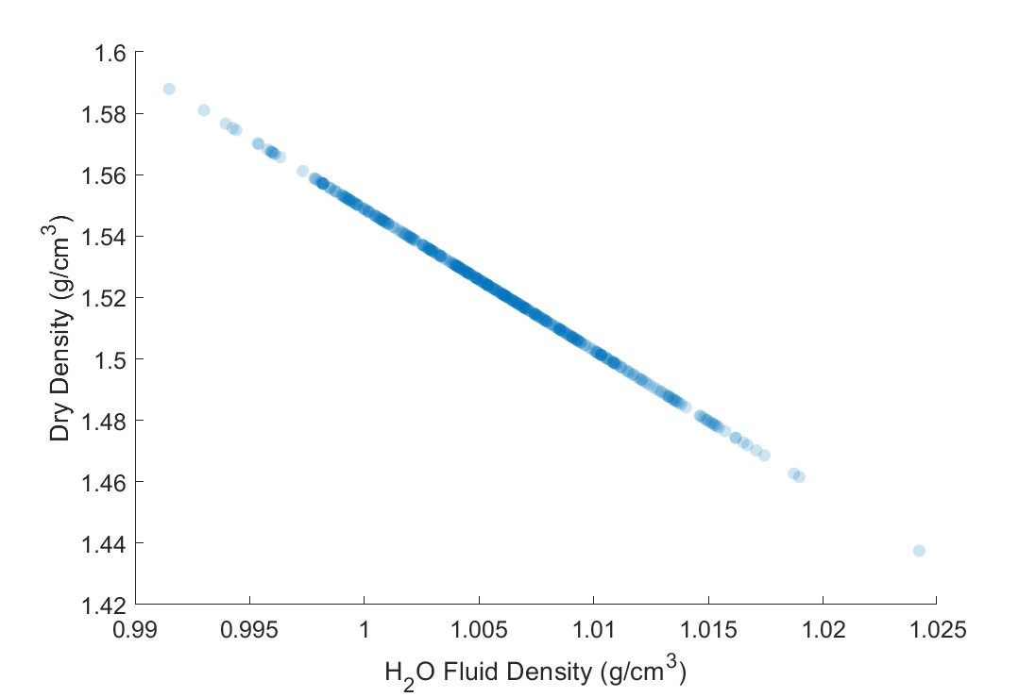
H2O fluid density vs. WC/dry properties

Slide 3
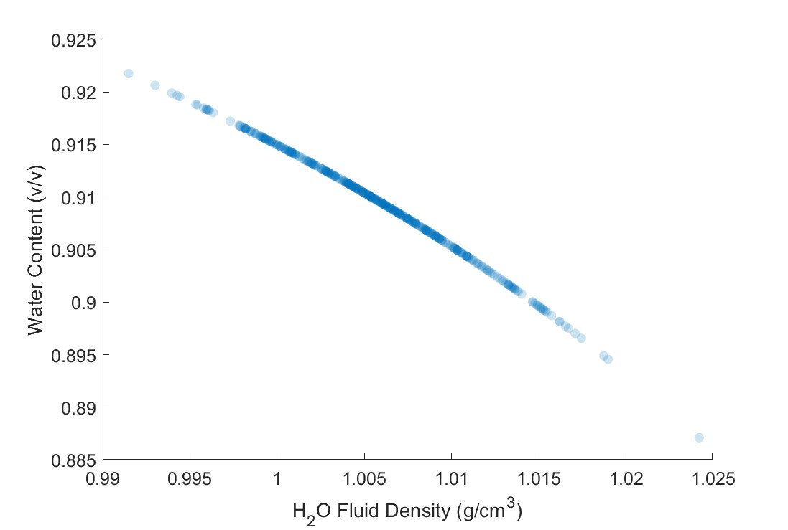
H2O fluid density vs. WC/dry properties

Slide 4
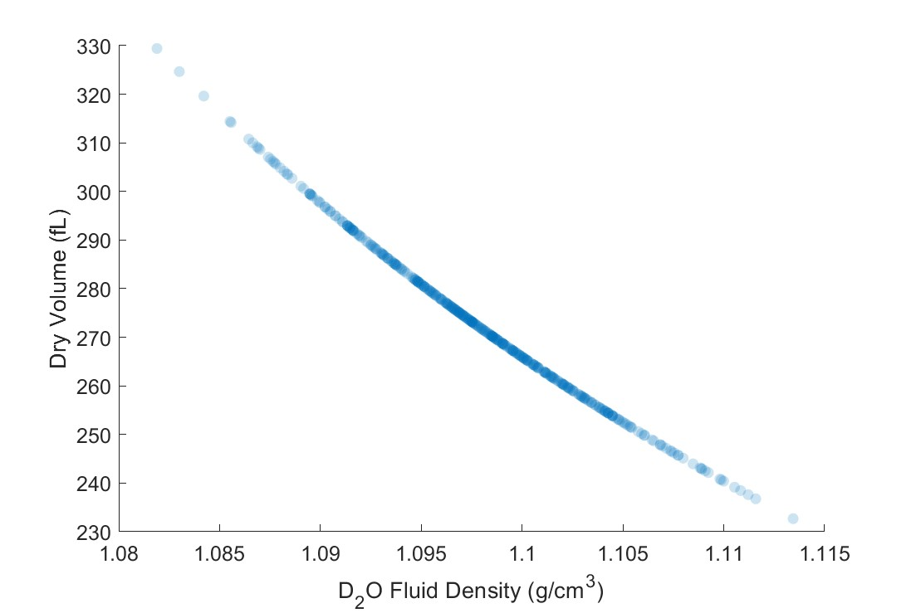
D2O fluid density vs. WC/dry properties

Slide 5
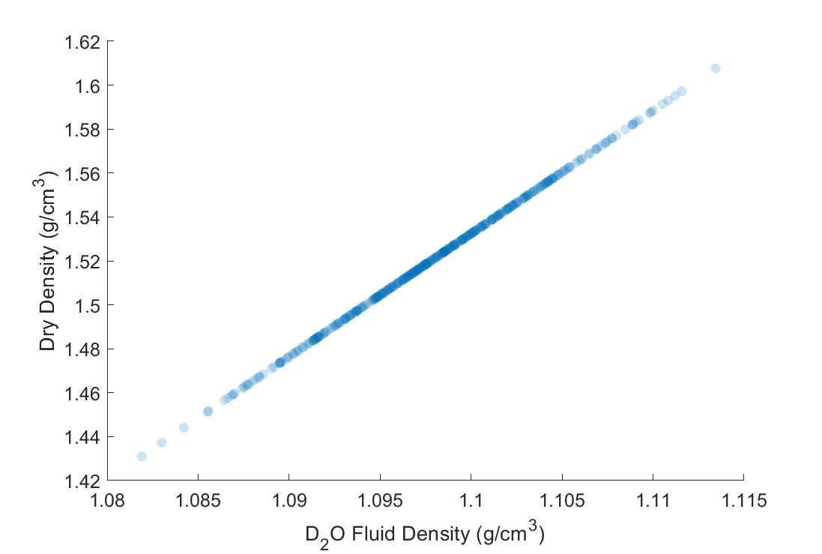
D2O fluid density vs. WC/dry properties

Slide 6
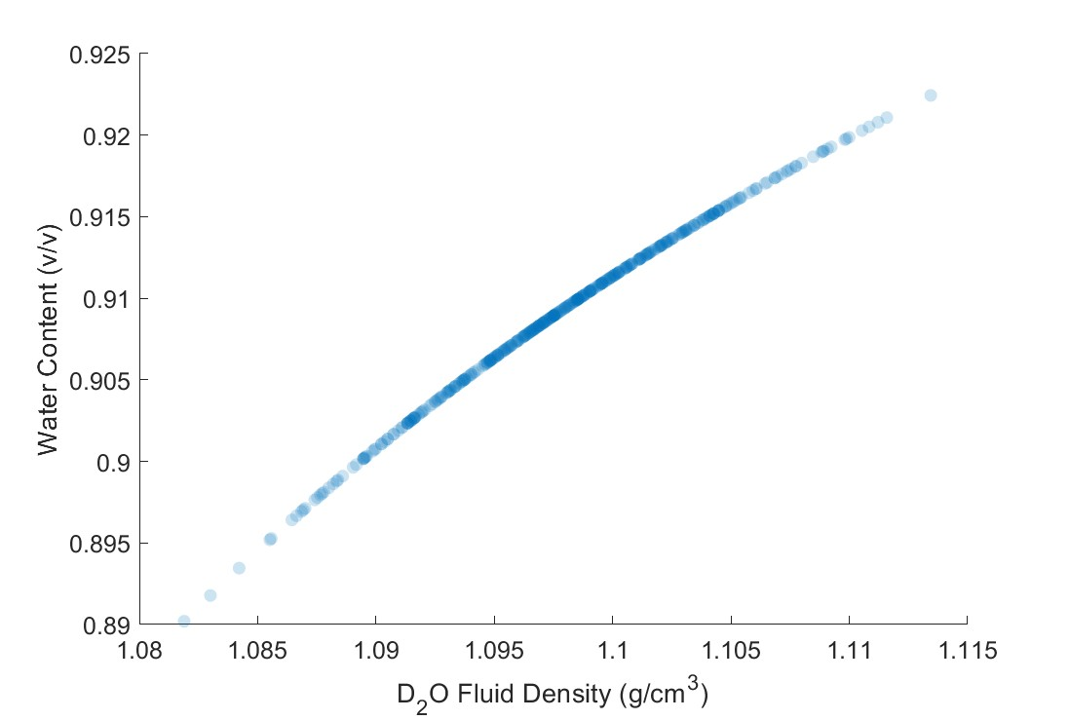
D2O fluid density vs. WC/dry properties

Slide 7
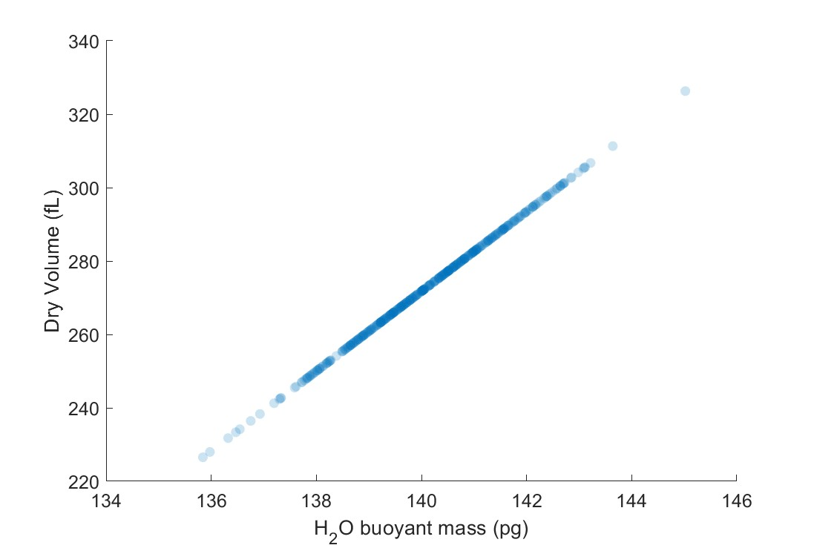
H2O buoyant mass vs. WC/dry properties

Slide 8
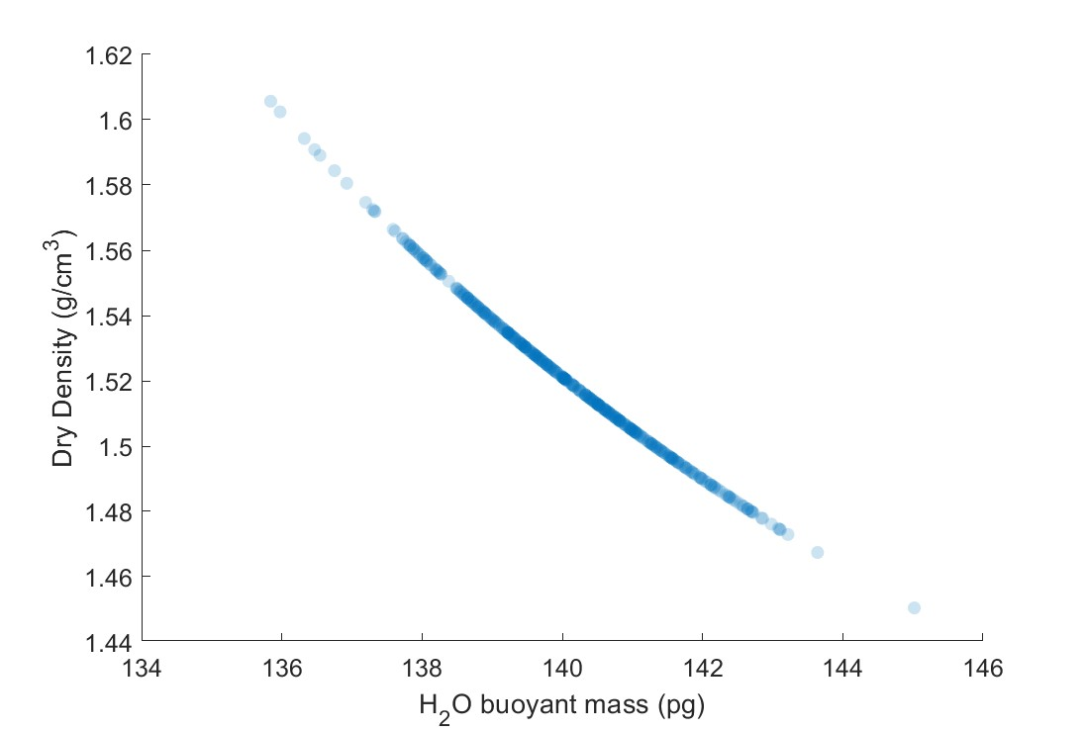
H2O buoyant mass vs. WC/dry properties

Slide 9
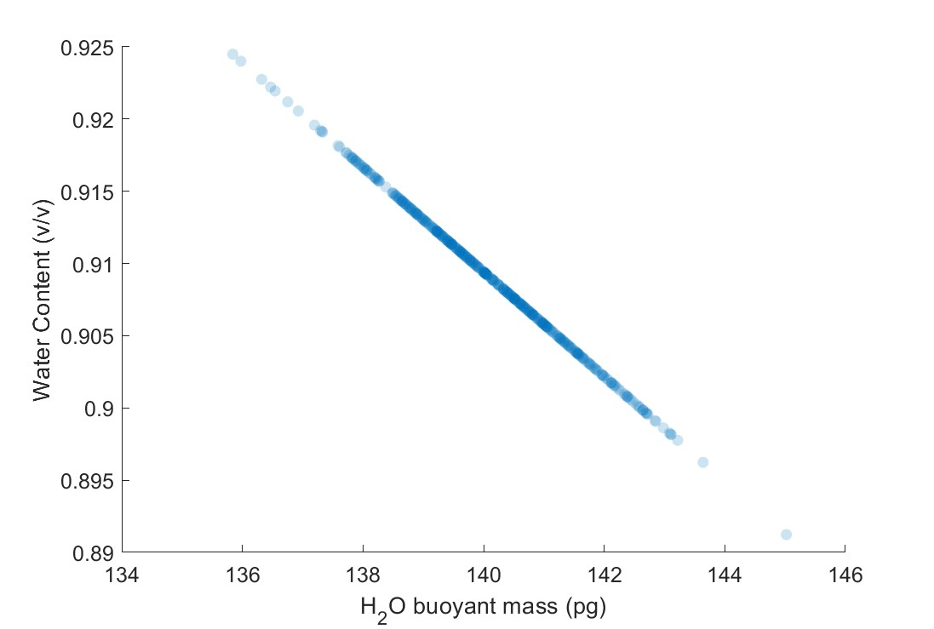
H2O buoyant mass vs. WC/dry properties

Slide 10
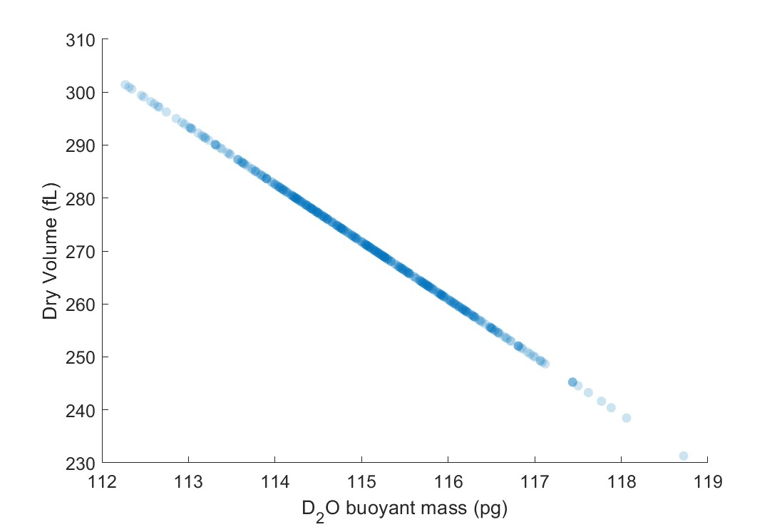
D2O buoyant mass vs. WC/dry properties

Slide 11
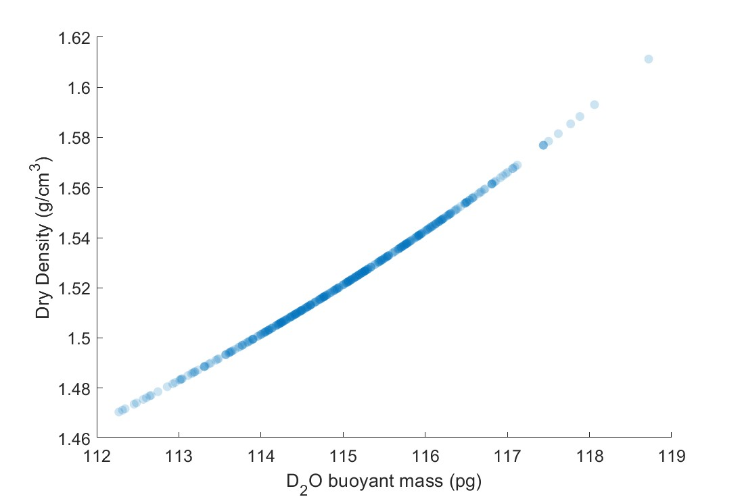
D2O buoyant mass vs. WC/dry properties

Slide 12
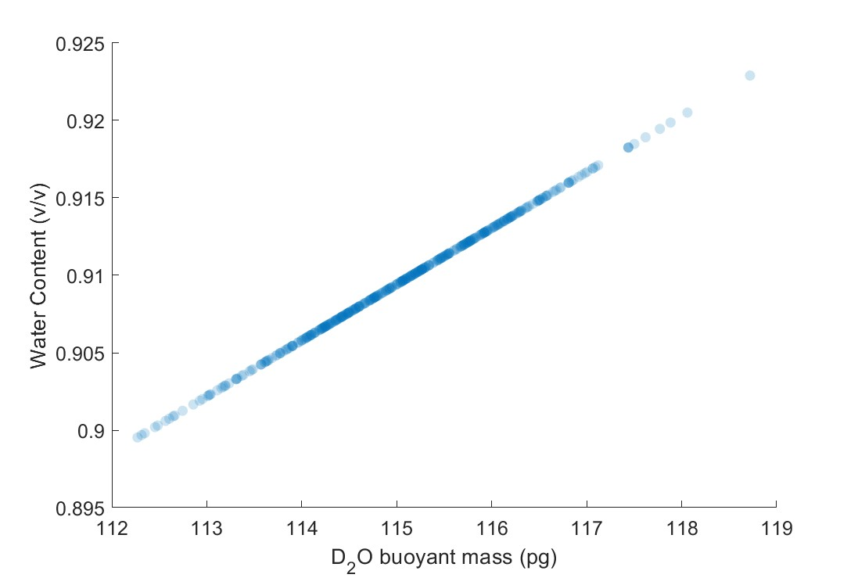
D2O buoyant mass vs. WC/dry properties

Slide 13
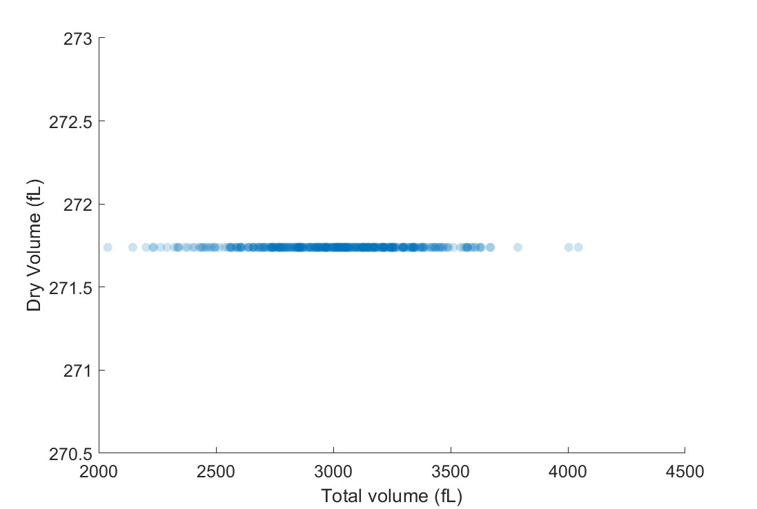
Total volume vs. WC/dry properties

Slide 14
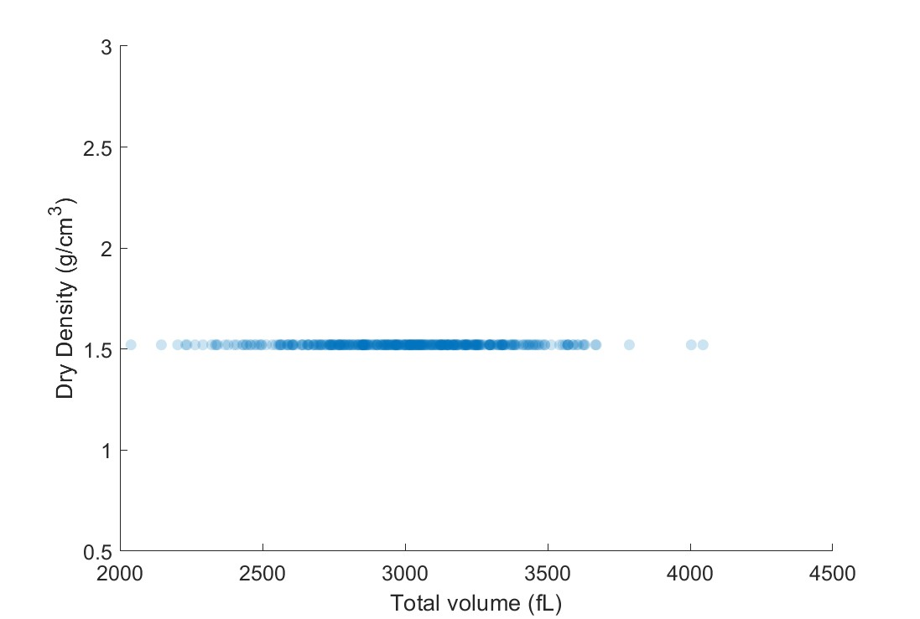
Total volume vs. WC/dry properties

Slide 15
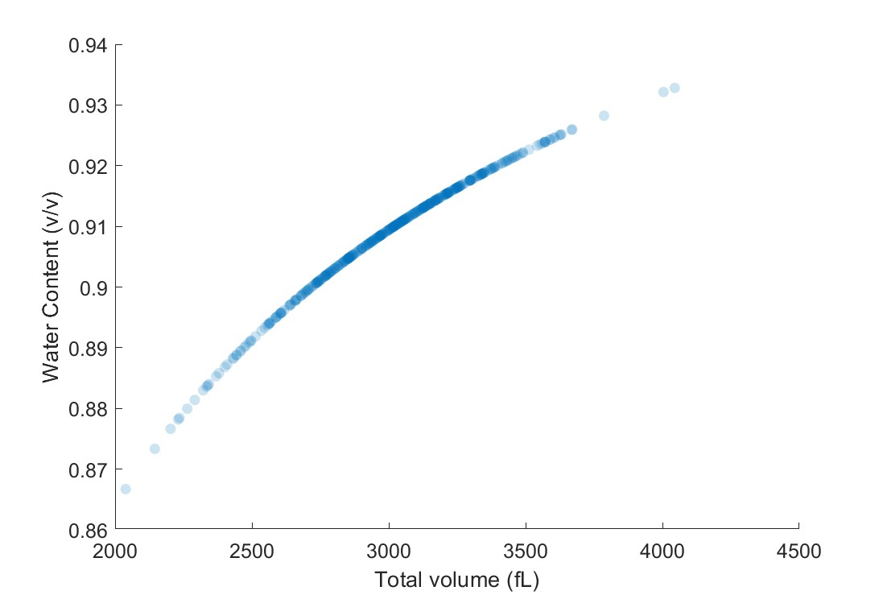
Total volume vs. WC/dry properties

Slide 16
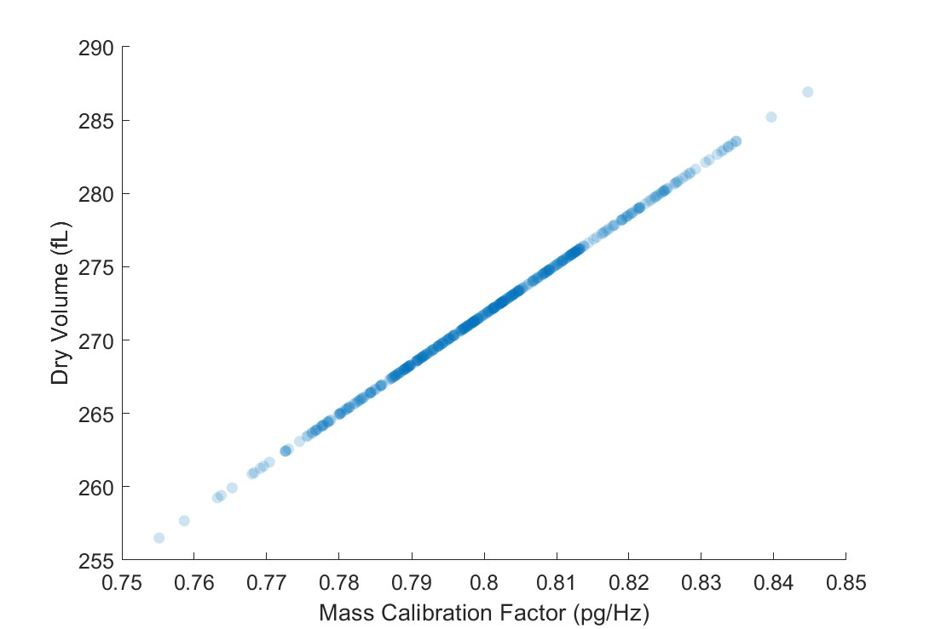
Mass cal. factor vs. WC/dry properties

Slide 17
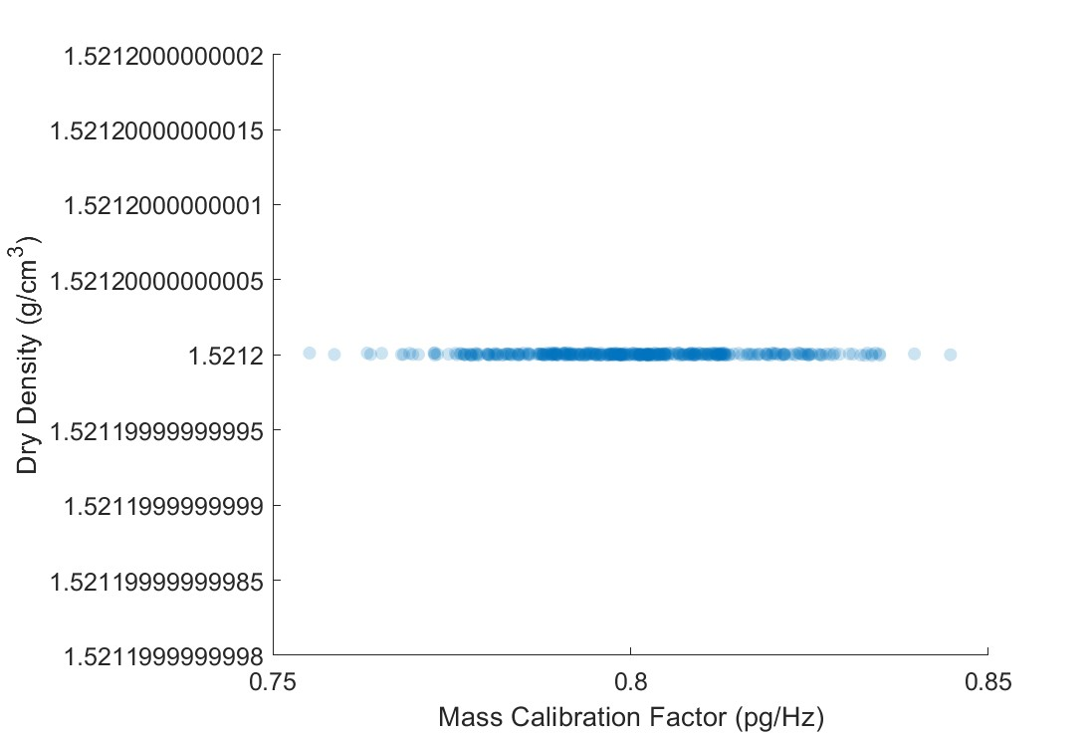
Mass cal. factor vs. WC/dry properties

Slide 18
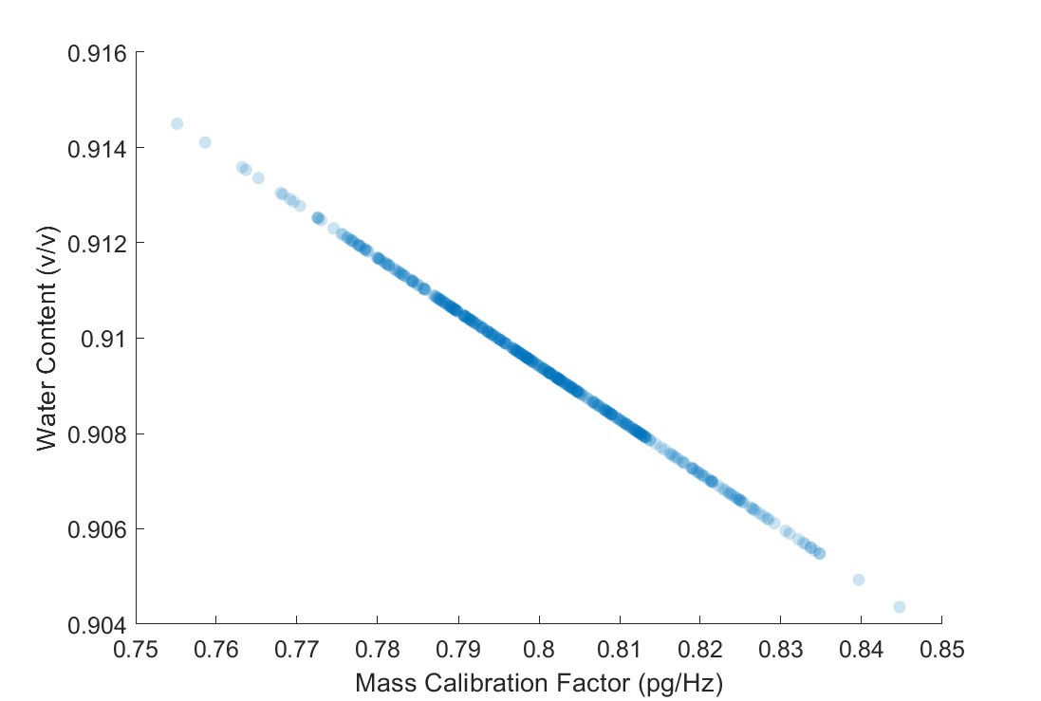
Mass cal. factor vs. WC/dry properties

