Slide 1

Programming Merit Badge
Troop 613

Slide 2
outline
I only have ~15 minutes!
Introduction: Why study programming?
  What counts as “computer literacy”
What types of computer programming languages & technologies are there?
Where does Python fit?
What makes Python cool?

Slide 3
Introduction
"A human being should be able to change a diaper, plan an invasion, butcher a hog, conn a ship, design a building, write a sonnet, balance accounts, build a wall, set a bone, comfort the dying, take orders, give orders, cooperate, act alone, solve equations, analyze a new problem, pitch manure, program a computer, cook a tasty meal, fight efficiently, die gallantly. Specialization is for insects."
— Robert Heinlein, Time Enough for Love, (1973)

Slide 4
Introduction
These are the three great virtues of a programmer:
Laziness: The quality that makes you go to great effort to reduce overall energy expenditure. It makes you write labor-saving programs that other people will find useful and document what you wrote so you don't have to answer so many questions about it.
Impatience: The anger you feel when the computer is being lazy. This makes you write programs that don't just react to your needs, but actually anticipate them. Or at least pretend to.
Hubris: The quality that makes you write (and maintain) programs that other people won't want to say bad things about.
— Larry Wall, Programming Perl 2nd Edition, (1996)
n.b.: these virtues are not endorsed by BSA

Slide 5
Why Study Programming
I don't really care if all or none or some of you learn to truly program a computer. It is simultaneously fun and hard, frustrating and rewarding. It is not for everybody.
I do care that all of you learn to be “computer literate”
Notes:
Consider the following analogies...
not everybody can or should be a chef; everybody should be able to cook healthy food
not everybody can or should be a tailor or a seamstress; everybody should be able to sew on a button or a patch
not everybody can or should be a mechanic; everybody should be able to change a flat tire and jumpstart a battery
not everybody can or should be a doctor; everybody should know 1st aid.

Slide 6
What counts as computer literacy
computer literacy is not knowing how to use MS Word
computer literacy is not blindly accepting Facebook, Google, Windows, etc.
computer literacy is understanding what is going on underneath the hood
computer literacy is recognizing patterns of activity/functionality
computer literacy means not panicking when things go wrong

Slide 7
Types of Programming Technologies
there are a lot of different programming languages and technologies
  list of “Hello World” programs
each has similarities & differences
each has pros & cons
Notes:
each can vary in terms of abstractness and strictness
all have some type of variable structure, loops, if/then statements, etc.

Slide 8
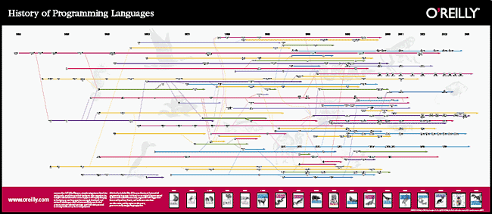
Types of Programming Technologies
http://cdn.oreillystatic.com/news/graphics/prog_lang_poster.pdf

Slide 9
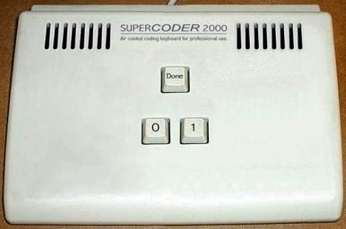
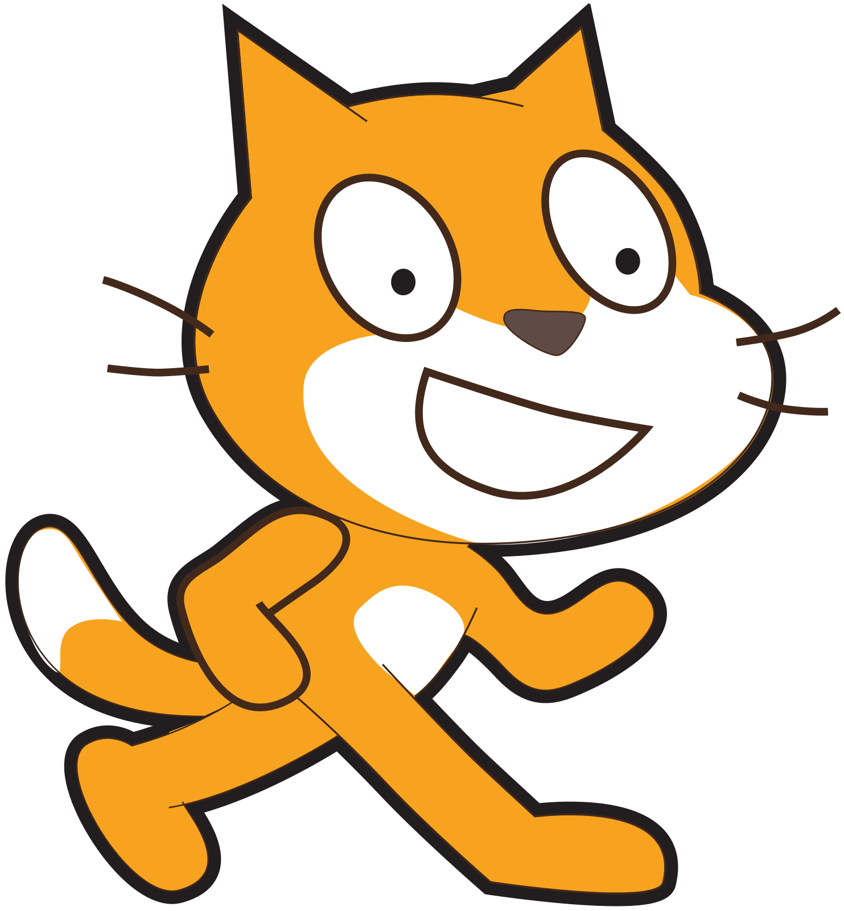
types of programming technologies
JavaScript
Scratch
Python
C++
assembly
Fortran
C
Java
electronics
object-oriented

Slide 10
Types of Programming Technologies
interpreted vs. compiled languages
strongly vs. weakly typed
memory management
object oriented
  advantages:
    dealing w/ set of related variables rather than individually
    makes more sense to human programmers
    “polymorphism”
Notes:
used to be that a computer program was a self-contained unit running logically from top to bottom that was written in a simple text editor (I'm not old enough to have used punch cards)
these days, a computer program has many more moving parts...

Slide 11
Where does Python fit?
Python is a high-level object-oriented weakly-typed language
Python is very pretty
  >> import this
Notes:
used to be that a computer program was a self-contained unit running logically from top to bottom that was written in a simple text editor (I'm not old enough to have used punch cards)
these days, a computer program has many more moving parts...

Slide 12
What makes it cool?
code blocks are identified by indentation rather than explicit brackets (this makes it pretty)
automatic memory management (this makes it simple)
packages / libraries / namespaces (this makes it extensible)
“duck typing” (sometimes this makes things easy, sometimes not)

Slide 13
What makes it cool?
I will go over some basic python code and maybe try to demonstrate...
  variables
  lists & dictionaries
  loops
  control flow
  modules & packages
  functions
  classes

