Slide 1
DATA BOSSES
Christine Domercant (acd201)
Truc Hoang (tth46)
Tasnim Quayum (tnq3)

Slide 2
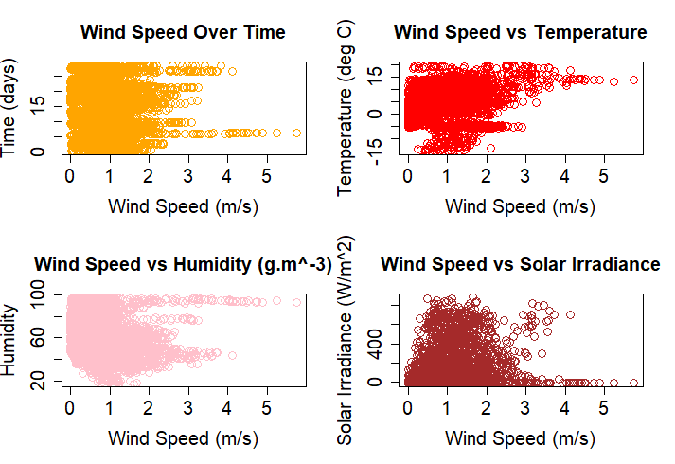
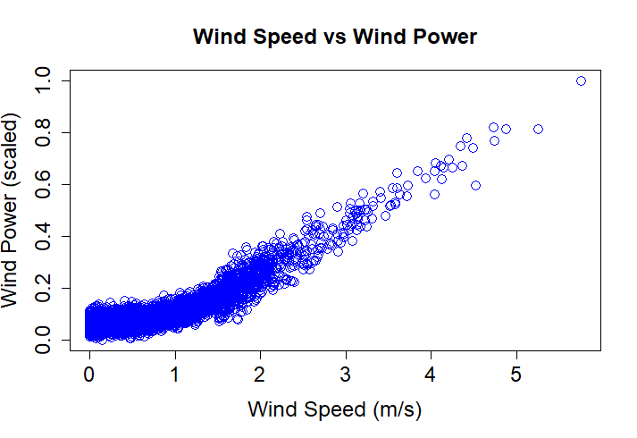
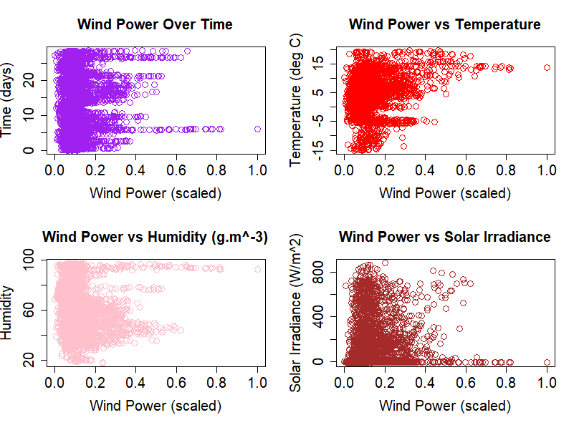
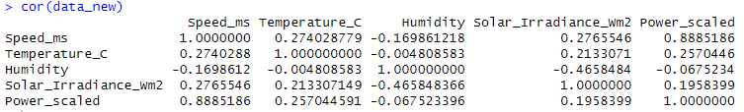
Descriptive Analytics
Visualization
Created various plots to visually analyze the relationship between the variables
Analysis
Correlation
Computed the correlation to strength visual analysis
Pseudocode
Brainstormed how parts mentioned above can be used to implement prediction

Slide 3
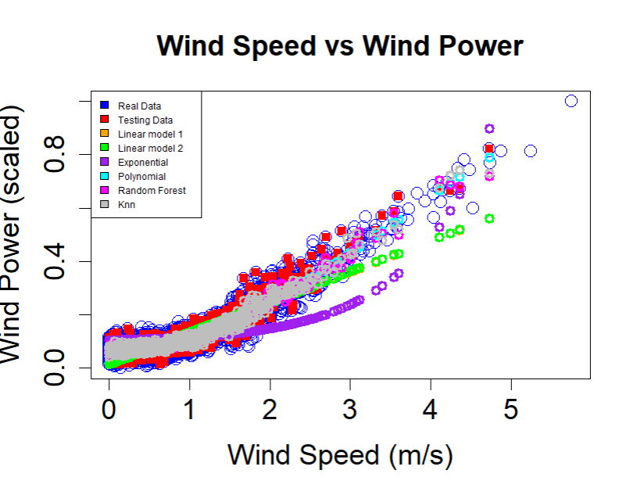
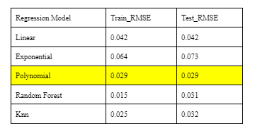
Wind Power Prediction Modeling Efforts
Linear
Exponential
Polynomial
Random Forest
Knn
Scatter plot showed slight curvature
Capture the nonlinear relationship
Model the complex relationship in prediction
Investigate non parameter approach
High correlation between wind power and wind speed
Notes:
Briefly explain each model
Linear
Exponential
Polynomial : Capture the nonlinear relationship between the environmental variables and wind power
Random Forest : Model the complex relationship between the wind speed and temperature in prediction
Knn : Investigate non parameter approach using temperature and wind speed as inputs
Go over the training and test rsme and observable overfitting

Slide 4
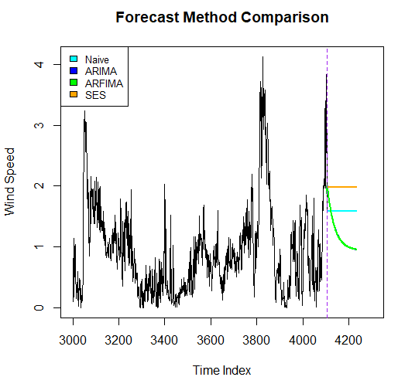
Wind Speed Forecasting Modeling Efforts
01
02
03
04
ARIMA
ARFIMA
Use historical wind speed data to forecast - assume time series data to be stationary (removing trend and seasonality)
Use historical wind speed data to forecast - handle non-stationary data by introducing a fractionally integrated component.
SES
ARIMAX
Use a weighted average of past observations to forecast future values
Extend ARIMA by allowing the inclusion of exogenous variables in the model (Temperature and Solar Irradiance)

Slide 5
Final Model Description
ARFIMA
Polynomial
Power_scaled ~ Temperature_C + I(Speed_ms^2) + I(Speed_ms^3)
Forecast Model | RMSE Wind speed | RMSE PowerScale (Linear Regression) | RMSE PowerScale (Polynomial Regression)
Naive | 0.6380118 | 0 | 0
ARIMA | 0.5599901 | 0.0596 | 0.0544
ARFIMA | 0.5599882 | 0.0596 | 0.0544
Exponential Smoothing | 0.6157661 | 0.0605 | 0.0603
ARIMAX | 0.6009415 | 0.06 | 0.058
Table: RMSE of wind speed from different time series forecast models and its RMSE of Wind Scaled power by Polynomial regression model.
Notes:
Due to the lowest RMSE observed from 4 models, we decided that ARFIMA is the best model.
The table also shows that our Polynomial regression model for wind power prediction also perform well based on the forecasted wind speed.

Slide 6
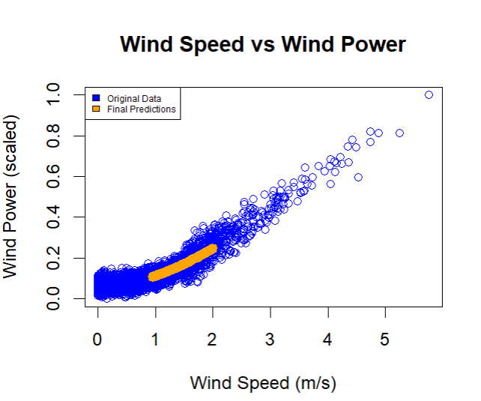
Results and Findings
Wind speed is predicted using ARFIMA model.
Wind power is predicted using polynomial model.
All historical data was used to train models.
Jupiter is the biggest planet in the Solar System
AND STILL GOING STRONG!

Slide 7
Recommendations & Takeaways
Recommendations:
Continue to improve forecasting and regression model.
Use larger data set to better understand trends over time.
Takeaways:
There are many ways to predict future events.
It is a continuous process.

