Slide 1


GROUP 4 – T1.2109.E0
Team Member:
Leader: Nguyễn Ngọc Kim Ngân
Members: Nguyễn Toán Trương Dương Trúc Duy Nguyễn Phúc Duy
Instructor: Nguyễn Kim Thuần

Slide 2
Table Of Contents
Introduction
Requirements
Sitemap
Task List

Slide 3
Introduction
After being affected by the Covid-19 epidemic, many industries had to switch to online business activities.The Vehicle Insurance industry is also starting to digitize its business. On the internet, you can buy a product like Vehicle Insurance at any time and from anywhere. You can buy a Vehicle Insurance policy from the comforts of your home at midnight and you will still have a seamless experience. Buying Vehicle Insurance online provides convenience.
This is not possible while buying Vehicle Insurance manually i.e from the insurance company or an agent.
In addition, Current manual system that is employed is extremely laborious and quite inadequate; it only makes the process more difficult and hard. Main purpose of this software should be to reduce the manpower, paperwork and provide security from unauthorized access. It should also help in producing difficult kinds of reports required for different managerial aspects.

Slide 4
Requirements
Module 1: Login Module 2: Customer Information Module 3: Vehicle Information Module 4: Estimate Module 5: Insurance Process Module 6: Company Billing Policy Module 7: Report Module 8: Company Expense Module 9: Claim details
Functional Requirement:
About us
Types of insurance Testimonials Site map Contact us

Slide 5
Requirements 1-2
Customer:
User needs to register as customer by providing the necessary information in the registration form and provide the user name and password
Customer can login with unique user name and password.
He can change the password.
Can purchase the policy online: For purchasing the policy online, he has to fill in the application form which would capture all the required information about the vehicle. On successful payment, copy of policy would be generated which customer can save for the records.
Initiate the claim by filling the claim form.

Slide 6
Requirements 1-3
Employee:
Employee will be admin who can login with admin user name and password.
He can perform all the admin functions as maintaining the policy records, claim records, payment schedules etc
Following reports needs to be generated
Monthly sell of policies
Vehicle wise analysis
Claims report
Policies due renewals
Policies lapsed report

Slide 7
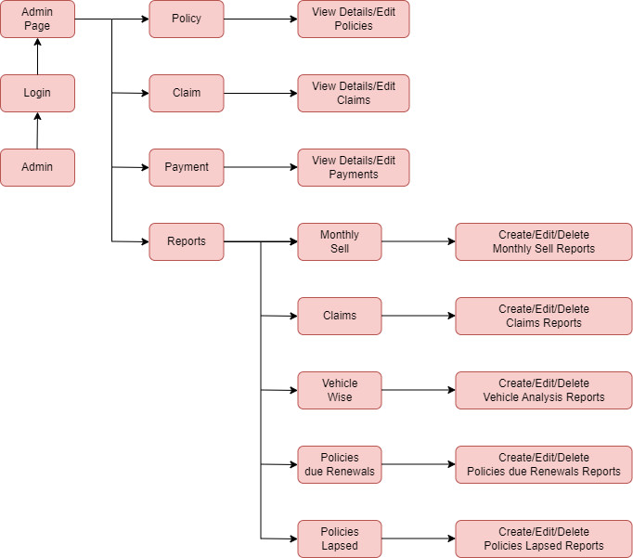
Sitemap - employee

Slide 8
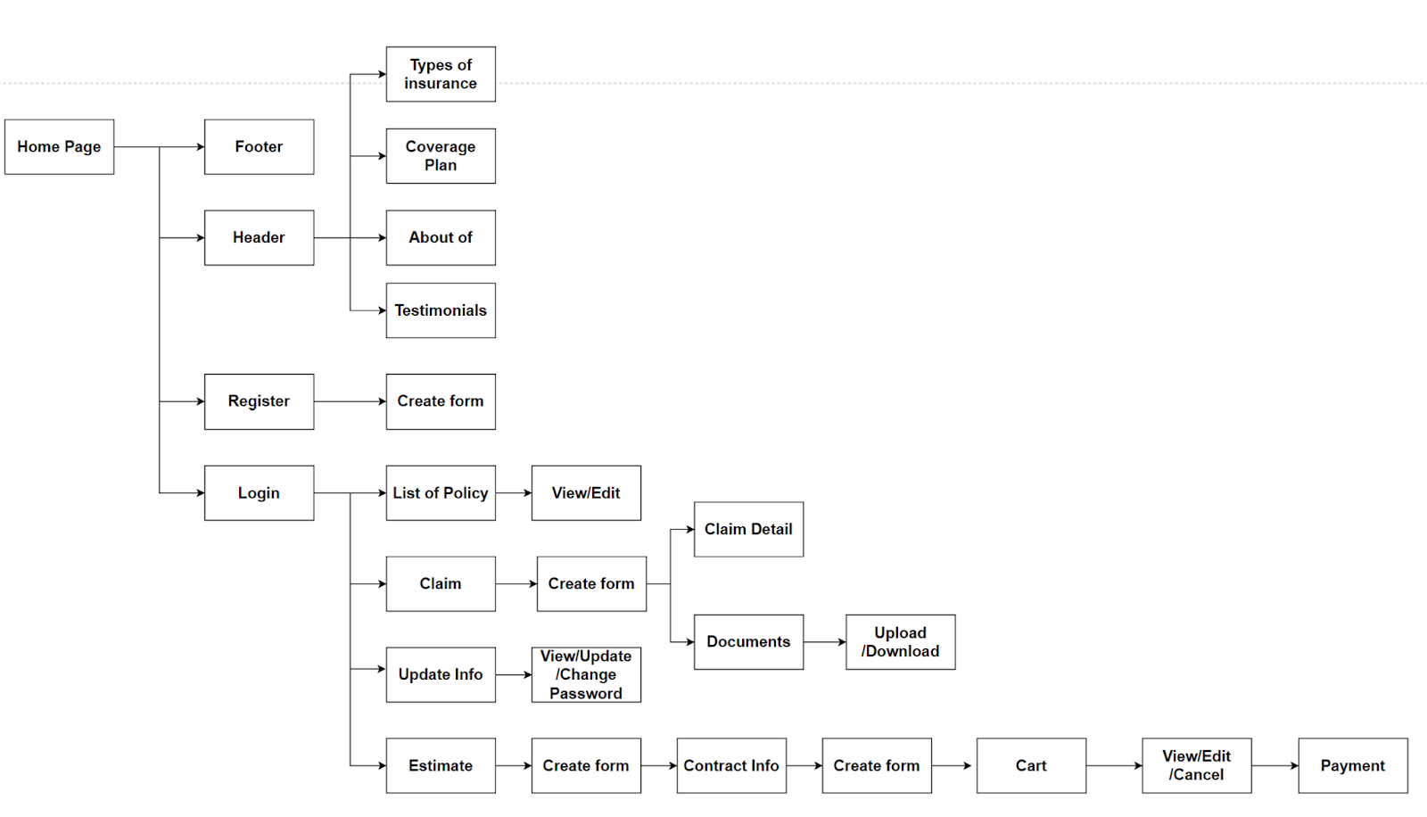
Sitemap – customer

Slide 9
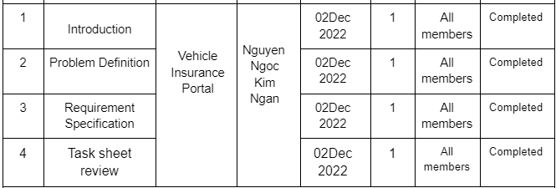
Tasks 1-1

Slide 10
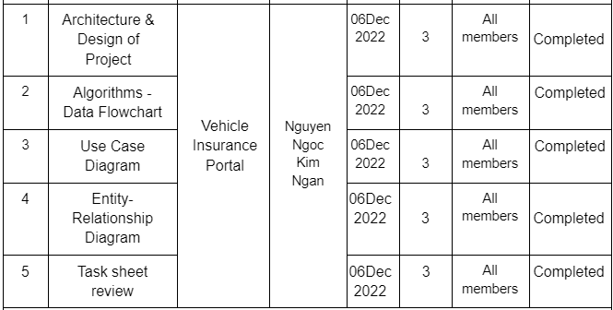
Tasks 1-2

Slide 11
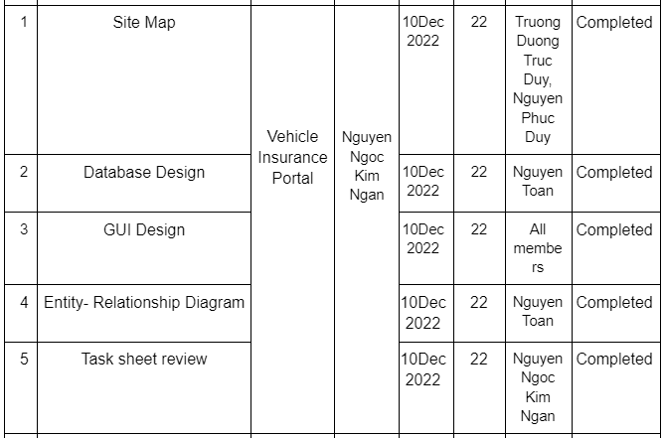
Tasks 1-3

Slide 12
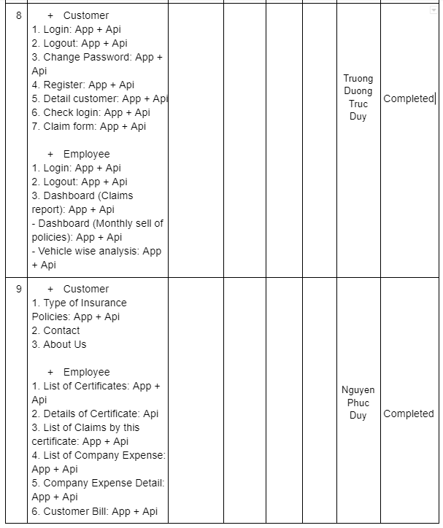
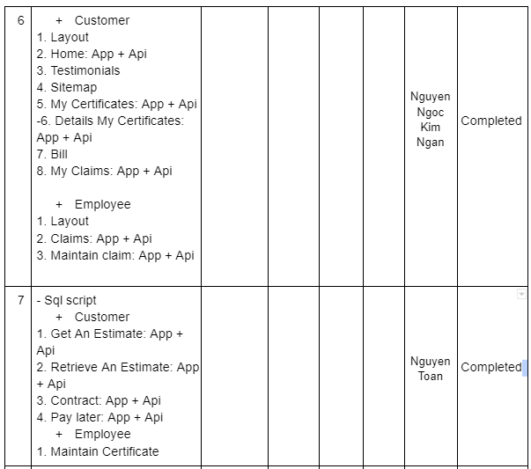
Tasks 1-4

Slide 13
Thank You

