Slide 1

Differential Gene Expression of Luminal A Invasive Ductal Carcinoma in Comparison to Unaffected Breast Tissue
A Transcriptomic Analysis of UCSC's Xena TCGA-BRCA Cohort
Thomas Rucinski
Course: BIOL-616: Bioinformatics
University of Nevada, Las Vegas

Slide 2
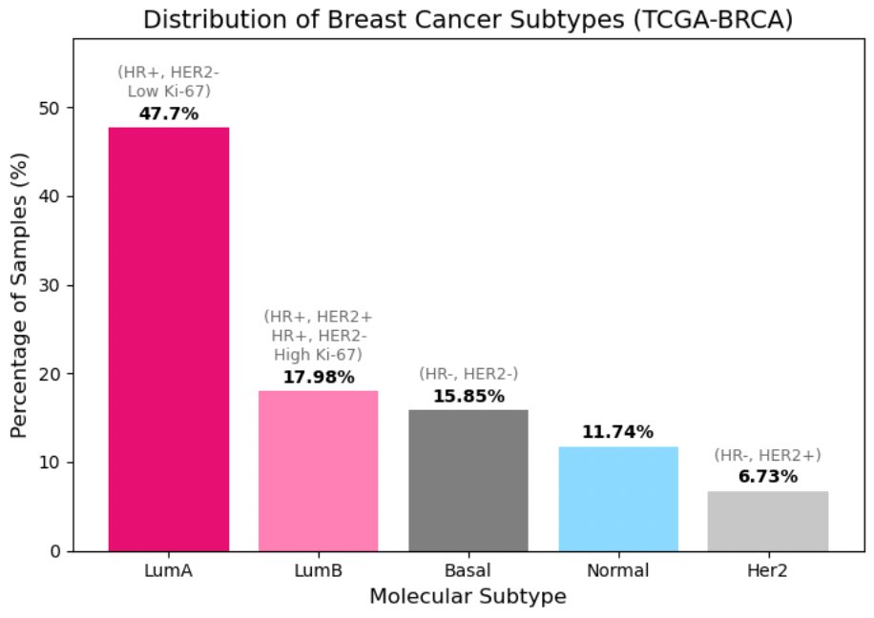
Significance
Luminal A breast cancer is the most common PAM50-subtype according to the American Cancer Society (2024).
The TCGA-BRCA Cohort within UCSC's Xena database has 47.7% of all 1218 samples diagnosed as Luminal A.
Luminal A is considered the most favorable diagnosis compared to other PAM50-subtypes, however patient outcomes vary.
While hormonal drivers are well defined (HR+ vs HR-), the suppression of specific metabolic pathways is often overshadowed by proliferative and hormonal pathways.
Little to no research in pathway dysregulation and etiology for Luminal A invasive ductal carcinoma (IDC) samples compared to unaffected breast tissue.
Figure 1. Subtype Distribution of 1218 Breast Cancer Subtypes in TCGA-BRCA Cohort (UCSC Xena)

Slide 3
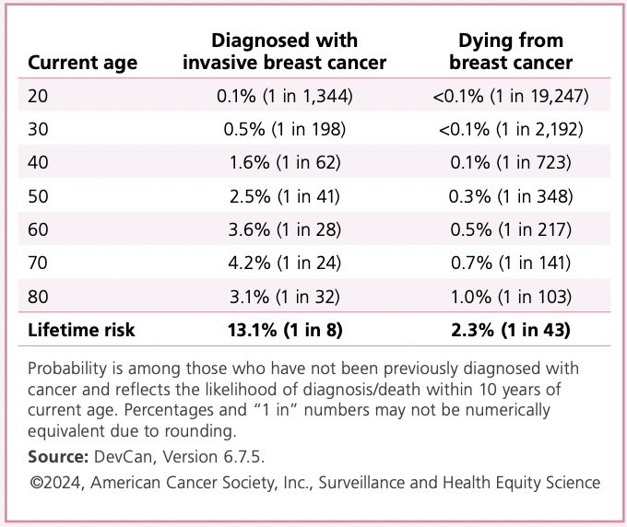
Research Problem
One in every eight women (13.1%) is diagnosed with a form of breast cancer in their lives, and about one in every forty-three women (2.3%) will die from this disease.
Goal: Uncover specific genes and molecular pathways which are significantly dysregulated in Luminal A invasive ductal carcinoma.
Proposal Hypothesis: Differentially expressed genes in Luminal A Invasive Ductal Carcinoma will reveal enrichment in hormone-regulated and cell-cycle pathways distinct from those in unaffected breast tissue.
Uncovering downregulated metabolic pathways in Luminal A IDC samples provides insight to the how the homeostatic environment is modified within the tumor environment.

Slide 4
Literature Review and Limitations
In literature related to Breast Cancer RNA-seq Gene Expression, TCGA is commonly used, but other databases also prove to be extremely well-curated (METABRIC, GEO, ICGC).[Identification of differentially expressed genes-related...]
Recent publications have called for the integration of multiple pathway libraries (Hallmark, KEGG variants, reactome) to avoid single database bias and to have a greater interpretation of how gene or pathway dysregulation is related to proliferation of the disease [Toward a gold standard for benchmarking gene set...]
Limitations:
Sample size & TCGA limitations: Compared to my proposal presentation, I greatly expanded the sample size from 50 total samples to over 400 (~300 Luminal A IDC Primary Tumor Samples, and ~100 Unaffected Breast Tissue Samples) however 400 samples is still quite low for this type of analysis. See future directions slide.
Bulk RNA-seq cannot separate tumor, stromal, and immune signals. A more effective approach for DEG and pathway dysregulation analysis may come from single-cell RNA-seq data, to isolate certain metabolic or cellular sources.
GSEA databases differ in curation and pathway overlap, and pathway enrichment is correlative, not always causal.

Slide 5
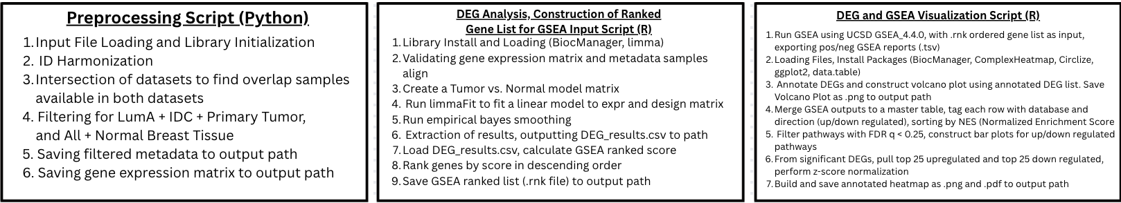
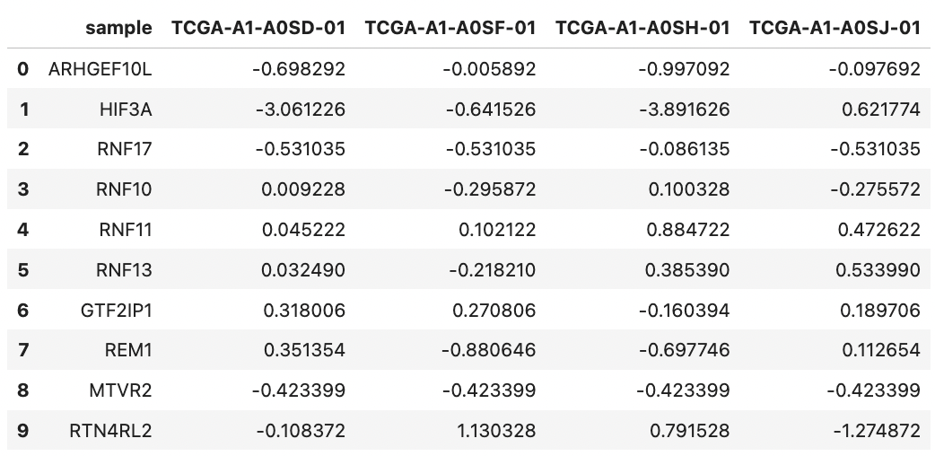
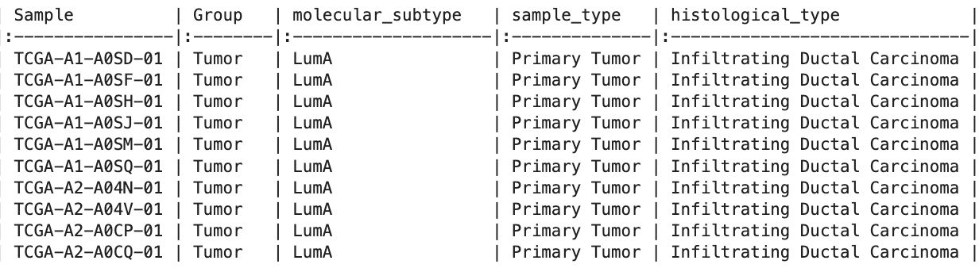
Final Pipeline Flowchart
1.
2.
3.
Table 2: Metadata File Structure:
Table 3: Gene Expression Matrix File Structure:

Slide 6
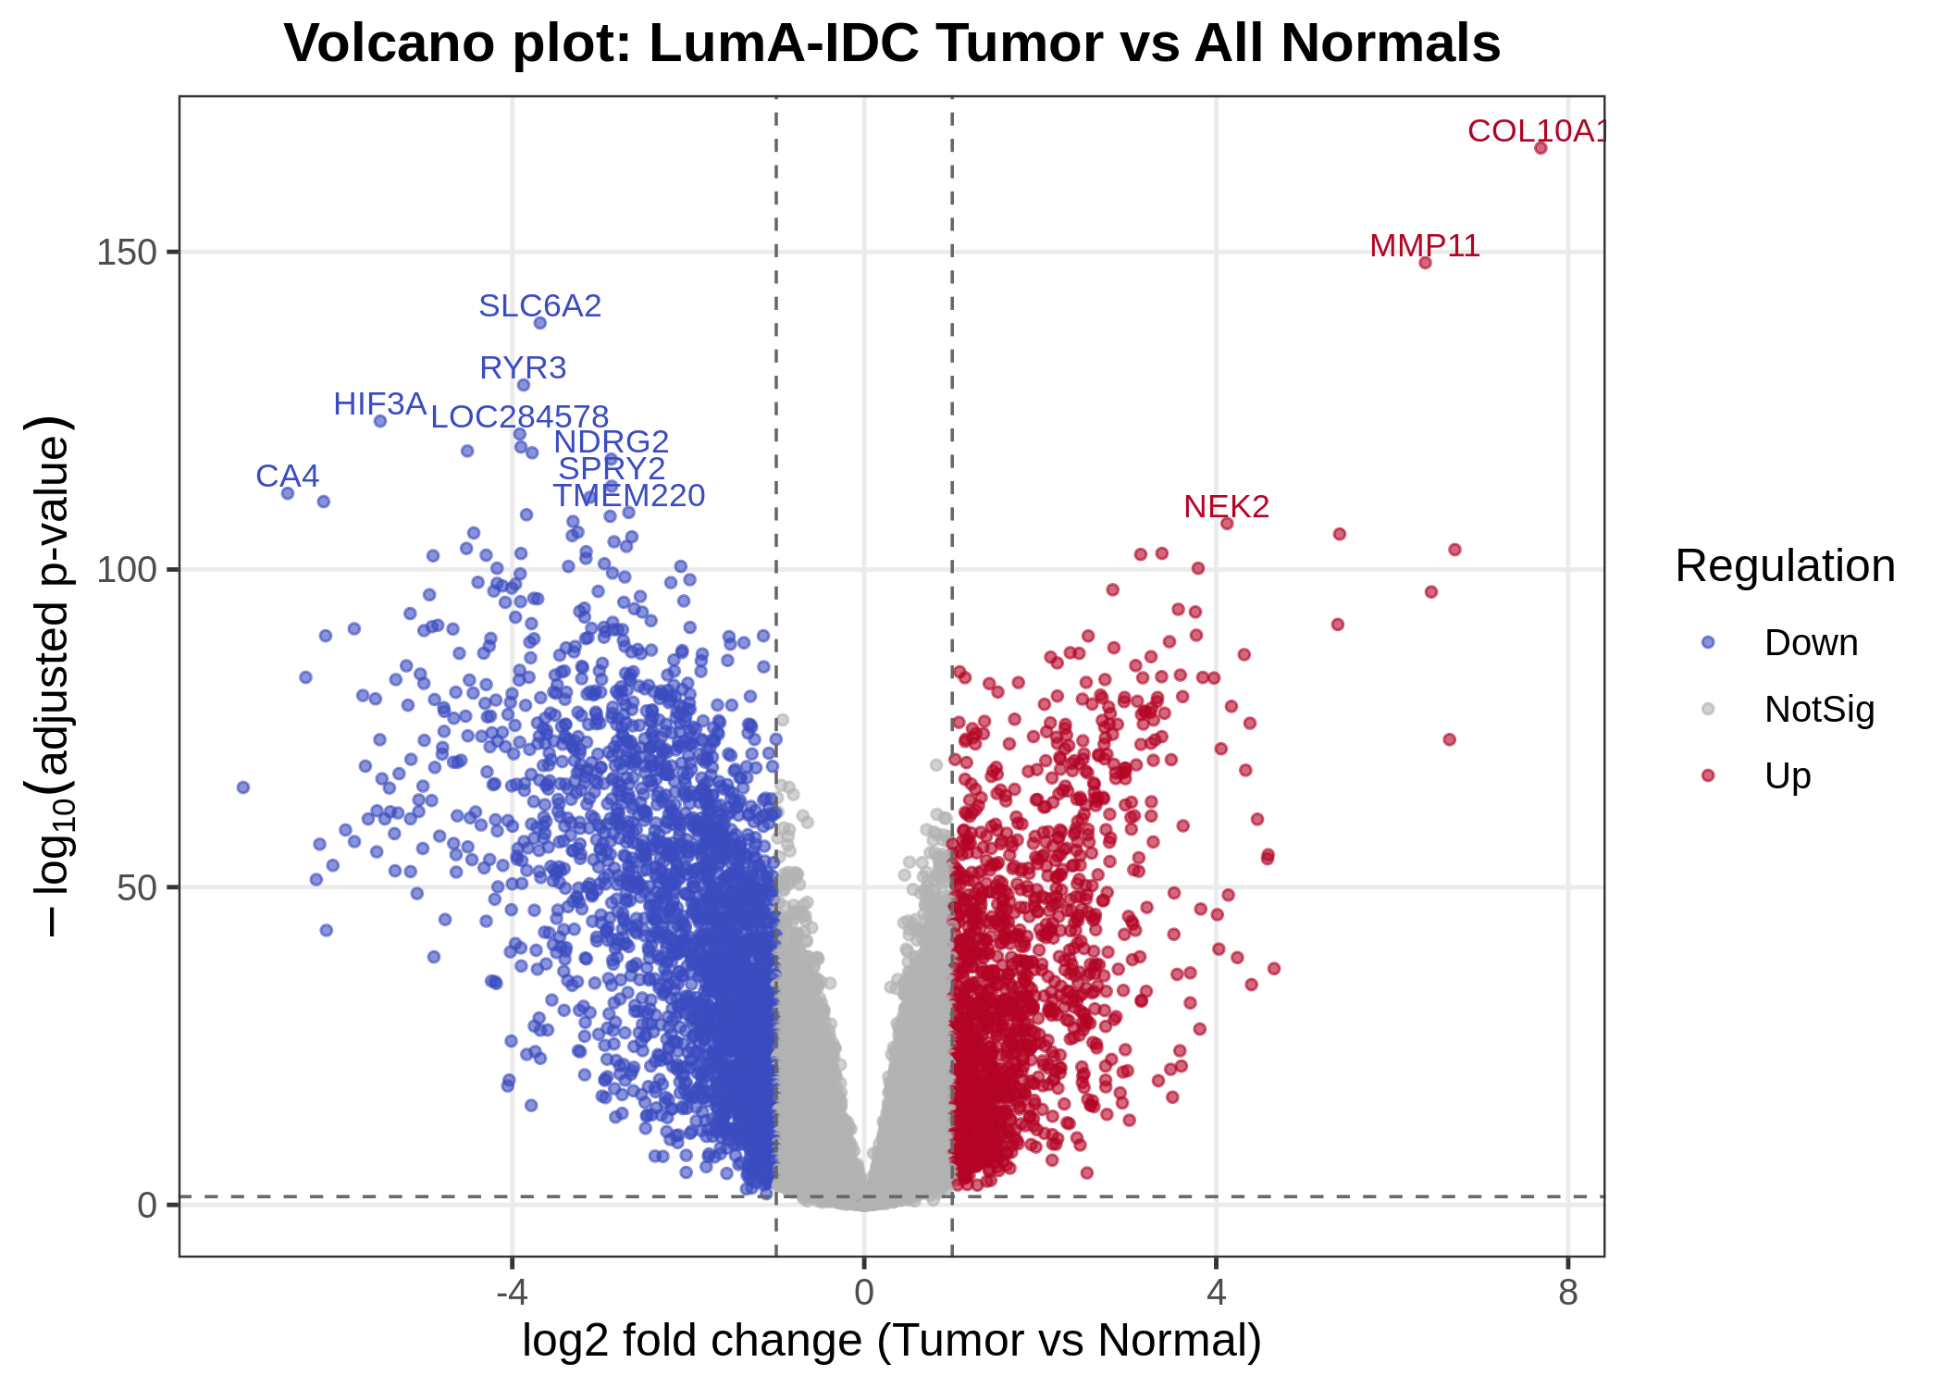
Differentially expressed genes Implementation
4,191 Significant DEGs (1,421 Upregulated, 2770 Downregulated).
Using thresholds: padj < 0.05 , |log2FC| > 1
While this segment of the pipeline is not novel, it is necessary to validate the DEG script to ensure the gene list produced is accurate.
Figure 2. Volcano Plot Displaying Differentially Expressed Genes Between Luminal A IDC Samples and Unaffected Breast Samples

Slide 7
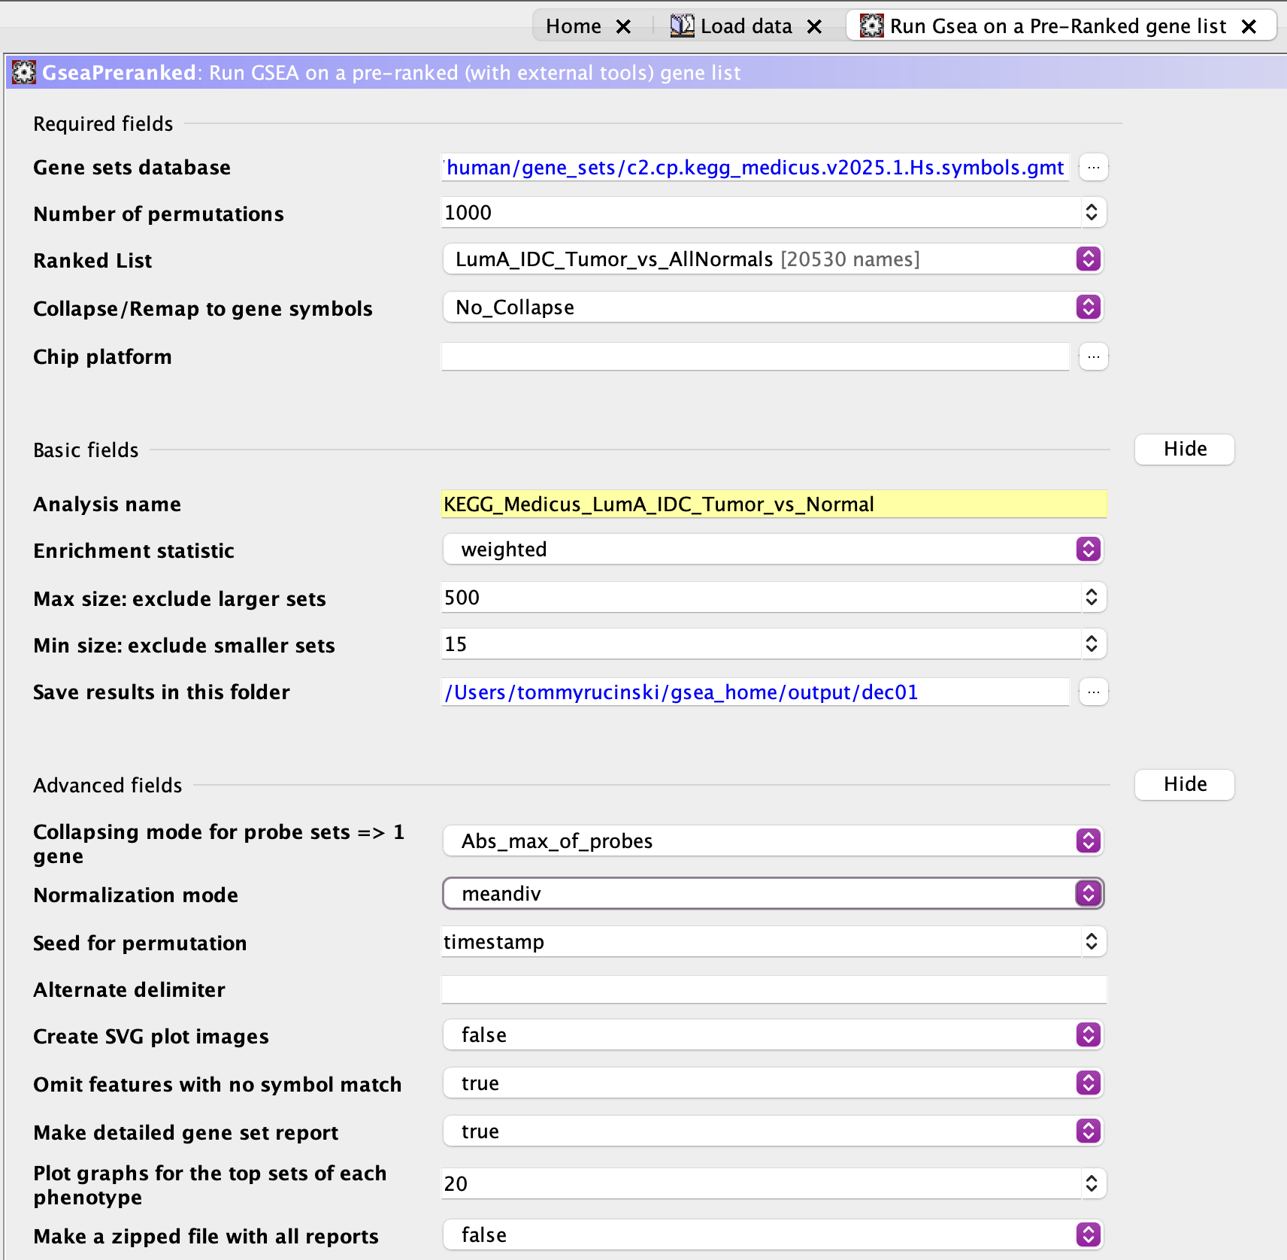
Gene set & Pathway enrichment analysis
3 Gene List Databases used in GSEA: KEGG_Legacy, KEGG_Medicus, and Hallmark_All
Expected Results: Downregulated p53 pathway, DNA-repair pathway, upregulated cell cycle proliferation, proteasome activity, spliceosome activity, etc.
Used the three gene lists to reference over different TYPES of analysis, with Hallmark being the largest and most broad gene list available within UCSD's GSEA_4.4.0 Software
Hallmark: Largest gene list, extremely well defined.
KEGG_Legacy: Slightly smaller gene list than Hallmark, commonly used in similar pipelines.
KEGG_Medicus: Gene list used especially for disease pathway dysregulation, heavy focus on immunological drivers that affect downstream processes.
Figure 3. GSEA Settings for KEGG_Medicus Gene List

Slide 8
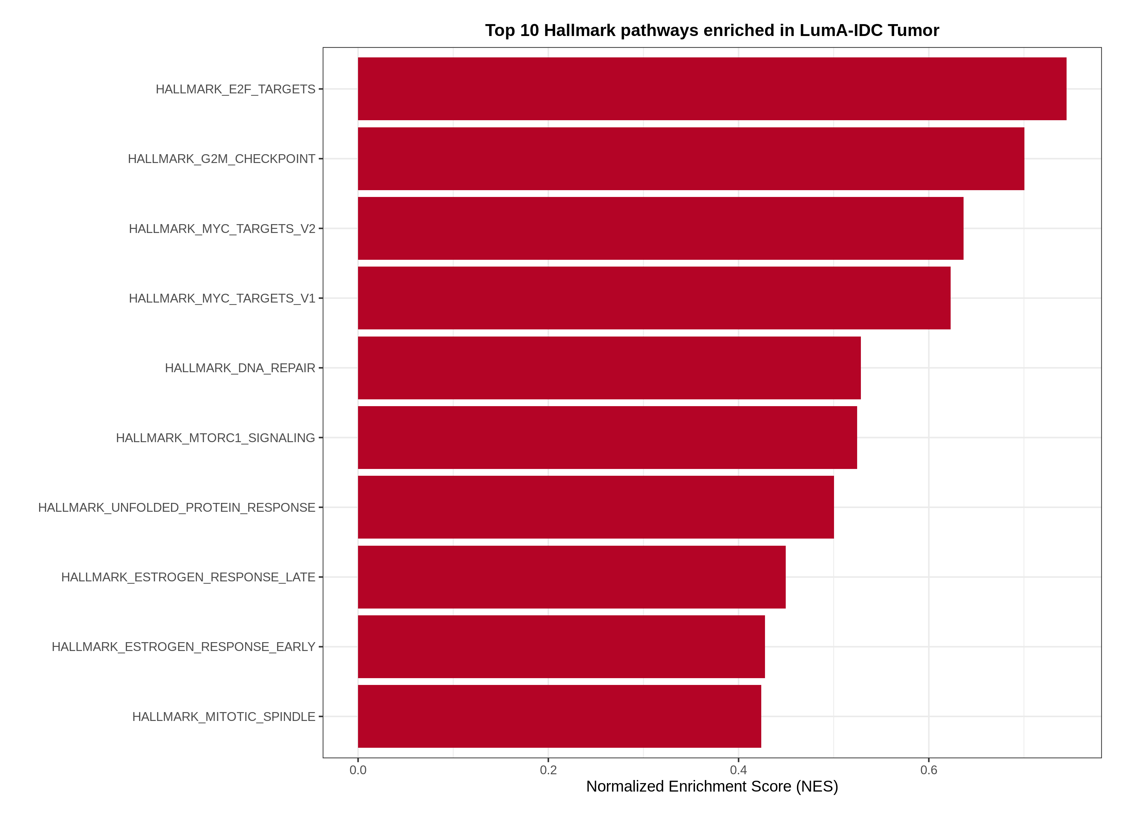
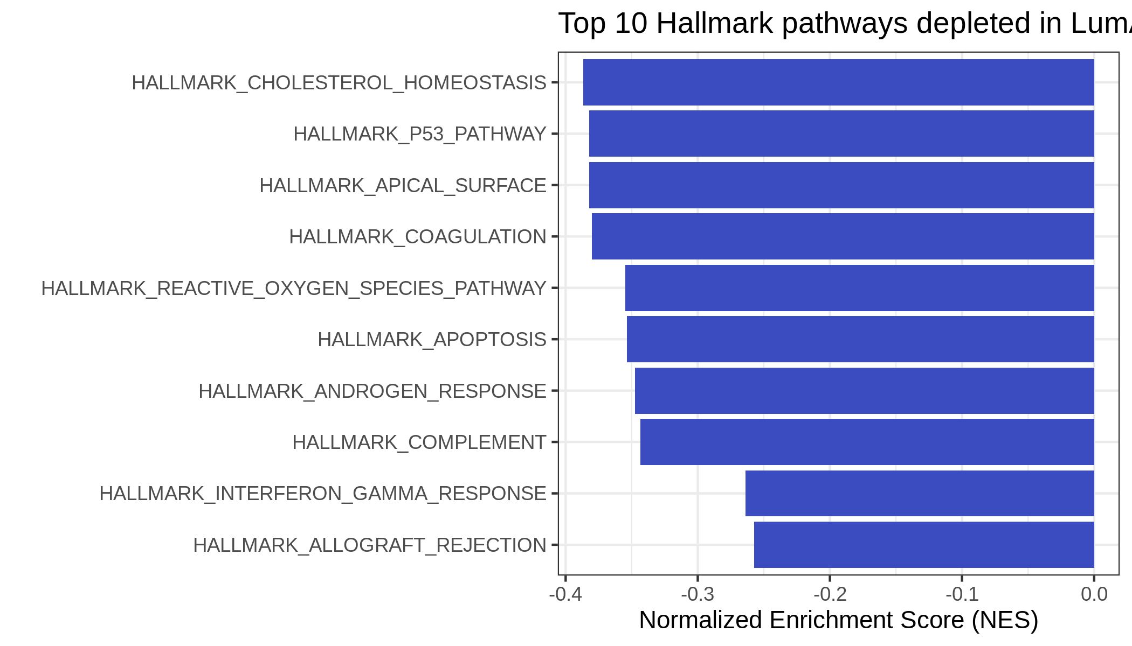
GSEA REsults visualization
Figure 4. Top 10 Downregulated Hallmark Pathways from GSEA
Figure 5. Top 10 Upregulated Hallmark Pathways from GSEA

Slide 9
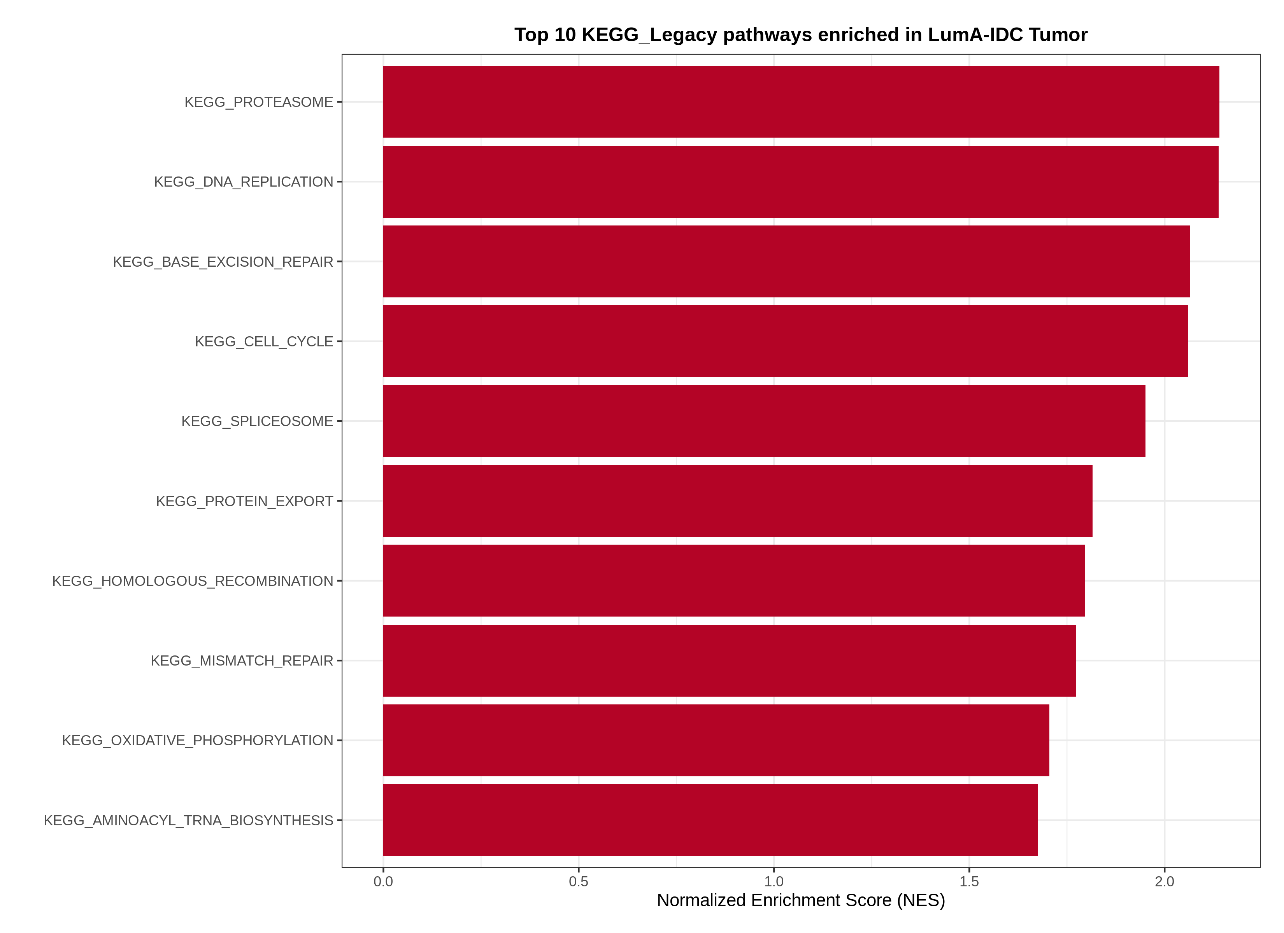
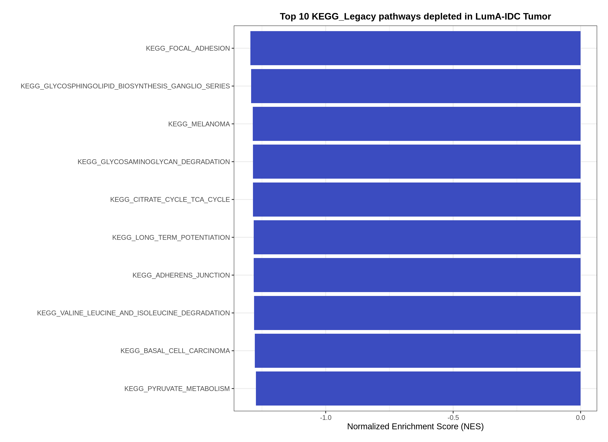
GSEA REsults visualization Cont.
Figure 6. Top 10 Downregulated KEGG-Legacy Pathways from GSEA
Figure 7. Top 10 Upregulated KEGG-Legacy Pathways from GSEA

Slide 10
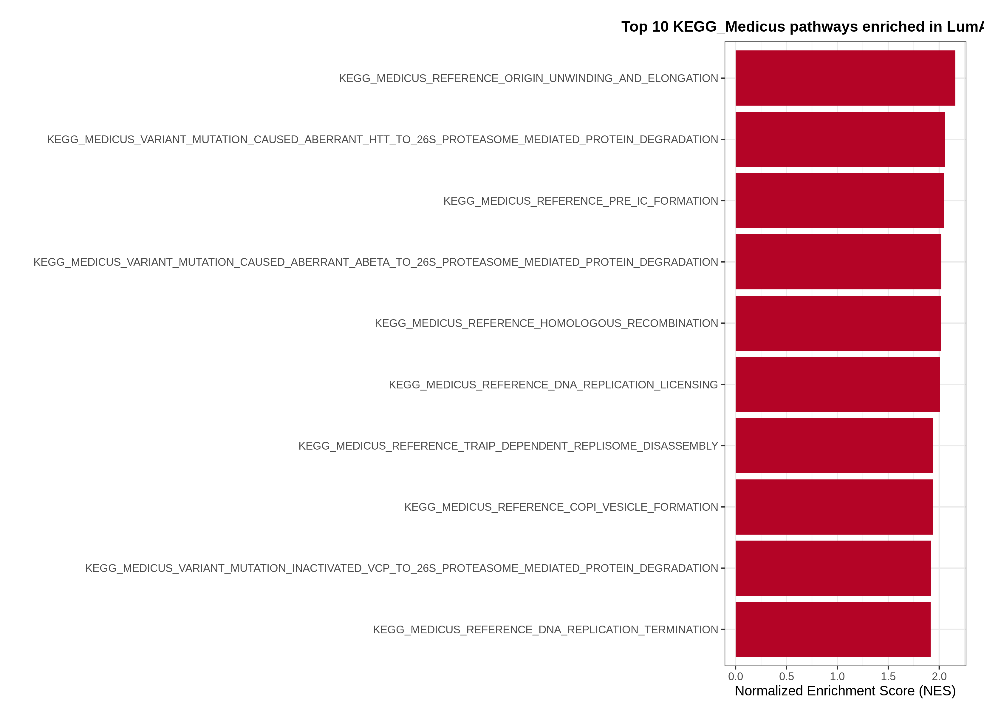
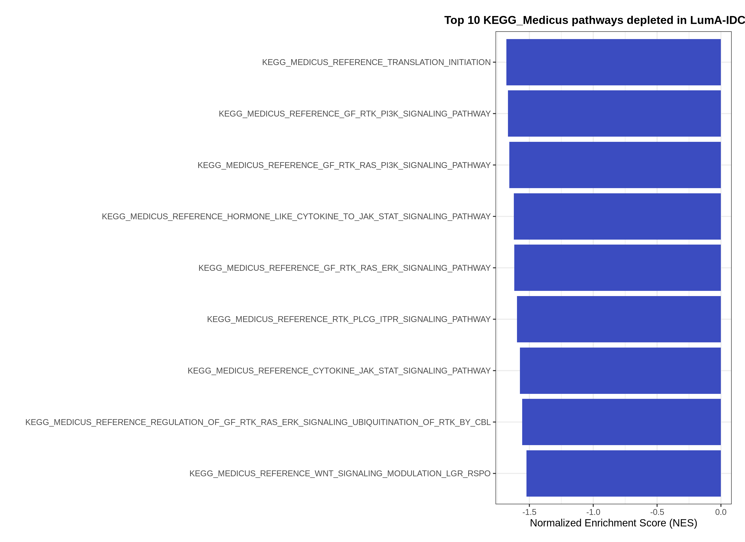
GSEA REsults visualization Cont.
Figure 8. Top 10 Downregulated KEGG-Medicus Pathways from GSEA
Figure 9. Top 10 Upregulated KEGG-Medicus Pathways from GSEA​
​

Slide 11
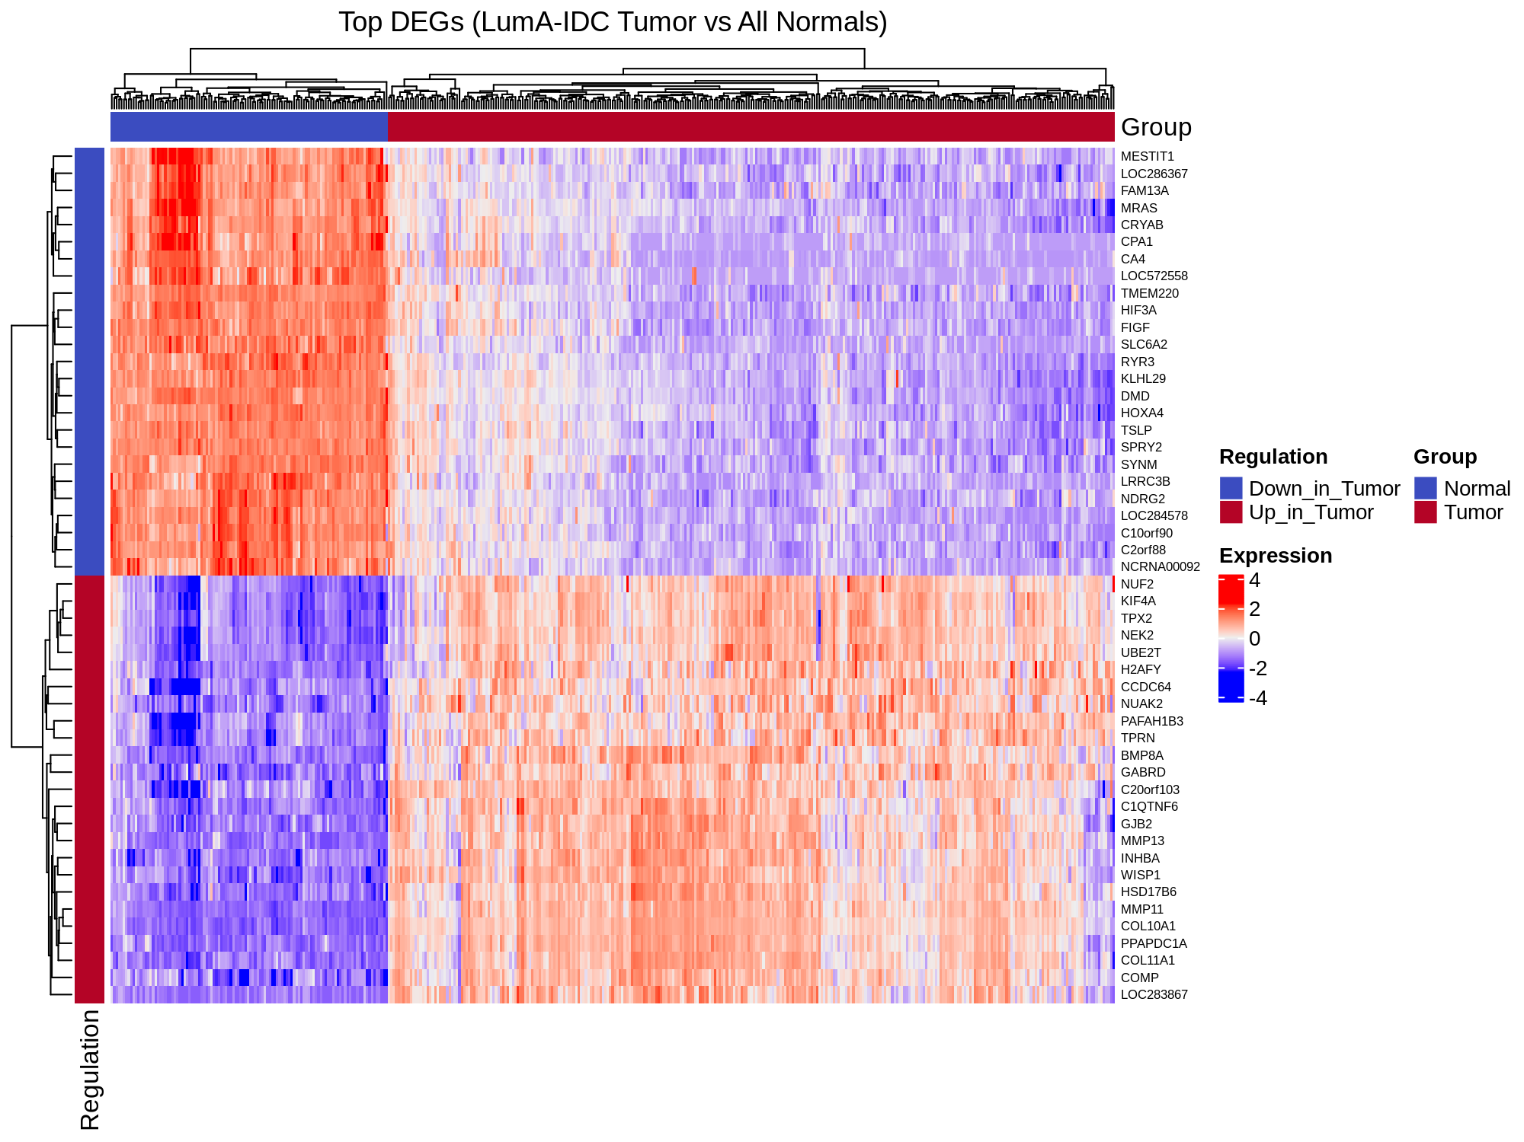
GSEA REsults visualization Cont.
Figure 10. DEG Heatmap for Gene Dysregulation in Luminal A IDC Samples Compared to Unaffected Breast Tissue Samples

Slide 12
conclusion
Upregulated Pathways consistent with literature review and proposal hypothesis, found enrichment in key pathways such as cell cycle, DNA replication, and estrogen response pathways.
Key Downregulated Pathways: Cholesterol Homeostasis Pathway, Reactive Oxygen Species Pathway, Interferon Gamma Pathway, Complement Pathway, and Coagulation Pathway.
The downregulated pathway findings are significant, because suppression of cholesterol homeostasis suggests that a tumors redefine the role of cholesterol in the tumor environment. Furthermore, the downregulation of ROS and IFN-gamma pathways suggest Luminal A IDC tumors optimize for survival by minimizing oxidative stress and evading normal immune function.
This pipeline successfully characterized Luminal A IDC as a subtype defined not only by hormone sensitivity, but by active suppression of homeostatic and immune defense mechanisms, supporting the classification of Luminal A IDC as an immunologically "cold" subtype.

Slide 13
Future direction
Validating and expand the findings of this project using other RNA-Seq Breast Cancer Tumor Gene Expression Databases (METABRIC, GEO, ICGC) for Single Cell RNA-Seq, Spatial Transcriptomics and Proteogenomics.
Straying from the Luminal A Subtype to classify pathway and immune dysregulation across the more lethal subtypes of breast cancer.
Continuing the literature review and studying drug interactions and drug delivery systems to propose more effective treatments while reducing risk and invasive approaches.
Continuing pipeline development using more clinical phenotype information to classify DEGs and pathway dysregulation in different types of patients (faster recurrence, early death) with goal of classifying how transcriptomic and proteomic factors affect life span and recurrence rates using a machine learning model.
Focus on reproducibility and implementation of git into my pipeline/thesis.

Slide 14
References
https://www.cancer.org/content/dam/cancer-org/research/cancer-facts-and-statistics/breast-cancer-facts-and-figures/2024/breast-cancer-facts-and-figures-2024.pdf
https://pmc.ncbi.nlm.nih.gov/articles/PMC8266316/
https://www.sciencedirect.com/science/article/pii/S2666979X21000835
https://link.springer.com/article/10.1186/1755-8794-5-44
https://www.cancerimagingarchive.net/collection/tcga-brca/
https://pmc.ncbi.nlm.nih.gov/articles/PMC12011706/
https://pubmed.ncbi.nlm.nih.gov/32026945/

Slide 15
Questions?
https://github.com/trucinski-portfolio/BIOL-616-Final-Project

