Slide 1
Introduction to Cyber Security
COMP3134 Week 3

Slide 2
Overview
Objective
Passive and Active Sniffing
Address Resolution protocol (ARP)
ARP poisoning
Media Access Control (MAC) address flooding
Main Teaching Points
Listening/ monitoring / observation is intermediate step
Exploitation is advanced step
Learning Outcome(s)
Identify & baseline network traffic using network monitoring tools
Identify and filter various protocols and network ports

Slide 3
Network Sniffing

Slide 4
Network Sniffing
Definition
Process of monitoring and capturing data (packets) of a network
Promiscuous mode
Allows device to intercept and read each network packet that arrives in its entirety
Sniffing is the process of monitoring and capturing all the packets passing through a given network using sniffing tools.
Comparison:
Chat Room VS Instant Messenger
Significance / Risks
Can see all traffic even if it was no intended for your network

Slide 5
Network Sniffing Game
Groups of 3
2 people speak to each other sitting down
Can move around in chair but stay seated
1 person listens 2 meters away write down all NOUNS you hear
BONIS: write down name of person whom uttered the noun
Talk for 1 minute
30 seconds listener recaps nouns
Repeat until everyone was the listener once

Slide 6
Key definitions
Hub
All data is sent and received on all open ports (traffic broadcasted to all hosts)
Switch
Knows which hosts to send specific message to and does so directly
Hub vs Switch
Hub works on the physical layer (Layer 1) of OSI model
Switch works on the data link layer (Layer 2).
Switch is more efficient than the hub.
Switch can join multiple computers within one LAN,
Hub just connects multiple Ethernet devices together as a single segment.

Slide 7
How Network Sniffing Works
Sniffer tools turns the Network Interface Card (NIC) of system to the promiscuous mode
A sniffer can continuously monitor all the traffic to a computer through the NIC by decoding the information encapsulated in the data packets.

Slide 8
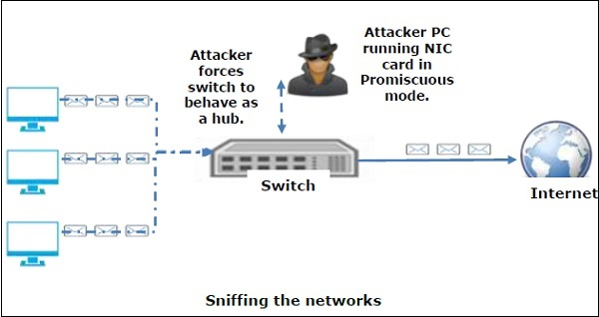
How Network Sniffing Works

Slide 9
Network Sniffing: Passive Sniffing
Traffic is recorded but not altered
Only listening
Hub devices
traffic is sent to all the ports.
Network that uses hubs
All hosts on the network can see the traffic.
Therefore attacker can easily capture traffic
Hubs are almost obsolete
Modern networks use switches.
Passive sniffing is no longer effective.

Slide 10
Network Sniffing: Active Sniffing
Traffic is monitored and may be altered
Used to sniff a switch-based network.
Injects address resolution packets (ARP) into a target network to flood on the switch content addressable memory (CAM) table.
CAM keeps track of which host is connected to which port.

Slide 11
Network Sniffing: Active Sniffing
Active Sniffing Techniques (4)
MAC Flooding
DNS Poisoning
Spoofing Attacks
ARP Poisoning
(4) Protocols which are affected
HTTP
SMTP
FTP
IMAP

Slide 12
Network Sniffing
Implication
Open unused ports provide gateway to potential attackers
Application
Various sniffing tools are used to accomplish network sniffing
Wireshark
Demo
Let’s look at Wireshark

Slide 13
Address Resolution Protocol

Slide 14
Address Resolution Protocol
Definition
ARP is acronym
Runs on data link layer (Layer 2) of the OSI model.
Purpose is to resolve an IP address to a MAC address
Every hardware connected to the Internet has a unique MAC address association

Slide 15
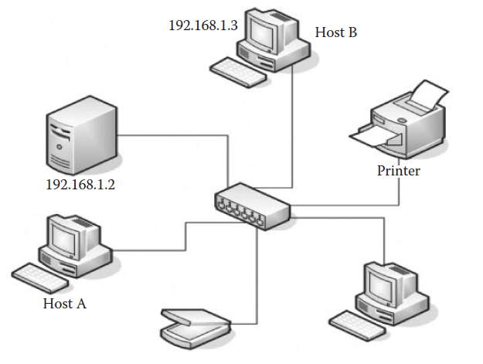
Address Resolution Protocol

Slide 16
Address Resolution Protocol
Host A wants to communicate with Host B with an IP 192.168.1.3.
Host A needs MAC address of Host B.
Host A will look inside its ARP table cache to search of Host B’s IP address
If not present, Host A will send an ARP broadcast packet to every device on the network asking, “Who has Host B’s IP address?”
Once Host B receives the ARP request, it will send an ARP reply telling Host A “I am Host B and here is my MAC address.”
The MAC address would be then saved inside the ARP table.
Command to view ARP table
arp -a

Slide 17
Spoofing Game
Groups of 3
1 person is acting, 1 person is judge, 1 person is guessing
Actor
Write down famous individual name and pass it to judge
Speak like famous person BUT without uttering noun
Judge
Determine if guesser correctly guessed OR actor violated noun-rule
1-minute rounds

Slide 18
ARP Poisoning

Slide 19
ARP Poisoning
Definition
Also know as ARP Spoofing
Get in the middle of regular communication.
Method
Spoofed ARP reply sent to any host on a network
Make it believe that a certain IP is associated with a certain MAC address,
Thereby poisoning its ARP cache that keeps track of IP to MAC addresses.
Significance / Risks
ARP protocol always trust reply is coming from correct device.

Slide 20
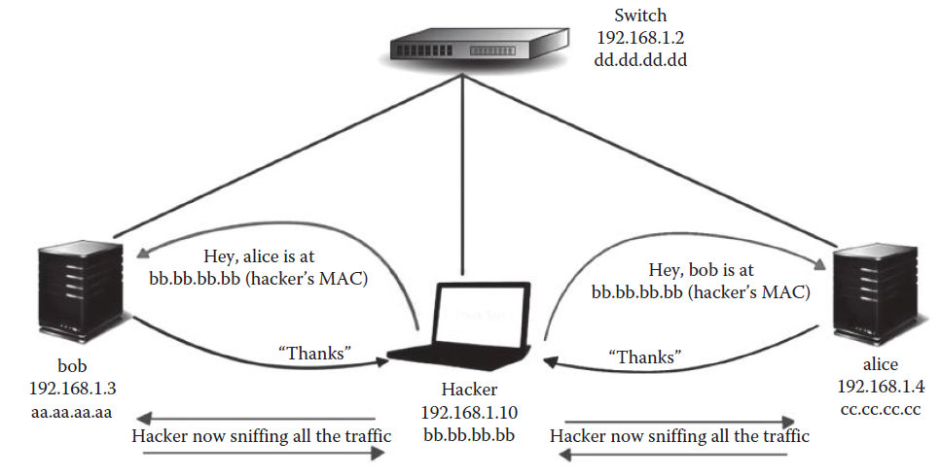
ARP Poisoning

Slide 21
MAC Address Flooding
Media Access Control

Slide 22
MAC Address Flooding
Definition
Send huge amount of ARP replies to a switch
Thereby overloading the cam table of the switch.
Once the switch overloads, it goes into hub mode
It will forward the traffic to every computer on the network
Significance / Risks
Switches behaving like hubs makes network sniffing easier

Slide 23
Sniffing and Spoofing Counter Measurements
Static ARP
Add IP-MAC address pairs manually
Time-consuming
Port security
Map each switch to port for sending and receiving
Cisco = Dynamic ARP Inspection (DAI)
Discards invalid IP-MAC address pairs
Protections against DNS poisoning & spoofing

Slide 24
Terms to Know
Passive and Active Sniffing
Address Resolution protocol (ARP)
ARP poisoning
Media Access Control (MAC) address flooding
Hub
Switch
Network Interface Card (NIC)
Promiscuous mode
Content addressable memory (CAM)

Slide 25
Resources
Websites
ARP Poisoning
https://doubleoctopus.com/security-wiki/threats-and-tools/address-resolution-protocol-poisoning/
MAC Address Flooding
https://www.interserver.net/tips/kb/mac-flooding-prevent/
Videos
Network Sniffing
https://www.youtube.com/watch?v=gXTuTfOoFjg
ARP
https://www.youtube.com/watch?v=cn8Zxh9bPio

